Slide 1
CPS 310 / ECE 353
The View From Your Process
Jeff Chase
Duke University

Slide 2
Key points for today
Virtualize!
CPU, memory, and “disk” (or other I/O devices)
Example: C/Ux programming environment
Where do program variables live?
Your args/env
Your stack
Your heap
Under the hood: finding your stuff

Slide 3
Timeslicing in action Virtualizing the CPU
1. Compile and link.
2. Run 3x &.
chase$ cc –o democ democ.c
chase$ ./democ A & ./democ B & ./democ C
[1] 54922
[2] 54923
./democ C
./democ A
./democ B
./democ B
./democ A
./democ C
./democ A
./democ B
./democ C
[1]- Done ./democ A
[2]+ Done ./democ B
chase$
democ.c
int
main(int argc, char *argv[])
{
int i, j;
for (i=0; i<3; i++) {
printf("%s %s\n",
argv[0], argv[1]);
for (j=0;
j<500000000; j++);
}
return 0;
}

Slide 4
The story so far…
A
B
C
data
data
process
kernel
A process is a running program instance.
OS kernel multiplexes the computer among processes.
Kernel launches processes and provides services to them.

Slide 5
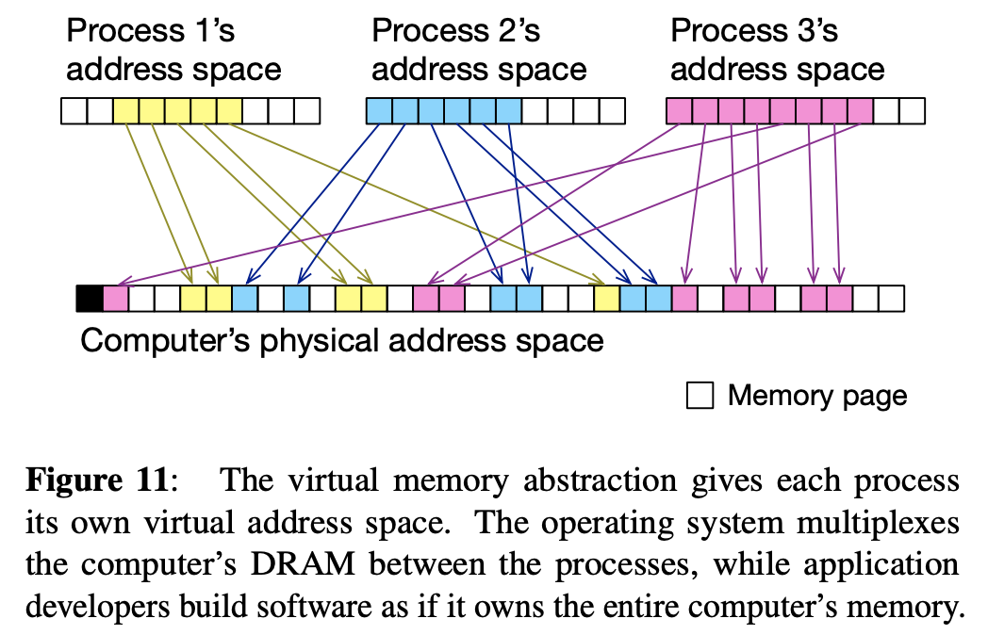
Virtualizing memory
Graphic from Intel SGX Explained (Costan and Devadas, IACR Cryptology, 2016)

Slide 6
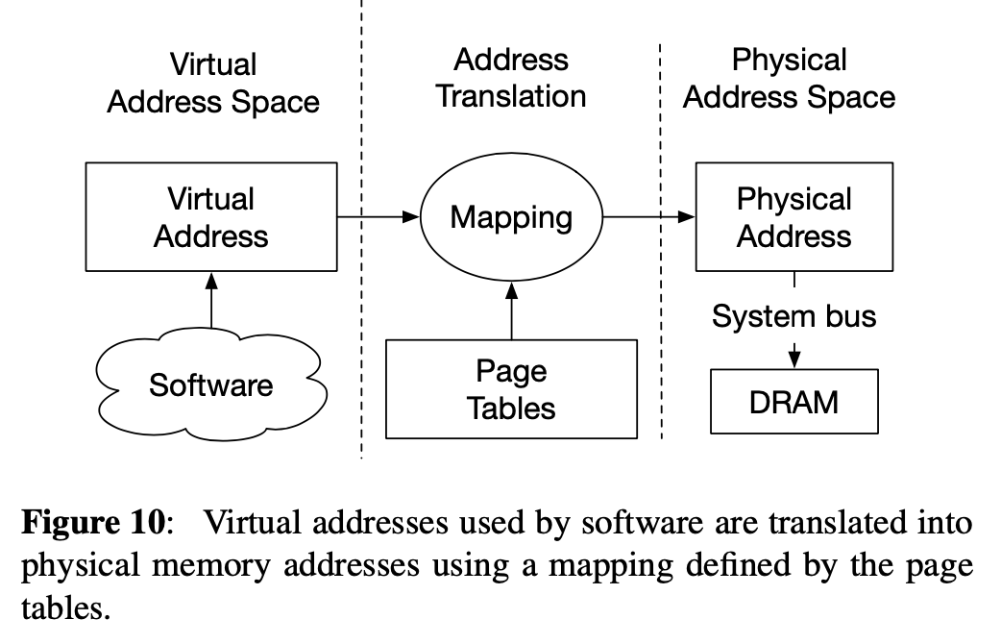
A peek at virtual memory (VM)
Graphic from Intel SGX Explained (Costan and Devadas, IACR Cryptology, 2016)

Slide 7
VM and files
Process
(running program)
Files on “disk”
File system calls (e.g., open/read/write)
globals
Memory-mapped
sections of
program file
Thread
text
Program
heap
Anonymous
Segments
(zero-fill)
register
context
stack
Segments (regions)
in Virtual Address Space

Slide 8
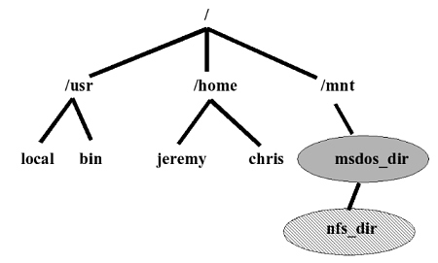

Files: hierarchical name space
root directory
applications etc.
mount point
user home directory
external media volume or network storage

Slide 9
The file abstraction
Program A
Program B
open
“/a/b”
write
(“abc”)
read
open
“/a/b”
read
write
(“def”)
Library
Library
system call trap/return
OS kernel

Slide 10
Files: open and chdir
fd = open(pathname, <options>);
write(fd, “abcdefg”, 7);
read(fd, buf, 7);
lseek(fd, offset, SEEK_SET);
close(fd);
Files
Syscalls like open interpret a file pathname relative to the current directory of the calling process.
Pathname starting with “/” is relative to the root directory.
Change current directory with the chdir syscall.
“.” in a pathname means current directory (curdir).
“..” in a pathname means parent directory of curdir.

Slide 11
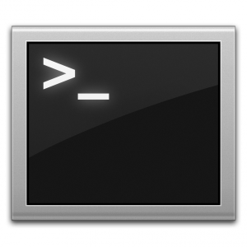


Unix process view: data
A process has multiple channels for data movement in and out of the process (I/O).
I/O channels
(“file descriptors”)
stdin
stdout
Process
The channels are typed.
tty
stderr
Each channel is named by an I/O descriptor (called a “file descriptor”).
pipe
Thread
socket
A file descriptor is an integer value assigned by the kernel (e.g., at open).
Files
Program

Slide 12
Standard I/O descriptors
I/O channels
(“file descriptors”)
stdin
Open files or other I/O channels are named within the process by an integer file descriptor value.
stdout
tty
stderr
Standard descriptors for
primary input (stdin=0), primary output (stdout=1), error/status (stderr=2).
count = read(0, buf, count);
if (count == -1) {
perror(“read failed”); /* writes to stderr */
exit(1);
}
count = write(1, buf, count);
if (count == -1) {
perror(“write failed”); /* writes to stderr */
exit(1);
}
By default they are bound to the controlling tty.

Slide 13
Where do your variables live?
Implicit Allocation
User stack
N
Explicit Allocation
Heap (via malloc)
Uninitialized data (.bss)
Static Allocation
Initialized data (.data)
Program text (.text)
0

Slide 14
Command line arguments (C)
chase$ cc -o args args.c
chase$ ./args 1 2 3 4 5 6
arguments: 7
0: ./args
1: 1
2: 2
3: 3
4: 4
5: 5
6: 6
#include <stdio.h>
int
main(int argc, char* argv[])
{
int i;
printf("arguments: %d\n", argc);
for (i=0; i<argc; i++) {
printf("%d: %s\n", i, argv[i]);
}
}
OS copies arguments into the VAS, passes count+address to main().

Slide 15
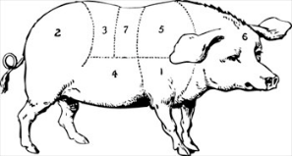
Heap: dynamic memory
Heap segment. A contiguous chunk of memory obtained from OS kernel.
E.g., with Unix sbrk() syscall, or mmap()
Allocated heap blocks for structs or objects. Align!
A runtime library obtains the block and manages it as a “heap” for use by the programming language environment, to store dynamic objects.
E.g., with Unix malloc and free library calls, or new in Java or C++.

Slide 16
Heap manager
N
high addresses
Program (app or test)
Stack
free
“0xA”
alloc
“0xA”
alloc
“0xB”
“ok”
“break”
Heap manager
sbrk
system call (or mmap)
Dynamic data
(heap)
OS kernel
sbrk(X) increments program’s data/heap segment size by X bytes

Slide 17
The heap manager contract
User program calls malloc API to allocate a block of any desired size to store some dynamic data.
Heap manager returns a pointer to a block. The program uses that block for its purpose. The block’s memory is reserved exclusively for that use.
Program calls heap manager to free (deallocate) the block when the program is done with it.
Once the program frees the block, the heap manager may reuse the memory in the block for another purpose.
User program is responsible for initializing the block, and deciding what to store in it. Initial contents could be old. Program must not try to use the block after freeing it.

Slide 18
Memory management: two levels
Program (app or test)
Allocate and free heap blocks of varying sizes, with arbitrary lifetimes.
free
“0xA”
alloc
“0xA”
alloc
“0xB”
“ok”
Heap manager
Allocate and free VM regions of varying sizes, with arbitrary lifetimes.
mmap
system call
OS kernel

Slide 19
Memory management: user/kernel
Program (app or test)
User code: works for the user and program.
free
“0xA”
alloc
“0xA”
alloc
“0xB”
“ok”
Heap manager
Kernel code: works for the system and all of its users and programs.
mmap
OS kernel

Slide 20
Memory management: trust
Program (app or test)
The program trusts it.
It trusts the program.
free
“0xA”
alloc
“0xA”
alloc
“0xB”
“ok”
Heap manager
Kernel code: trusted by everyone. Trusts no-one.
mmap
OS kernel

Slide 21
Memory management: isolation
Program (app or test)
Leaves memory uninitialized.
free
“0xA”
alloc
“0xA”
alloc
“0xB”
“ok”
Never exposes data across process boundaries: zero-fill to “clean” empty memory.
Heap manager
mmap
OS kernel

Slide 22
Example stack
Code
Memory
Stack
SP
void C () {
A (0);
}
void B () {
C ();
}
void A (int tmp){
if (tmp) B ();
}
int main () {
A (1);
return 0;
}
0xfffffff
tmp=0
RA=0x8048347
A
0x8048347
SP
const=0
RA=0x8048354
C
SP
0x8048354
RA=0x8048361
B
…
SP
tmp=1
RA=0x804838c
0x8048361
A
SP
const1=1
const2=0
main
0x804838c
0x0

Slide 23
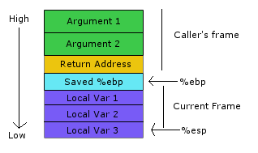
IA32 stack discipline
Caller pushes
Callee pushes
(prolog)
Fixed-size stack frame data area: size determined by compiler of the called procedure. The procedure’s compiled code addresses locals and arguments at fixed offsets from %ebp (frame pointer).
Note: callee code may push some callee-saved register values in here too.

Slide 24
Stack layout when calling functions
void func(char *arg1, int arg2, int arg3)
{
char loc1[4]
int loc2;
int loc3;
}
old base pointer
low
return address
high(N)
…
loc2
loc1
%ebp
%eip
arg1
arg2
arg3
caller’s data
local variables pushed in the
same order as
they appear in the code
arguments pushed in reverse order
of code

Slide 25
Example: C structs, global, stack, heap
Local variables
int main() {
struct stuff sstuff;
struct stuff *hstuffp =
(struct stuff *) malloc(sizeof(struct stuff));
gstuff.i = 13;
gstuff.j = 14;
gstuff.c[0] = 'z';
gstuff.c[1] = '\0';
printf("%s\n", gstuff.c);
sstuff.i = 13;
sstuff.j = 14;…
hstuffp->i = 13;
hstuffp->j = 14;…
}
Heap allocation
#include <stdio.h>
#include <stdlib.h>
struct stuff {
int i;
long j;
char c[2];
};
struct stuff gstuff;
Accessing a global structure
Data structure type definition
Local data of a procedure (on the stack)
A global structure
Accessing a heap-allocated struct through a pointer.

Slide 26
On MacOS, the otool –vt command shows contents of the text section of an executable file.
Here are the instructions for the structs program. When the program runs, the OS loads them into a contiguous block of virtual memory (the text segment) at the listed virtual addresses.
cc –o structs structs.c
otool –vt structs
0000000100000ea0 pushq %rbp
0000000100000ea1 movq %rsp, %rbp
0000000100000ea4 subq $48, %rsp
0000000100000ea8 movabsq $24, %rdi
0000000100000eb2 callq 0x100000f42
0000000100000eb7 leaq 182(%rip), %rdi
0000000100000ebe leaq 347(%rip), %rcx
0000000100000ec5 movq %rcx, %rdx
0000000100000ec8 addq $16, %rdx
0000000100000ecf movq %rax, -32(%rbp)
0000000100000ed3 movl $13, (%rcx)
0000000100000ed9 movq $14, 8(%rcx)
0000000100000ee1 movb $122, 16(%rcx)
0000000100000ee5 movb $0, 17(%rcx)
0000000100000ee9 movq %rdx, %rsi
0000000100000eec movb $0, %al
0000000100000eee callq 0x100000f48
0000000100000ef3 movl $0, %r8d
0000000100000ef9 movl $13, -24(%rbp)
0000000100000f00 movq $14, -16(%rbp)
0000000100000f08 movb $122, -8(%rbp)
0000000100000f0c movb $0, -7(%rbp)
0000000100000f10 movq -32(%rbp), %rcx
0000000100000f14 movl $13, (%rcx)
0000000100000f1a movq -32(%rbp), %rcx
0000000100000f1e movq $14, 8(%rcx)
0000000100000f26 movq -32(%rbp), %rcx
0000000100000f2a movb $122, 16(%rcx)
0000000100000f2e movq -32(%rbp), %rcx
0000000100000f32 movb $0, 17(%rcx)
0000000100000f36 movl %eax, -36(%rbp)
0000000100000f39 movl %r8d, %eax
0000000100000f3c addq $48, %rsp
0000000100000f40 popq %rbp
0000000100000f41 ret

Slide 27
Simplified…
pushq %rbp
movq %rsp, %rbp
subq $48, %rsp
movabsq $24, %rdi
callq 0x100000f42
movq %rax, -32(%rbp)
leaq 347(%rip), %rcx
...address stack data relative to (%rbp)
; move pointer to heap block into %rcx
movq -32(%rbp), %rcx
...address heap block relative to (%rcx)
addq $48, %rsp
popq %rbp
ret
Push a frame on the stack: this one is 48 bytes.
Who decided that?
int main() {
struct stuff sstuff;
struct stuff *hstuffp =
(struct stuff *)
malloc(24);
gstuff.i = 13;
gstuff.j = 14;
gstuff.c[0] = 'z';
gstuff.c[1] = '\0';
sstuff.i = 13;
sstuff.j = 14;…
hstuffp->i = 13;
hstuffp->j = 14;…
}
Call malloc(24): move return value into a local variable (at an offset from the stack base pointer).
Address global data relative to the code address (%rip=PC).
position-independent
Pop procedure frame from the stack before returning from main().

Slide 28
Addressing stuff
struct stuff {
int i;
long j;
char c[2];
};
global data segment
0x0
&gstuff
0x18
(24)
347(%rip)
heap data segment (BSS)
hstuffp
RCX
stack data segment
&sstuffp
RIP
x
RBP
y
registers
-xx(%rbp)

Slide 29
Addressing stuff
struct members stored in memory in order they are declared (hence i is at the lowest address)
%rcx
0x0
struct stuff {
int i;
long j;
char c[2];
};
24 bytes
(=0x18)
0x18
stack growth
%rbp
sstuff.i = 13;
sstuff.j = 14;
sstuff.c[0] = 'z';
sstuff.c[1] = '\0’;
movl $13, -24(%rbp)
movq $14, -16(%rbp)
movb $122, -8(%rbp)
movb $0, -7(%rbp)
hstuffp->i = 13;
hstuffp->j = 14;
hstuffp->c[0] = 'z';
hstuffp->c[1] = '\0';
movl $13, (%rcx)
movq $14, 8(%rcx)
movb $122, 16(%rcx)
movb $0, 17(%rcx)

Slide 30
Better than sbrk
mapping is not backed by a file
pages may be written
pages may be read
int prot = (PROT_WRITE | PROT_READ);
int flags = (MAP_SHARED | MAP_ANONYMOUS);
freelist = (metadata_t*)
mmap(NULL, max_bytes, prot, flags, -1, 0);
starting address (here chosen by kernel)
used for mapping a file to memory (here no file)
freelist = (metadata_t*)
sbrk(max_bytes);
mmap is a general “swiss army knife” system call to create a new region/segment in the virtual address space, and make it valid for reference.

