Slide 1
Userspace Threading
https://repl.it/@hewner/UserspaceThreadsDuke

Slide 2
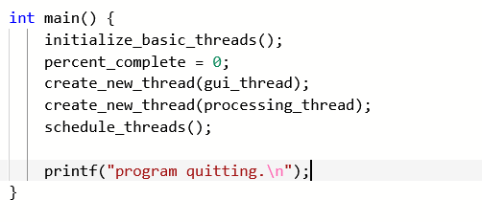
The basic idea

Slide 3
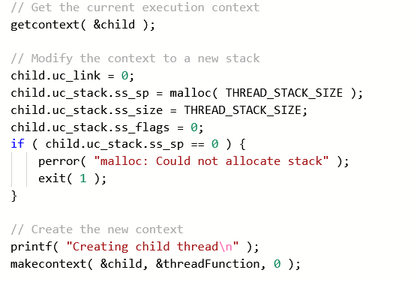
Make a new “context”
Will run threadFunc

Slide 4

Swapping contexts
“freeze” current state
“Unthaw” and run this state

Slide 5
What to do
In your breakout rooms…
Go to https://repl.it/@hewner/UserspaceThreadsDuke
Follow the readme
First completely read and understand example1.elf
Then attempt the steps in the readme
Step 1 is mostly cut and paste. Keep parent and child – parent is the scheduler, child is the one child thread
Step 2 keep parent but get rid of child – we now have an array of child threads
Step 3 we need to reuse slots in our array

Slide 6
What to take away
This idea of freezing and thawing register state is how your computers runs 100s of processes in “parallel”
The only difference is that the timer interrupt forces calls to “yield” at regular intervals
You’ll be building a more sophisticated threading system in your homework in a few weeks – but the basic fundamentals of makecontext/swapcontext are the same

