Slide 1
CPS 310
Processes, Threads, and the Kernel
Jeff Chase
Duke University

Slide 2

The kernel
The operating system kernel!
What is it?
Where is it?
How do we get there?
How is it protected?
How does it control resources?
How does it control access to data?
How does it keep control?
User processes
user
space
kernel
space
kernel

Slide 3
A process and its threads
virtual address space
main thread
other threads
(optional)
+
+…
stack
Each process has a virtual address space (VAS): a private name space for the virtual memory it uses.
Each process has a main thread bound to the VAS, with a stack.
The scheduler (in kernel) can suspend/resume threads wherever and whenever it wants.
On modern systems they are all visible to the kernel.
They can all make system calls and enter the kernel independently.

Slide 4
Process vs. thread: what’s the difference?
In classical Unix, each process (each VAS) has exactly one thread—it predates any distinction.
Linux people say that threads are “just processes” that happen to share an address space, file descriptors, and a program—they like to blur the distinction.
Sometimes it is useful to speak loosely when we emphasize what is common (e.g., context switch).
I want you to think in terms of the fundamental kernel-supported abstractions: threads and address spaces.
If we say a process does something, we really mean a thread within the process does it.

Slide 5
Threads and the kernel
process
Modern operating systems have multi-threaded processes.
Kernel API has syscalls to create threads
e.g., Linux clone, used by pthreads library
Threads may enter the kernel (e.g., for syscalls) and run concurrently in the kernel.
This model (1x1) applies to Linux, MacOS, Windows, Android, and pthreads or Java on those systems.
VAS
user mode
user space
data
threads
trap
fault
resume
In labs we implement Nx1 threads (user-level or green threads) in which the main thread calls library routines for switch/swap contexts. No true parallelism! We use it to emulate the kernel environment.
kernel mode
kernel space

Slide 6
The kernel
Example 32-bit VAS
0x0
The kernel is just a program: a collection of modules and their state.
E.g., it may be written in C and compiled/linked a little differently.
E.g., linked with –static option: no dynamic libs
At runtime, kernel code and data reside in a protected range of virtual addresses.
VPN->PFN translations for kernel space are global.
(Details vary by machine and OS configuration)
Access to kernel space is denied for user programs.
Portions of kernel space may be non-pageable and/or direct-mapped to machine memory.
user
space
0x7FFFFFFF
0x80000000
kernel
code
kernel
space
kernel
data
high
0xFFFFFFFF

Slide 7
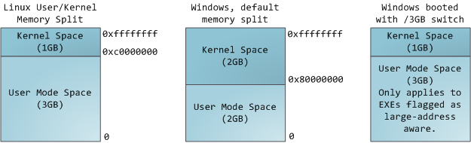
Where is kernel space?
N
2 high-order bits set
1 high-order bit set
Classically, the kernel is mapped in every process/VAS.
At least on Intel/AMD and most other machines. The details of the mapping are OS-dependent.
Recent OS unmap the kernel in user mode to defend against the Meltdown vulnerability.

Slide 8
CPU mode: user and kernel
CPU core
The current mode of a CPU core is represented by a field in a protected register.
We consider only two possible values: user mode or kernel mode (also called protected mode or supervisor mode).
If the core is in protected mode then it can:
access kernel space
access certain control registers
execute certain special instructions
mode
U/K
R0
Rn
PC
x
registers
If software attempts to do any of these things when the core is in user mode, then the core raises a CPU exception (a fault).

Slide 9
Kernel space example x86-64 Intel Core i7 PTE
Protection bits
XD: execute disable: 1 -> no instruction fetch from this page
R/W: read-write privilege? or read-only?
U/S: accessible from user code? Or only by OS (supervisor)?
This is an example of how to map portions of the VAS as accessible only in protected kernel (supervisor) mode. These portions constitute kernel space. If an instruction addresses kernel space while the core is in user mode, then it raises a protection fault.
63
51
12
8
7
6
5
4
3
2
1
0
XD
PFN / PPN (40-bit)
G
0
D
A
CD
WT
U/S
R/W
P=1
[from CS:APP3e F9.24: edited and not to scale]

Slide 10
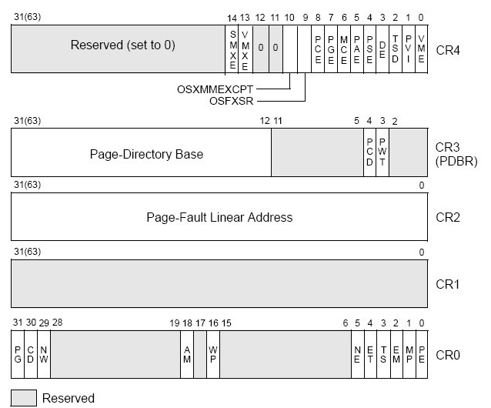
Example: x86 (32-bit/IA32) Privileged control registers
Points to page table (in machine memory) for current VAS active on this core
Faulting VA (if page fault is active)
Protected mode Enable
The details aren’t important.
See [en.wikipedia.org/wiki/Control_register]

Slide 11
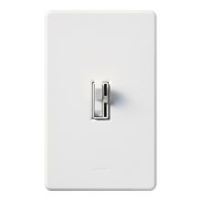
Kernel mode
What turns it on? Exceptions
Trap: system call from user code
Fault: CPU needs kernel help
Interrupt: device needs attention
What turns it off?
Kernel code executes special instruction to enter user mode.
Kernel decides where to enter.
E.g., return to saved user context.
kernel
user

Slide 12
Exceptions and interrupts “trap, fault, interrupt”
intentional
happens every time
unintentional
contributing factors
synchronous
caused by an instruction
trap: system call
open, close, read, write, fork, exec, exit, wait, kill, etc.
fault
invalid or protected address or opcode, page fault, overflow, etc.
asynchronous
caused by some other event
“software interrupt” software requests an interrupt to be delivered at a later time
interrupt
caused by an external event: I/O op completed, clock tick, power fail, etc.
Terminology notes: some sources distinguish exceptions and interrupts, and some don’t. Some sources (e.g., xv6) use “trap” to refer to both traps and faults. Some sources (e.g., old Intel) use “software interrupt” to refer to a trap.

Slide 13
Hear the fans blow
int
main()
{
while(1);
}
How does the OS regain control of the core from this program?
No system calls! No faults!
How to give someone else a chance to run?
How to “make” processes share machine resources fairly?

Slide 14

Timer interrupts
user mode
while(1);
…
resume
time
u-start
kernel mode
interrupt handlers
clock interrupt
interrupt
return
Enables timeslicing
The system clock (timer) interrupts periodically, giving control back to the kernel. The kernel can do whatever it wants, e.g., switch threads.
time →

Slide 15

How the kernel gains control
When processor core is running a user program, the user program/thread controls (“drives”) the core.
The hardware has a timer device that interrupts the core after a specified interval of time.
Interrupt transfers control back to the OS kernel, which may switch the core to another thread, or resume.
Other events also return control to the kernel.
Wild pointers
Divide by zero
Other program actions
Page faults

Slide 16
“Limited direct execution”
user mode
syscall trap
fault
fault
time
u-start
u-return
u-start
u-return
syscall/fault handlers (runs as thread)
kernel mode
interrupt handlers
interrupt
interrupt
return
boot
User code runs on a CPU core in user mode in a user space. If it tries to do anything weird, the core transitions to the kernel, which takes over.
The kernel executes a special instruction to transition to user mode (labeled as “u-return”), with selected values in CPU registers.

Slide 17
Syscalls/traps
Programs in C, C++, etc. invoke system calls by linking to a standard library (libc) written in assembly.
The library defines a stub or wrapper routine for each syscall.
Stub executes a special trap instruction (e.g., chmk or callsys or syscall/sysenter instruction) to change mode to kernel.
Syscall arguments/results are passed in registers (or user stack).
OS+machine defines Application Binary Interface (ABI).
read() in Unix libc.a Alpha library (executes in user mode):
#define SYSCALL_READ 27 # op ID for a read system call
move arg0…argn, a0…an # syscall args in registers A0..AN
move SYSCALL_READ, v0 # syscall dispatch index in V0
callsys # kernel trap
move r1, _errno # errno = return status
return
Example read syscall stub for Alpha CPU ISA (defunct)

Slide 18
MacOS x86-64 syscall example
section .data
hello_world db "Hello World!", 0x0a
section .text
global start
start:
mov rax, 0x2000004 ; System call write = 4
mov rdi, 1 ; Write to standard out = 1
mov rsi, hello_world ; The address of hello_world string
mov rdx, 14 ; The size to write
syscall ; Invoke the kernel
mov rax, 0x2000001 ; System call number for exit = 1
mov rdi, 0 ; Exit success = 0
syscall ; Invoke the kernel
Illustration only: this program writes “Hello World!” to standard output (fd == 1), ignores the syscall error return, and exits.
Illustration only: the details aren’t important.
http://thexploit.com/secdev/mac-os-x-64-bit-assembly-system-calls/

Slide 19
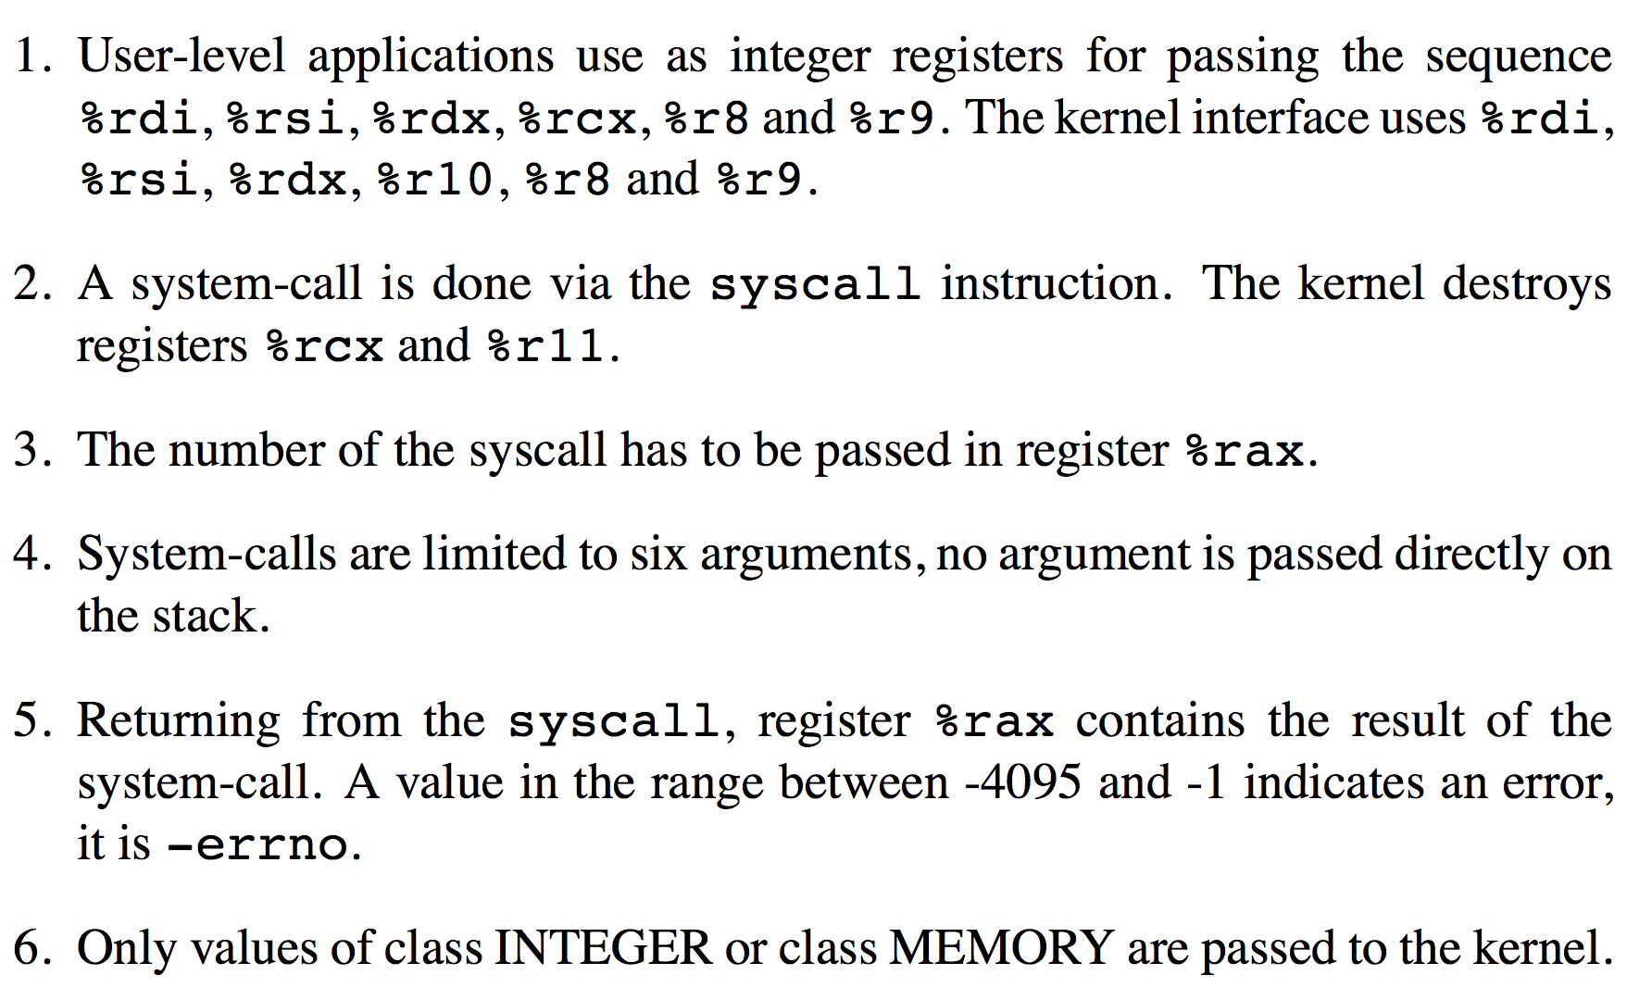
Linux x64 syscall conventions (ABI)
(user buffer addresses)
Illustration only: the details aren’t important.

Slide 20
Entering the kernel
CPU event: trap, fault, interrupt
Core transitions to kernel mode
Map kernel space—if not already mapped.
Set PC to execute a pre-designated handler routine for that event type.
Lookup event type in table or “vector”
Set SP to pre-designated kernel stack.
Per-thread or interrupt stack
user
space
Safe control transfer
kernel
code
kernel
space
kernel
data

Slide 21
Kernel Stacks and Trap/Fault Handling
System calls and faults run in kernel mode on a kernel stack for the current thread.
Threads execute user code on a user stack in user space (the process virtual address space).
data
stack
stack
Each thread has a second kernel stack in kernel space (VM accessible only in kernel mode).
Kernel code running in P’s process context has access to P’s virtual memory.
syscall dispatch table
stack
stack
The syscall (trap) handler makes an indirect call through the system call dispatch table to the handler registered for the specific system call.

Slide 22
The kernel must be bulletproof
Secure kernels handle system calls verrry carefully.
User program / user space
Syscalls indirect through syscall dispatch table by syscall number. No direct calls to kernel routines from user space!
Kernel copies all arguments into kernel space and validates them.
user buffers
trap
copyout
copyin
Kernel interprets pointer arguments in context of the user VAS, and copies the data in/out of kernel space (e.g., for read and write syscalls).
What about references to kernel data objects passed as syscall arguments (e.g., file to read or write)?
read() {…}
write() {…}
kernel
Use an integer index into a kernel table that points at the data object. The value is called a handle or descriptor. No direct pointers to kernel data from user space!

Slide 23

Entry to the kernel
Every entry to the kernel is the result of a trap, fault, or interrupt. The core switches to kernel mode and transfers control to a handler routine.
syscall trap/return
fault/return
OS kernel code and data for system calls (files, process fork/exit/wait, pipes, binder IPC, low-level thread support, etc.) and virtual memory management (page faults, etc.)
I/O completions
interrupt/return
timer ticks
The handler accesses the core register context to read the details of the exception (trap, fault, or interrupt). It may call other kernel routines.

Slide 24
Recap: OS protection
Know how a classical OS uses the hardware to protect itself and implement a limited direct execution model for untrusted user code.
Virtual addressing. Applications run in sandboxes that prevent them from calling procedures in the kernel or accessing kernel data directly (unless the kernel chooses to allow it).
Events. The OS kernel installs handlers for various machine events when it boots (starts up). These events include machine exceptions (faults), which may be caused by errant code, interrupts from the clock or external devices (e.g., network packet arrives), and deliberate kernel calls (traps) caused by programs requesting service from the kernel through its API.
Designated handlers. All of these machine events make safe control transfers into the kernel handler for the named event. In fact, once the system is booted, these events are the only ways to ever enter the kernel, i.e., to run code in the kernel.

