Slide 1


CPS 310
Threads in the Kernel: See How they Block
Jeff Chase
Duke University

Slide 2
The story so far…
data
data

Slide 3
Simplify for today
For today, and for the thread labs, let’s assume classic processes, with a single thread.
Then we can use the terms “process” and “thread” interchangeably.
(As Linux people would do anyway.)
Let’s also assume a uniprocessor: one core, one slot.
Then we can ignore physical concurrency. There is only logical concurrency.
Which comes from….what?

Slide 4
Two threads sharing a CPU/core
concept
reality
context switch

Slide 5


The core-and-driver analogy
The machine has a bank of CPU cores for threads to run on.
The OS allocates cores to threads (the “drivers”).
Cores are hardware. They go where the driver tells them.
OS can force a switch of drivers any time.
Core #1
Core #2

Slide 6
What causes a context switch?
There are three possible causes:
Preempt (yield). The thread has had full use of the core for long enough. It has more to do, but it’s time to let some other thread “drive the core”.
E.g., timer interrupt, quantum expired → OS forces yield
Thread enters Ready state, goes into pool of runnable threads.
Exit. Thread is finished: “park the core” and die.
Block/sleep/wait. The thread cannot make forward progress until some specific occurrence takes place.
Thread enters Blocked state, and just lies there until the event occurs. (Think “stop sign” or “red light”.)
STOP
wait

Slide 7
Thread states Concept: block/sleep/wait
running
yield
preempt
sleep
dispatch
blocked
ready
wakeup
STOP
wait
Often a thread’s execution is blocked: it cannot continue until a designated event occurs. The thread waits for the event. We say that the thread blocks or sleeps and that the event wakes it up.

Slide 8
Thread states: user mode vs. kernel
running
user mode
kernel mode
yield
preempt
sleep
dispatch
blocked
ready
wakeup
STOP
wait
In a “real” OS, threads/processes change states only in kernel mode.
Let us assume for today that our threads are in kernel mode

Slide 9
Mode switches
running
user mode
kernel mode
yield
preempt
sleep
mode
switches
dispatch
blocked
ready
wakeup
STOP
wait
Mode switches
User mode to kernel mode: trap, fault, or interrupt.
Kernel mode to user mode: return from trap, fault, or interrupt.

Slide 10
Handling a page fault
What should this thread be doing while it waits here for the disk operation to complete?
fault
5. Re-execute faulting instruction, continue
fault handler
…..
wait
1. identify
missing page
2. Allocate empty page frame
3. Read page from disk
4. Map VPN→PFN and return

Slide 11
Blocking/sleeping in a page fault
Sleep (block): suspend execution until the read is complete and the thread can continue.
fault
5. Re-execute faulting instruction, continue
fault handler
…..
wait
1. identify
missing page
2. Allocate empty page frame
3. Read page from disk
4. Map VPN→PFN and return
When a thread blocks, it stops running, leaves the core for use by other threads, and sleeps: it wakes/resumes only after some specified event or condition occurs.
Threads block for page faults, and for many other reasons as well.
It happens all the time.

Slide 12
Blocking/sleeping in a page fault
Sleep (block): suspend execution until the read is complete and the thread can continue.
fault
5. Re-execute faulting instruction, continue
fault handler
…..
wait
1. identify
missing page
2. Allocate empty page frame
3. Read page from disk
4. Map VPN→PFN and return
When a thread blocks, it stops running, leaves the core for use by other threads, and sleeps: it wakes/resumes only after some specified event or condition occurs.
Threads block for page faults, and for many other reasons as well.
It happens all the time.

Slide 13
Anatomy of a read()
3. Check to see if requested data (e.g., a block) is in memory. If not, figure where it is on disk, and start the I/O.
6. Return to user mode.
5. Copy data from kernel buffer to user buffer in read.
(kernel mode)
2. Enter kernel for read syscall.
1. Compute
(user mode)
4. sleep for I/O (stall)
Wakeup by interrupt.
CPU
seek
transfer (DMA)
Disk
Time

Slide 14
Portrait of a thread: the TCB
In an implementation, each thread is represented by a data structure. We call it a “thread object” or “Thread Control Block”. It stores information about the thread, and may be linked into other system data structures.
Thread Control Block (“TCB”)
“Heuristic fencepost”: try to detect stack overflow errors
Storage for context (register values) when thread is not running.
name/status etc
0xdeadbeef
ucontext_t
Stack
Each thread also has a runtime stack for its own use. As a running thread calls procedures in the code, frames are pushed on its stack.

Slide 15
Kernel Stacks and Trap/Fault Handling
System calls and faults run in kernel mode on a kernel stack for the current thread.
Threads execute user code on a user stack in user space (the process virtual address space).
data
stack
stack
Each thread has a second kernel stack in kernel space (VM accessible only in kernel mode).
Kernel code running in P’s process context has access to P’s virtual memory.
syscall dispatch table
stack
stack
The syscall (trap) handler makes an indirect call through the system call dispatch table to the handler registered for the specific system call.

Slide 16

More analogies: threads and stacks
Each thread chooses its own path. (By its program.)
But they must leave some “bread crumbs” to find their way back on the return!
Where does a thread leave its crumbs? On its stack!
Call frames with local variables
Return addresses
See: Hansel and Gretel
This means that each thread must have its own stack in memory, so that their crumbs aren’t all mixed together.
stack
stack

Slide 17

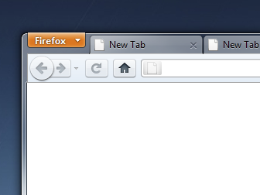
More analogies: context/switching
1
Page links and back button navigate a “stack” of pages in each tab.
2
Each tab has its own stack.
One tab is active at any given time.
You create/destroy tabs as needed.
You switch between tabs at your whim.
3
Similarly, each thread has a separate stack.
The OS switches between threads at its whim.
One thread is active per CPU core at any given time.
time →

Slide 18
Thread states and queues
At most one thread T is running (per core).
Current[core] points at T’s TCB.
Any other thread P is blocked or ready.
Link P’s TCB onto a thread queue.
exit
running
Internal routines manage thread state changes.
E.g.: yield, sleep, wakeup.
These routines slam thread TCBs on and off various internal thread queues.
yield
preempt
sleep
dispatch
create
blocked
wakeup
ready
Ready→ready queue
Blocked→waiter queue for event/object

Slide 19
The ready queue
new
threads
ThreadCreate
If timer expires, or running thread blocks, yields, or terminates:
blocked
threads
ready queue
GetNextToRun
Wakeup
SWITCH()
For p1t, the ready pool is a simple FIFO queue: the ready list or ready queue (runqueue). Scalable multi-core systems use multiple runqueues to reduce locking contention among cores. It is typical to implement a ready pool as an array of runqueues for different priority levels.

Slide 20
What cores do
Idle loop
scheduler
getNextToRun()
pause
idle
nothing?
get thread
put thread
sleep?
exit?
got thread
ready queue
(runqueue)
timer
quantum expired?
switch in
switch out
run thread

Slide 21
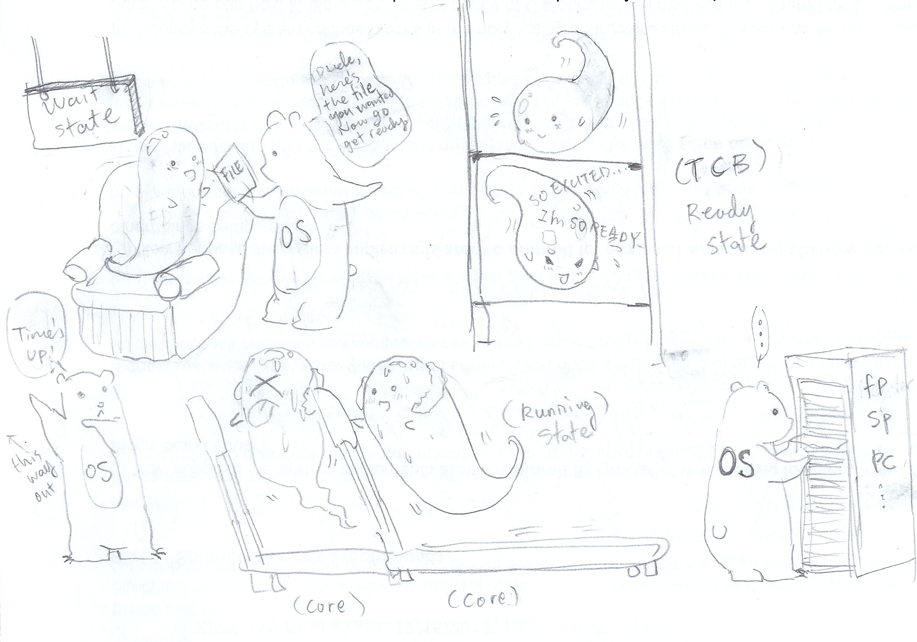
A former student named Grace Chen drew this artwork freeform for extra credit on a final exam.

