Slide 1
Pthread Activity
https://repl.it/@hewner/PthreadDuke#README.md

Slide 2
Minor aside
Upcoming assignment p1d – deli problem
There’s an issue with the repos you check out from AG350 – two files are corrupted and for various reasons this can’t be easily fixed
We have new versions of the files you can copy into your repos
There’s a pinned post on Piazza explaining it – we will also be adding it to the assignment instructions very soon

Slide 3
Let’s start in threadExample.c
Thread function pointer
To make a thread:
pthread_create(&tid[i], NULL, runner, &threadData[i]);
To wait for a thread to complete:
pthread_join(tid[i], NULL);
Output parameter: threadID
Parameter void pointer
Input parameter: threadID
NOTE: no &

Slide 4
Be careful with your parameters
Broken:
pthread_create(&tid[i], NULL, runner, &i);
This value is the same on each pass through the for loop. That means your threads are sharing their parameters.

Slide 5
Let's use pthreads
In you breakout rooms, try to solve factoring.c (following the readme)
At some point, I’m going to move you to the race condition part which is add_a_lot.c
As always, ask for help if you need it

Slide 6
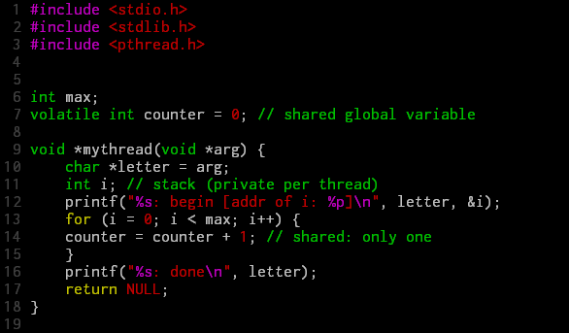
Problem illustration with example
* volatile means the variable may change.

Slide 7
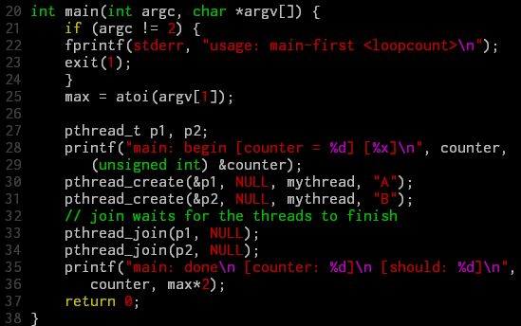
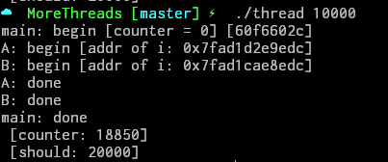


Problem illustration with example (cont.)

Slide 8
Problem investigation
mov 0x8049a1c, %eax //1. load count
add $0x1, %eax //2. add one
mov %eax, 0x8049a1c //3. store new value
count = count + 1 →
If ..
Thread 1
Thread 2
mov 0x8049a1c, %eax
add $0x1, %eax
mov %eax, 0x8049a1c
mov 0x8049a1c, %eax
add $0x1, %eax
mov %eax, 0x8049a1c

Slide 9
Solution: The Wish For Atomicity
Goal: finish code in a critical section as a unit – no interrupt.
Correctness
Performance

