Slide 1

CPS 310
Synchronization:
Digging Deeper
Jeff Chase
Duke University

Slide 2

Roots: monitors
A monitor is a module in which execution is serialized.
A module is a set of procedures with some private state.
state
[Brinch Hansen 1973]
[C.A.R. Hoare 1974]
At most one thread runs in the monitor at a time.
P1()
(enter)
ready
to enter
P2()
P3()
Other threads wait until the monitor is free.
signal()
P4()
blocked
wait()
Java “monitors”? synchronized allows finer control over the entry/exit points. Also, each Java object is its own “module”: objects of a class share methods of the class but have private state and a private monitor.

Slide 3
Monitor wait/signal
We need a way for a thread to wait for some condition to become true, e.g., until another thread runs and/or changes the state somehow.
At most one thread runs in the monitor at a time.
state
A thread may wait (sleep) in the monitor, exiting the monitor.
P1()
(enter)
ready
to enter
A thread may signal in the monitor.
Signal means: wake one waiting thread, if there is one, else do nothing.
The awakened thread returns from its wait and reenters the monitor.
P2()
signal()
P3()
signal()
P4()
wait()
waiting
(blocked)
wait()

Slide 4
Monitor wait/signal
Design question: when a waiting thread is awakened by signal, must it start running immediately? Back in the monitor, where it called wait?
At most one thread runs in the monitor at a time.
state
Two choices: yes or no.
If yes, what happens to the thread that called signal within the monitor? Does it just hang there? They can’t both be in the monitor.
If no, can’t other threads get into the monitor first and change the state, causing the condition to become false again?
P1()
(enter)
ready
to enter
P2()
signal()
???
P3()
signal
P4()
wait()
waiting
(blocked)
wait

Slide 5
Mesa semantics
Design question: when a waiting thread is awakened by signal, must it start running immediately? Back in the monitor, where it called wait?
Mesa semantics: no.
state
An awakened waiter gets back in line. The signal caller keeps the monitor.
So, can’t other threads get into the monitor first and change the state, causing the condition to become false again?
Yes. So the waiter must recheck the condition:
“Loop before you leap”.
ready
to (re)enter
P1()
(enter)
ready
to enter
P2()
signal()
P3()
signal
P4()
wait()
waiting
(blocked)
wait

Slide 6
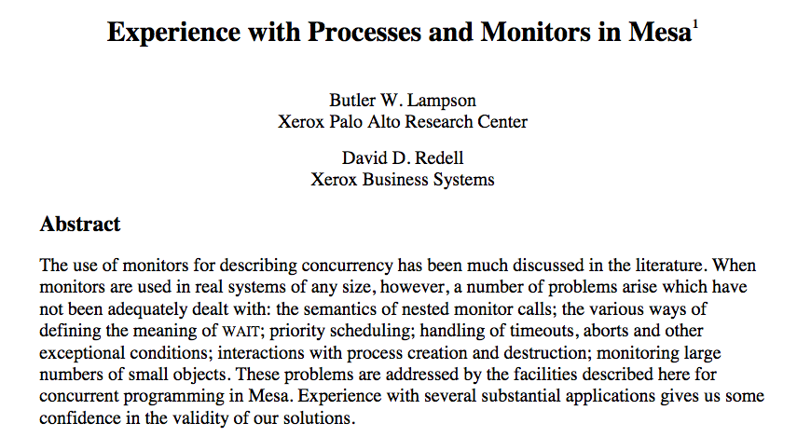
1980

Slide 7
Thread project APIs
thread_create(func, arg);
thread_yield();
Threads
thread_lock(lockID);
thread_unlock(lockID);
Locks/Mutexes
Mesa monitors
thread_wait(lockID, cvID);
thread_signal(lockID, cvID);
thread_broadcast(lockID, cvID);
Condition Variables
All functions return an error code: 0 is success, else -1.

Slide 8
Terminology and syntax
The abstractions for concurrency control in this class are now sort-of universal at the OS/API level.
Monitors (mutex+CV) with Mesa semantics appear in:
Java (e.g., on Android) and JVM languages (e.g., Scala)
POSIX threads or Pthreads (used on Linux and MacOS/iOS)
Windows, C#/.NET, and other Microsoft systems
Terminology and APIs vary a bit.
mutex == lock == Java “synchronized”
monitor == mutex + optional condition variable(s) or CV(s)
signal() == notify(), broadcast() == notifyAll()
Windows/C# calls notify “pulse”
The slides use interchangeable terms interchangeably.

Slide 9
Using locks/mutexes: invariants
T
T2
Get from list
lock(mx);
element = list.pop();
unlock(mx);
Shared list
Put to list
lock(mx);
list.push(element);
unlock(mx);
Every data structure has invariant conditions: assumptions that must be true for the code to work.
E.g., e.back.next == e for a doubly linked list.
Code methods temporarily violate the invariants, then restore them before completing. E.g, insertion to a list:
Lock it down! Until invariants are restored.

Slide 10

Shared vs. Per-Thread State
Lock it down! When accessing shared state.

Slide 11
The missed wakeup problem
T
T2
Get from list
lock(mx);
while (empty(list))
unlock; sleep(); lock;
element = list.pop();
unlock(mx);
Put to list
lock(mx);
list.push(element);
if (…)
T.wakeup();
unlock(mx);
Pseudocode OK.
But this won’t work!
We need sleep/wakeup primitives that are integrated with locking. Why? Sleep is inherently racy!
If T sleeps due to state of shared structure (e.g., empty list), it must unlock first, else T2 can’t get in to “fix it”.
But if T unlocks, then T2 could finish before T even gets to sleep! T can miss the wakeup and sleep “forever”.
This is called the missed wakeup or wake up waiter problem.

Slide 12
Monitors fix the missed wakeup problem
T
T2
Get from list
lock(mx);
while (empty(list))
wait(mx, cv);
element = list.pop();
unlock(mx);
Put to list
lock(mx);
list.push(element);
signal(cv);
unlock(mx);
Monitor wait() unlocks for duration of the wait, atomically. It’s magic!
Monitors are designed to solve the missed wakeup problem.
The integrated lock protects the data structure and condition covered by the CV.
Another synchronization construct called semaphores also fixes the problem in a different way.
More on all this later.

Slide 13
Monitors make no promises
T
T2
pop
Get from list
lock(mx);
if (empty(list))
wait(mx, cv);
element = list.pop();
unlock(mx);
Good:
Put to list
lock(mx);
list.push(element);
signal(cv);
unlock(mx);
wait
signal
???
Bad:
pop
The monitor contract is nondeterministic.
User cannot know which waiter a mutex or CV chooses next.
The monitor implementation is free to choose. E.g., the thread lab is All FIFO All the Time.
But a user/programmer should never assume any particular choice.
Loop before you leap!

Slide 14
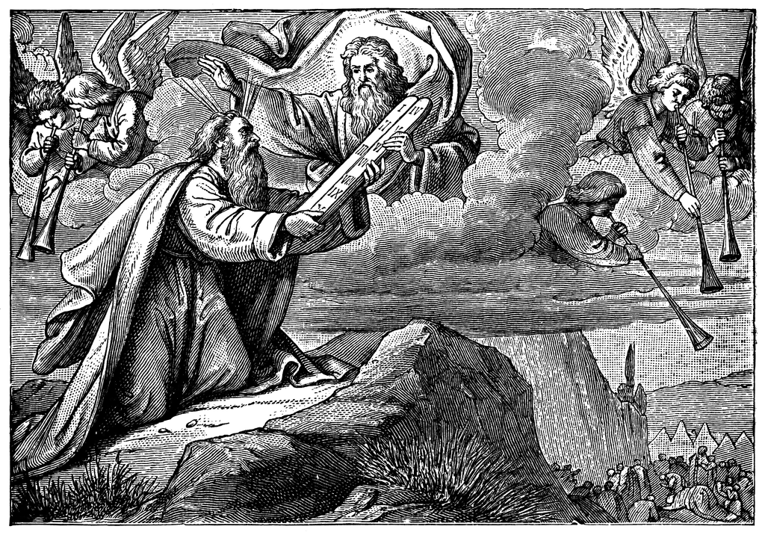
A note on “loop before you leap”
Loop before you leap is my slogan for the looping requirement of CVs with Mesa semantics: when a thread wait()s for a condition to become true, it can't be sure that the condition is in fact true when it returns from wait(). This it might have to loop and wait again.
SharedLock and soda machine illustrate “loop before you leap”: every wait() is in a while loop that rechecks the condition each time it wakes up, before continuing ("leaping") into the rest of the program. Be sure that you understand why this is necessary (see the slide/s on Mesa semantics).
Note also that if your CV programs loop before leaping, that also protects you against “sloppy” use of broadcast/notifyAll and of condition variables that represent multiple conditions. This can simplify programs considerably.
In particular, it is correct to use notifyAll() if all waiters "loop before leaping". If the wakeup was spurious, they will just go back into the wait(). Similarly, if multiple threads wait on the same condition variable for different reasons, or if other threads signal/notify the condition variable early, then some threads may wake up before the condition they are waiting for is true. That is OK as long as they loop before leaping.
In fact, a good way to write correct code quickly is to always use notifyAll/broadcast and always loop before leaping. It always works, although it might be slow (due to thundering herds). But that’s OK: correctness first, then performance.

Slide 15
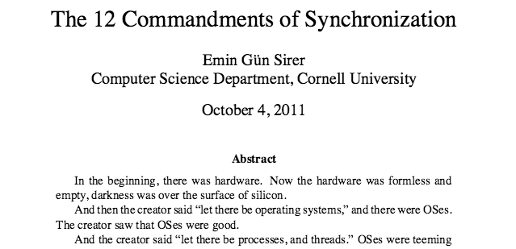

Commandment 9. Thou shalt cover thy naked waits.
Commandment 10. Thou shalt guard your wait predicates in a while loop. Thou shalt never guard a wait statement with an if statement.

Slide 16
The spurious wakeup problem
T
T2
Get from list
lock(mx);
while (empty(list) ||
list.head.type != what_I_want)
wait(mx, cv);
element = list.pop();
unlock(mx);
Put to list
element.type = not_what_T_wants;
lock(mx);
list.push(element);
signal(cv);
unlock(mx);
Suppose elements on the list are typed.
T and some T1 (not shown) wait for different types.
T2 pushes an element of T1’s type, but T gets the signal (spurious).
T ignores element and goes back to wait, and T1 waits “forever”.
Spurious wakeups occur when a CV is used for multiple conditions.
How to ensure that the “right” thread wakes up?

Slide 17
Wake ‘em all, let them sort it out
T
T2
Get from list
lock(mx);
while (empty(list) ||
list.head.type != what_I_want)
wait(mx, cv);
element = list.pop();
unlock(mx);
Put to list
element.type = not_what_T_wants;
lock(mx);
list.push(element);
broadcast(cv);
unlock(mx);
If we use broadcast (notifyAll or pulseAll), then both T and T1 wake.
T goes back to wait, and T1 gets its element.
If we loop before leaping, broadcast is always safe!
In this example, it is signal that is unsafe! Broadcast works.
But still spurious wakeups, which have a cost: thundering herd.
“Signal is just a performance hint.” [Hauser et. al.]

Slide 18

Thundering herd
Thundering herd: an event occurs (e.g., a CV broadcast) and many threads wake up as a result, where only one of them can actually consume/handle the event.
The others go back to sleep, and their work is wasted.
Thus the system is briefly under heavy load while a "herd of threads thunders through", like a herd of buffalo stampeding.
Image: http://www.artbarbarians.com/gallery2/images/13/thunder-and-dust-american-bison-buffalo-fine-art-print-daniel-smith-large11318193.jpg

Slide 19
Producer/consumer bounded buffer
Let’s apply what we know to an example problem.
Manage flow of items from producers to consumers.
Use a “buffer” to store the items in transit.
The buffer decouples producer and consumer so they can be fully asynchronous: avoids forcing a rendezvous.
But if buffer is empty, consumer must wait for item(s).
And any practical buffer is bounded: it can max out.
If the buffer is full, producer must drop item(s) or wait.
Producer/consumer bounded buffers occur everywhere in systems: I/O, pipes, networking, services.
And in a soda machine. Slides from Landon Cox.

Slide 20
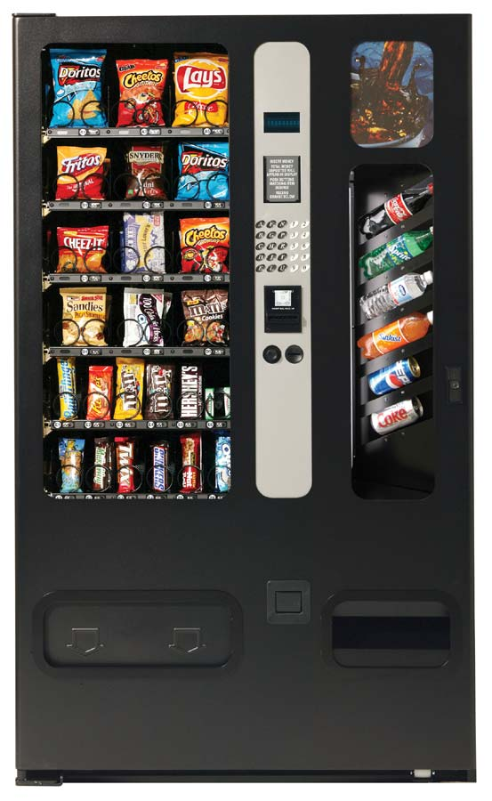



Example: the soda/HFCS machine
Soda drinker
(consumer)
Delivery person
(producer)
Vending machine
(buffer)

Slide 21
Producer-consumer code
consumer () {
take a soda from machine
}
producer () {
add one soda to machine
}

Slide 22
Solving producer-consumer
What are the variables/shared state?
Soda machine buffer
Number of sodas in machine (≤ MaxSodas)
Locks?
One, to protect all shared state (sodaLock)
Mutual exclusion?
Only one thread can manipulate machine at a time
Ordering constraints?
Consumer must wait if machine is empty (CV hasSoda)
Producer must wait if machine is full (CV hasRoom)

Slide 23
Producer-consumer code
consumer () {
lock
take a soda from machine
unlock
}
producer () {
lock
add one soda to machine
unlock
}

Slide 24
Producer-consumer code
consumer () {
lock
wait if empty
take a soda from machine
notify (not full)
unlock
}
producer () {
lock
wait if full
add one soda to machine
notify (not empty)
unlock
}

Slide 25
Producer-consumer code
consumer () {
lock (sodaLock)
while (numSodas == 0) {
wait (sodaLock,hasSoda)
}
take a soda from machine
signal (hasRoom)
unlock (sodaLock)
}
producer () {
lock (sodaLock)
while(numSodas==MaxSodas){
wait (sodaLock, hasRoom)
}
add one soda to machine
signal (hasSoda)
unlock (sodaLock)
}
Mx
CV1
Mx
CV2
CV2
CV1

Slide 26
Producer-consumer code
consumer () {
lock (sodaLock)
while (numSodas == 0) {
wait (sodaLock,hasSoda)
}
take a soda from machine
signal(hasRoom)
unlock (sodaLock)
}
producer () {
lock (sodaLock)
while(numSodas==MaxSodas){
wait (sodaLock, hasRoom)
}
fill machine with soda
broadcast(hasSoda)
unlock (sodaLock)
}
The signal should be a broadcast if the producer can produce more than one resource, and there are multiple consumers.
lpcox slide edited by chase

Slide 27
Variations: one CV?
consumer () {
lock (sodaLock)
while (numSodas == 0) {
wait (sodaLock,hasRorS)
}
take a soda from machine
signal (hasRorS)
unlock (sodaLock)
}
producer () {
lock (sodaLock)
while(numSodas==MaxSodas){
wait (sodaLock,hasRorS)
}
add one soda to machine
signal(hasRorS)
unlock (sodaLock)
}
Mx
CV
Mx
CV
CV
CV
Two producers, two consumers: who consumes a signal?
ProducerA and ConsumerB wait while ConsumerC signals?

Slide 28
Variations: one CV?
consumer () {
lock (sodaLock)
while (numSodas == 0) {
wait (sodaLock,hasRorS)
}
take a soda from machine
signal (hasRorS)
unlock (sodaLock)
}
producer () {
lock (sodaLock)
while(numSodas==MaxSodas){
wait (sodaLock,hasRorS)
}
add one soda to machine
signal (hasRorS)
unlock (sodaLock)
}
Is it possible to have a producer and consumer both waiting? Suppose MaxSodas==1
cA, cB wait, pC adds/signals/leaves, pD waits, cA wakes/signals/leaves, cB wakes (!), waits
Now: pC, cA gone, cB, pD both waiting!

Slide 29
Variations: one CV?
consumer () {
lock (sodaLock)
while (numSodas == 0) {
wait (sodaLock,hasRorS)
}
take a soda from machine
broadcast (hasRorS)
unlock (sodaLock)
}
producer () {
lock (sodaLock)
while(numSodas==MaxSodas){
wait (sodaLock,hasRorS)
}
add one soda to machine
broadcast (hasRorS)
unlock (sodaLock)
}
Use broadcast instead of signal: safe but slow.

Slide 30
Notes from soda machine
Producer/consumer illustrates using multiple CVs to reduce spurious wakeups: can be more selective/targeted with wait/notify.
If we use one CV for multiple conditions, a signal/notify might wake up the “wrong” thread (“spurious”), leaving a thread blocked forever.
Broadcast gets it done: “wake ‘em all and let them sort it out”.
“Loop before you leap!” makes broadcast safe to “sort it out”.
But broadcast may be slow: thundering herd.
“Signal is just a performance hint.” Tells system waking just one is good enough: program functions the same but performs better.

Slide 31
Thinking about threads
Threads don’t “know” about one another: they coordinate through shared locks and CVs.
Threads don’t have agency or intention; they don’t “decide” when to lock, signal, or wait; they just execute the program.
Thread calls on locks and CVs are conventions in the program to protect (synchronize) their accesses to the shared data.
Concurrency control is about using synchronization in the right ways and in all the right places in the program’s code.
A program is correctly synchronized or data-race-free iff it excludes all dangerous schedules that cause unintended behavior.
Its threads “do the right thing” in any remaining legal schedule, on any system, on any machine.

