Slide 1

CPS 310
Starvation and Deadlock
Jeff Chase
Duke University

Slide 2
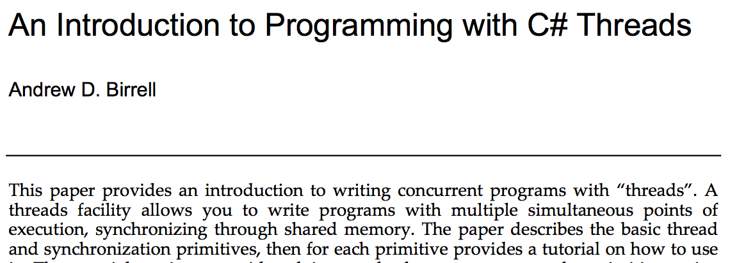
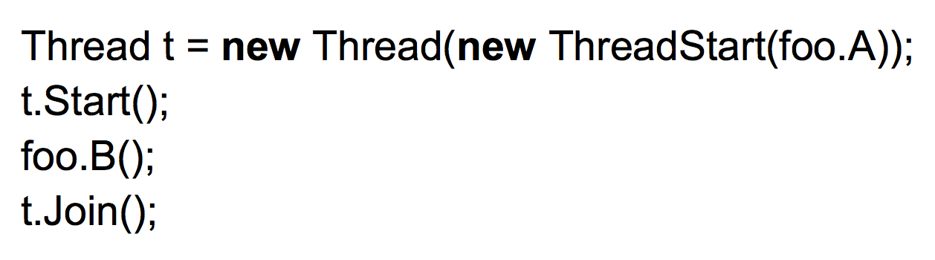
This paper is recommended reading if you want to see thread programming through the eyes of one of the great “village elders” of computer systems. He wrote it for you. We present the SharedLock example from this paper.
2003
An Introduction to Programming with with C# Threads

Slide 3
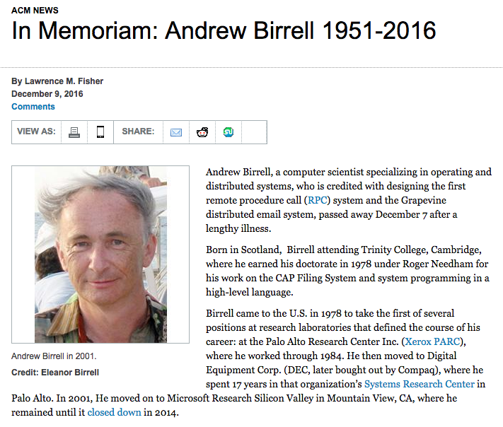

Slide 4
SharedLock: reader/writer lock
A reader/write lock or SharedLock is a new kind of “lock” that is similar to our old definition:
Acquire and Release primitives
Mutual exclusion for writes to shared state
But: a SharedLock allows more concurrency for readers when no writer is present.
class SharedLock {
AcquireRead(); /* shared mode */
AcquireWrite(); /* exclusive mode */
ReleaseRead();
ReleaseWrite();
}

Slide 5
Reader/Writer Lock illustrated
Multiple readers may hold
the lock concurrently in shared mode.
A_{r}
A_{r}
A_{w}
R_{r}
R_{r}
Writers always hold the lock in exclusive mode. They must wait for all readers or competing writer to exit.
With monitors—mutexes and conditions—as a foundation, we can build higher-level abstractions like SharedLock.
R_{w}
mode read write max allowed
shared yes no many
exclusive yes yes one
not holder no no many
Writer mode is a mutex: at most one holder at any given time; allows writes.

Slide 6
SharedLock: outline
int i; /* # active readers, or -1 if writer */
void AcquireWrite() {
while (i != 0)
sleep….;
i = -1;
}
void AcquireRead() {
while (i < 0)
sleep…;
i += 1;
}
void ReleaseWrite() {
i = 0;
wakeup….;
}
void ReleaseRead() {
i -= 1;
if (i == 0)
wakeup…;
}

Slide 7
SharedLock: lock it down
int i; /* # active readers, or -1 if writer */
Lock rwMx;
AcquireWrite() {
rwMx.Acquire();
while (i != 0)
sleep…;
i = -1;
rwMx.Release();
}
AcquireRead() {
rwMx.Acquire();
while (i < 0)
sleep…;
i += 1;
rwMx.Release();
}
ReleaseWrite() {
rwMx.Acquire();
i = 0;
wakeup…;
rwMx.Release();
}
ReleaseRead() {
rwMx.Acquire();
i -= 1;
if (i == 0)
wakeup…;
rwMx.Release();
}

Slide 8
SharedLock: cleaner syntax
int i; /* # active readers, or -1 if writer */
synchronized AcquireWrite() {
while (i != 0)
wait();
i = -1;
}
synchronized AcquireRead() {
while (i < 0)
wait();
i += 1;
}
synchronized ReleaseWrite() {
i = 0;
notifyAll();
}
synchronized ReleaseRead() {
i -= 1;
if (i == 0)
notify();
}
We can use Java syntax for convenience.
That’s the beauty of pseudocode. We use any convenient syntax. These syntactic variants have the same meaning.

Slide 9
The Little Mutex Inside SharedLock
A_{r}
A_{r}
A_{w}
R_{r}
R_{r}
Caller thread holds mutex only while acquiring or releasing SharedLock .
A_{r}
R_{w}
R_{r}
SharedLock holders do not hold its mutex, permitting concurrent readers.
To block in Acquire*, use condition wait(), releasing mutex.

Slide 10
Limitations of the SharedLock first try
This implementation has weaknesses; see [Birrell89/03].
Spurious lock conflicts (on a multiprocessor): multiple waiters contend for the mutex after a signal or broadcast.
Solution: drop the mutex before signaling (if permitted).
Spurious wakeups (thundering herd)
ReleaseWrite awakens writers as well as readers.
Solution: add a separate condition variable for writers.
Starvation
How can we be sure that a writer can ever acquire if faced with a continuous stream of arriving readers?

Slide 11
Culling the thundering herd
The first try at SharedLock illustrates thundering herd again. It is slow under contention: too many context switches.
Why?
ReleaseWrite uses notifyAll to wake all waiting readers.
Maximizes concurrency for readers: they all get in.
But it uses the same CV for readers and writers.
And if a waking writer gets in first, then all other threads must wait() again: thundering herd.
For them, the broadcast wakeup is “spurious”.
How to fix it?
Use two CVs to separate readers and writers.

Slide 12
SharedLock: second try
SharedLock::AcquireWrite() {
rwMx.Acquire();
while (i != 0)
wCv.Wait(&rwMx);
i = -1;
rwMx.Release();
}
SharedLock::AcquireRead() {
rwMx.Acquire();
while (i < 0)
...rCv.Wait(&rwMx);...
i += 1;
rwMx.Release();
}
SharedLock::ReleaseWrite() {
rwMx.Acquire();
i = 0;
if (readersWaiting)
rCv.Broadcast();
else
wCv.Signal();
rwMx.Release();
}
SharedLock::ReleaseRead() {
rwMx.Acquire();
i -= 1;
if (i == 0)
wCv.Signal();
rwMx.Release();
}

Slide 13
SharedLock: second try
synchronized AcquireWrite() {
while (i != 0)
wCv.Wait();
i = -1;
}
synchronized AcquireRead() {
while (i < 0) {
readersWaiting+=1;
rCv.Wait();
readersWaiting-=1;
}
i += 1;
}
synchronized ReleaseWrite() {
i = 0;
if (readersWaiting)
rCv.Broadcast();
else
wCv.Signal();
}
synchronized ReleaseRead() {
i -= 1;
if (i == 0)
wCv.Signal();
}
wCv and rCv are protected by the monitor mutex: pseudocode.

Slide 14
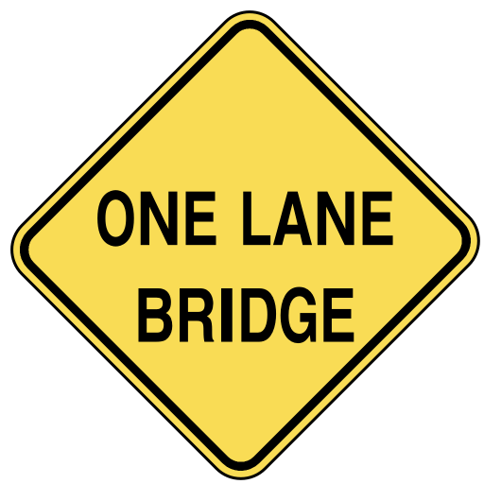
Starvation
These reader/writer locks also illustrate starvation: under load, a writer might be stalled forever by a stream of readers.
Example: a one-lane bridge or tunnel.
Wait for oncoming car to exit the bridge before entering.
Repeat as necessary…
Solution: some reader must politely stop before entering, even though it is not forced to wait by oncoming traffic.
More code…
More complexity…

Slide 15


Slide 16
Third try: writer priority
synchronized AcquireW() {
while (i != 0) {
cw++;
wCv.Wait();
cw--;
}
i -= 1; /* -1 */
}
synchronized AcquireR() {
while (i < 0 || cw) {
rCv.Wait();
}
i += 1;
}
synchronized ReleaseW() {
i += 1; /* 0 */
if (cw)
wCv.Signal();
else
rCv.Broadcast();
}
synchronized ReleaseR() {
i -= 1;
if (i == 0 && cw)
wCv.Signal();
}

Slide 17
Starvation in SharedLock
The first/second try may starve the writers.
Why? Because if a reader is in, then any arriving reader can just jump right in with it.
Writers must wait for the last reader to exit.
The third try adds logic to block any arriving reader if any writer is waiting. And the writers get priority for a signal.
Fixed it for you! But now the readers can starve.
We can fix that problem too, with more code.
See “Highway 110-310” in list of concurrency problems.

Slide 18
Dining Philosophers
N processes share N resources
resource requests occur in pairs w/ random think times
hungry philosopher grabs fork
...and doesn’t let go
...until the other fork is free
...and the linguine is eaten
4
A
1
D
B
3
C
2
while(true) {
Think();
AcquireForks();
Eat();
ReleaseForks();
}

Slide 19
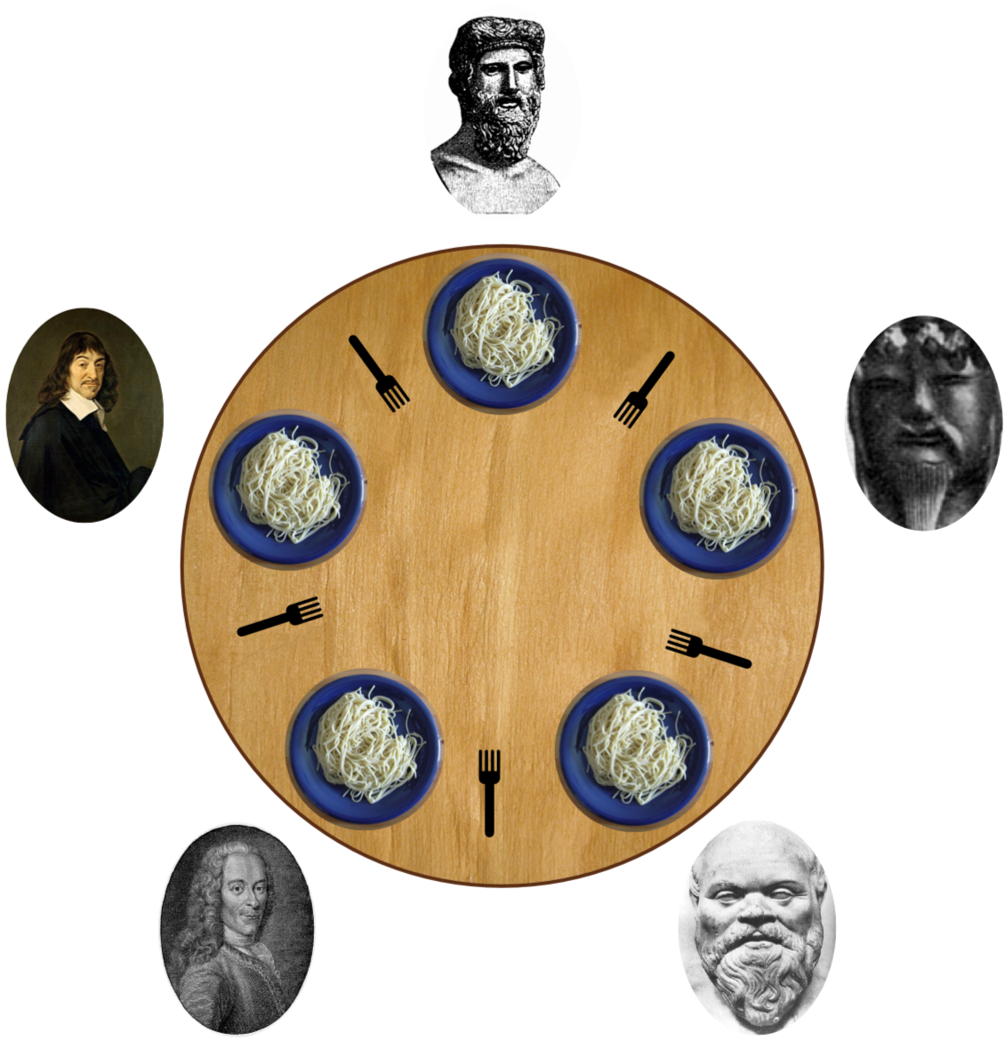

Slide 20
Resource graph or wait-for graph
A vertex for each process and each resource
If process A holds resource R, add an arc from R to A.
A
A grabs fork 1
B grabs fork 2
1
2
B

Slide 21
Resource graph or wait-for graph
A vertex for each process and each resource
If process A holds resource R, add an arc from R to A.
If process A is waiting for R, add an arc from A to R.
A
A grabs fork 1
and
waits for fork 2.
B grabs fork 2
and
waits for fork 1.
1
2
B

Slide 22
Resource graph or wait-for graph
A vertex for each process and each resource
If process A holds resource R, add an arc from R to A.
If process A is waiting for R, add an arc from A to R.
The system is deadlocked iff the wait-for graph has at least one cycle.
A
A grabs fork 1
and
waits for fork 2.
B grabs fork 2
and
waits for fork 1.
1
2
B

Slide 23
Deadlock vs. starvation
A deadlock is a situation in which a set of threads are all waiting for another thread to move.
But none of the threads can move because they are all waiting for another thread to do it.
Deadlocked threads sleep “forever”: the software “freezes”. It stops executing, stops taking input, stops generating output. There is no way out.
Starvation (also called livelock) is different: some schedule exists that can exit the livelock state, and the scheduler may select it, even if the probability is low.

Slide 24
RTG for Two Philosophers
Y
2
1
Sm
Sn
R2
R1
Sn
X
A1
2
1
Sm
A2
(There are really only 9 states we
care about: the key transitions are acquire and release events.)
A1
A2
R2
R1

Slide 25
Two Philosophers Living Dangerously
R2
X
R1
2
1
A1
Y
???
A2
A1
A2
R2
R1

Slide 26
The Inevitable Result
R2
X
R1
2
1
A1
Y
A2
This is a deadlock state:
There are no legal transitions out of it.
A1
A2
R2
R1

Slide 27
Four conditions for deadlock
Four conditions must be present for deadlock to occur:
1. Non-preemption of ownership. Resources are never taken away from the holder.
2. Exclusion. A resource has at most one holder.
3. Hold-and-wait. Holder blocks to wait for another resource to become available.
4. Circular waiting. Threads acquire resources in different orders.

Slide 28
Not all schedules lead to collisions
The scheduler+machine choose a schedule, i.e., a trajectory or path through the graph.
Synchronization constrains the schedule to avoid illegal states.
Some paths “just happen” to dodge dangerous states as well.
What is the probability of deadlock?
How does the probability change as:
think times increase?
number of philosophers increases?

Slide 29
Wikipedia animations

Slide 30
Dealing with deadlock
1. Ignore it. Do you feel lucky?
2. Detect and recover. Check for cycles and break them by restarting activities (e.g., killing threads).
3. Prevent it. Break any precondition.
Keep it simple. Avoid blocking with any lock held.
Acquire nested locks in some predetermined order.
Acquire resources in advance of need; release all to retry.
Avoid “surprise blocking” at lower layers of your program.
4. Avoid it.
Deadlock can occur by allocating variable-size resource chunks from bounded pools: google “Banker’s algorithm”.

