Slide 1
3 Concurrency Problems
https://repl.it/@hewner/DukeSimpleCondVar

Slide 2
General advice for solving concurrency problems
Make sure you understand the problem
Think about your solution, don’t just jump into coding
Solutions require recombining existing primitives and their basic operations (lock unlock wait broadcast signal) plus some state
Never access a global variable in an unprotected way
You should never busywait, you should never signal/broadcast when there is no reason to do so

Slide 3

Condition variable waiting
Conceptually condition variables are waiting till some condition is true – but you must code that yourself
conceptual condition
You must understand how this mutex is used!
ALWAYS in a loop. Remember than spurious wakeups is a thing

Slide 4
3 concurrency problems
https://repl.it/@hewner/DukeSimpleCondVar#README.txt
Solve them in your breakout rooms
The given code already “works” in the sense of running the threads, but needs mutexes/condition variables to enforce the desired rules
Just because your output looks right doesn’t mean it works – think carefully!
Ordered easiest to hardest – alternating.c, size.c, coffee break.c
Get help if you need!

Slide 5
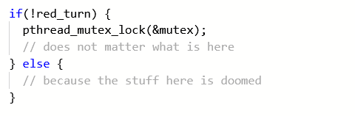
Solution notes: alternating
Don’t access state variables in an unprotected way!

Slide 6

Solution notes: size
Use broadcast when you’re not sure which of the waiting threads should be woken up
Use signal if you only want one and it doesn’t matter which (like in alternating)

Slide 7
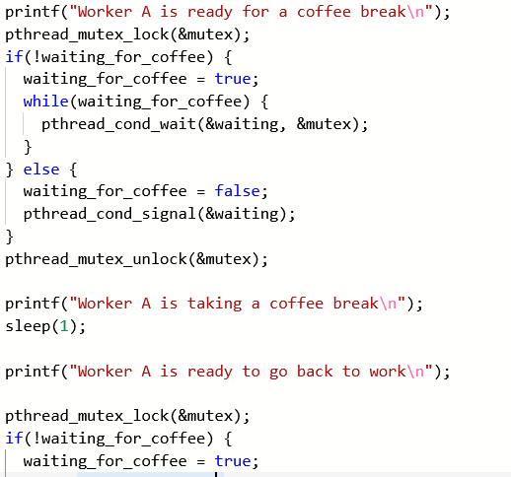
Solution notes: coffee break
You need 2 waiting variables not 1
Start here

