Slide 1
Semaphore Concurrency Problems

Slide 2
General semaphore advice
Semaphores initialized to 1 usually act like mutexes, semaphores initialized to zero usually act like initially locked mutexes, semaphores initialized to >1 allow a certain number of threads in before locking
Never access a global variable in an unprotected way (and you usually need to be explicit to have a mutex in semaphores)
In semaphores doing a sem_wait (which is usually how you enter a queue) does not free any mutex semaphore you have
Do not attempt to access the value within the semaphore
Unlike condition variables – when a process blocked on a semaphore awakens, it should always be possible for it to make progress…a process should not re-wait on the same semaphore it just was woke from

Slide 3
Work in your breakout rooms
https://repl.it/@hewner/DukeSimpleSemaphores
Alternating, Order, Printers
Band (slightly more advanced, just for fun)
If you need to remember syntax, take a look at example.c

Slide 4
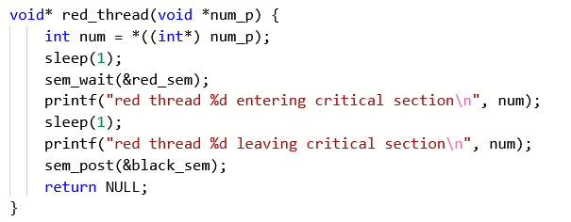
Alternating solution
No state variables needed! State of the semaphores determines who is let through

Slide 5
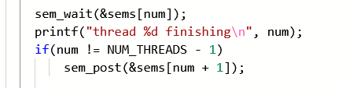
Order solution
Many queues! But then when you wakeup you know it is safe to move forward
Again note there’s no need to keep or look at separate state…weather or not my sem_post awakens somebody right this minute, it’ll let through the right thread when that thread is ready

Slide 6
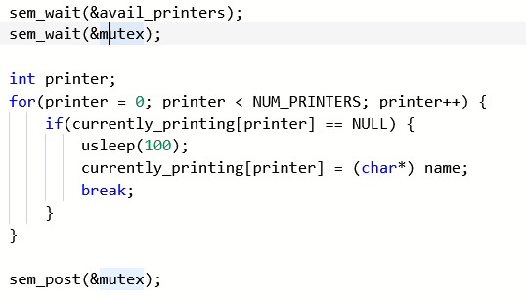
Printers Solution
Key is not to decide which printer you want till you know there’s one available
Picking the printer must be protected with a separate mutex
This problem is way easier with condition variables

Slide 7
One of things that is not so great about semaphores is that oftentimes what a particular setup will do is not obvious from looking at the code.

Slide 8
Ping-pong with semaphores
blue->Init(0);
purple->Init(1);
void
PingPong() {
while(not done) {
blue->P();
Compute();
purple->V();
}
}
void
PingPong() {
while(not done) {
purple->P();
Compute();
blue->V();
}
}

Slide 9
Basic barrier
blue->Init(1);
purple->Init(1);
void
Barrier() {
while(not done) {
blue->P();
Compute();
purple->V();
}
}
void
Barrier() {
while(not done) {
purple->P();
Compute();
blue->V();
}
}

