Slide 1

CPS 310
Taming Concurrency:
Design Patterns
Jeff Chase
Duke University

Slide 2
How to use threads?
Preview some common abstract design patterns.
Abstract → they strip out lots of details about the system context in which they (re)appear.
Unix programming, servers, GUI apps, streaming data processing, concurrent PLs, scalable everything.
These patterns illustrate ways to:
Spread the processing work to parallelize and scale up.
Structure any needed blocking to maintain responsiveness.
Limit shared data to reduce synchronization.
Decompose complex programs —or— compose simple components into complex programs.

Slide 3



Software architecture
What are the “right” building blocks for large systems?
How to structure concurrency in large systems?

Slide 4
Modular atomic objects
A set of procedures/methods and API that defines how threads call/invoke them.
Private state: data accessed (only) by the methods, shared by threads inside.
E.g., objects instantiated from classes
Threads invoke API→ concurrency inside, but we don’t care where threads came from.
Atomic→hides internal concurrency: behavior equivalent to some serial order.
No locks across API→ “freely composable”.
state
P1()
P2()
P3()
P4()
E.g., classical monitors
Abstract Data Type (ADT): the module is encapsulated: its state is manipulated only through its API (Application Programming Interface).

Slide 5
Parent-child (fork/join)
parent
Parent thread creates Child.
P passes input/arguments.
C runs, outputs result.
Optional: P joins on C.
P’s join “reaps” result from C.
Join blocks until C terminates.
create
child
time
Examples:
Pthreads in shared memory
Unix shell: run command in C
Unix process tree: fork/wait
wait
result
EXIT
Unix: P launches C as an isolated process, which may run a different program and return an exit status.

Slide 6
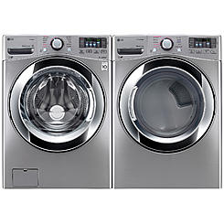
Pipeline
Thread design pattern: pipeline.
To process a stream of data.
data flow
input
out
in
output
Pipe/Q
(bounded)
Producer
Consumer
Sequence of processing stages
Run stage when input is ready and space for output.
Block if no input or no space.
Or
time
Run stages in parallel (on multi-core): faster completion.
Unix uses pipes to compose (string together) independent programs.
Auto-match speeds by wait/notify on full/empty conditions (soda).

Slide 7
Mailbox
put
get
Suppose only one slot to pass data.
Then the producer and consumer must alternate strictly: ping pong.
Ping pong is the exception to prove the “loop before you leap” rule.
If bounded buffer has multiple slots, then it becomes soda machine.
Bounded queue:
Example: pipe between pipeline stages.
These schemes provide flow control to speed-match producer and consumer.
Producer
Consumer
lock(m);
while(true) {
put/get() etc.;
signal(m,c);
wait(m,c);
}
unlock(m);

Slide 8
Event-driven programming
Event-driven programming is a design pattern for a thread’s program.
The thread receives and handles a sequence of typed messages or events.
The program is a set of handler routines, one for each event type.
The thread handles each event in sequence by calling the event’s handler.
Reactive: thread “reacts” to events.
In its pure form handlers do not block.
Thread blocks only if no event (idle).
→ responsive, no way to “get stuck”.
events
event loop
handlers

Slide 9
Event-driven example: UI thread
In GUI apps, e.g.: Android, Windows:
App’s main thread is event-driven, e.g., by User Interface (UI) events.
Also called the “UI thread”.
UI toolkit code defines a handler for each kind of UI event (e.g., a click).
UI handlers called only by UI thread: no need for locks. (Not thread-safe!)
UI handlers should not block, or app becomes unresponsive.
What if some task needs to block?
UI events
event loop
handlers

Slide 10
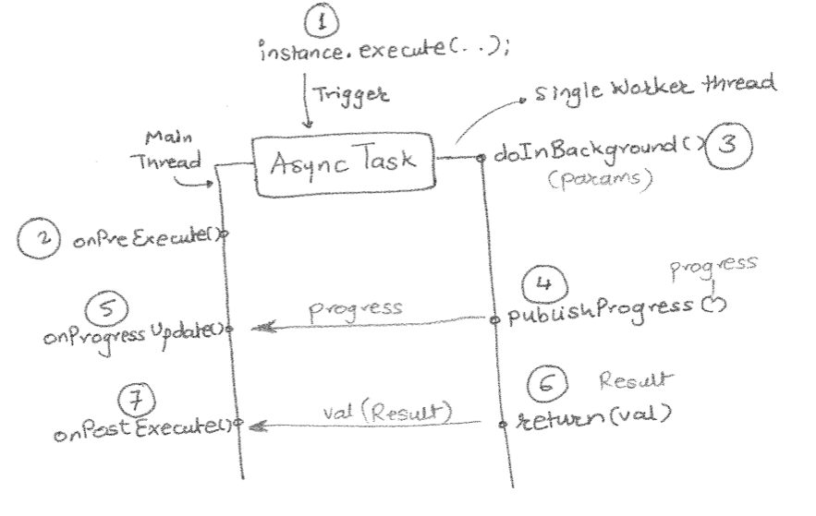
AsyncTask (Android)
[http://techtej.blogspot.com/2011/03/android-thread-constructs-part-3.html]

Slide 11
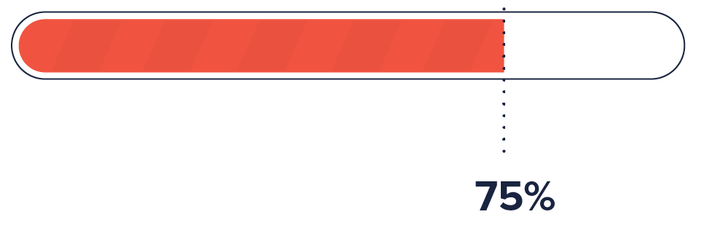
AsyncTask ← Parent/child + event-driven
UI thread P spawns AsyncTask C for background ops.
Worker for e.g., downloads, media, data processing
C may block, but P remains responsive UI events.
P never blocks to receive result from C.
Instead, C sends status as events on P’s event queue.
P handles C’s events mixed with other (e.g., UI) events.
In essence, P “calls” C’s function but never waits for it.
E.g., UI thread updates progress bar on status from C.

Slide 12

Asynchronous API
AsyncTask illustrates an asynchronous API.
Call method.
Method returns immediately.
Caller receives completion event (notification upcall).
Enables a thread to initiate multiple concurrent activities and oversee them without blocking.
Languages: Future in Java, Scala, etc.
Also used in modern OS APIs for asynchronous I/O
E.g., Windows; BSD/MacOS kqueue; Linux epoll
Similar to low-level I/O: initiate DMA + interrupt

Slide 13
Upcall
“Do it.”
“OK”
“It is done.”
Upcall: cause to invoke a procedure in a client module.
E.g., by sending an event message to its event queue.
Notifies client of an asynchronous event or completion.
“Like an interrupt.” See also: Unix signal handler.

Slide 14
Perils of shared state→mitigate
Shared state→races. Synchronize! Do it right—but can we do less of it?
Less is more!
More concurrency?
Fewer bugs?
Less/safer blocking?
The thread design patterns create opportunities to factor state among threads and keep state private.
Decouple state into objects/processes.
Place each under control of e.g. a single thread.
Pass events/data via mailboxes, queues, buffers.

Slide 15
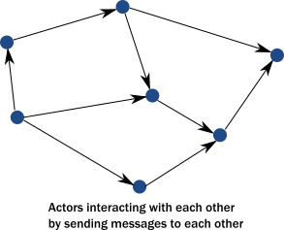
Actor model (“Reactive”)
An actor has private state and one thread that reacts to messages on its one queue (event-driven).
Single-threaded→no internal synchronization!
Parallelism—with no shared state!
Actors can live anywhere!
All asynchronous
→ actors don’t “get stuck”.
Sends are “fire and forget”.
No synchronous request-reply!
Languages: Erlang, Scala/Akka.
Graphic from: https://doc.akka.io/docs/akka/current/typed/guide/actors-intro.html

Slide 16
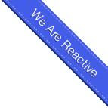
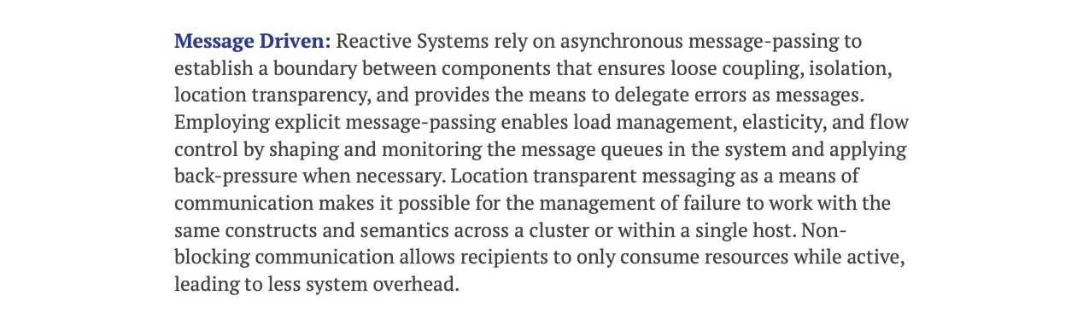
The Reactive Manifesto
https://www.reactivemanifesto.org/

Slide 17
Be wary of extremist ideologies
Which brings us back where we started.
“Reactivisionism” is appealing.
It is a valuable tool in our toolkit.
But sometimes you need shared state.
Reactive models are built on classical threads with shared state (e.g., queues).
It’s what we teach; it’s what we do.
There is no One True Way to tame concurrency.
Or to solve any problem!
state
P1()
P2()
P3()
P4()

Slide 18
Extra
Threads in Android

Slide 19
Threads in Android
Three examples/models for use of threads in Android.
Main thread (UI thread): receives UI events and other upcall events on a single incoming message queue. Illustrates event-driven pattern: thread blocks only to wait for next event.
ThreadPool: an elastic pool of threads that handle incoming calls from clients: Android supports “binder” request/response calls from one application to another. When a request arrives, a thread from the pool receives it, handles it, responds to it, and returns to the pool to wait for the next request.
AsyncTask: the main thread can create an AsyncTask thread to perform some long-running activity without blocking the UI thread. The AsyncTask thread sends progress updates to the main thread on its message queue.
These patterns are common in many other systems as well.

Slide 20
Adapted from
http://developer.android.com/guide/components/processes-and-threads.html
Summary: By default, all components of the same application run in the same process and thread (called the "main" thread). The main thread controls the UI, so it is also called the UI thread. If the UI thread blocks then the application stops responding to the user. You can create additional background threads for operations that block, e.g., I/O, to avoid doing those operations on the UI thread. The background threads can interact with the UI by posting messages/tasks/events to the UI thread.
Details: When an application component starts and the application does not have any other components running, the Android system starts a new Linux process for the application with a single thread of execution called the main thread.
All components that run in the same process are initialized by its main thread, and system upcalls to those components (onCreate, onBind, onStart,…) run on the main thread.
The main thread is also called the UI thread. It is in charge of dispatching events to user interface widgets and interacting with elements of the Android UI toolkit. For instance, when the user touches a button on the screen, your app's UI thread dispatches the touch event to the widget, to set its pressed state and redraw itself.
If you have operations that might require blocking, e.g., to perform I/O like network communication or database access, you should run them in separate threads. A thread that is not the UI thread is called a background thread or "worker" thread.

Slide 21
Adapted from
http://developer.android.com/guide/components/processes-and-threads.html
Your app should never block the UI thread. When the UI thread is blocked, no events can be dispatched, including drawing events. From the user's perspective, the application appears to “hang” or “freeze”.
Even worse, if the app blocks the UI thread for more than a few seconds, Android presents the user with the infamous "application not responding" (ANR) dialog. The user might then decide to quit your application and uninstall it.
In a correct Android program the UI thread blocks only to wait for the next event, when it has nothing else to do (it is idle). If you have an operation to perform that might block for any other reason, then you should arrange for a background/worker thread to do it.
Additionally, the Android UI toolkit is not thread-safe: if multiple threads call a module that is not thread-safe, then the process might crash. A correct app manipulates the user interface only from a single thread, the UI thread. So: your app must not call UI widgets from a worker thread.
So how can a worker thread interact with the UI, e.g., to post status updates? Android offers several ways for a worker to post operations to run on the UI thread.
Note: this concept of a single event-driven main/UI thread appears in other systems too.

