Slide 1

CPS 310
Servers and concurrency
Jeff Chase
Duke University

Slide 2
From objects to servers
Modular atomic objects
A set of procedures/methods and API that defines how threads call/invoke them.
Encapsulated/isolated: state accessed (only) by methods.
Threads invoke API→ concurrency inside.
“Atomic”→ internal concurrency control.
Servers are objects whose API calls are implemented with message exchanges.
Calling threads are independent clients.
Run anywhere; interact over a network.
Protection boundary: machine+process
state
P1()
P2()
P3()

Slide 3
Request/reply messaging
client
server
Client initiates.
Server accepts.
Client waits.
Server replies.
Remote Procedure Call (RPC) is one common example of this pattern.
The Web is another.
Today many services run “RPC over HTTP”, e.g., REST, gRPC.
wait
request
wait
handle request
wait
reply

Slide 4

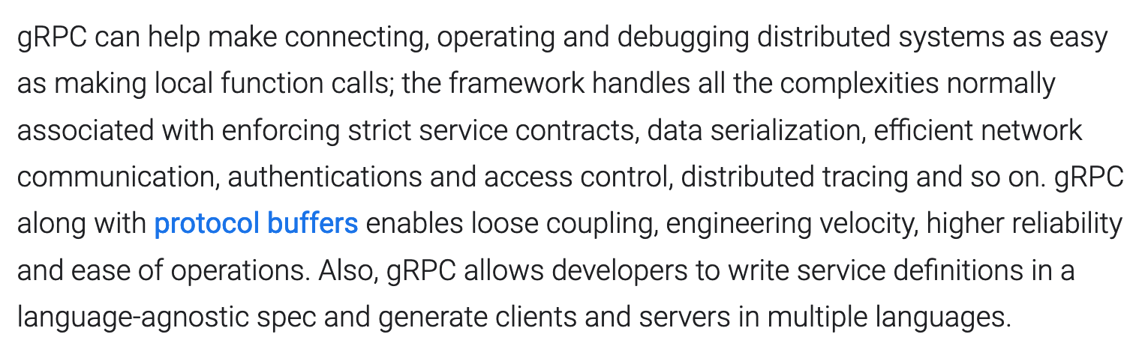

2020
https://cloud.google.com/blog/products/gcp/grpc-a-true-internet-scale-rpc-framework-is-now-1-and-ready-for-production-deployments?m=1

Slide 5
Remote Procedure Call (RPC)
“RPC is a canonical structuring paradigm for client/server request/response services.”
First saw wide use in 1980s client/server systems for workstation networks (e.g., Network File System).
Build it over TCP or over raw messaging, or…
Humans focus on getting this code right.
client
server
Auto-generate stub code from API spec (IDL).
“glue”
[sockets]
[sockets]
This code is “canned”, independent of the specific application.

Slide 6
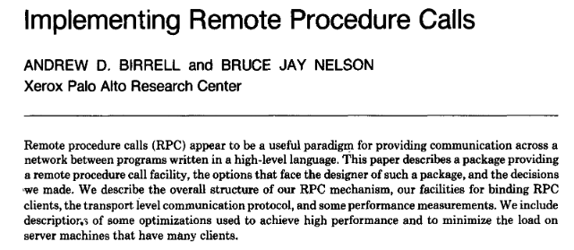
ACM SIGOPS Hall of Fame paper
2700 citations

Slide 7
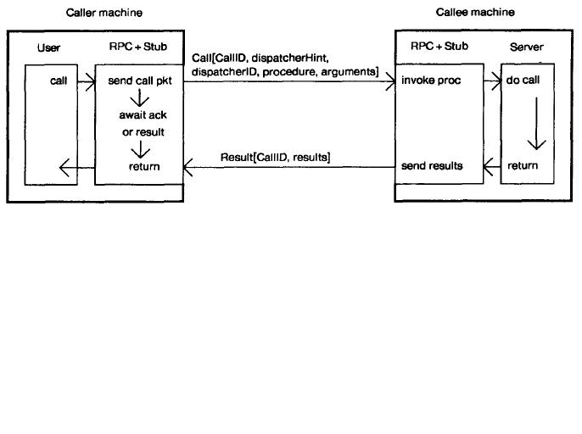
Simple RPC Diagram

Slide 8
Server (serial process)
Option 1: could handle requests serially
Easy to program, but painfully slow (why?)
Client 1
WS
Client 2
R1 arrives
Receive R1
Disk request 1a
R2 arrives
1a completes
R1 completes
Receive R2

Slide 9
Server (event-driven)
Option 2: use asynchronous I/O
Fast, but hard to program (why?)
Client 2
Client 1
WS
Disk
R1 arrives
Receive R1
Disk request 1a
Start 1a
R2 arrives
Receive R2
Finish 1a
1a completes
R1 completes

Slide 10
Server (multiprogrammed)
Option 3: assign one thread per request
Where is each request’s state stored?
Client 1
WS1
WS2
Client 2
R1 arrives
Receive R1
Disk request 1a
R2 arrives
Receive R2
1a completes
R1 completes

Slide 11
Multi-threaded server
Multi-threaded server is a common design pattern.
Standard multi-threaded process
Bounded incoming request queue
Why not processes instead of threads?
OK for “classic” Web servers
And other stateless servers
Isolated/contained
Multi-threading is accepted now:
More comfortable for shared state
“Lightweight” concurrency, easy blocking
state
P1()
P2()
P3()

Slide 12
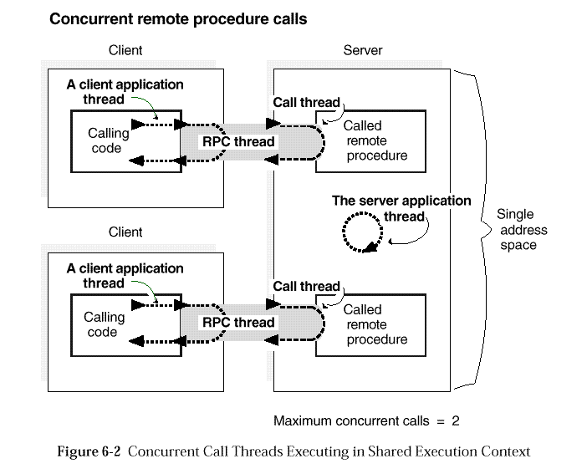
Threads and RPC
Q: How do we manage server “call threads”?
A: Create them as needed, and keep idle threads in a thread pool.
When an RPC call arrives, wake up an idle thread from the pool to handle it.
On the client, the client thread blocks until the server thread returns a response.
[OpenGroup, late 1980s]

Slide 13
Thread pool (executor)
Worker pool
worker loop
Handlers
worker thread {
consume event;
call handler;
(or run task)
} loop and
block if no event
in
idle workers
event
queue
Workers wait here for next event/request/task.
Thread pool: a pattern for parallel programs and network servers.
N workers can run in parallel on N cores: also called WorkCrew.
Queue of incoming tasks—equivalent to events+handler calls.
Any worker thread can call any handler or run any task.

Slide 14
Event/request queue
Synchronize queue with a monitor: a mutex/CV pair.
worker loop
Protect the event queue data structure itself with the mutex.
handler
Handle one event, blocking as necessary.
dispatch
Incoming event
queue
handler
workers waiting on CV
When handler is complete, return to worker pool.
Workers wait on the CV if the event queue is empty. Signal the CV when a new event arrives. Producer/consumer bounded buffer.
handler

Slide 15
Ideal event poll API for thread pooling
Abstract poll(): a long time to get this right in real systems.
Delivers: returns exactly one event (message or notification), in its entirety, ready for service (dispatch).
Idles: Blocks iff there is no event ready for dispatch.
Consumes: returns each posted event at most once.
Combines: any of many kinds of events (a poll set) may be returned through a single blocking call to poll.
Synchronizes: may be shared by multiple processes or threads (→ handlers must be thread-safe as well).

Slide 16
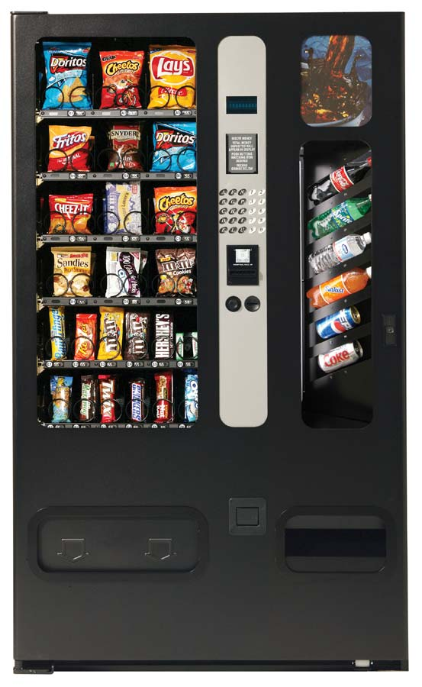

Managing load and concurrency
How many worker threads?
What if requests/tasks block?
>N workers to keep N cores busy
What if request queue is full?
More threads?
Flow control in the network?
Drop and say “try again later”?
Get a bigger server?
Shed load to another server?
…
Magic elastic worker pool

