Slide 1
CPU Scheduling
Jeff Chase
Duke University

Slide 2
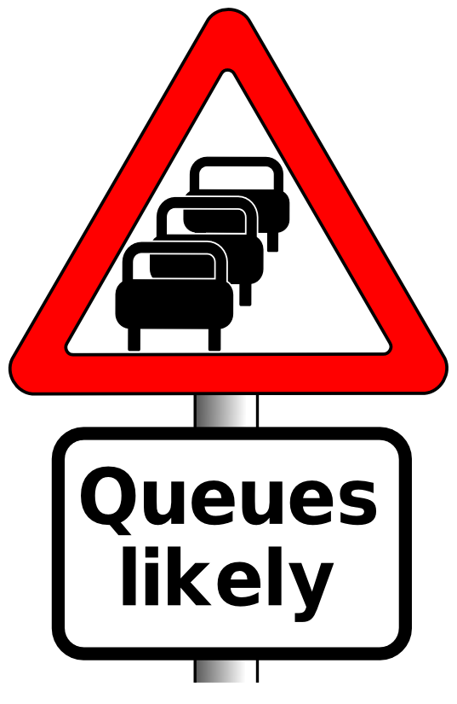

CPU scheduling: the role of policy
Thread in ready state may dispatch “at any time”.
Thread in running state may preempt “at any time”.
CPU scheduling policy governs these transitions.
running
preempt
sleep
dispatch
blocked
ready
wakeup
“nondeterministic”
STOP
wait

Slide 3
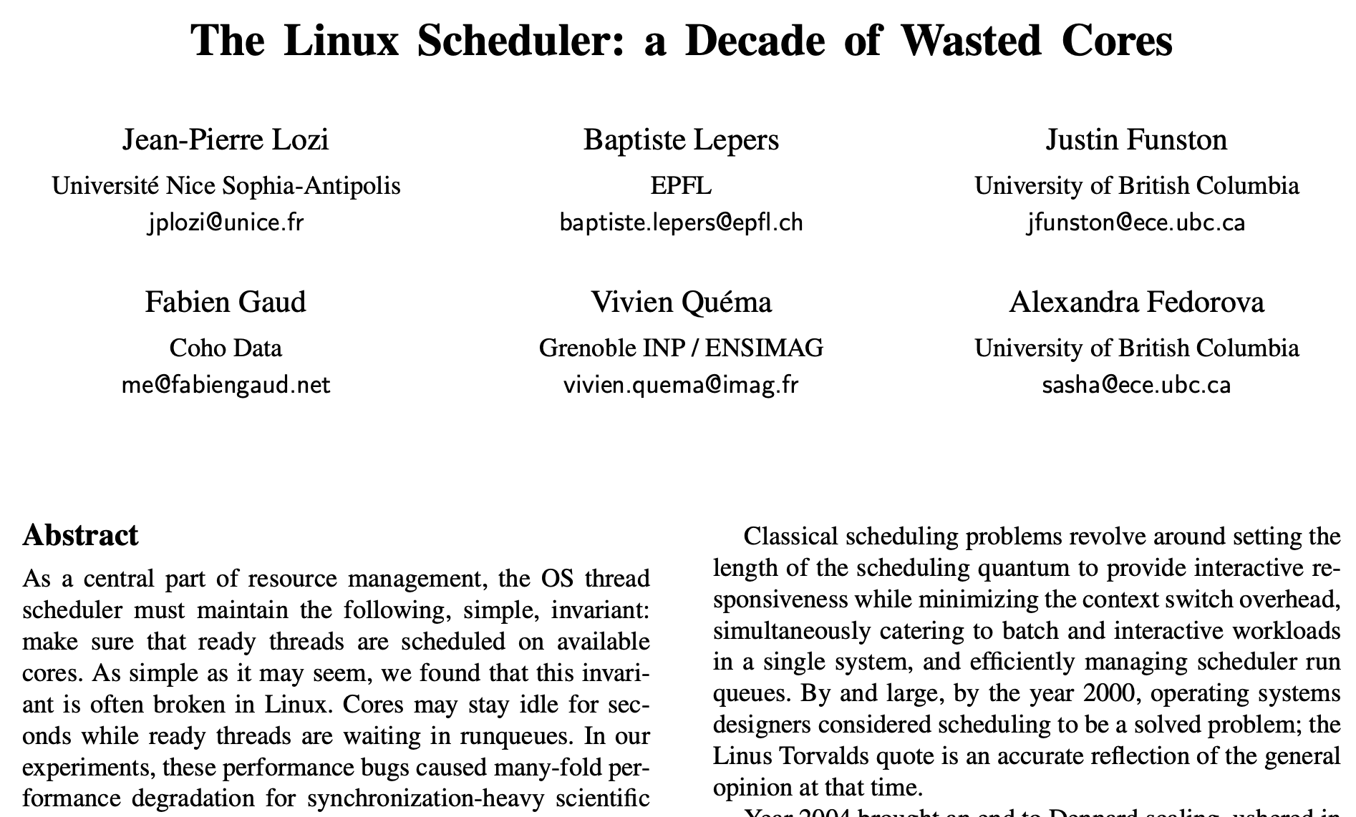
Scheduling matters
EuroSys 2016

Slide 4
Workload: tasks and jobs
We often use the words task or job with scheduling.
The concepts are more general than thread or process.
Let’s suppose for simplicity that a task t_{i} is a thread with a CPU service demand of D_{i} time units.
Arrive at random.
Queue on runqueue.
Dispatch when selected.
Exit (or sleep) after time D_{i}.
ready queue
(runqueue)
CPU

Slide 5
A simple policy: FCFS/FIFO
The most basic scheduling policy is first-come-first-served (FCFS), also called first-in-first-out (FIFO).
FCFS is just like the checkout line at the QuickiMart.
Maintain a queue ordered by time of arrival.
GetNextToRun selects from the front (head) of the queue.
wakeup
put
runqueue
put
get
get thread to dispatch
yield or preempt
tail
head

Slide 6

Metric: response time
How long to get the job done?
Suppose two jobs arrive “together”.
Schedule 1: blue (D=4) goes first.
Schedule 2: purple (D=2) goes first.
S1 slows down purple by 3x. Mean = 5.
S2 slows down blue by only 50%. Mean = 4. Better.
4
6
2
6

Slide 7
Is it fair?
Run the small job first!
But what if another small one arrives?
What if a D=1 arrives at time t=2?
Run it? Defer blue again?
Slows blue down by only 15%!
Otherwise slow new arrival by 5x!
Then what if another short task arrives…
2
3
7
R=1
Mean R=(2+1+7)/3

Slide 8
Metric: fairness
Scheduler allocates a resource: CPU. Is it fair?
What does fairness mean? What makes it “fair”?
Early bird gets the worm; everyone is fed eventually?
Low variance? (E.g., equal slowdown, Jain fairness index)
“Divide the pie” evenly? (Or according to weights?)
Freedom from starvation? (E.g., upper bound on wait time)
Serve the clients who pay the most? (Market-based)
Serve the clients who benefit most? (Maximize global welfare)
Freedom from envy?
This is a deep topic. But we gloss over it.

Slide 9
Minimizing Response Time: SJF (STCF)
Shortest Job First (SJF) is provably optimal if the goal is to minimize average-case R.
Also called Shortest Time to Completion First (STCF) or Shortest Remaining Processing Time (SRPT).
Example: express lanes at the MegaMart
Idea: get short jobs out of the way quickly to minimize the number of jobs waiting while a long job runs.
Intuition: longest jobs do the least possible damage to the wait times of their competitors.
D=1
D=2
D=3
1
3
6
R = (1 + 3 + 6)/3 = 3.33

Slide 10
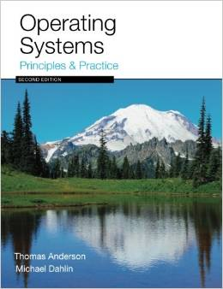
FIFO vs. SJF

Slide 11
Preemptive FIFO: Round Robin
FIFO with preemption each quantum Q of time.
Timeslicing shares evenly among contending jobs.
Minimize variance→reduce impact of large jobs.
Delay is proportional to one’s demand.
Overhead to context switch every Q.
Q=1 yields mean R = 4.
3
4
7
R=2

Slide 12
Overhead and goodput
Context switching is overhead: “wasted effort”. It is a cost that the system imposes in order to get the work done. It is not actually doing the work.
This graph is obvious. It applies to so many things in computer systems and in life.
Q/(Q+ε)
1
100%
Efficiency
or goodput
What percentage of the time is the busy resource doing useful work?
Q ε
Quantum Q

Slide 13
Round Robin
Tasks get a short ride sooner; maybe a short ride is enough for them.
Degrades toward FIFO with longer quantum.

Slide 14
Round Robin vs. FIFO
RR minimizes variance in R, at the cost of higher mean R.
Notes:
Everything is fair, but average response time in this case is awful – everyone finishes very late! In fact, this case is exactly when FIFO is optimal, RR is poor.
On the other hand, if we’re running streaming video, RR is great – everything happens in turn. SJF maximizes variance. But RR minimizes it.

Slide 15
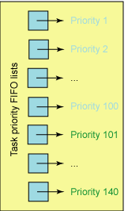
Task priority
In a typical OS, each task has a priority value (e.g., an integer) which may change over time.
Pick the task with the highest priority.
Or round-robin if there’s a tie.
Preempt if a higher-priority task appears.
Threads inherit a base priority.
User-settable relative priority.
E.g., Unix nice command.
Internal priority adjustments in scheduler.
How many priority levels?
32 (Windows) to 128 (MacOS)

Slide 16
Multi-level priority queue
Multi-level priority queue is a common structure.
Bit vector of non-empty queues.
Find highest non-empty queue.
Take task from its head.
If now empty, clear its bit.
Dispatch task.
Constant time, no sorting.
Ready pool
high
P=1:
high
low
P=N:
low
CPUs have an instruction to find the highest (or lowest) bit set in a word: find-first-set (ffs), count-leading-zero (clz). Gives index of highest-priority non-empty queue.
Array of queues
indexed by priority
Queue status: 1101

Slide 17
Challenge: Mixed workload
Can we do better? Getting that I/O started sooner would help, at low cost for CPU-bound jobs.
The issue also applies to threads that interact with a user (UI threads). Goal: improve responsiveness to user.
Notes:
I/O task has to wait its turn for the CPU, and the result is that it gets a tiny fraction of the performance it could get.
By contrast the compute bound
We could shorten the RR quantum, and that would help, but it would increase overhead.
what would this do under SJF? Every time the task returns to the CPU, it would get scheduled immediately!

Slide 18
Challenge: CPU scheduling and I/O
Suppose thread T does a lot of I/O.
Suppose T blocks while its I/O is in progress.
When each I/O completes, T gets back on the readyQ.
Where T waits for threads that use a lot of CPU time.
While the disk or other I/O device sits idle!
T needs “just a smidgen” on CPU to start its next I/O.
Maybe let T jump the queue, and get it started? So that both the disk and CPU can work in parallel?
“Like SJF”

Slide 19
Two Schedules for CPU/Disk
1. Naive Round Robin
5
5
1
1
4
CPU busy 25/37: U = 67%
Disk busy 15/37: U = 40%
2. Add internal priority boost for I/O completion
33% improvement in utilization
Keep all units busy doing useful work when possible—improves all metrics.
CPU busy 25/25: U = 100%
Disk busy 15/25: U = 60%

Slide 20
Estimating time-on-core
How to predict which tasks have short CPU demand for their next ride on the core?
Like guessing the weather: predict from recent past.
Judge jobs by their behavior.
Heuristic: could be wrong! But mostly works over time.
Example heuristic: adaptive internal priority
Quantum expires? → task is CPU-bound.
Drop its priority down one level.
Task blocks? → task is I/O bound (short rides)
So bump its priority up one level.
CPU-bound tasks sink to the bottom, I/O bound rise up.

Slide 21
Multilevel Feedback Queue
Many systems (e.g., Unix variants) implement internal priority using a multilevel feedback queue.
Multilevel priority queue. A queue for each of N priority levels.
Use RR on each queue; look at queue i+1 only if queue i is empty.
Feedback. Adaptive internal priority.
I/O bound jobs
high
jobs holding resources
jobs with high external priority
GetNextToRun selects task
at the head of the highest
non-empty queue: constant time, no sorting.
low
CPU-bound jobs
ready queues
indexed by priority
Priority of CPU-bound
jobs decays with system
load and service received.
Notes:
Linux uses a bitmap priority array to figure which queues are populated. X86 provides a find-first-set-bit instruction.
That is the vaunted Linux “O(1)” scheduler.

Slide 22
MFQ
Note: OSTEP has a thorough treatment and calls it MLFQ.

Slide 23
Some deep lessons
Resource allocation! It’s everywhere.
“Separate policy and mechanism.”
Policy matters. We can measure it!
But there are multiple competing metrics.
The results depend on workload.
Use heuristics: “simple” (and maybe wrong).
Interplay of heuristics and workload: “it’s complicated”.

Slide 24
Extra
More slides on the same stuff

Slide 25
Example: a recent Linux rev
“Tasks are determined to be I/O-bound or CPU-bound based on an interactivity heuristic. A task's interactiveness metric is calculated based on how much time the task executes compared to how much time it sleeps. Note that because I/O tasks schedule I/O and then wait, an I/O-bound task spends more time sleeping and waiting for I/O completion. This increases its interactive metric.”
Key point: interactive tasks get higher priority for the CPU, when they want the CPU (which is not much).

Slide 26
Evaluating Round Robin
D=5
D=1
R = (5+6)/2 = 5.5
R = (2+6 + ε)/2 = 4 + ε
Response time. RR reduces it for short jobs.
For a given load, wait time is proportional to the job’s total service demand D.
Fairness. RR reduces variance in wait times.
But: RR forces jobs to wait for other jobs that arrived later.
Throughput. RR imposes extra context switch overhead.
Degrades to FCFS-RTC with large Q.
Notes:
Linux determines timeslice dynamically on a per-process basis based on priority.

Slide 27
Evaluating FCFS
How well does FCFS achieve the goals?
Throughput. FCFS is as good as any non-preemptive policy.
….if the CPU is the only schedulable resource in the system.
Fairness. FCFS is intuitively fair…sort of.
“The early bird gets the worm”…and everyone is fed…eventually.
Response time. Long jobs keep everyone else waiting.
Consider service demand (D) for a task (i.e., its runtime).
D=1
D=2
D=3
D=3
D=2
D=1
3
5
6
Time
tail
CPU
R = (3 + 5 + 6)/3 = 4.67
runQueue

Slide 28
Preemptive FCFS: Round Robin
Preemptive timeslicing is one way to improve fairness of FCFS.
If job does not block or exit, force an involuntary context switch after each quantum Q of CPU time.
FCFS without preemptive timeslicing is “run to completion” (RTC).
FCFS with preemptive timeslicing is called round robin.
D=3
D=2
D=1
FCFS-RTC
round robin
3+ε
5
6
Q=1
R = (3 + 5 + 6 + ε)/3 = 4.67 + ε
In this case, R is unchanged by timeslicing.
Is this always true?
Context switch
time = ε

