Slide 1
Of servers and sockets
Jeff Chase
Duke University

Slide 2
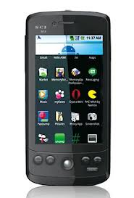
Servers and the cloud
Where is your application?
Where is your data?
Where is your OS?
networked server “cloud”
Cloud and Software-as-a-Service (SaaS)
Rapid evolution, no user upgrade, no user data management.
Agile/elastic deployment on clusters and virtual cloud utility-infrastructure.

Slide 3
Servers: request/reply
client
server
Client initiates.
Server accepts.
Client waits.
Server replies.
RPC, HTTP/S (web)
wait
request
wait
handle request
Servers combine multiple threading design patterns.
wait
reply

Slide 4



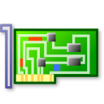

Networked services: big picture
client host
NIC device
Internet “cloud”
client applications
kernel network software
server hosts with server applications
Data is sent on the network as messages called packets.`

Slide 5

Network communication
Source node
Destination node
(host, peer)
Message network
Computers (nodes, hosts) send and receive packets.
A packet has a maximum size. e.g., 1536 bytes.
A message could be sent as one or more packets.
Nodes often communicate with a stream (sequence, flow) of many packets over a connection to a peer.

Slide 6
Internet communication
Source node
Destination node
(host, peer)
IP network
We consider networks using Internet Protocol (IP).
IP networks may delay or discard packets arbitrarily. So
Hosts run a transport protocol to communicate reliably.
E.g. Transmission Control Protocol (TCP) for streams.
“Everybody uses it”—the foundation of the Web.

Slide 7
TCP/IP communication
TCP
TCP
Client
server
IP network
TCP is a reliable stream protocol implemented in host software “above” IP, end-to-end.
https://www.rfc-editor.org/info/rfc793 (1981)
A client initiates a TCP connection to a server.
A TCP connection enables bi-directional stream communication between a pair of endpoints (IP+port).

Slide 8



Client/server connection Using the socket syscall API
request
“GET /images/fish.gif HTTP/1.1”
reply
client (initiator)
server
sd = socket(…);
connect(sd, name);
write(sd, request…);
read(sd, reply…);
close(sd);
s = socket(…);
bind(s, name);
listen(s, 10);
sd = accept(s);
read(sd, request…);
write(sd, reply…);
close(sd);

Slide 9
Ports and packet demultiplexing
The IP network carries data packets addressed to a destination node (host named by IP address) and port. Kernel network stack demultiplexes incoming network traffic: choose process/socket to receive it based on destination port and source address.
Apps with open ports/sockets
Incoming network packets
Network adapter hardware aka, network interface controller (“NIC”)

Slide 10
TCP/IP Ports
Each IP transport endpoint on a host has a logical port number (16-bit integer) that is unique on that host.
Source/dest port is named in every packet.
Receiving kernel looks at port to demultiplex incoming traffic.
What port number to connect to?
Ports 1023 and below are ‘reserved’ and privileged: generally you must be root/admin/superuser to bind to them.
Used for well-known ports for common services
Look at /etc/services
Clients need a return port, but it can be an ephemeral port assigned dynamically by the kernel.

Slide 11
Server listens on a port
struct sockaddr_in socket_addr;
sock = socket(PF_INET, SOCK_STREAM, 0);
…
memset(&socket_addr, 0, sizeof socket_addr);
socket_addr.sin_family = PF_INET;
socket_addr.sin_port = htons(port);
socket_addr.sin_addr.s_addr = htonl(INADDR_ANY);
if (bind(sock, (struct sockaddr *)&socket_addr, sizeof socket_addr) < 0) {
perror(”bind failed");
exit(1);
}
listen(sock, 10);
Port number is passed as an input.
Let kernel fill in this host’s IP address.
htons and htonl byte-swap to network endian.
Bind fails if server process is already running on the port.
Illustration only

Slide 12


Endianness
What are htons() and htonl()?
Lilliput and Blefuscu are at war over which end of a soft-boiled egg to crack.
Gulliver’s Travels 1726
A silly difference among machine architectures creates a need for byte swapping when unlike machines exchange data over a network.
Intel processors are little-endian, Internet is big-endian: the most significant byte is transmitted on the network first.

Slide 13



Unix process view: data
A process has multiple channels for data movement in and out of the process (I/O).
I/O channels
(“file descriptors”)
stdin
stdout
Process
The channels are typed.
tty
stderr
Each channel is named by an I/O descriptor (called a “file descriptor”).
pipe
Thread
socket
A file descriptor is an integer value assigned by the kernel (e.g., at open).
Files
Program

Slide 14
“File” (I/O) descriptors in Unix
user space
kernel space
Disclaimer: this drawing is oversimplified
file
int fd
pointer
pipe
per-process
descriptor
table
socket
tty
Type-specific structures (e.g., queues)
“open file table”
An I/O descriptor is a positive integer value in an integer variable (e.g., fd). The user program passes it to the kernel to identify the channel for each I/O syscall. The kernel uses the fd to index into an internal per-process table to find a typed object to operate on it.

Slide 15
Socket descriptors in Unix
user space
kernel space
Disclaimer: this drawing is oversimplified
file
int fd
pointer
pipe
socket
Inbound traffic
per-process
descriptor
table
tty
global
port
table
“open file table”
There’s no magic here: processes use read/write (and similar syscalls called send* and recv*) to operate on sockets.
Deeper in the kernel, sockets are handled differently from files, pipes, etc.
Sockets are the entry/exit point for the network protocol stack.

Slide 16
Server accept loop A trivial example
while (1) {
int acceptsock = accept(sock, NULL, NULL);
char *input = (char *)malloc(1024*sizeof (char));
recv(acceptsock, input, 1024, 0);
int is_html = 0;
char *contents = handle(input,&is_html);
free(input);
…send response…
close(acceptsock);
}
Accept returns another socket for connection.
Accept blocks to wait for a connection.
Use read/write or send/recv syscalls for I/O on connection.
Always close descriptor when done with it, e.g., else client waits.
Illustration only

Slide 17
Request/reply over a connection
Client (active)
Server (passive)
socket
socket
connect
bind
TCP SYN
Connection establishment (TCP handshake)
accept
SYN-ACK
write
request
read
Handle request
write
read
reply

Slide 18
Streams over a TCP/IP connection
Client (active)
Server (passive)
socket
socket
connect
bind
TCP SYN
Connection establishment (TCP handshake)
accept
SYN-ACK
write
read
Bi-directional reliable byte stream
write
…
read

Slide 19
Send HTTP/HTML response
const char *resp_ok = "HTTP/1.1 200 OK\nServer: BuggyServer/1.0\n";
const char *content_html = "Content-type: text/html\n\n";
send(acceptsock, resp_ok, strlen(resp_ok), 0);
send(acceptsock, content_html, strlen(content_html), 0);
send(acceptsock, contents, strlen(contents), 0);
send(acceptsock, "\n", 1, 0);
free(contents);
Illustration only

Slide 20
Know the socket system calls
Socket. Create/open a socket that can be one side of a connection. Does not block.
Bind. Advertise an open socket as an open port on the network for clients to connect to (a ServerSocket). Does not block.
Connect an open socket to a server port. Used by client. Blocks waiting for an accept reply from server.
Accept a connect request from a client. Used by server. Blocks waiting for next client connect request.
Read/write or send/receive. Write data into a connected socket, or read data from a connected socket. Blocks waiting for data or for space. (soda machine)

Slide 21

Inside your Web server
Server operations
create socket(s)
bind to port number(s)
listen to advertise port
wait for client to arrive on port
accept client connection
read or recv request
write or send response
close client connection
Server application
(Apache, Tomcat/Java, etc)
accept queue
packet queues
listen queue
disk queue

Slide 22
The listen queue
Not tested
Why do we have both a listen queue and an accept queue?
This is part of the next level of detail on TCP socket behavior to know about. It explains some of the behaviors we observe. E.g., why you can connect() to a server process even if the server process does not accept() or respond to input, e.g., because you smashed it.
After listen(), the kernel handles the connection handshake for incoming connect requests, independent of the user process.
Established connections go on the accept queue until (on Linux) the accept queue is full up to the specified listen() backlog (e.g., 10). If full, the kernel rejects connect requests until an accept() makes space on the queue.
While handshake is in progress a connection is partially established (“half-open“) Those go on the listen queue, which is also of bounded size, but separate. Putting them on the accept queue could allow a denial-of-service attacker to jam the server process with half-open connnections.
http://veithen.github.io/2014/01/01/how-tcp-backlog-works-in-linux.html

Slide 23
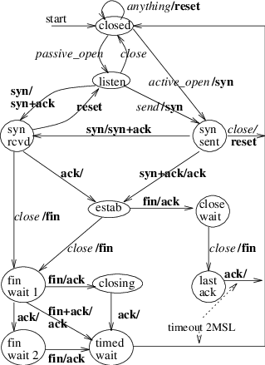
TCP connection state is a FSM
Not tested
Both peers of a TCP connection track its state as a finite state machine (FSM).
Connections in syn-sent or syn-rcvd states are “half open”.
Connections in *wait* or closing states are “half closed”. These can cause a bind() for the port to fail after server restart.

Slide 24
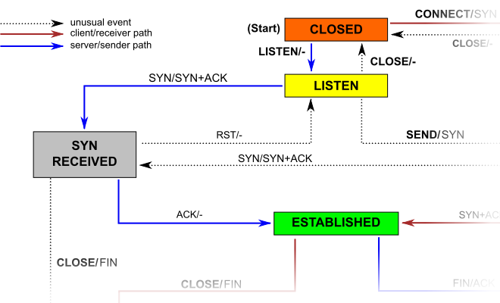
Listen
Not tested
http://veithen.github.io/2014/01/01/how-tcp-backlog-works-in-linux.html

