Slide 1
Server Performance
Jeff Chase
Duke University

Slide 2

Server performance
How many clients can the server handle?
What happens to performance as we increase the number of clients?
What do we do when there are too many?

Slide 3
Performance: metrics
Latency or response time. How long to get it done?
Overhead. How much CPU/core time does it consume?
Utilization or occupancy. What share of time does the resource (e.g., CPU core, disk) spend doing it?
The resource is idle when not working (idle share = 1-U).
Throughput. How many of them per unit time?
Throughput per core is bounded by 1/overhead.
Efficiency. Vague: lower overhead, or higher utilization.
Pronouns: “it” or “them” refers to any operation, e.g., handling a request.

Slide 4
Server performance: the story so far
Requests
Queue(s)
Worker pool
Resources: cores, disks
Resources are “exclusive”
Any thread→any core
ThreadPool keeps cores busy
MFQ keeps disks busy
Queues everywhere
CPU
core(s)
Storage
(“disk”)

Slide 5
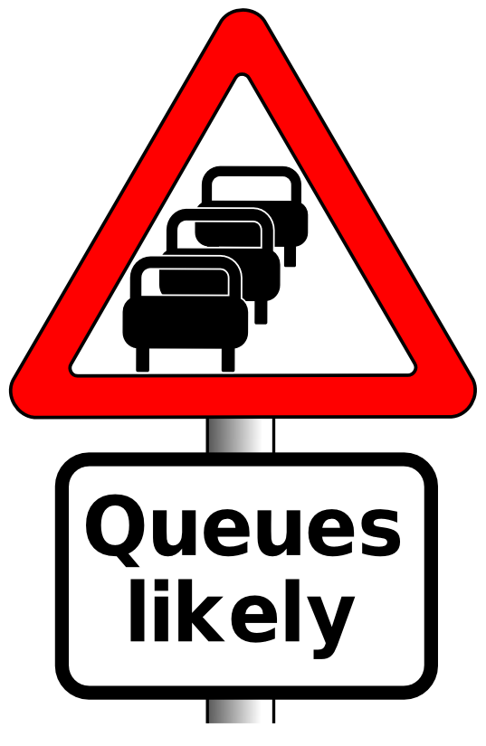
Understanding performance: queues
offered load
request stream @
arrival rate λ
Request == task == job
Handle request: task occupies center for D time units (its service demand).
Service
Center
Note: real systems are networks of centers and queues. To maximize overall utilization/throughput, we must think about how the centers interact. E.g., MFQ priority.
But we can also “squint” and think of the entire server as a single queuing center, and we won’t go too far astray.
CPU
Disk

Slide 6
Queuing theory for busy people
Requests wait here in FIFO queue
offered load
request stream @
arrival rate λ
(requests/time)
Handle request: task occupies center for D time units (its service demand).
Service
Center
“M/M/1”
Consider: single service center (e.g., a core), exclusive occupancy.
Queue is First-Come-First-Served (FIFO, FCFS).
Independent requests:
Independent arrivals at mean rate λ (poisson arrivals).
Requests have independent service demands at mean D.
i.e., arrival interval (1/λ) and service demand (D) are exponentially distributed around their means. Noted as “M”: M/M/1 queue.
These assumptions are rarely exactly true for real systems, but they give a rough (“back of napkin”) understanding of queue behavior.

Slide 7
Ideal throughput: cartoon version
throughput == arrival rate
The center is not saturated: it completes requests at the rate requests are submitted.
throughput == peak rate
The center is saturated. It can’t go any faster, no matter how many requests are submitted.
Ideal throughput
Response rate (throughput)
i.e., request completion rate
This graph shows throughput (e.g., of a server) as a function of offered load. It is idealized: your mileage may vary.
saturation
peak rate
(1/D)
Request arrival rate (offered load)

Slide 8
Throughput: reality
Thrashing, also called congestion collapse
Real servers/devices often have some pathological behaviors at saturation. E.g., they abort requests after investing work in them (thrashing), which wastes work, reducing throughput.
delivered throughput
(“goodput”)
Response rate (throughput)
i.e., request completion rate
saturation
Illustration only
Saturation behavior is highly sensitive to implementation choices and quality.
peak rate
(ideal)
Request arrival rate (offered load)

Slide 9
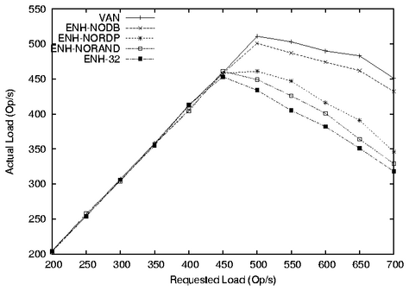
Exemplary throughput graph
This graph shows how certain design alternatives under study impact a server’s throughput. The alternatives reduce per-request work (D or overhead) and/or improve load balancing. (This is a graph from a random research paper: the design alternatives themselves are not important to us.)
saturation
Measured
throughput
(“goodput”)
Higher numbers are better.
Note how throughput degrades in overload on this system.
Offered load (requests/sec)

Slide 10
Utilization
Assume any service center (e.g., a CPU core) is mutually exclusive.
Only one task can occupy it at a time. Occupied→busy.
E.g., mutexes.
What is the probability that the center is busy?
Answer: some number between 0 and 1.
What percentage of time is the center busy?
Answer: some number between 0 and 100
These are interchangeable: called utilization U.
The probability that the service center is idle is 1-U.

Slide 11
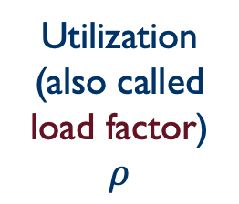
Utilization: cartoon version
U = XD
X = throughput
D = service demand, i.e., how much time/work to complete each request (on average).
U = 1 = 100%
The server is saturated. It has no spare capacity. It is busy all the time. Peak X = 1/D.
saturated
1 == 100%
This graph shows utilization (e.g., of a server) as a function of offered load. It is idealized: each request works for D time units on a single service center (e.g., a single CPU core).
Utilization
(also called load factor)
$$ρ$$
saturation
peak rate
Request arrival rate (offered load)

Slide 12
The Utilization “Law”
If the center is not saturated then:
U = λD = (arrivals/time) * service demand
Reminder: that’s a rough average estimate for a mix of arrivals with average service demand D.
If you actually measure utilization at the center, it may vary from this estimate.
But not by much.

Slide 13
It just makes sense
The thing about all these laws is that they just make sense. So you can always let your intuition guide you by working a simple example.
If it takes 0.1 seconds for a center to handle a request, then peak throughput is 10 requests per second. So let's say the offered load λ is 5 requests per second.
Then U = λ*D = 5 * 0.1 = 0.5 = 50%.
It just makes sense: the center is busy half the time (on average) because it is servicing requests at half its peak rate. It spends the other half of its time twiddling its thumbs. The probability that it is busy at any random moment is 0.5.
Note that the key is to choose units that are compatible. If I had said it takes 100 milliseconds to handle a request, it changes nothing. But U = 5*100 = 500 is not meaningful as a percentage or a probability. U is a number between 0 and 1. So you have to do what makes sense. Our treatment of the topic in this class is all about formalizing the intuition you have anyway because it just makes sense. Try it yourself for other values of λ and D.

Slide 14
Understanding utilization and throughput
Is high utilization good or bad?
Good. Why pay good $$$ for resources and then leave them idle? Especially if there is useful work for them to do! Occupy!
Bad. We want resources to be ready for use on demand, with no waiting.
Utilization ←→ contention
How use resources fully with low delay?

Slide 15
Understanding utilization and throughput
Throughput/utilization are “easy” to understand for a single service center that stays busy whenever there is work to do.
It is more complex for a network of centers/queues that interact, and where each task/job/request visits multiple centers.
And that’s what real computer systems look like.
E.g., CPU, disk, network, and mutexes…
Other synchronization objects
Multiple centers service requests concurrently!
Some centers may have higher occupancy than others.
That is unbalanced capacity → some centers are underutilized even as bottleneck centers saturate, limiting throughput.

Slide 16

Understanding bottlenecks
In a multi-center queue system, performance is limited by the center with the highest utilization for any workload.
That’s the center that saturates first: the bottleneck.
Always optimize for the bottleneck.
E.g., it’s easy to know if your service is “CPU-limited” or “I/O limited” by running it at saturation and looking at the CPU utilization. (e.g., “top”).

Slide 17
Capacity and bottlenecks A simple example
Four CPU cores, four disks
Average request demand:
50 ms on (any) core
100 ms on (any) disk
What is the peak rate (max throughput)?
CPU-limited or I/O-limited? What is the CPU utilization at the peak rate?
Does upgrading to 8 cores help?
Does adding disks (or switching to fast SSDs) help?
How many disks can I add before it stops helping?

Slide 18
Mean response time (R) for a center
R == D
The server is idle. The response time of a request is just the time to service the request (do requested work).
R = D + queuing delay (DN)
Queue size N and delay DN grows with U and is unbounded at saturation. (We see why soon.)
R_{max}
saturation (U = 1:
U is server utilization)
Average response time R
Illustration only
Saturation behavior is highly sensitive to implementation choices and quality.
U
R
saturation
D
λ_{max}
Request arrival rate (offered load)

Slide 19
Little’s Law
For a FIFO/FCFS queue in steady state, mean response time R and mean queue length N are governed by:
Little’s Law: N = λR
Why?
Suppose a task T is in the system for R time units.
During that time:
λR new tasks arrive (on average)
N tasks depart (all the tasks ahead of T, on average).
But in steady state, the flow in balances flow out.
“Obviously”: throughput X = λ in steady state. Otherwise requests “bottle up” in the server — not a steady state.

Slide 20
Inverse Idle Time “Law”
Service center saturates as 1/ λ → D. Then small increases in λ cause large increases in R.
At saturation R is unbounded.
U→1, idle → 0: divide by zero.
R
U
1(100%)
Little’s Law gives mean response time R = D/(1 – U).
(“Service demand over the idle time”)
Intuitively, an average task T’s response time R = D + DN.
Why? Serve T plus N tasks ahead of T each at cost D.
Substituting λR for N (by Little’s Law): R = D + D λR
Substituting U for λD (by Utilization Law): R = D + UR
Do the math: R - UR = D → R(1 - U) = D → R = D/(1 - U)

Slide 21
Why Little’s Law is important
1. Intuitive understanding of FCFS queue behavior.
Compute response time from demand parameters (λ, D).
Compute N: how much storage is needed for the queue.
2. Notion of a saturated service center.
Response times rise rapidly with load and are unbounded.
At 50% utilization, a 10% increase in load increases R by 10%.
At 90% utilization, a 10% increase in load increases R by 10x.
3. Basis for predicting performance of queuing networks.
Cheap and easy “back of napkin” (rough) estimates of system performance based on observed behavior and proposed changes, e.g., capacity planning, “what if” questions.
Guides intuition even in scenarios where the assumptions of the theory are not (exactly) met.

Slide 22
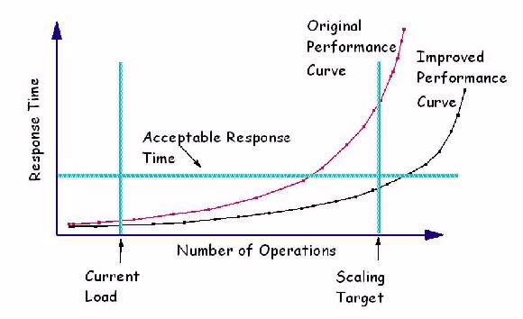
Improving mean response time
If we improve a service for “higher capacity” by any means, the effect is to push the response time curve out to the right.
λ_{max}
R_{max}
λ
[graphic from IBM.com]

Slide 23
Saturation and response time
We want systems to be responsive.
Pick the highest λ_{max} that yields response time below threshold R_{max}
R_{max} is a service level objective or SLO.
How to capture maximum capacity of a server?
Characterize max request rate λ_{max} this way:
Define a response time objective: maximum acceptable mean response time (R_{max}).
Increase λ until system response time surpasses R_{max} : that is λ_{max}.
λ_{max}
R_{max}
λ
[graphic from IBM.com]

Slide 24
Beware: averages can lead you astray
R=D/(1-U)
A rough rule of thumb for average (mean) R.
But individual requests may complete slower or faster.
E.g., requests have different resource demands, and delays vary at the resources → some slow requests (stragglers).
Focusing on averages obscures important effects.
Outliers shift the mean: Bill Gates walks into a bar…
Mean wealth rises, but nobody is richer.
Sometimes you have to look at the distribution and quantile measures. (“We are the 99%.”)

Slide 25
Example of a Cumulative Distribution Function (CDF)
80% of the requests (90-10) have response time R with x1 < R < x2.
“Tail” of 10% of requests with response time R > x2.
90%
quantile
A few requests have very long response times.
What’s the mean R?
50%
(median)
median value
10%
quantile
R
x1
x2
Understand how/why the mean (average) response time can be misleading.

Slide 26
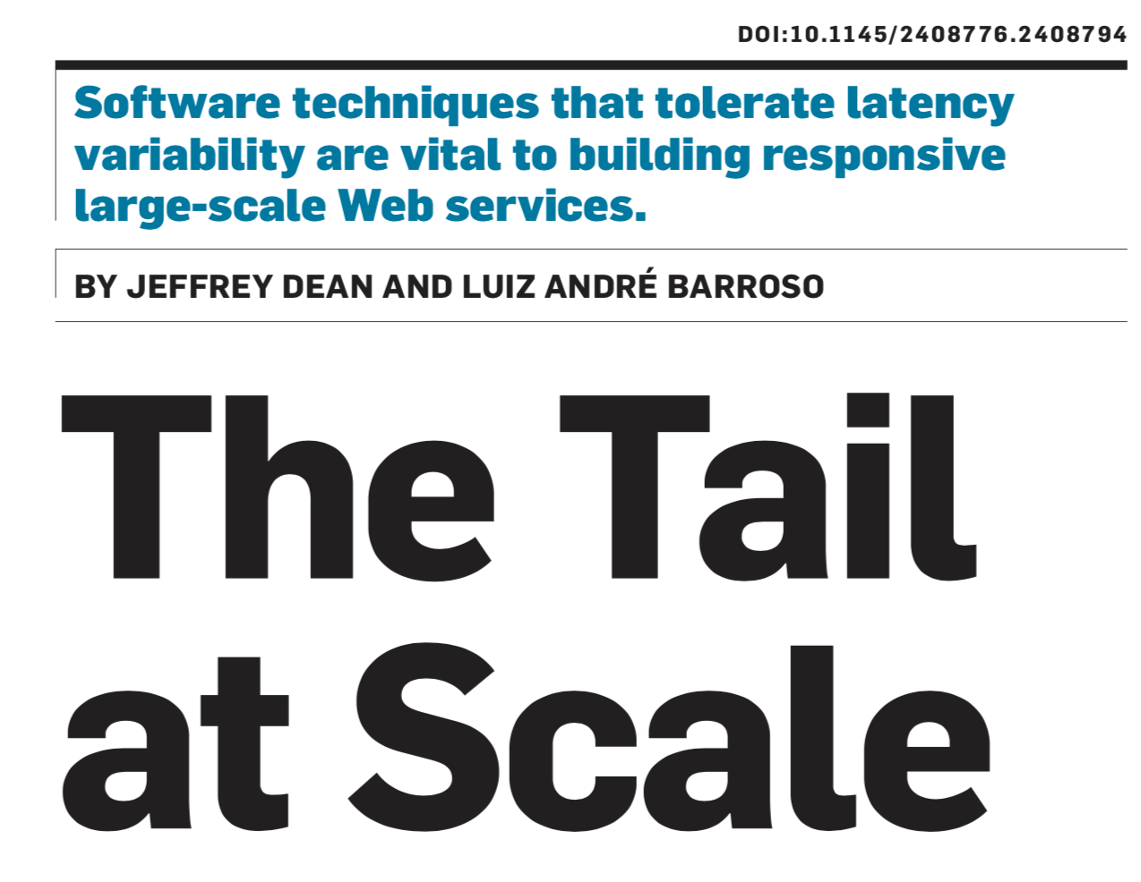
Communications of the acm | february 2013 | vol. 56 | no. 2

Slide 27
Tail at Scale: some points
Importance of latency budget for tiered services
Sources of response time (“latency”) variability.
Caching: may reduce mean R, but not the tail.
Head of line blocking: requests stuck behind a big op that must complete first→ break work into smaller chunks.
Unbalanced load across multiple servers/disks in a cluster.
Techniques to deal with tail latency (stragglers):
Tail-tolerant techniques for living with latency variability
Various cluster techniques for complex tiered services (Google)
Send parallel requests to backends (e.g., for search); discard late results to give best on-time answer within a latency budget.

