Slide 1
Managing Service Performance
Jeff Chase
Duke University

Slide 2
Overload
What should we do when a service is in overload?
Overload: service is close to saturation.
Overload → work queues grow without bound, increasing memory consumption and response time.
λ > λ_{max}
Throughput
X
λ
λ_{max}
offered load

Slide 3
Overload: options
Choke. Hope that things get better.
They might! But hope is not a plan. Make a plan.
Scale up. Add more resources, e.g., more cores.
What are the limits to scaling?
Admission control. Drop selected requests.
How to select? Load conditioning
Scale out. Spread the load across more servers.
Horizontal scaling
Elastic computing and the cloud

Slide 4
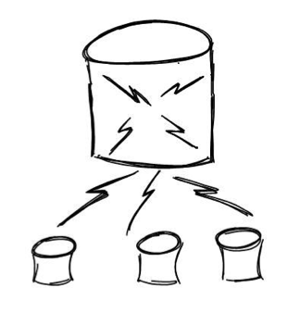
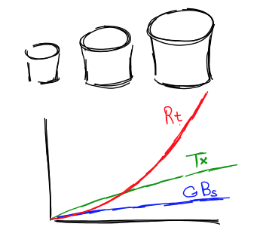
Scale-up vs. scale-out
“We’re gonna need a bigger server.”
“Get more and lash them together.”
http://dbshards.com/dbshards/database-sharding-white-paper/

Slide 5
Limits to scaling
Part 1

Slide 6
Scaling
Effective scaling—by any means—pulls curves “right”.
Handle higher load (λ_{max}) with (mean) R < R_{max}.
Examples: faster cores → lower D; faster I/O → less waiting; more cores → more concurrency.
U=1
R_{max}
Average response time R
R₁
Pull those curves to the right.
U₁
U₂
R₂
D
λ_{max}
U=0
Request arrival rate (offered load)

Slide 7
Limits to scaling
Adding N cores/centers/nodes gives Nx throughput?
But code has some locked critical sections: sequential.
How much speedup can we get?
This is a mortar shot scaling graph. Applies to any parallel program.
It shows diminishing marginal returns from adding parallelism.
What is the limit?
speedup
of λ_{max}
ideal (linear) scaling
cores

Slide 8
Amdahl’s Law
Suppose each request runs on the CPU, with no I/O.
But each spends 25% of its time in a locked section.
Mutual exclusion→critical sections are serial/sequential.
Then the maximum speedup is 4x.
Generally: share p is parallelizable, 1-p is sequential
→ speedup bounded by 1/(1-p)

Slide 9
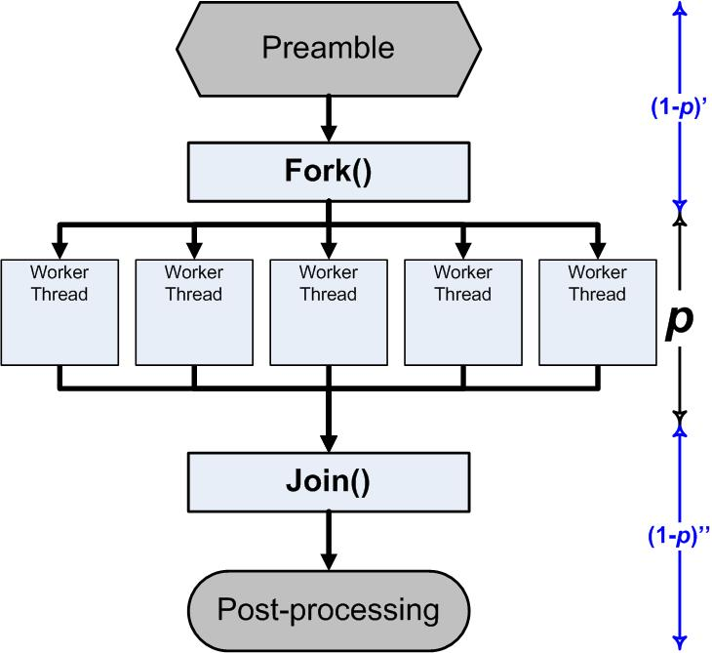
Parallelization A simple treatment
A program has some work to do. We want to do it fast. How?
Do it on multiple computers/cores in parallel.
But we won’t be able to do all of the work in parallel.
Suppose some portion p of the work can be done in parallel.
Then a portion 1-p is serial.
How much does that help?
Some portion will be serial/sequential.
E.g.:
startup
locking
combining results (reducers)
read specific disk
http://blogs.msdn.com/b/ddperf/archive/2009/04/29/parallel-scalability-isn-t-child-s-play-part-2-amdahl-s-law-vs-gunther-s-law.aspx

Slide 10
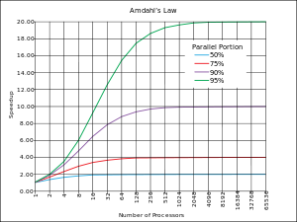
Amdahl’s Law: parallel runtime
Normalize runtime = 1
(On a single core.)
Now parallelize:
Parallel portion: P (0 ≤ P ≤1)
Serial portion: 1-P
N-way parallelism (N cores)
Runtime is now: P/N + (1-P)
Even if “infinite parallelism”, runtime is 1-P in the limit. Serial
Bottleneck limits performance.
Speedup = before/after
Bounded by 1/(1-P)
1/(1 - 0.95)
P
1/(1 - 0.90)
1/(1 - 0.75)
speedup
1/(1 – 0.50)
N (log scale)
Law of Diminishing Returns
“Optimize for the primary bottleneck.”

Slide 11
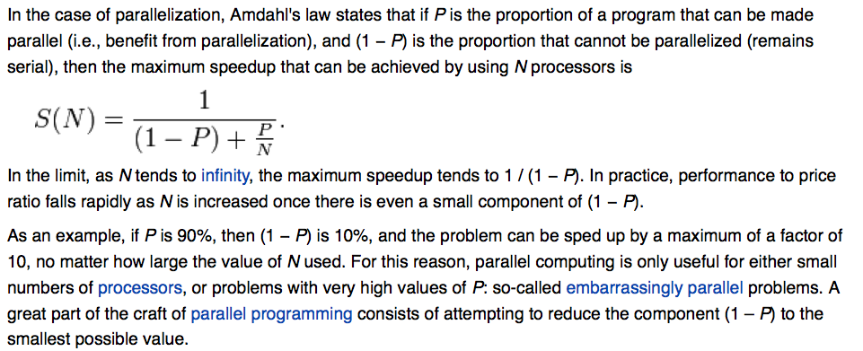
Amdahl’s Law
[Wikipedia snapshot]

Slide 12
Managing load
Part 2

Slide 13
Load conditioning
How to handle overload at the limit?
Admission control rejects requests: “try again later.”
Reduces mean response time and tail latency.
Reject them early, before they incur costs!
Easy answer: max queue threshold at server entry.
If server does not accept, then incoming connect requests drop off the listen queue once it is full.
perror() says “connection reset by peer.”
Alternative: load conditioning. Choose victims with intention, e.g., prefer “gold” customers, or reject by cost.
Example: SEDA.

Slide 14
SEDA
SOSP 2001, 1300 citations

Slide 15
SEDA vision: reactive stages
Idea: structure complex services as networks of stages.
A stage is a multi-threaded actor.
Each has an internal threadpool.
Each handles specific functions.
Each request flows along a path.
Queue it for downstream stage.
Modulate threadpool sizes.
Watch queues under feedback control.
Too long? Add threads, or drop here.

Slide 16
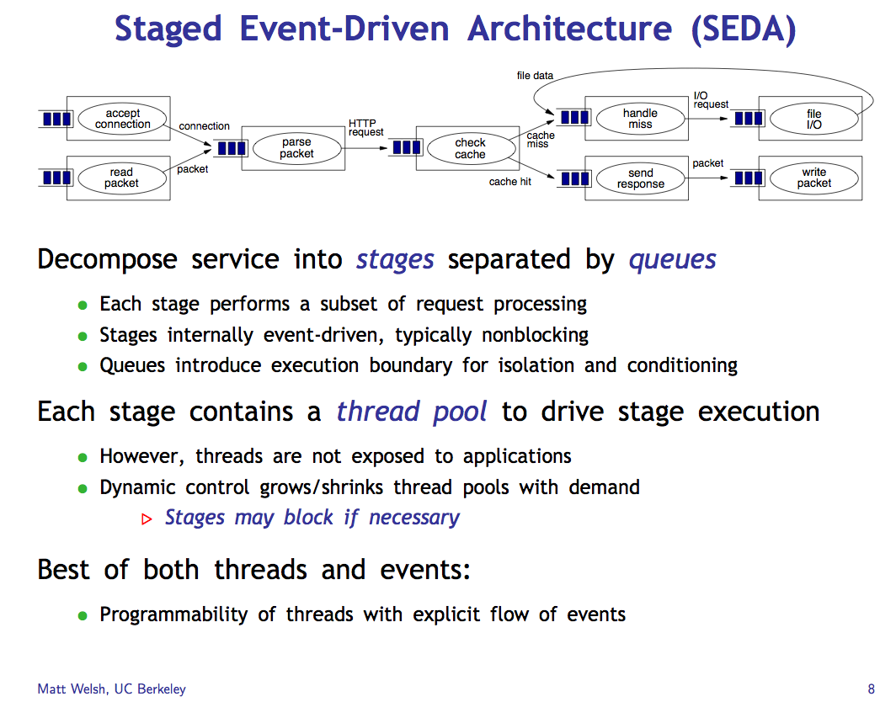

Slide 17
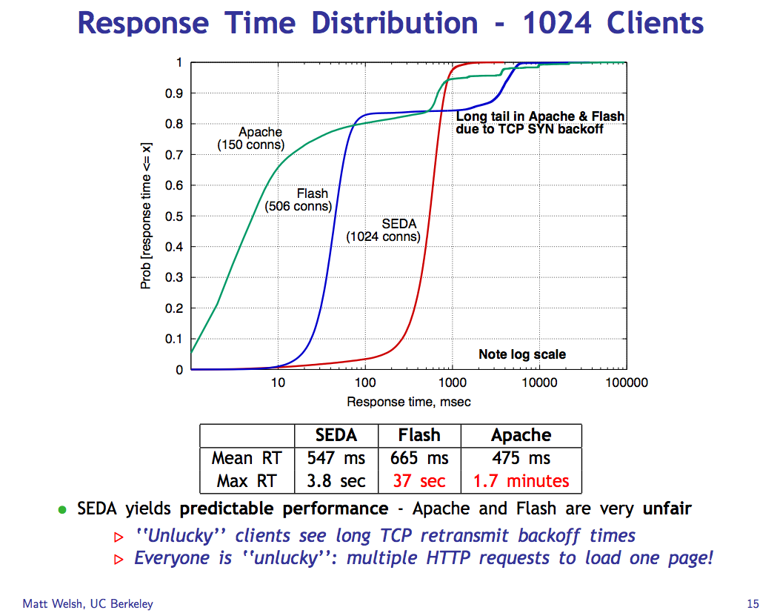
Slower.
But nice shape!
(Low variance)

Slide 18
Elastic scale-out
Part 3

Slide 19

Scaling out a service
Magic dispatcher
many
many
clients
Requests
Server cluster/farm/cloud/grid
Data center
Adding capacity. Add interchangeable server “bricks” to partition (“shard”) and/or replicate service functionality for scale and robustness. Rent virtual servers on the fly from a cloud infrastructure (IaaS) provider.

Slide 20

Load spreading
4x U=50%
Peak λ? R?
Unbalanced load
Average U=50%
Peak λ? Same
R = ???
We can always add servers. Distribute incoming requests in the network or preceding stage/tier, based on round-robin or a hash over TCP source/dest 5-tuple or request arguments. But load balancing is not perfect! And most services required shared data in a lower tier (e.g., a database). We discuss these topics in CPS 512 (Distributed Systems).

Slide 21
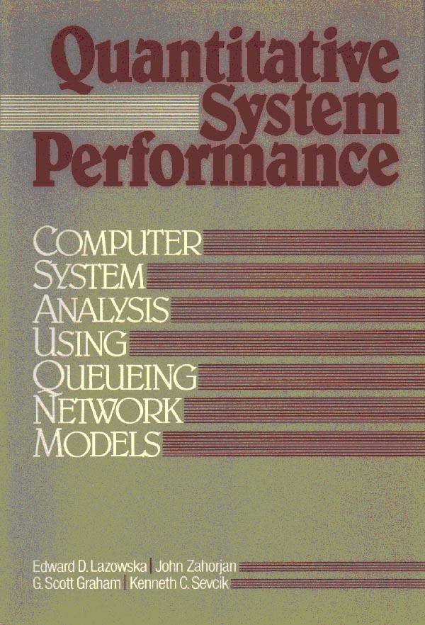
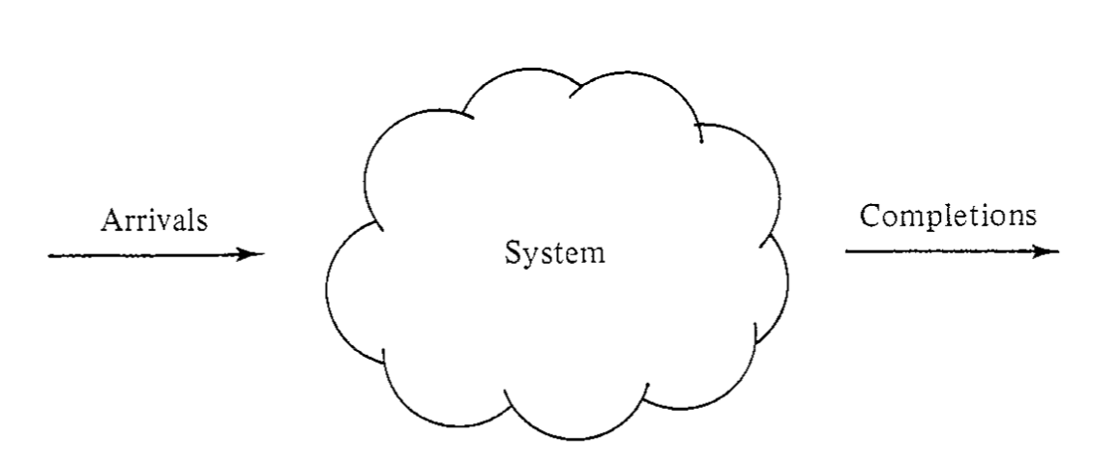
Using models to predict performance
Varying workload
Fixed system
Varying performance

Slide 22
Using models to provision for an SLO
Varying workload
Varying system
(use elastic scaling)
Fixed performance
(meet SLO target)
The math also works in the other direction….

Slide 23
“Elastic Cloud”
Resource Control
Feedback for elastic provisioning
Varying workload
Varying system
Target performance

Slide 24
Elastic scaling: points
Rent cloud capacity as needed: “pay as you grow”.
What are the triggers that drive capacity scaling?
Monitor system measures: N, R, U, X
Use models to derive the capacity needed to meet targets
Set a target for average utilization, scale to stay on target.
Challenges:
Direct traffic to spread workload across your capacity (servers) as evenly and reliably as you can. (Use some replication.)
Rebalance on failures or other changes in capacity.
Leave some capacity “headroom” for sudden load spikes.
Feedback stability. Watch out for bottlenecks!

Slide 25
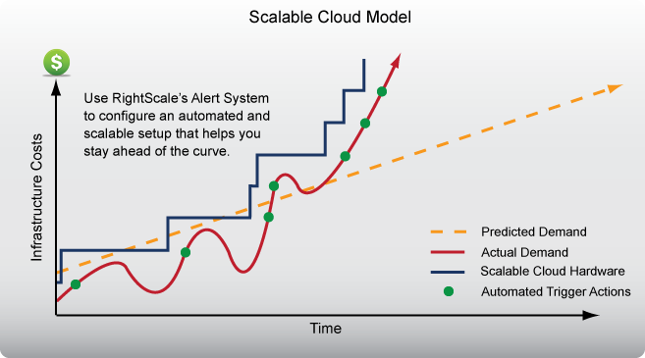
Elastic scaling: “pay as you grow”

Slide 26
Review: options for overload
Thrashing
Accept each request and inject it into the system. Then drop requests at random if some queue overflows its memory bound. Note: late drops incur sunk costs, wasting work and reducing throughput (e.g., “congestion collapse”).
Admission control or load conditioning
Reject requests as needed to keep system healthy. Reject them early, before they incur processing costs. Choose your victims carefully.
Dynamic provisioning or elastic scaling
E.g., acquire new capacity “on the fly” (e.g., from a cloud provider), and shift load over to the new capacity.

Slide 27
Improving performance (X and R)
Make the service center faster. (“scale up”)
Upgrade the hardware, spend more $$$
Reduce the work required per request (D).
More/smarter caching, code path optimizations, use smarter disk layout.
Add service centers, expand capacity. (“scale out”)
RAIDs, blades, clusters, elastic provisioning
N centers improves throughput by a factor of N: iff we can partition the workload evenly across the centers!
Note: the math is different for multiple service centers, and there are various ways to distribute work among them, but we can “squint” and model a balanced aggregate roughly as a single service center: the cartoon graphs still work.

