Slide 1


CPS 310
Fork & Exec
Michael Hewner & Jeff Chase
Duke University

Slide 2
Unix process model: the story so far
fork() syscall clones the calling parent process to create a child process.
exec*() syscall runs a new program in the calling process.
data
Unix: fork/exec
program
virtual address space
thread(s)
process control block (PCB)
user ID
process ID
parent PID
sibling links
children
current directory
+
+
stack
I/O channels
kernel state

Slide 3
Unix fork/exec/exit/wait syscalls
int pid = fork();
Create a new process that is a clone of its parent, running the same program.
exec*(“program” [argvp, envp]);
Overlay the calling process with a new program, and transfer control to it, passing arguments and environment.
exit(status);
Exit with status, destroying the process.
int pid = wait*(&status);
Wait for exit (or other status change) of a child, and “reap” its exit status.
Recommended: use waitpid().
fork parent
fork child
parent
program
initializes child context
exec
time
wait
exit

Slide 4
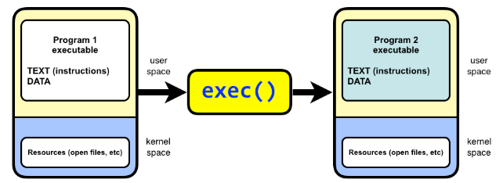
The exec family of system calls
The exec family of system calls replaces the program executed by a process.
When a process calls exec, all code (text) and data in the process is lost and replaced with the executable of the new program.
*all open file descriptors remains open.

Slide 5
execv
int execv(const char *path, char *const argv[]);
path
The path to the new program executable.
argv
Argument vector. The argv argument is an array of character pointers to null-terminated strings. The last member of this array must be a null pointer. The value in argv[0] should point to the filename of the executable for the new program.

Slide 6
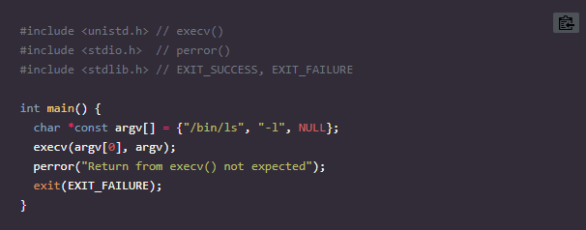
execv example

Slide 7
Fork
A parent process uses fork() to create a new child process.
The child process is a copy of the parent. After fork, both parent and child executes the same program but in separate processes.

Slide 8
Fork returns twice on success
On failure fork returns -1.
once in the parent
If the return value is greater than zero, the program executes in the parent process and the return value is the process ID (PID) of the created child process.
once in the child
If the return value is 0 the program executes in the new child process.
On failure fork returns -1.

Slide 9
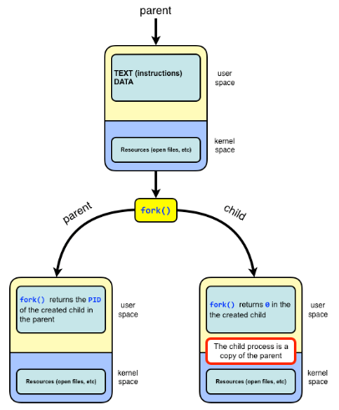
Fork illustration

Slide 10
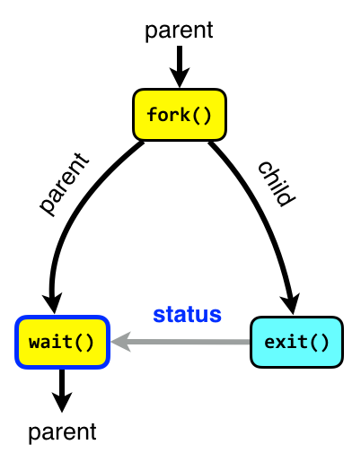
Wait
The wait system call blocks the caller until one of its child process terminates.
If the caller doesn’t have any child processes, wait returns immediately without blocking the caller.
Using wait the parent can obtain the exit status of the terminated child.

Slide 11
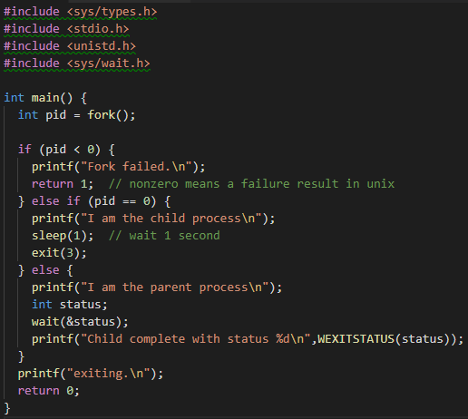

Fork example
8-bit status code.
Note that by unix tradition, a non-zero exit code signifies an error (but you can use it as you like)

Slide 12
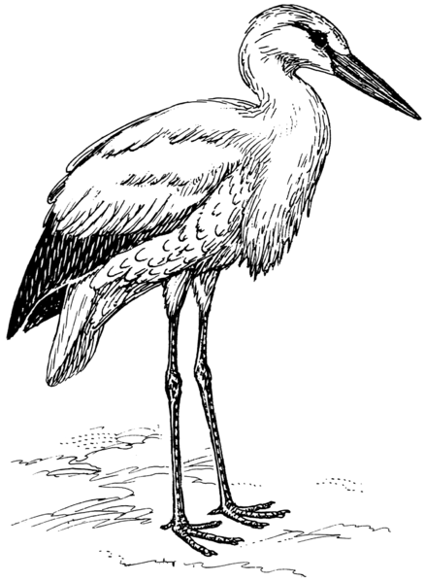
But how is the first process made?

Slide 13
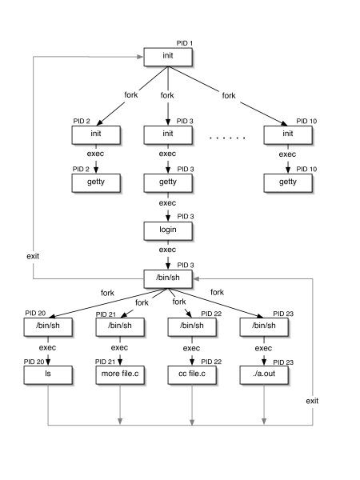
Init and Descendants
Kernel “handcrafts” initial process to run “init” program.
Other processes descend from init, including one instance of the login program for each terminal.
Login runs user shell in a child process after user authenticates.
User shell runs user commands as child processes.

Slide 14
Init and Descendants
Kernel “handcrafts” initial root process to run “init” program.
Other processes descend from init, and also run as root, including user login guards.
Login invokes a setuid system call before exec of user shell, after user authenticates.
Children of user shell inherit the user’s identity (uid).

Slide 15
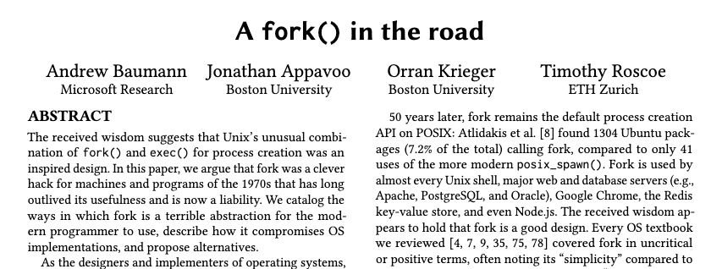
fork+exec: a great idea?
We shall see how fork+exec is simple+powerful in the original Unix setting of single-threaded processes. But fork is wasteful and expensive to implement. Also, it does not compose well with threads.
Classic paper: Evolving the Unix System Interface to Support Multithreaded Programs, McJones and Swart, 1987 (DEC SRC report).
ACM/USENIX HotOS ’19, May 13–15, 2019, Bertinoro, Italy

