Slide 1


8b Access Control & Setuid
Mike Hewner & Jeff Chase
Duke University

Slide 2
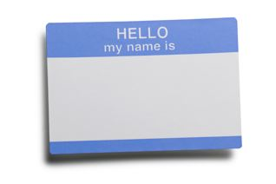
Identity in an OS (Unix)
Every process has a security label that governs access rights granted to it by kernel.
Abstractly: the label is a list of named attributes and values. An OS defines a space of attributes and their interpretation.
Some attributes and values represent an identity bound to the process.
Unix: e.g., userID: uid
uid=“alice”
Alice
Every Unix user account has an associated userID (uid). (an integer)
credentials
uid
There is a special administrator uid==0 called root or superuser or su.
Root “can do anything”: normal access checks do not apply to root.

Slide 3
Labels and access control
Alice
Every system defines rules for assigning security labels to subjects (e.g., Bob’s process) and objects (e.g., file foo).
Bob
login
login
Every system defines rules to compare the security labels to authorize attempted accesses.
shell
shell
creat(“foo”)
tool
foo
open(“foo”)
write,close
read
tool
uid=“alice”
owner=“alice”
uid=“bob”
Should processes running with Bob’s userID be permitted to open file foo?

Slide 4
Unix: setuid and login
A process with uid==root may change its userID with the setuid system call.
This means that a root process can speak for any user or act as any user, if it tries.
This mechanism enables a system login process to set up a shell environment for a user after the user logs in (authenticates). This is a refinement of privilege.
Alice
log in
login
setuid(“alice”), exec
shell
fork/exec
A privileged login program verifies a user password and execs a command interpreter (shell) and/or window manager for a logged-in user. A user may then interact with a shell to direct launch of other programs. They run as children of the shell, with the user’s uid.
tool
uid=“alice”

Slide 5
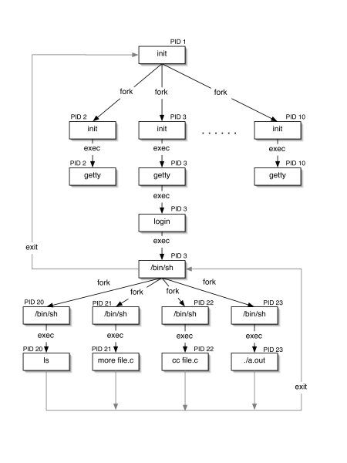
Init and Descendants
Kernel “handcrafts” initial root process to run “init” program.
Other processes descend from init, and also run as root, including user login guards.
Login invokes a setuid system call before exec of user shell, after user authenticates.
Children of user shell inherit the user’s identity (uid).

Slide 6

The need for access control
Processes run programs on behalf of users. (“subjects”)
Processes create/read/write/delete files. (“objects”)
The OS kernel mediates these accesses.
How should the kernel determine which subjects can access which objects?
This problem is called access control or authorization (“authz”). It also encompasses the question of who is authorized to make a given statement.
The concepts are general, but we can consider Unix as an initial example.

Slide 7

Concept: reference monitor
requested operation
“boundary”
Alice
identity
protected
state/objects
subject
program
guard
A reference monitor is a program/module that controls accesses to a set of objects by other programs. The reference monitor has a guard that checks all requests against an access control policy before permitting them to execute.

Slide 8
Requirements for a reference monitor
requested operation
“boundary”
Alice
identity
protected
state/objects
subject
program
guard
Isolation: the reference monitor is protected from tampering.
Interposition: the only way to access the objects is through the reference monitor: it can examine and/or reject each request.
Authentication: the reference monitor can identify the subject.

Slide 9
Reference monitor
requested operation
“boundary”
Alice
identity
protected
state/objects
subject
program
guard
What is the nature of the isolation boundary?
If we’re going to post a guard, there should also be a wall. Otherwise somebody can just walk in past the guard, right?

Slide 10
The kernel is a reference monitor
No access to kernel state by user programs, except through syscalls.
Syscalls transfer control to code chosen by the kernel, and not by the user program that invoked the system call.
The kernel can inspect all arguments for each request.
The kernel knows which process issues each request, and it knows everything about that process.
User programs cannot tamper with the (correct) kernel.
The kernel determines everything about how the machine is set up on boot, before it ever gives user code a chance to run.

Slide 11
Objects also have security labels
An object in Unix (e.g./i.e., a file or directory) also has a security label.
It is stored with the object and maintained by the kernel.
Unix file: owner’s uid and mode bits (later).
The mode bits specify who can access the file and how.
E.g., mode = 644 means owner can read/write, others can read.
E.g., mode = 755 also allows everyone to execute the file, or search it if it is a directory.
The object’s owner can modify the security label through some special system calls: chmod, chgrp.

Slide 12
Labels and access control
Alice
Every file and every process is labeled/tagged with a user ID.
Bob
log in
A privileged process may set its user ID.
log in
login
login
setuid(“alice”), exec
setuid(“bob”), exec
shell
shell
fork/exec
creat(“foo”)
fork/exec
tool
foo
open(“foo”)
write,close
read
tool
uid=“alice”
owner=“alice”
uid=“bob”
A process inherits its userID from its parent process.
A file inherits its owner userID from its creating process.

Slide 13
Programs as security subjects
Unix has a cool way to assign special privilege to a trusted program in its security label.
If the program has setuid bit set (“trusted”), any process that execs the file runs with the file’s owner userID.
Gives process the privileges of the program owner (after exec).
Doesn’t matter who ran (with fork) the containing process.
Illustrates a crucial general concept: trusted programs as security identities (principals).
Access is determined by identity of the program, not (just) of its user.
Cornerstone of trusted computing architectures (TCPA/TPM, SGX).

Slide 14
The setuid bit: another way to setuid
The mode bits on a program file may be tagged to setuid to owner’s uid on exec*.
This is called setuid bit. Some call it the most important innovation of Unix.
It enables users to run secure programs that execute with the uid of the program owner, rather than of the program’s user.
The user cannot choose the code: only the program owner can choose the code to run with the program owner’s uid.
Parent cannot subvert/control a child after program launch: a property of Unix exec*.
Alice
log in
login
fork
setuid(“alice”)
exec
shell
fork
exec(“sudo”)
/usr/bin/sudo
owner= root
setuid bit set
sudo
uid=“root”
fork
exec(“tool)
Example: sudo is a setuid (trusted) program owned by root.
tool
uid=“root”

Slide 15
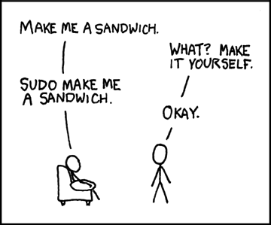
A trusted program: sudo
Alice
log in
login
fork
setuid(“alice”)
exec
shell
“sudo tool”
fork/exec
uid = 0 (root)
sudo
xkcd.com
fork
exec(“tool”)
With great power comes great responsibility.
tool
The sudo program runs as root, checks user authorization to act as superuser, and (if allowed) executes requested command as root.
uid=“root”

Slide 16
The secret of setuid
Setuid is the name of both a syscall (to refine privilege) and an object attribute to amplify it (the setuid bit).
The setuid bit can be seen as a mechanism for a trusted program to function as a reference monitor.
E.g., a trusted program can govern access to files.
Protect the files with the program owner’s uid.
Make them inaccessible to other users.
Other users can access them (only) via the trusted program.
But only in the manner permitted by the trusted program.
The running program can query the “real” (user’s) uid, make decisions based on it, or set to it to refine privilege temporarily. (The setreuid syscall.)

Slide 17
Trusted program as reference monitor
requested operation
“boundary”
Alice
protected
state/objects
subject
program
What is the nature of the isolation boundary?
Subject can supply input and interact with the process through a user interface (e.g., clicking, typing). The trusted program chooses how to respond to its input. The user can kill or suspend the setuid process, but cannot tamper with it.

Slide 18
Server as reference monitor
requested operation
“boundary”
Alice
protected
state/objects
subject
program
What is the nature of the isolation boundary?
Clients can interact with the server only by sending messages through a socket channel. The server chooses the code that handles received messages. The client cannot tamper with it. Unless…

Slide 19
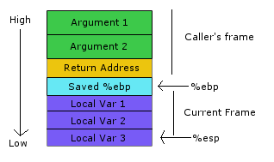
Buffer overflow / stack smash
RA
Shellcode
Attacking client sends code of its choosing in a request and forces server to execute it. Possible (easy!) if the server fails to check inputs carefully, copies inputs into local variables, and is undefended by {ASLR, NX, stack canaries…}.

