Slide 1


CPS 310
Pipes
Michael Hewner & Jeff Chase
Duke University

Slide 2
Unix process: parents rule
Created with fork by parent program running in parent process.
Virtual address space
(Virtual Memory, VM)
Child Process
text
data
Child inherits parent program, but may exec*() a different program after setup.
heap
Thread
Inherit from parent process, may be modified in child
(e.g., using dup* to remap descriptors).
Program
Initial VAS contents inherited from parent on fork, or reset for child program on exec. Parent chooses environment (argv[] and envp[]) on exec.
kernel state

Slide 3



Unix process view: data
A process has multiple channels for data movement in and out of the process (I/O).
I/O channels
(“file descriptors”)
stdin
stdout
Process
The channels are typed.
tty
stderr
Each channel is named by an I/O descriptor (called a “file descriptor”).
pipe
Thread
socket
The parent process and parent program set up and control the channels for a child (until exec).
Files
Program

Slide 4
Standard I/O descriptors
I/O channels
(“file descriptors”)
stdin
Open files or other I/O channels are named within the process by an integer file descriptor value.
stdout
tty
stderr
Standard descriptors for
primary input (stdin=0), primary output (stdout=1), error/status (stderr=2).
count = read(0, buf, count);
if (count == -1) {
perror(“read failed”); /* writes to stderr */
exit(1);
}
count = write(1, buf, count);
if (count == -1) {
perror(“write failed”); /* writes to stderr */
exit(1);
}
Their bindings are inherited from the parent process and/or set by the parent program.
By default they are bound to the controlling tty.

Slide 5
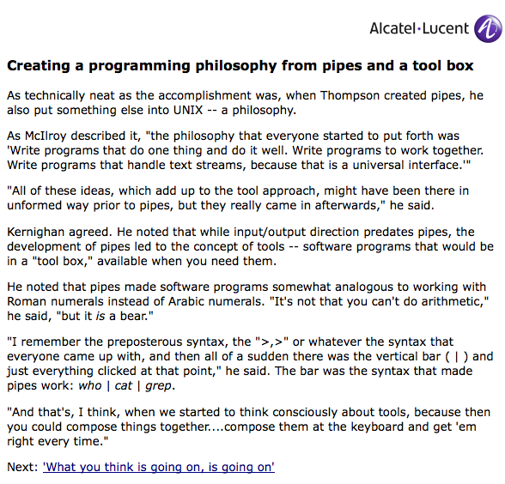
A key idea: Unix pipes
The shell offers an intuitive syntax for pipes. That makes it possible to combine programs interactively from the shell. They each operate on a data stream flowing through them.
source | filter | sink
[http://www.bell-labs.com/history/unix/philosophy.html]

Slide 6
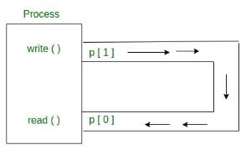
Message Passing: pipe
int pipe(int fds[2]);
Parameters :
fd[0] will be the fd(file descriptor) for the read end of pipe.
fd[1] will be the fd for the write end of pipe. Returns : 0 on Success. -1 on error.

Slide 7
How to plumb a pipe?
1
P creates pipe.
P
2
P forks C1 and C2.
Both children inherit both ends of the pipe, and stdin/stdout/stderr.
Parent closes both ends of pipe after fork.
stdout
stdin
tty
tty
stdin
stdout
C1
C2
3A
C1 closes the read end of the pipe, “dups” the write end onto its stdout, and execs.
3B
C2 closes the write end of the pipe, “dups” the read end onto its stdin, and execs.

Slide 8
Simpler example Feeding a child through a pipe
Parent
close(ifd[0]);
count = read(0, buf, 5);
count = write(ifd[1], buf, 5);
waitpid(cid, &status, 0);
printf("child %d exited…”);
Parent
int ifd[2] = {0, 0};
pipe(ifd); /* sets fds */
cid = fork();
parent
stdout
stdin
stderr
pipe
Child
close(0);
close(ifd[1]);
dup2(ifd[0],0);
close(ifd[0]);
execve(…);
stdin
chase$ man dup2
chase$ cc -o childin childin.c
chase$ ./childin cat5
12345
12345
5 bytes moved
child 23185 exited with status 0
chase$
stdout
stderr
child cid
Program to exec

Slide 9
Pipeline setup: spelling it out
The pipe() syscall returns two integer file descriptors.
read end ← references an I/O channel to read data out of this pipe.
write end ← references an I/O channel to write data into this pipe.
Parent creates one pipe for each pair of forked children in a pipeline.
Parent (e.g., shell) passes pipe ends to children (C1, C2) via fork().
C1 dups write end onto its stdout; C2 dups read end onto its stdin.
C1 and C2 exec*() programs that know nothing of the pipe: it just works.
Leftmost child reads input from terminal, outputs to pipe.
Rightmost child reads from pipe, outputs to terminal.
stdin
stdout
stdin
stdout
tty
tty
write end
pipe
read end
C1
C2
cat | cat

Slide 10
Pipeline teardown (1)
How does a piped process “know” that it is done?
A read on a pipe returns end-of-file (EOF) if no more data to read and no writer, i.e., no more data can ever appear.
A write on a pipe returns error EPIPE (and generates a fatal “broken pipe” signal) if there is no reader, i.e., nobody to hear the writer.
Therefore: if any process in a pipeline exits, upstream processes exit on next write; downstream processes exit after reading all data.
E.g., if writer exits (or closes), the reader receives EOF after the data.
X
pipe
tty
read end
tty
write end
C1
C2
cat | cat

Slide 11
Pipeline teardown (2)
How does the kernel know that there is no reader or writer?
The kernel uses reference counting of descriptors to make it work.
If a process holds an open file descriptor on an I/O object (e.g., the pipe’s read end or write end), the object’s refcount reflects that.
An exit (or crash) closes all descriptors, decrementing the refcounts.
If writer exits/closes, the count on the write end goes to zero.
No writer.
If reader exits/closes, the count on the read end goes to zero.
No reader.
X
pipe
X
tty
read end
tty
write end
C1
C2
cat | cat

Slide 12
Close it!
Close unused descriptors, or pipes (and other stuff) won’t work!
Parent calls pipe(), so it gets descriptors for both ends. If it does not intend to use them, then it must close them after fork().
Similarly, children inherit both ends of the pipe. But C1 uses only the write end, and C2 uses only the read end. Close the other end!
If a process fails to close unused descriptors, an object’s reference count won’t go to zero when it should: if a pipeline breaks, the surviving processes may block forever (a form of deadlock).
pipe
tty
tty
stdin
stdout
C1
C2
cat | cat

Slide 13
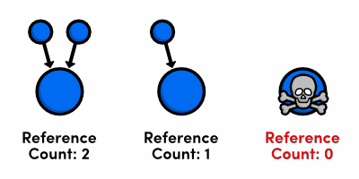
Reference counting
Used in various applications and programming language environments, and in the kernel, e.g., Unix file management.
Keep a count of references to the object.
Increment count when a new reference is created (shallow copy).
Decrement count when a reference is destroyed.
Free object when the count goes to zero.
[http://rypress.com/tutorials/objective-c/memory-management.html]

Slide 14
Processes reference objects
text
Files
data
The kernel objects referenced by a process have reference counts. They may be destroyed after the last ref is released, but not before.
What operations release ref counts?

Slide 15
Fork clones all references
text
Files
data
Child inherits open descriptors from parent.
Cloned references to VM segments are likely to be copy-on-write to create a lazy, virtual copy of the shared object.
Cloned descriptors share a read/write offset.
Fork increments reference counts on shared objects.
What operations release ref counts?

Slide 16
“File” (I/O) descriptors in Unix
user space
kernel space
Disclaimer: this drawing is oversimplified
file
int fd
pointer
pipe
per-process
descriptor
table
socket
tty
Type-specific structures (e.g., inode)
“open file table”
An I/O descriptor (e.g., fd) is just an integer value in a process address space. The user program passes a descriptor value as an argument to the I/O system calls to identify the I/O channel to operate on. The kernel maintains internal data structures for each I/O channel. It finds these by using the fd to index into an internal table. It checks validity and access etc. before carrying out the requested operation.

Slide 17
Unix dup* syscall
System “open file table”
int fd2 = 0
tty in
int fd1 = 5
tty out
per-process
descriptor
table
pipe out
pipe in
Hypothetical initial state before dup2(fd1, fd2) syscall.
dup2(oldfd1, newfd2). What does it mean?
fd1 and fd2 denote entries in the file descriptor table of the calling process. The dup2 syscall is asking the kernel to operate on those entries in a kernel data structure. It doesn’t affect the I/O objects themselves. Except their reference counts.
Note: each pipe is really two I/O objects: a read end for reading data out of the pipe (“pipe out”) and a write end for writing into the pipe (“pipe in”).

Slide 18
Unix dup* syscall
int fd2 = 0
tty in
int fd1 = 5
X
tty out
per-process
descriptor
table
pipe out
pipe in
Final state after dup2(fd1, fd2) syscall.
Then dup2(fd1,fd2); close(fd1) means: “remap the object referenced by file descriptor fd1 to fd2 instead”.
It is convenient for remapping descriptors onto stdin, stdout, stderr, so that some program will use them “by default” after exec*.
Note that we still have not changed the values in fd1 or fd2. Also, changing the values in fd1 and fd2 can never affect the state of the entries in the file descriptor table. Only the kernel can do that.

Slide 19
Unix dup* syscall
int fd2 = 0
X
tty in
int fd1 = 5
>
tty out
per-process
descriptor
table
pipe out
pipe in
Final state after dup2(fd1, fd2) syscall.
Then dup2(oldfd1, newfd2) means: “close(fd2) (if it was open) then set fd2 to refer to the same underlying I/O object as fd1.”
It results in two file descriptors referencing the same underlying I/O object. You can use either of them to read/write: they are equivalent.
But you should probably just close(fd1).

Slide 20
Unix dup* syscall
Final state after dup2(fd1, fd2) syscall.
int fd2 = 0
X
tty in
int fd1 = 5
>
tty out
per-process
descriptor
table
pipe out
pipe in
System open file table
refcount == 2
Why should you close(fd1) after dup2(fd1, fd2)? Because the kernel uses reference counting to track open file descriptors. Resources associated with an I/O object are not released until all of the open descriptors on the object are closed. They are closed automatically on exit, but you should always close any descriptors that you don’t need.

Slide 21
Notes on reference counting
The reference counts on file entries in the open file table are an example of a very important technique in software systems.
Kernel tracks the reference counts across fork/dup*/close.
Kernel also reference-counts the underlying I/O objects, based on the number of file entries for it, and other state (e.g., process curdir).
If some process holds an open reference, the kernel must keep the state for the I/O object in memory. Need to reclaim this space!
If some process accidentally holds an open reference, the I/O object may behave differently (e.g., pipes).
Process exit() releases all references held by the process. Any process crash (fault, uncaught signal) triggers an exit internally.
Other operating systems (such as Android) also make extensive use of reference counting in a similar way.

Slide 22
Notes on pipes
All the processes in a pipeline run concurrently. The order in which they run is not defined. They may execute at the same time on multiple cores. They do NOT execute in sequence (necessarily).
Their execution is “synchronized by producer/consumer bounded buffer”. It means that a writer blocks if there is no space to write, and a reader blocks if there are no bytes to read. Otherwise they may both run: they might not, but they could.
They do NOT read “all the input” before passing it downstream.
The pipe itself must be created by a common parent. The children inherit the pipe’s file descriptors from the parent on fork. Unix has no other way to pass a file descriptor to another process.
Programs in a shell pipeline “do not know” they are using pipes, and do not need to know. They just read from stdin and write to stdout. All the “plumbing” is done pre-exec: it works for any program. Cool.

Slide 23
More not to miss about pipes+refcounts
The point is not “how to use pipes in Unix” (although there is that), it is how data streams between processes.
The same producer/consumer bounded buffer blocking behavior also appears for network sockets to keep sender/receiver “in sync”.
With help from stream protocol (e.g., TCP: everywhere in the Internet).
We call it flow control and it is also the basis for congestion control.
The setup/teardown behavior of pipes also applies to network sockets.
Illustrates pipeline parallelism model in software.
All the same in dataflow network programming environments (e.g., MapReduce) widely used for streaming data analytics (Spark, Hadoop).
Illustrates the importance of reference counting in OS APIs.
Refcounts drive behavior for OS abstractions in many systems.
Misuse is a source of bugs that the uninitiated fail to understand.

