Slide 1

Authentication, Part 1: Passwords
Jeff Chase
Duke University

Slide 2

The First Principle of Security
“Security is at least as much a social problem as it is a technical problem.”
Translation: humans are the weak link.
Never lose sight of the social dimension.
Keys left in lock
Phishing
Executable attachments
Trojan software
Post-it passwords
Bribes, torture, etc.
Etc.

Slide 3
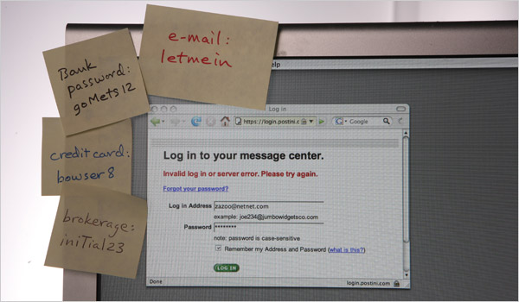

Slide 4
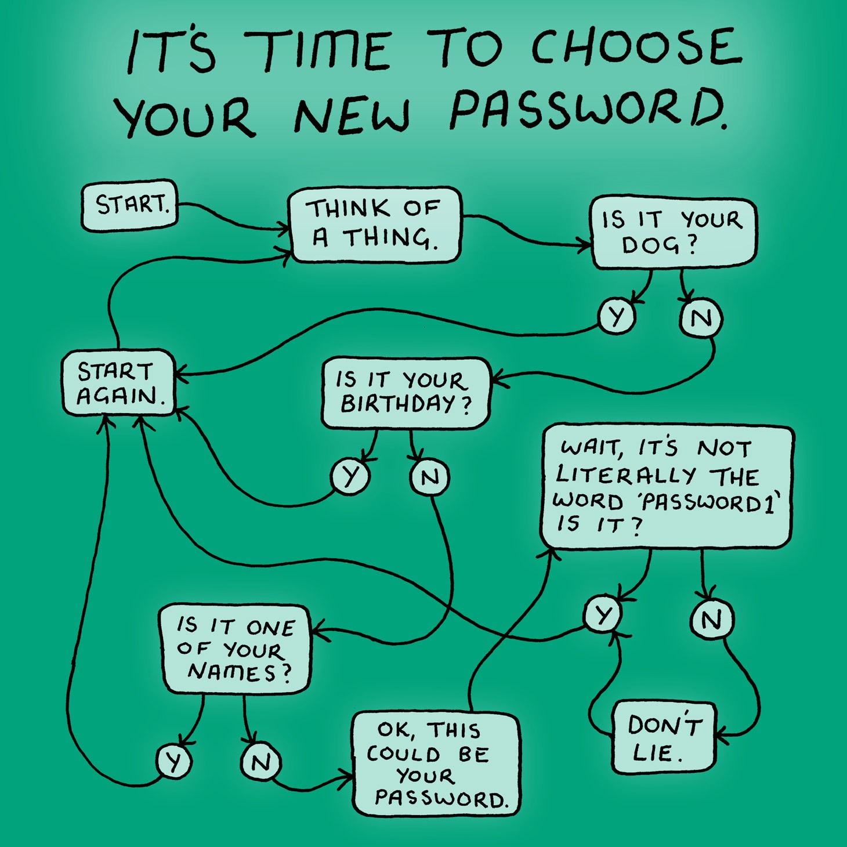

Slide 5
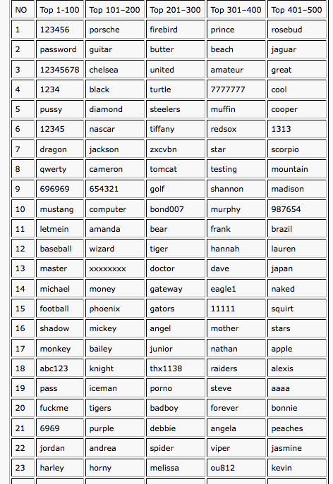

Obviously these popular passwords are not “hard to guess”. No meaningful password is hard to guess, because there is a limited number of meaningful passwords to choose from.
Duke OIT slogan: “I’m an 11+”.
Generate passwords randomly; remember them with a password manager. (?)

Slide 6
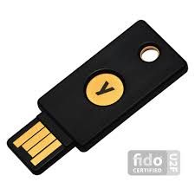
Password security
What if I use a hard-to-guess password, don’t write it down, and I am wise to phishing? Am I safe?
Can an attacker intercept the password on the network?
Defense: Secure sockets (SSL)/Transport-layer Security (TLS)
Does the server store a copy to steal or leak?
Defense: Hashing (with salt) on server
Also: Don’t use the same password at multiple sites.
And use MFA: multi-factor authentication
Warning: if you are a high-value target (politics, technology, activism, financial, journalist), you will be targeted!

Slide 7
Hashing for passwords at rest
Password security is our intro to cryptosystems.
One element of crypto is secure hashing.
It has many uses. We illustrate its use to protect passwords at rest in storage, e.g., on a server.
A server must “know” your password to check it.
If a server stores passwords in a file, and an attacker steals the file, it is a disaster.
So server stores password hashes instead of clear text.
The server can still check the passwords easily, but it makes it much harder to leak/steal them.

Slide 8
Egregious password leak example #1

Slide 9
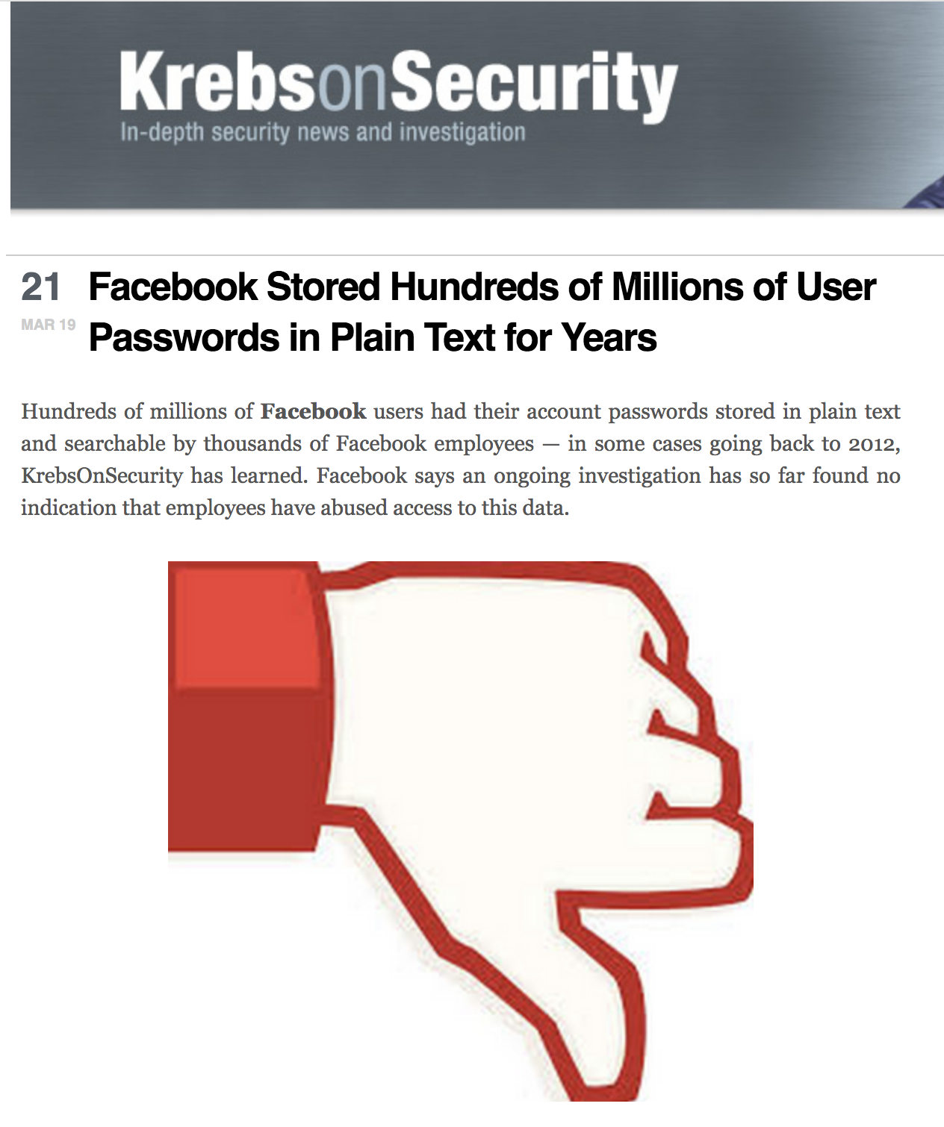
Egregious password leak example #2

Slide 10
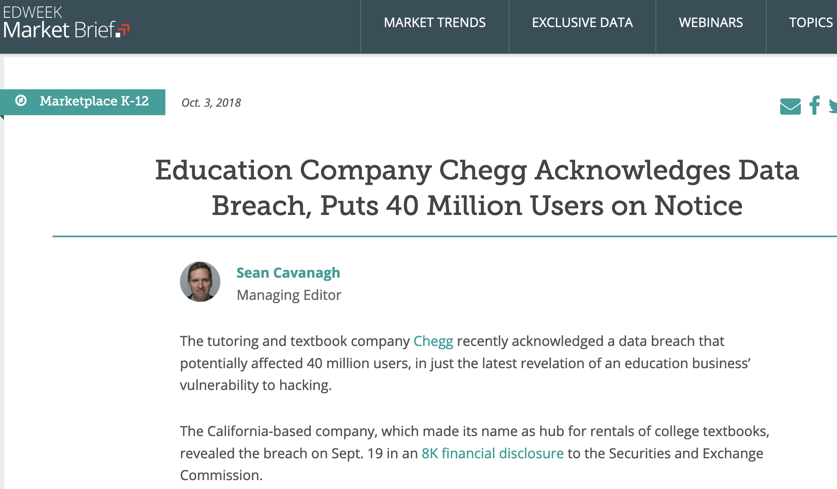
Egregious password leak example #3
About 1000 Duke NetID accounts compromised, 100 entered by hackers.

Slide 11
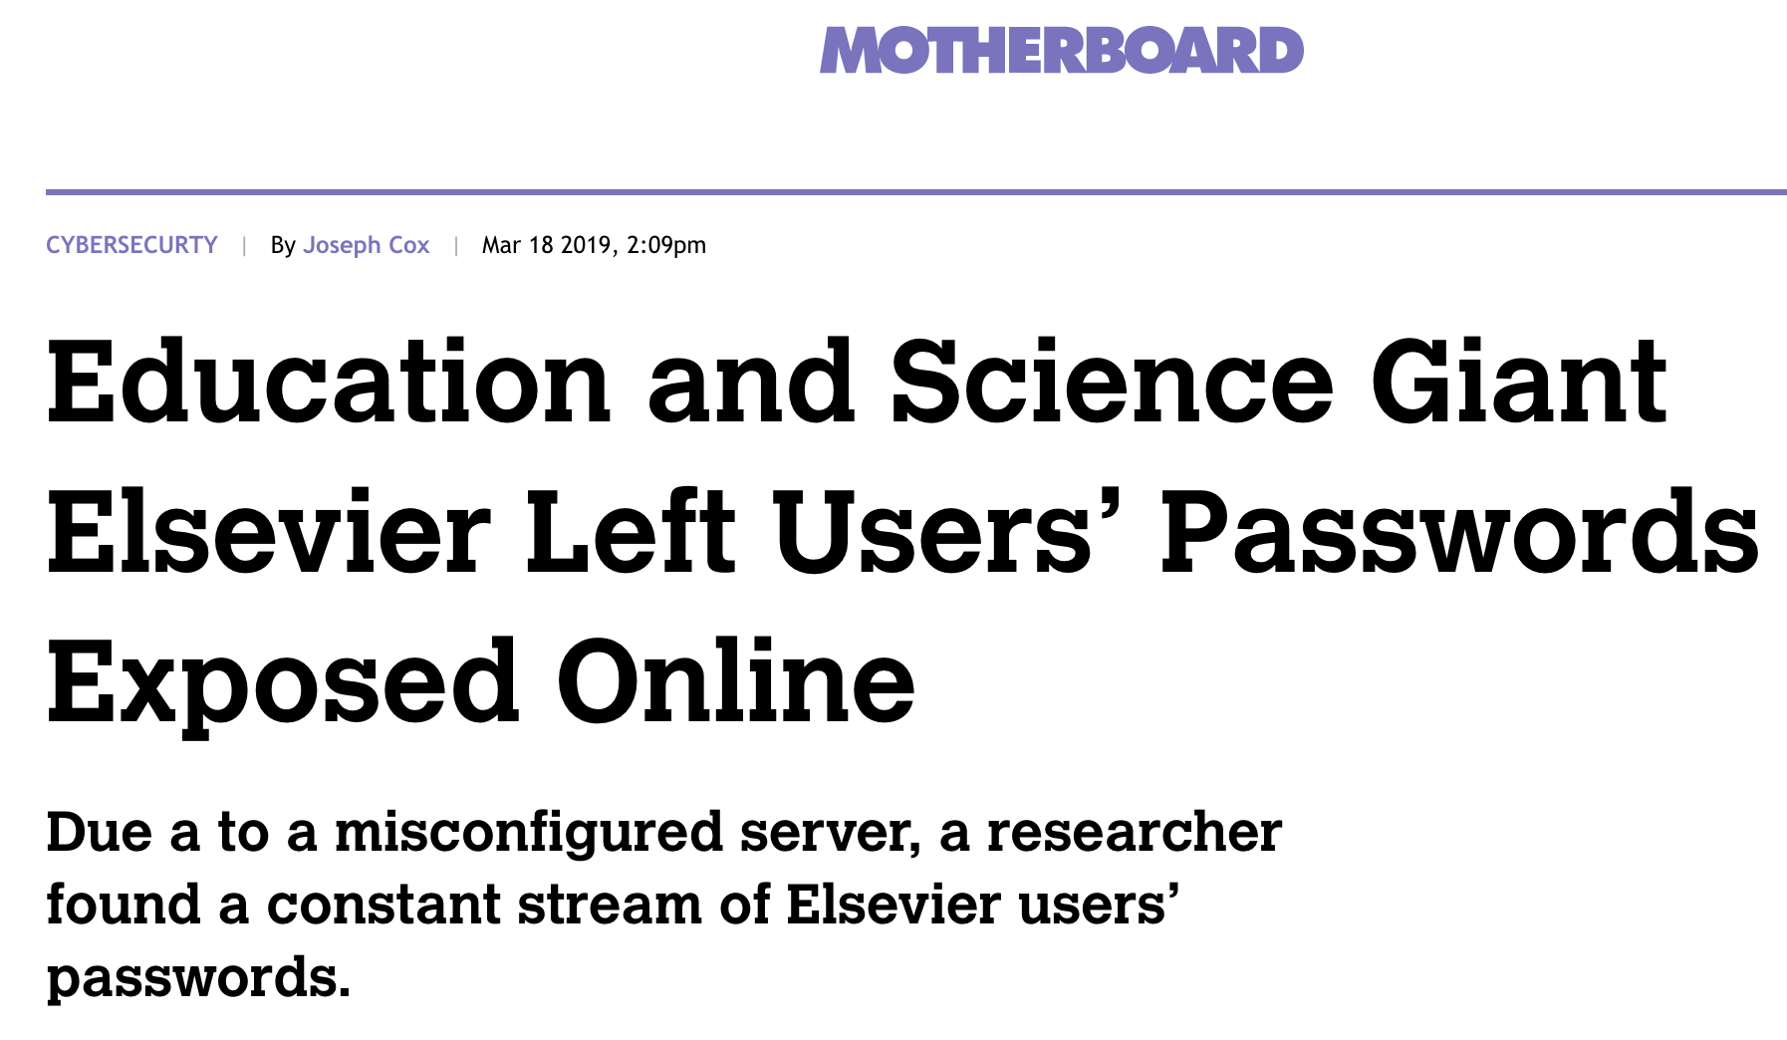
Egregious password leak example #4

Slide 12
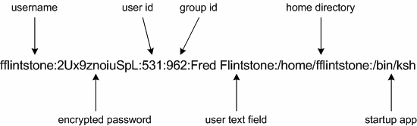

Defense: hashed password file
#
hashed
This is a line from the standard Unix /etc/passwd file for user Fred Flintstone.
login uses this record to validate the user’s password.
The file is public, but Fred’s password is secret.
Or is it?

Slide 13


Cryptographic hashes
#
Also called a secure hash or one-way hash
The hash function h takes a byte sequence M as input.
E.g., SHA0, MD5, SHA1, SHA2/SHA-256, SHA3, MD6
SHA-x: Secure Hashing Algorithm
Very efficient, produces a small fixed-width result: h(M)
Result is called a hash, checksum, fingerprint, digest
SHAx hash
“Hash digest”
Arbitrarily large
Fixed, e.g., 256 bits

Slide 14
Properties of Secure Hashing
Collision-resistant
Sure, there exist distinct M₁ and M₂ such that h(M₁) == h(M₂).
But such collisions are “very hard” to find.
One way
Given digest, cannot generate an M with h(M) == digest.
Such collisions are “very hard” to find.
Secure
The digest does not help to discover any part of M.
#
X
X
#
SHAx
SHAx
Cheap
“Computationally infeasible”

Slide 15
http://www.oditorium.com/ou/courses/various/introduction-to-bitcoins/

Slide 16

Example: hashed passwords
This protocol takes place over an encrypted connection. The connection is established first, e.g., using SSL/TLS. (later)
Threat model: attacker steals stored password from server.
Defense: the server stores a hash of the password, and not the password itself. So an attacker cannot steal the password.
“Hi, this is server. Login please.”
“I’m fflintstone. Password: yabbadabbado.”
Server code:
phash = SHAx(“yabbadabbado”);
shash = getStoredHash(“fflintstone”);
verify shash == phash;
Server
(e.g., login program)
Fred
“Hi Fred. Welcome back.”
…

Slide 17
Password file (example)
chase$ cat /etc/passwd
##
# User Database
#
# Note that this file is consulted directly only when the system # is running in single-user mode. …
##
nobody:*:-2:-2:Unprivileged User:/var/empty:/usr/bin/false
root:*:0:0:System Administrator:/var/root:/bin/sh
daemon:*:1:1:System Services:/var/root:/usr/bin/false
_uucp:*:4:4:Unix to Unix Copy Protocol:/var/spool/uucp:/usr/sbin/uucico
_taskgated:*:13:13:Task Gate Daemon:/var/empty:/usr/bin/false
_networkd:*:24:24:Network Services:/var/networkd:/usr/bin/false
…
See also /etc/shadow on Linux.
What if a rogue admin or hacker gets a copy of the file? Then they can try a list of candidate passwords offline….

Slide 18
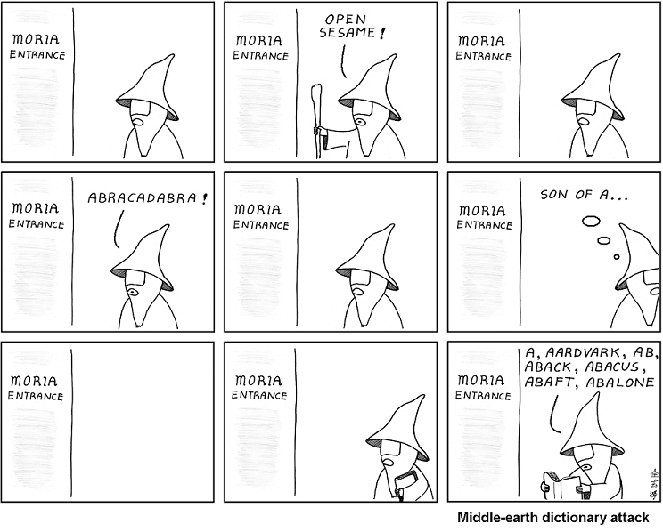
abstrusegoose.com

Slide 19
Dictionary attack
Just to spell it out…
Pick a candidate password P, e.g., from a list.
Compute h(P) or look it up in a table of precomputed hashes (see also “rainbow table”).
Compare h(P) to the hashed password.
If it’s a match, then you win: the victim’s “secret” password is P. Use P to masquerade as the victim. The victim loses.
Else go to step 1. Repeat as necessary.
Defenses:
(1) Pick a secret P that is “hard to guess”. (2) Add “salt”.

Slide 20
Password hashing: add salt
Threat model: attacker steals hashed password from server, looks up the hashed password in a table of hashes of likely passwords (precomputed at high cost), and obtains a (candidate) password.
Defense: concatenate password with a salt (a per-user value) before hashing. Then a standard (precomputed) table is useless.
“Hi, this is server. Login please.”
“I’m fflintstone. Password: yabbadabbado.”
Server code:
phash = SHAx(“yabbadabbado” || “fflintstone”);
shash = getStoredHash(“fflintstone”);
verify shash == phash;
Server
(e.g., login program)
Fred
“Hi Fred. Welcome back.”
…

Slide 21

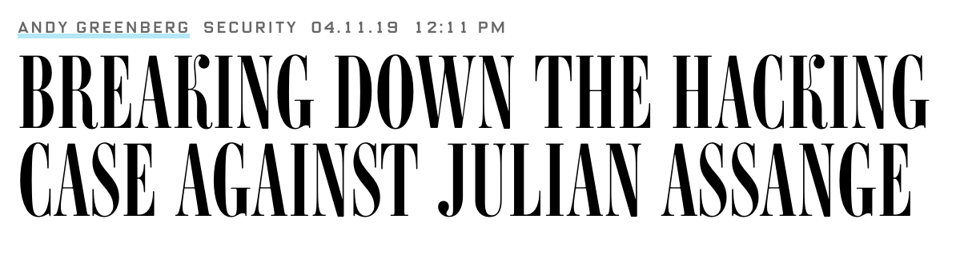
As WIRED first reported in 2011, prosecutors in Chelsea Manning's case asserted at the time that Assange had offered to help Manning crack a password "hash," a form of scrambling designed to protect stored passwords from abuse. Hashing irreversibly converts a password into another string of characters, but hackers often use lists of pre-computed hashes from millions of passwords, known as rainbow tables, to search for a matching hash, revealing the hidden password.
In a pretrial hearing in Manning's case, prosecutors presented evidence that Manning had asked Assange…if he had experience cracking hashes. Assange allegedly responded that he possessed rainbow tables for that, and Manning sent him a hashed password string. According to Thursday's unsealed indictment, Assange followed up two days later asking for more information about the password, and writing that he'd had "no luck so far." The indictment further alleges that Assange actively encouraged Manning to gather even more information, after Manning said she had given all she had.
It's not clear if Assange ever successfully cracked the password.

Slide 22
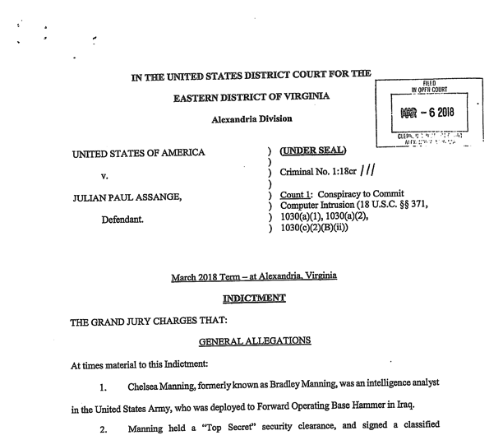

Slide 23
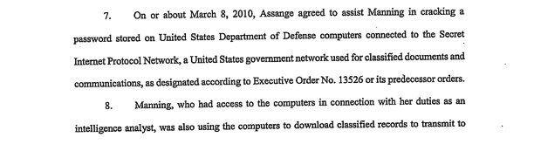
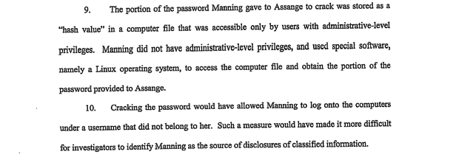
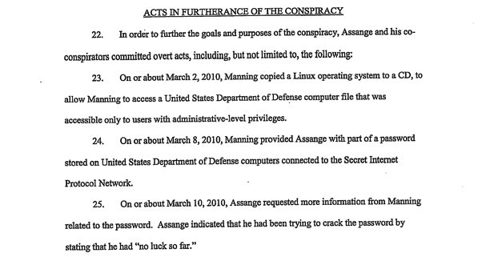

Slide 24
Let’s get this right
X
X
#
SHA1
Hashing is not encryption.
“One way” → No way to decrypt!
No keys!
Client uses password to login, and not the hash.
If the hash alone is sufficient to log in, then an attacker who gains access to the hashed password file can compromise all accounts, even without knowing the “real” passwords!
The goal is not to protect the password in transit: we use encryption for that. We want to protect it “at rest” on the server.
Server must remember something about a password so that it can verify it, but a hash is “good enough”: the server doesn’t need to remember the password itself.
So: server stores the hash, and forgets the password.
“Computationally infeasible”

