Slide 1

Crypto for Busy People
Jeff Chase
Duke University

Slide 2



Principals in a networked system
Principals are users or organizations, or software entities acting on their behalf.
Mallory
Bob
attack
How can principals communicate securely? How do they decide whom to trust?
Alice

Slide 3
Alice and Bob
Alice and Bob want to communicate securely.
How can they authenticate one another?
How can Alice verify that each message from Bob is not modified in transit by an adversary? (integrity)
How can Bob send private messages that Alice can read?
What assumptions must we rely on?

Slide 4


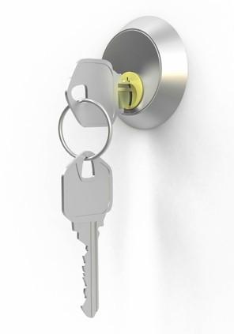

Crypto primitives
Encrypt/Decrypt
Use a shared secret key
(symmetric)
or
use a keypair
one public, one private
(asymmetric)
Signing
Secure hashing
useful for
fingerprinting data

Slide 5



Cryptography for Busy People
Standard crypto functions parameterized by keys.
Key is a fixed-width “random” value (width matters!)
Symmetric (DES): fast, requires shared key: K = K1 = K2
Asymmetric (RSA): slow, uses two keys: a keypair {K1, K2}
“Believed to be computationally infeasible” to break
M
Message
(plaintext)
{M}_{K1}
Encrypted version of M
(ciphertext)
Encrypt
K1
E
M
Decrypt
D
K2
[Image: Landon Cox]

Slide 6
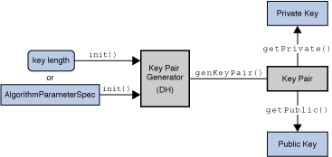
Asymmetric (public key) crypto
Each subject/principal possesses a keypair.
Decrypt(K, Encrypt(K⁻¹, M)) = M
Keep one key private; the other is public.
Either key can be used to encrypt/decrypt.
Anyone can mint a keypair.

Slide 7

Asymmetric crypto works both ways
Crypt
E
A’s private key
or
A’s public key
Crypt
D
A’s public key
or
A’s private key
[Landon Cox]

Slide 8
How to use asymmetric crypto?
Consider:
A sends a message to B, encrypted with A’s private key.
B sends a message to A, encrypted with A’s public key.
Benefits? Other possibilities?

Slide 9
How to use asymmetric crypto?
If B knows A’s public key, that is sufficient for:
A→B messages: authenticated but not secret.
B→A messages: secret but not authenticated.
A and B can communicate securely in both directions if they each know the other’s public key. (How? Later.)

Slide 10
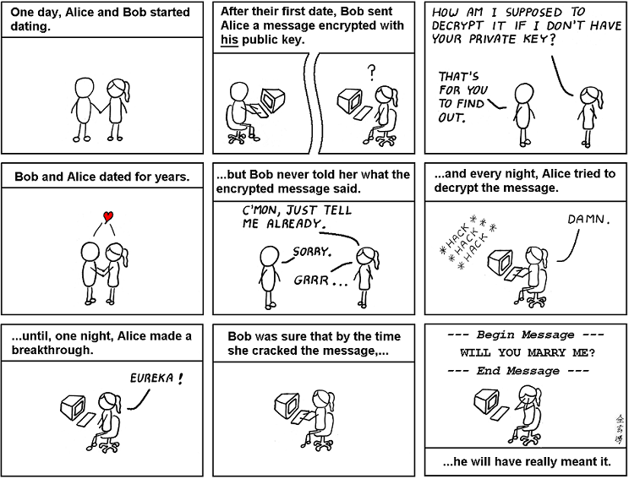
abstrusegoose.com

Slide 11
Spelling it out
Do encrypt message M with your private key to authenticate it, i.e., to convince the recipient that M really came from you.
Better yet, digitally sign M: that’s faster (later).
Do encrypt M with the recipient’s public key to keep it secret: only the intended recipient can decrypt it.
Don’t encrypt M with your public key: it’s just weird and pointless, since nobody else can read the encrypted message. Bob probably blew his chances with Alice.
Don’t encrypt M with the recipient’s private key: if you know someone’s private key then you should not use it! Forget it and don’t tell anyone.

Slide 12
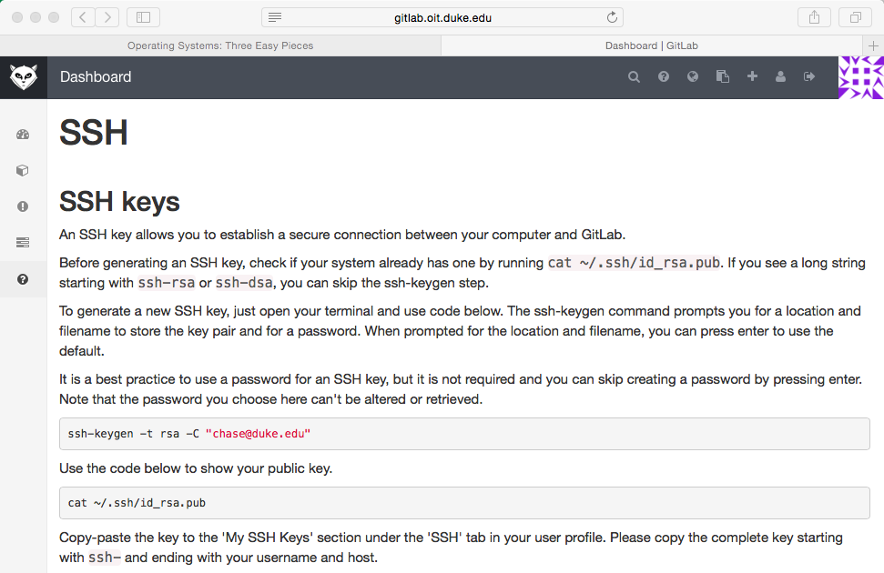
ssh@git
Anyone can mint a keypair.

Slide 13
Example: ssh@git
The git process (command) knows your private key.
It is in a file in directory ~/.ssh.
It might be password-protected (or not).
The git server (gitlab, github) knows your public key.
You told the server.
The server knows it was you.
Because you logged in with your password.
And your server session was “secure” (later).
Thus the server can know that your pushes and pulls come from you and have not been tampered.

Slide 14
Symmetric Crypto
“Secret key” or “private key” cryptography.
DES, 3DES, DESX, IDEA, AES
Sender and receiver must possess a shared secret
Shared key K [a random bit string of chosen length]
K = K1 = K2
Message M, Key K
{M}_{K} = Encrypt(M, K)
M = Decrypt({M}_{K} , K)

Slide 15
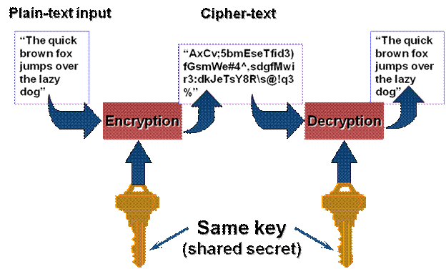
Symmetric crypto
Borrowed from https://spideroak.com/blog/20130523083520-drink-your-ovaltine-intro-to-encryption-101

Slide 16
Hybrid cryptosystems
Symmetric crypto is much cheaper than asymmetric (10Kx).
But asymmetric is useful to “bootstrap” communication.
All it takes is knowledge of another party’s public key, and it is not necessary to keep the public keys secret.
These properties motivate hybrid cryptosystems that combine techniques for practical solutions.
“As for SpiderOak, our old clients used a combination of 2048 bit RSA and 256 bit AES. Now new clients use 3072-bit RSA combined with 256 bit AES to meet industry recommendations. We use this mixture of techniques where each is best suited: asymmetric encryption for communications channel setup and key exchange, and symmetric encryption for internal data structures and improved client performance.”
August 2013: https://spideroak.com/blog/20130523083520-drink-your-ovaltine-intro-to-encryption-101

Slide 17

Better together
Use asymmetric crypto to “handshake” and establish a secret session key (slow, but allows for key distribution).
Then use the session key for symmetric crypto (fast and cheap)
Example: Secure Sockets Layer (SSL) or Transport-Layer Security (TLS), used in HTTPS (Secure HTTP), SSH, SCP, etc.
“TCP SYN, etc.”
“My public key is K.”
“Let’s establish a session key: {S}_{K} .”
Client
{M}_{S}
Server
[encrypted data or content]
…
Note: this depiction of SSL/TLS is cartoonishly oversimplified (more later).

Slide 18
“Key points” about basic cryptosystems
Anyone can generate a key or a keypair. It’s cheap enough to be practical. (But generating keypairs is costly enough to try to avoid.)
Choose your key length wisely. Smaller keys are cheaper to generate and use, but also easier to break.
All cryptosystems rely on two basic assumptions: the parties know their shared keys, and nobody else knows their secret keys.
Never forget it: crypto is only as secure as the keys. A well-resourced adversary can penetrate your system to “recover” stored keys.
Change (rotate) keys as appropriate. The longer they are in use, the more likely they are to be compromised.
Protocols must be designed to defend from replay attacks, in which an attacker can subvert the protocol without breaking the crypto!

Slide 19


Follow best practices for crypto, from authoritative sources. Best practices change frequently! Key sizes must grow as computational power increases.
Cryptographic Key Management Project
Cryptographic Key Management (CKM) is a fundamental part of cryptographic technology and is considered one of the most difficult aspects associated with its use. Of particular concern are the scalability of the methods used to distribute keys and the usability of these methods. NIST has undertaken an effort to improve the overall key management strategies used by the public and private sectors in order to enhance the usability of cryptographic technology, provide scalability across cryptographic technologies, and support a global cryptographic key management infrastructure.
[http://csrc.nist.gov/groups/ST/key_mgmt/]

Slide 21
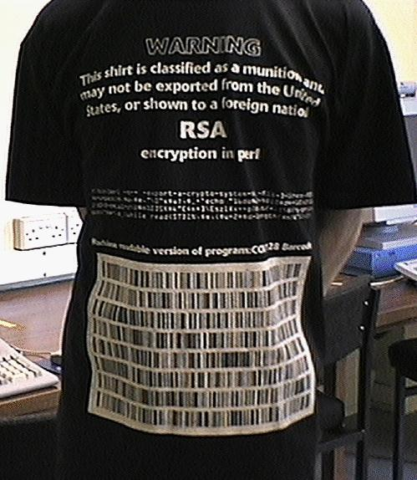
Reflections on crypto
A few decades ago, the US government controlled user access to crypto.
Activist released PGP for public use, 1991.
Federal crime?
“The crypto genie is out of the bottle.”
Foundational technology!
Grew out of curiosity-driven pure math (number theory).
Basic tool of safe living in a dangerous world.
By Adam Back &lt;adam@cypherspace.org&gt; - http://www.cypherspace.org/adam/rsa/uk-shirt.html, CC0, https://commons.wikimedia.org/w/index.php?curid=33690288
https://en.wikipedia.org/wiki/Crypto_Wars

Slide 22
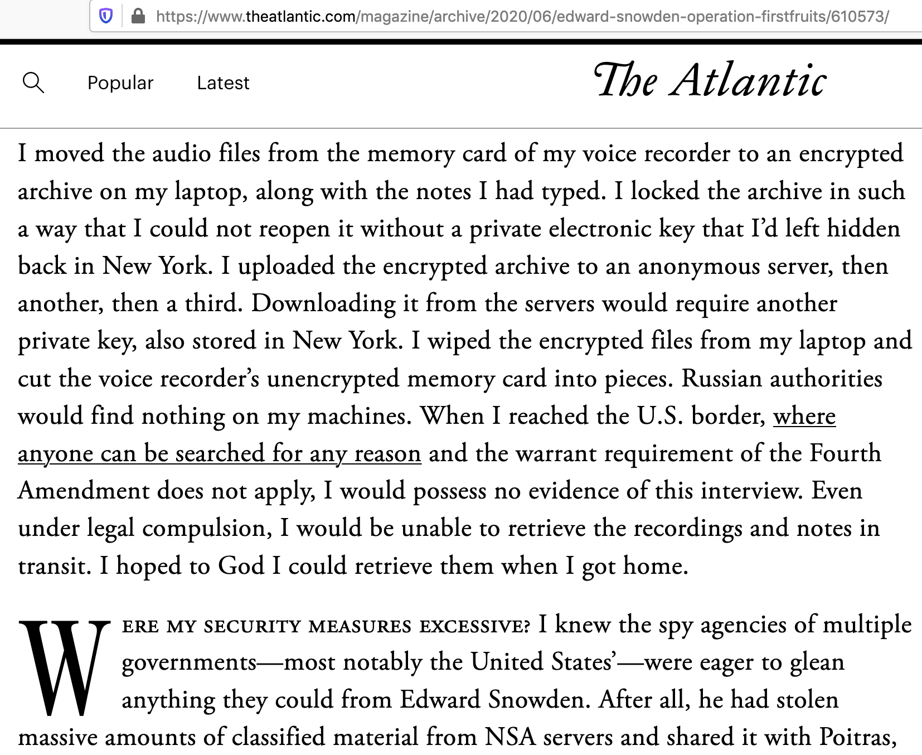

Slide 23
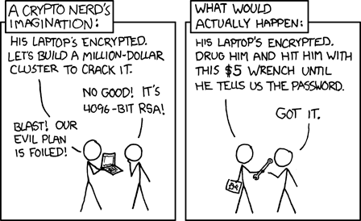
First principle of security: the weak link

