Slide 1
Block maps
Large storage objects (e.g., files, segments) may be mapped so they don’t have to be stored contiguously in memory or on disk.
object
Idea: use a level of indirection through a map to assemble a storage object from “scraps” of storage in different locations.
The “scraps” can be fixed-size slots: that makes allocation easy because the slots are interchangeable (fixed partitioning). Fixed-size chunks of data or storage are called blocks or pages.
map
Examples: page tables that implement a VAS.
One issue now is that each access must indirect through the map…

Slide 2
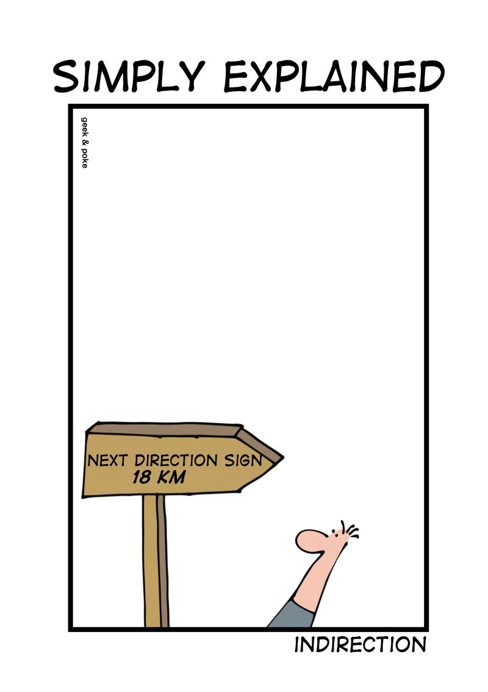
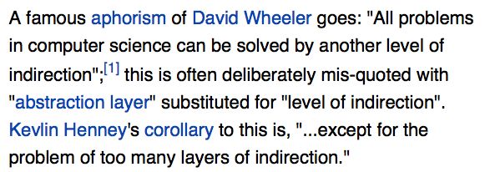
Indirection

Slide 3
To put it another way
Variable partitioning is a pain. We need it for heaps, and for other cases (e.g., address space layout).
But for files we can break the objects down into “pieces”.
When access to files is through an API, we can add some code behind that API to represent the file contents with a dynamic linked data structure (a map).
If the pieces are fixed-size (called pages or logical blocks), we can use fixed partitioning to allocate the underlying storage, which is efficient and trivial.
With that solution, internal fragmentation is an issue, but only for small objects. (Why?)
That approach can work for VM segments too: we have VM hardware to support it (since the 1970s).

Slide 4
Virtual memory
Memory
0:
Page Table
1:
Virtual
Addresses
Physical
Addresses
0:
1:
CPU
P-1:
N-1:
Disk
VMs (or segments) are storage objects described by maps. A page table is just a block map for one or more VM segments. The page tables (e.g., one for each process) are stored in memory. As threads reference memory, the machine uses the current page table to translate the virtual addresses. The MMU hardware hides the indirection from user programs.
CMU 15-213

Slide 5
Cartoon view of a page table
process page table (map)
This is an example. Any PFN may be used for any VPN.
PFN x
PFN y
The map itself is just another data structure stored in memory.
A protected CPU register holds the machine address of the current map.
PFN i
PFN i
+
offset
VPN #i
offset
virtual address
machine memory
page frames
Virtual page: a logical block in a segment.
VPN: Virtual Page Number (a logical block number).
Page frame: a physical block in machine memory.
PFN: Page Frame Number (a block pointer).
PTE: Page Table Entry (an entry in the block map).
VPN = VA DIV PAGE_SIZE
Offset = VA MOD PAGE_SIZE

Slide 6

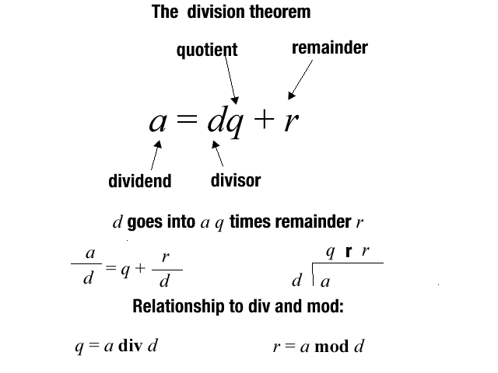
DIV/MOD is easy (in base ten)
Suppose I have a pocketful of dimes and pennies.
Suppose I count out 58 cents.
How many dimes?
How many pennies?
Think of it this way:
My money is in blocks of 10 units.
The pennies are an offset in the block.
The math is easy: just shift/mask!
DIV and MOD are trivial if the divisor is the base of the number system (e.g., 10).

Slide 7
“Making change” in binary or hex
To divide (DIV) by 2^{n}, shift right by n bits.
Drop off the low-order n bits: C “>>” operator.
The result is your logical block number or VPN.
The MOD (remainder) is just the low-order n bits.
remainder = x AND (2^{n} – 1): C “&” operator (bitwise AND)
That’s your offset.
Note: ALIGN is also easy, e.g.:
Round up to the nearest dime: “keep the change”.
Add 10, then DIV.
12
virtual address
VPN
offset
4K page = 2¹² bytes
12 bits

Slide 8
Virtual Address Translation
Example only: a typical 32-bit architecture with 4KB pages.
{
12
virtual address
0
VPN
offset
Virtual address translation maps a virtual page number (VPN) to a page frame number (PFN/PPN) in machine memory: the rest is easy.
address
translation
Deliver fault to
OS if translation is not
valid and accessible in
requested mode.
{
+
machine address
(e.g., physical address)
PFN
offset

