Slide 1

Synchronization: layering

Slide 2
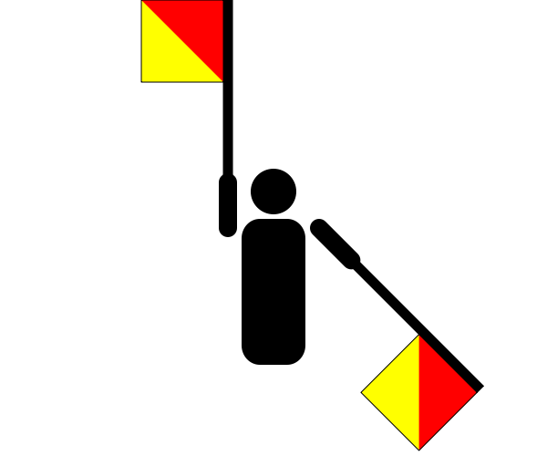
Semaphore
Now we introduce a new synchronization object type: semaphore.
A semaphore is a hidden atomic integer counter with only increment (V) and decrement (P) operations.
Decrement blocks iff the count is zero.
Semaphores handle all of your synchronization needs with one elegant but confusing abstraction.
V-Up
int sem
P-Down
if (sem == 0) then
until a V
wait

Slide 3
Example: binary semaphore
A binary semaphore takes only values 0 and 1.
It requires a usage constraint: the set of threads using the semaphore call P and V in strict alternation.
Never two V in a row.
P-Down
P-Down
1
0
wait
wakeup on V
V-Up

Slide 4

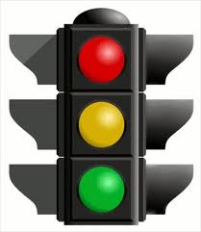
A mutex is a binary semaphore
A mutex is just a binary semaphore with an initial value of 1, for which each thread calls P-V in strict pairs.
Once a thread A completes its P, no other thread can P until A does a matching V.
V
P
P
V
P-Down
P-Down
1
0
wait
wakeup on V
V-Up

Slide 5
Ping-pong with semaphores
blue->Init(0);
purple->Init(1);
void
PingPong() {
while(not done) {
blue->P();
Compute();
purple->V();
}
}
void
PingPong() {
while(not done) {
purple->P();
Compute();
blue->V();
}
}

Slide 6
Basic producer/consumer
empty->Init(1);
full->Init(0);
int buf;
int Consume() {
int m;
full->P();
m = buf;
empty->V(); return(m);
}
void Produce(int m) {
empty->P();
buf = m;
full->V();
}
This use of a semaphore pair is called a split binary semaphore: the sum of the values is always one.
Basic producer/consumer is called rendezvous: one producer, one consumer, and one item at a time. It is the same as ping-pong: producer and consumer access the buffer in strict alternation.

Slide 7
Basic barrier
blue->Init(1);
purple->Init(1);
void
Barrier() {
while(not done) {
blue->P();
Compute();
purple->V();
}
}
void
Barrier() {
while(not done) {
purple->P();
Compute();
blue->V();
}
}

Slide 8
Semaphore
Step 0.
Increment and decrement operations on a counter.
But how to ensure that these operations are atomic, with mutual exclusion and no races?
How to implement the blocking (sleep/wakeup) behavior of semaphores?
void P() {
s = s - 1;
}
void V() {
s = s + 1;
}

Slide 9
Semaphore
void P() {
synchronized(this) {
….
s = s – 1;
}
}
void V() {
synchronized(this) {
s = s + 1;
….
}
}
Step 1.
Use a mutex so that increment (V) and decrement (P) operations on the counter are atomic.

Slide 10
Semaphore
synchronized void P() {
s = s – 1;
}
synchronized void V() {
s = s + 1;
}
Step 1.
Use a mutex so that increment (V) and decrement (P) operations on the counter are atomic.

Slide 11
Semaphore
synchronized void P() {
while (s == 0)
wait();
s = s - 1;
}
synchronized void V() {
s = s + 1;
if (s == 1)
notify();
}
Step 2.
Use a condition variable to add sleep/wakeup synchronization around a zero count.
(This is Java syntax.)

Slide 12
Semaphore
synchronized void P() {
if (s == 0)
………….;
s = s - 1;
ASSERT(s >= 0);
}
synchronized void V() {
s = s + 1;
……….
}

Slide 13
Semaphore
Loop before you leap!
Understand why the while is needed, and why an if is not good enough.
synchronized void P() {
while (s == 0)
wait();
s = s - 1;
ASSERT(s >= 0);
}
synchronized void V() {
s = s + 1;
signal();
}
Wait releases the monitor/mutex and blocks until a signal.
Signal wakes up one waiter blocked in P, if there is one, else the signal has no effect: it is forgotten.
This code constitutes a proof that monitors (mutexes and condition variables) are at least as powerful as semaphores.

