Slide 1


Discover Me
A Mobile App for Research Participants
Cameron Wilson, Emily Adams, Jonny Flint, Lara Johnson
Iterative Insights

Slide 2





The Team
LARA JOHNSON
EMILY ADAMS
JONNY FLINT
CAMERON WILSON
Team Leader and Data Science Lead
Longitudinal Studies Lead
Data Platform and Mobile App Developer Lead
Mental Health Lead

Slide 3
Defining the scope of our project
Threshold
Retention
Continuous
Retention
Recovery

Slide 4
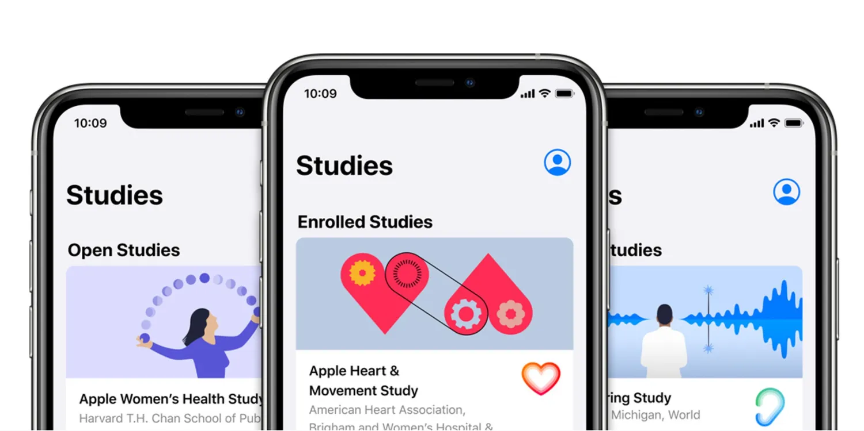

Apps in research
Benefits
Citizen scientist; Personalised insights
Motivational design
Data can be synchronised quickly
Increase representativeness ^{(1, 2)}
Longitudinal Research
Perspective

Slide 5




Discover Me – a Mobile App
Examples of research projects that could use Discover Me
Longitudinal Research
Perspective
Notes:
Does the app formatting stay the same for different research/clinical trails?

Slide 6







Mobile App Platform
Q1. How does your design improve the long-term retention of participants with mental health problems in a clinical research study?
Focusing on the front-end for participants
Platform
Mascot
Data Collection
User Preferences
User Feedback and Support
Personalised Insights and Interactive Chatbot
Active
Implicit
Passive
Longitudinal Research
Perspective

Slide 7

Features Across Ages
Interactive Mascot
Personalised Insights
~69% of U.S. adults track personal metrics
19–29-year-olds more likely to use a personalised health app ⁽⁴⁾
Effective with Duolingo, Snapchat, Tamagotchi
Gamification to engage and retain younger audiences ⁽³⁾
Longitudinal Research
Perspective
Notes:
https://mhealth.jmir.org/2018/4/e86

Slide 8


Incorporating Lived Experience
Olivia
Farid
Female
Middle Income
Male
Ethnic Minority
Q3. How have you considered the needs and requirements of research participants and researchers?
Scott
Male
Low Income
Mental Health Perspective

Slide 9


13
Enrols in study
Experiencing an ‘Other specified feeding or eating disorder’ (OSFED).
Will receive parental support to participate.
Has unrestricted access to a smartphone.
Olivia
Socioeconomic status: Middle Income
Rural, small Scottish village near Aberdeen
18
Begins university
Schooling: Private
In recovery from ED
Finds it difficult to remember to complete surveys.
Likes to get the ‘insights’ delivered.
Factors which could influence retention
Research burden
23
Participation Incentive
Research experience for future career and wants to make a difference for others experiencing OSFED
Junior doctor
New professional life limits prioritisation of engagement in the study
Mental Health Perspective

Slide 10
13
Enrols in study
Experiencing adverse childhood events
Has unrestricted access to a smartphone
No consistent support to study participation
Scott
18
Socioeconomic status: Low Income
Leaves school
Urban, Drumchapel Glasgow
No further education
Working in construction but high risk of incarceration
Mental health flare-ups include suicide attempts
Schooling: State
23
Factors which could influence retention
Mental health flare-up and Chaotic lifestyles
In temporary accommodation
No fixed address therefore only consistent contact is a mobile phone.
Diagnosed with multiple complex mental health conditions.
Not engaging with available mental health support.
Participation Incentive
Support through the intervention and financial compensation for each completed stage of the study.
Mental Health Perspective

Slide 11
13
Enrols in study
Family seeking asylum and English is a second language
Experiencing anxiety and depression but not as yet clinically diagnosed.
Culturally different views of mental health
Farid
18
Socioeconomic status: Low Income
Begins university
Urban, central Newcastle
Attending university to study computer science
Has episodic depression and anxiety now actively seeking support
Research app is not a priority
Schooling: State
23
Working in graduate job
Factors which could influence retention
Loss of interest
Has an entry-level graduate job in computer science
App is less interesting and too much like his day job
Financial incentives to support studies and personalised insights from data
Participation Incentive
Mental Health Perspective

Slide 12

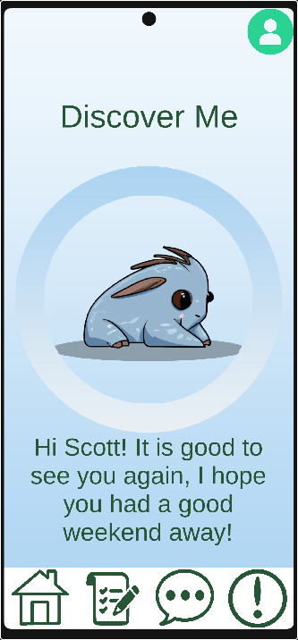
Demo of Prototype
Mobile App Developer
Perspective

Slide 13




BIRTHDAYS
MILESTONES
Additional Continuous
Retention Strategies
NOTIFICATION CUSTOMISATION
GAMIFICATION AND INTERACTION BONUSES

Slide 14

Predicting Drop-out
Individual Characteristics
App Usage
Research Satisfaction
Retention
Inclusivity – retaining a breadth of participants
Data Science
Perspective

Slide 15

Calculate Attrition Risk Scores
Stratified Risk
Threshold Retention
Ethnicity
Socioeconomic Class
Co-morbidities
Condition
Low Risk
High Risk
Data Science
Perspective

Slide 16


EMBEDDING PEER SUPPORT WORKERS INTO RESEARCH
Invite participants at risk of drop-out to support other participants
Threshold
Retention Strategies
SETTINGS
Participant gives permission for researchers to contact them
ABSENCE MESSAGES
For symptom tracking: "Haven't seen you for a while. Have you experienced any symptoms while you were away?"

Slide 17



Evaluating Impact (Retention)
App Usage Metrics
Annual Attrition Rate
Overall Participant Retention Rate
Short Term
Long Term
Q2. How would you evaluate the impact of your application? How could you discover utility of the application and likelihood of success in ten years within a shorter time period?
Data Science
Perspective

Slide 18
Benchmarks of Success
<5-20%
~26%
>30%
Target Attrition ⁽⁵⁾
Average Attrition in Longitudinal Research
(Clinical Trials and Non-Clinical Studies) ⁽⁵⁾
Attrition in Mental Health Research in Young Adults over 2 years ⁽⁶⁾
Longitudinal Research
Perspective

Slide 19
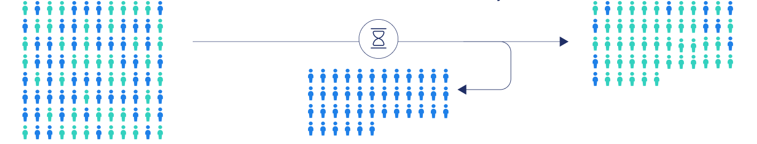
Evaluating Impact (Inclusivity)
The selective dropout of participants who systematically differ from those who remain in the study
Attrition Bias
Wave 1
Wave N
Participants in certain strata drop out

Slide 20
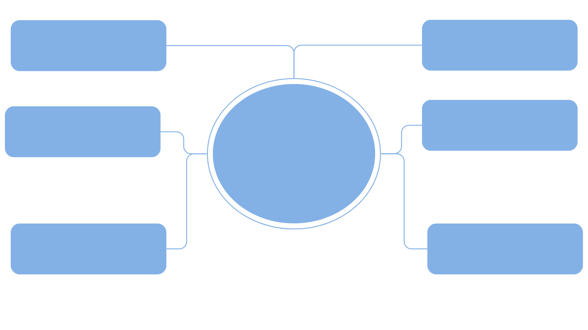

Conclusion
REPRESENTATIVE DATA
MASCOT
PERSONALISED AND TARGETED TREATMENT
CHATBOT
INCLUSIVE AND EFFECTIVE POLICIES
PERSONALISATION

Slide 21
References
Fischer F, Kleen S. Possibilities, problems, and perspectives of data collection by mobile apps in longitudinal epidemiological studies: scoping review. Journal of medical Internet research. 2021 Jan 22;23(1):e17691.
Amagai S, Pila S, Kaat AJ, Nowinski CJ, Gershon RC. Challenges in participant engagement and retention using mobile health apps: literature review. Journal of medical Internet research. 2022 Apr 26;24(4):e35120.
Boch A, Lucaj L, Corrigan C. A robotic new hope: Opportunities, challenges, and ethical considerations of social robots. Technical University of Munich. 2020:1-2.
Fox S, Duggan M. Tracking for health.
Teague S, Youssef GJ, Macdonald JA, Sciberras E, Shatte A, Fuller-Tyszkiewicz M, Greenwood C, McIntosh J, Olsson CA, Hutchinson D, SEED Lifecourse Sciences Theme Sharyn Bant Sophie Barker Anna Booth Tanja Capic Laura Di Manno Alisha Gulenc Genevieve Le Bas Primrose Letcher Claire Ann Lubotzky Jessica Opie Melissa O’Shea Evelyn Tan Jo Williams. Retention strategies in longitudinal cohort studies: a systematic review and meta-analysis. BMC medical research methodology. 2018 Dec;18:1-22.
Zhang Y, Pratap A, Folarin AA, Sun S, Cummins N, Matcham F, Vairavan S, Dineley J, Ranjan Y, Rashid Z, Conde P. Long-term participant retention and engagement patterns in an app and wearable-based multinational remote digital depression study. NPJ digital medicine. 2023 Feb 17;6(1):25.

