Slide 1
Platform for Long term retention in MH setting – Researcher Front End
Team StaffsHealth

Slide 2
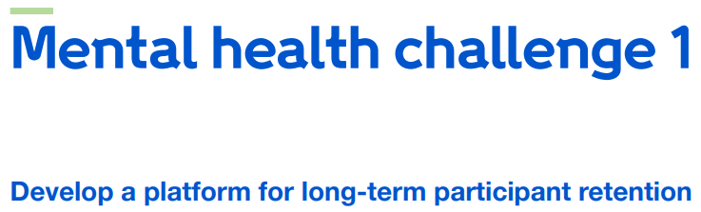
The challenge

Slide 3
The TEAM
Research Team | Personal attributes | Skills and expertise
Dr Robert Cook (PI) | Technical gremlin and data gubbins | Framework development, programming, implementation, analysis
Dr Md Asaduzzaman (Co-I) | Disruptor and critical thinker | Statistician/machine learning modeller, validation, verification and quality assurance
Dr Sarahjane Jones (Co-I) | Big picture thinker, jigsaw maker and cat herder | Research/data ethics, research governance, data and medical device legislation, partnerships and engagement
Test text

Slide 4
Imagined User Stories
Claire is:
a community mental health research nurse.
has just began working as an embedded researcher in a team trialling guided self-help for anxiety
has her own case load and is responsible for organising focus groups and following up with service users.

Slide 5
Imagined User Stories
Can we make their workflow easier?
Improve the methods of contact:
Allow service users to respond to communications, and be heard
Triage incoming messages for escalation/ safeguarding
Auditability:
If some work is shared – how do we know who sent the last contact or when?
When was the last time a particular service user engaged?
Automated investigation:
Detect emerging trends in demand/ shifts in demographics
Flag up service users who appear at risk of loss

Slide 6
Context
CRM (Customer Relationship Management) software exists. It:
Logs customer information to generate leads and assist in sales
Enables individuals from across an organisation to share information
Hosts the information in structured storage for analysis

Slide 7
context
What doesn’t a CRM do?
Communication is one way
They have little concept of safe-guarding
They treat customers as external bodies, not as engaged individuals.

Slide 8
The concept
What if we take the structure of the CRM and build a Participant Relationship Management (PRM) system?

Slide 9
The concept
We need a system built to focus on:
Understanding the needs of service users and participants
Simplifying communication
Highlighting individuals at high risk of withdrawing
Learning what might work for a new service user
Ease of audit

Slide 10
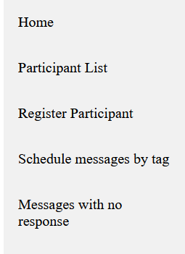
The prototype
To bring these facets together we need a data platform:
Always online
Interoperable with a range of communication tools
Extendable
Simple to re-style
All of the data going to a persistent backend for backup/ security

Slide 11
Q1. How does your design improve the long-term retention of participants with mental health problems in a clinical research study?
A key driver for retention is the removal of barriers, and broadening knowledge. Leveraging digital tools to improve communication (both the breadth and ease of different methods) will minimize barriers to involvement and enable the service delivery teams to have an easier route for communication. In addition, by creating a two way route of communication participants can feel more involved and heard, and drive retention.

Slide 12
Q2. How would you evaluate the impact of your application? How could you discover early utility of the application and likelihood of success in ten years within a shorter time period?
Retention will be driven by engagement, and what drives engagement will come as we understand the needs of participants. The platform will have the opportunity to succeed in the long term if it can prove capable of reactive development, able to identify and implement the workflows and features teams require to better communicate and identify those individuals most at risk of attrition.

Slide 13
Q3. How have you considered the needs and requirements of research participants and researchers?
The platform has been designed to be extendable to emerging needs and methods of communication. At the moment, we can only design around those use cases obvious to us – which is why the proposed project includes a series of advisory groups to iterate on real world scenarios and experiences from both service delivery and user groups. For the researchers, we aim to have the platform able to be provide easy summaries of open tasks and patient overviews to aid auditing and minimize time requirements.

