Slide 1

Monthly Wellness Data
JULY 2026

Slide 2
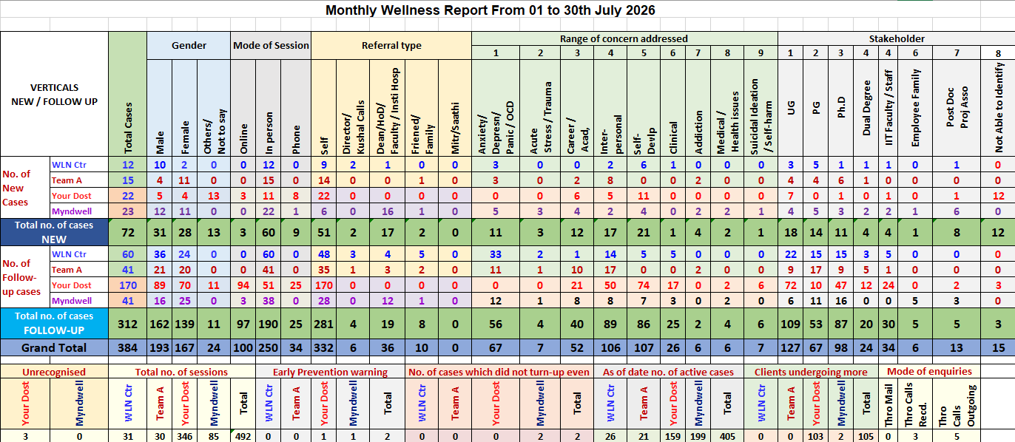

Slide 3
Wellness Data- Report
VERTICALS
TOTAL
JULY 2026

Slide 4
Wellness Data- Report
VERTICALS NEW CASES
JULY 2026

Slide 5
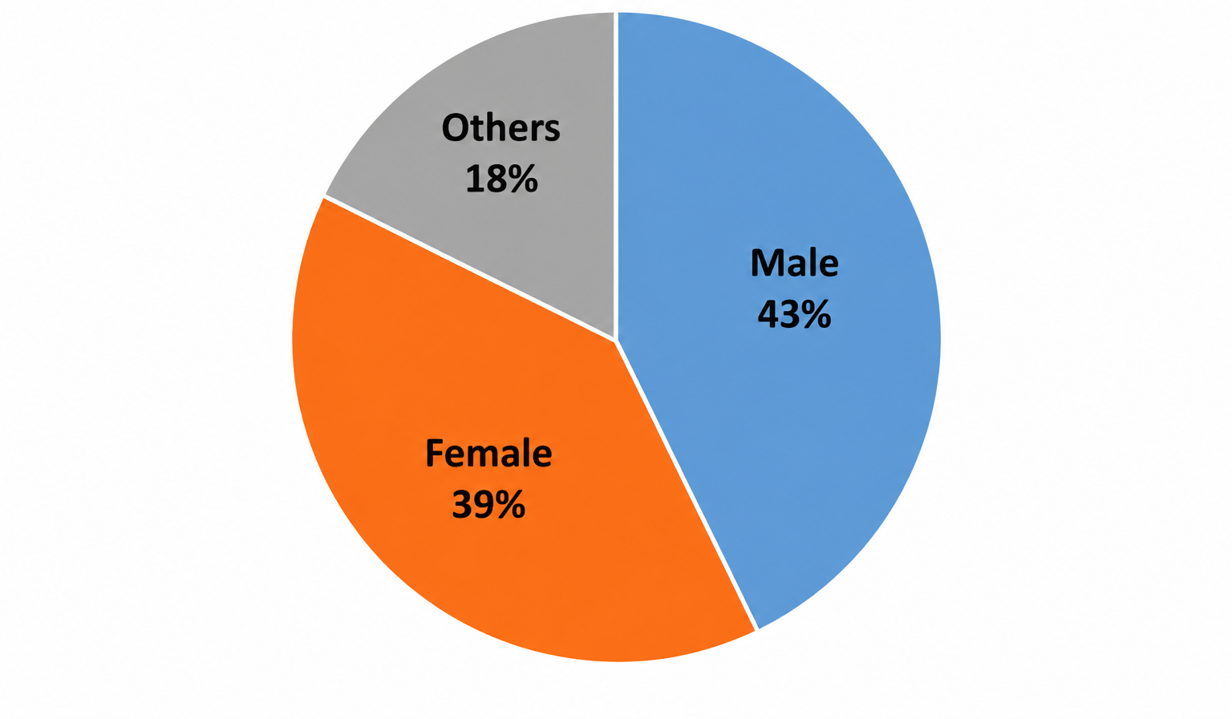
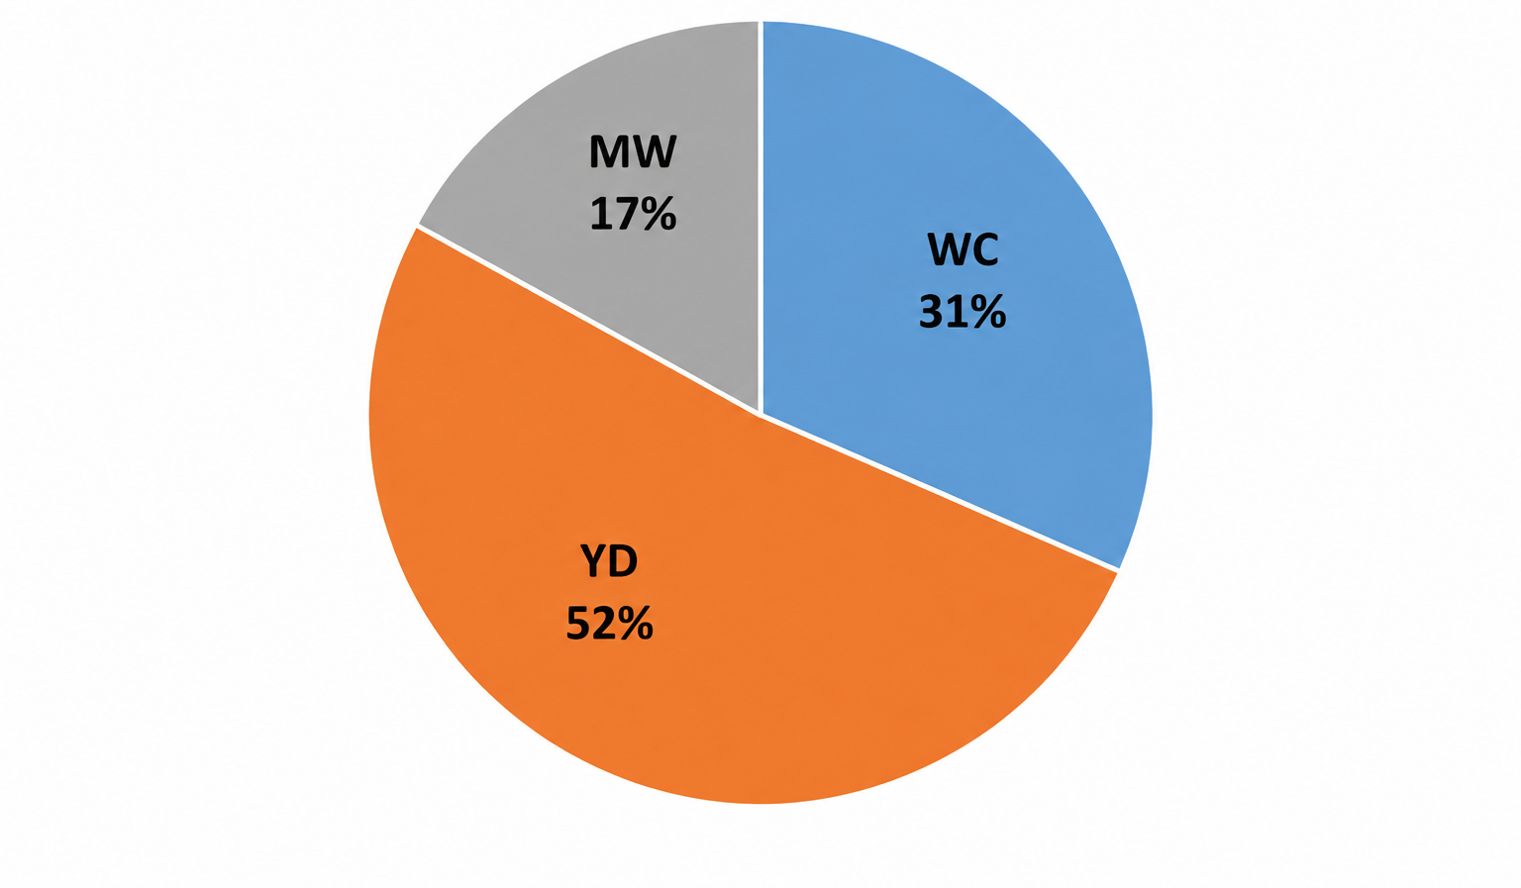
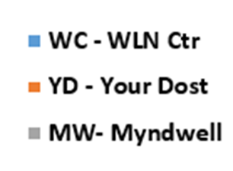
Wellness Data- Report
VERTICALS NEW CASES – GENDER DISTRIBUTION
JULY 2026
VERTICALS FOLLOWUP CASES
JULY 2026

Slide 6
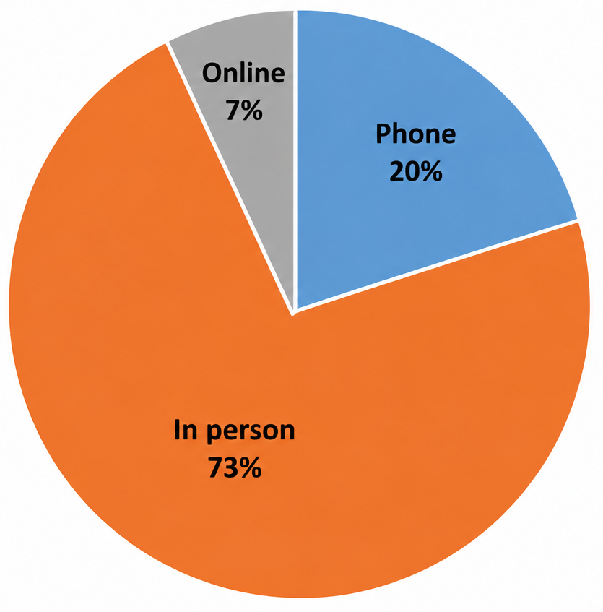
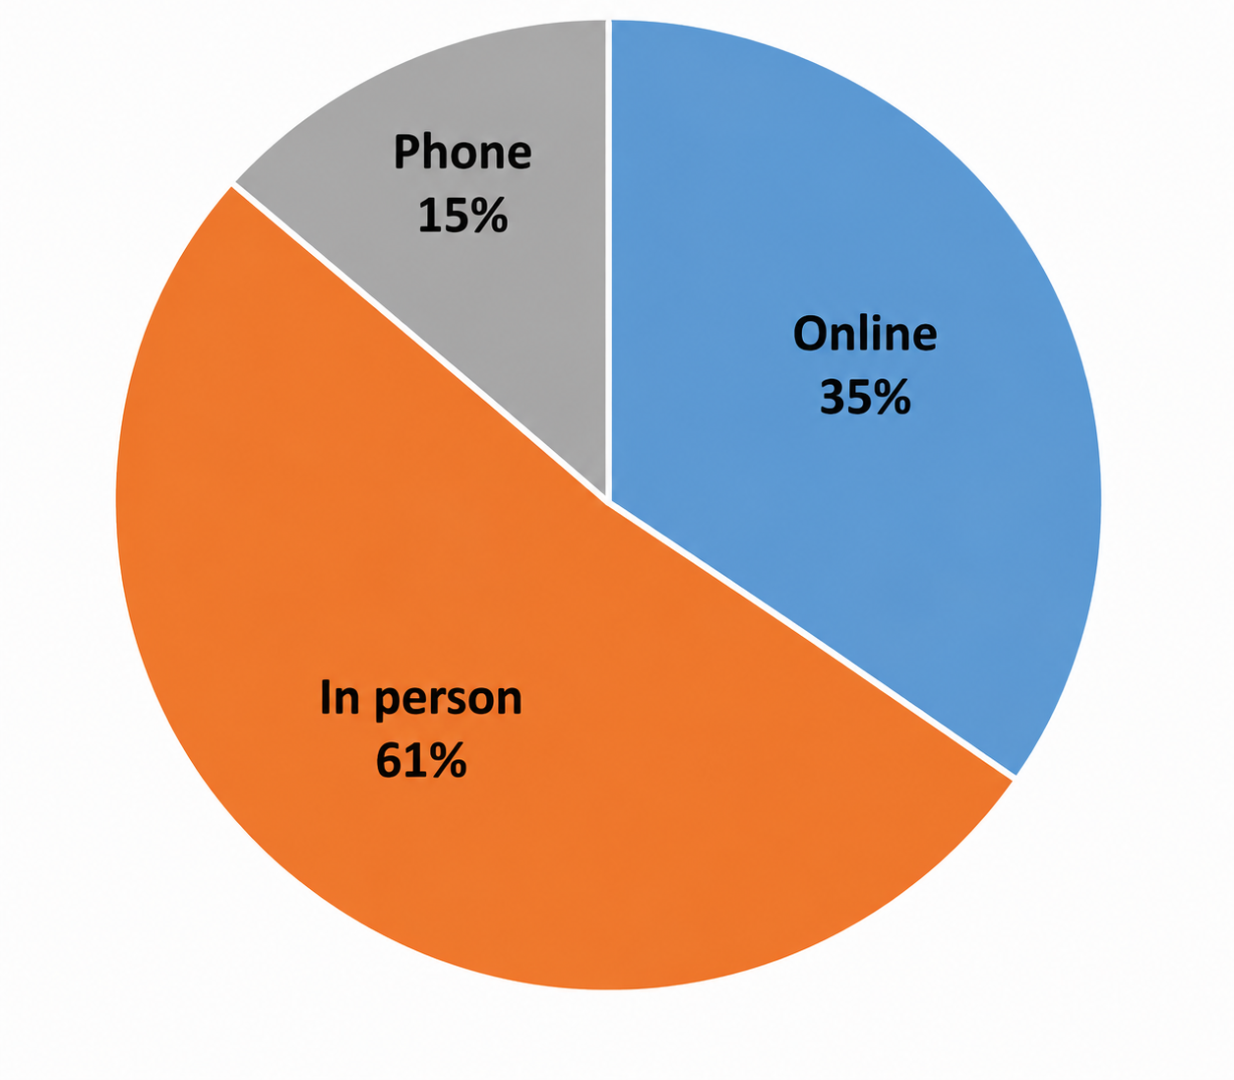
Wellness Data- Report
MODE OF SESSION – NEW CASES
JULY 2026
MODE OF SESSION – FOLLOW UP CASES
JULY 2026

Slide 7
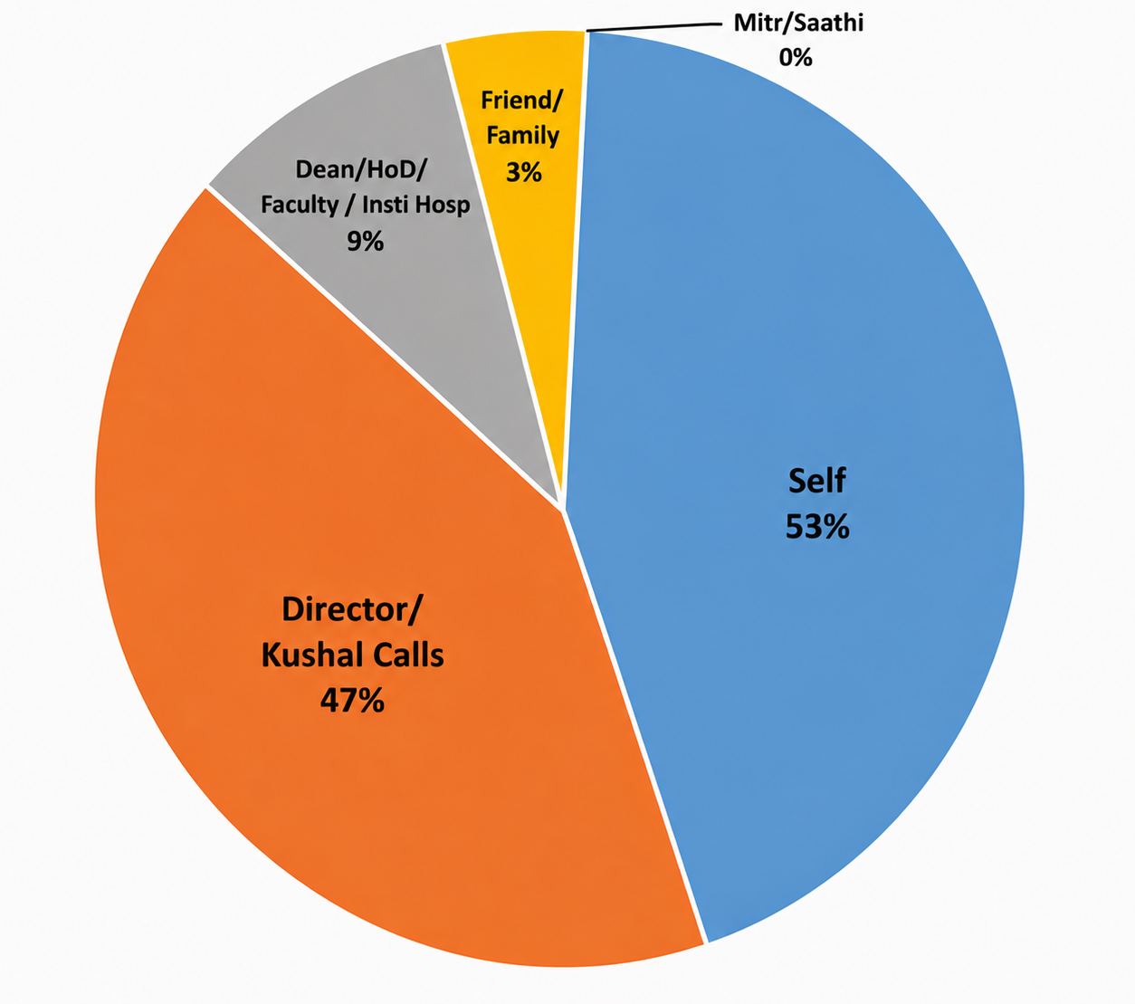
Wellness Data- Report – REFERALS – JULY 2026

Slide 8
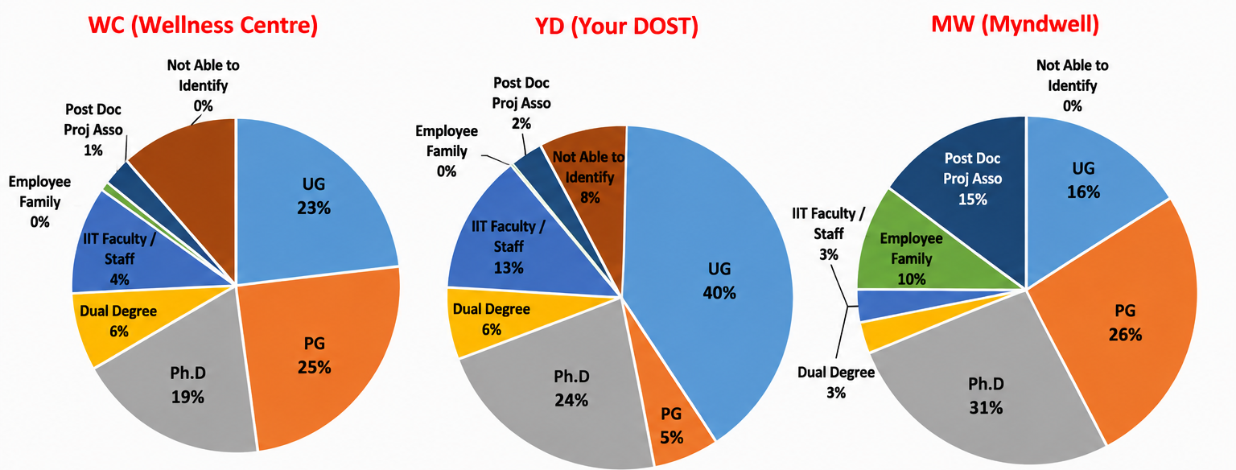
Wellness Data- Report – STAKE HOLDER – JULY 2026

Slide 9
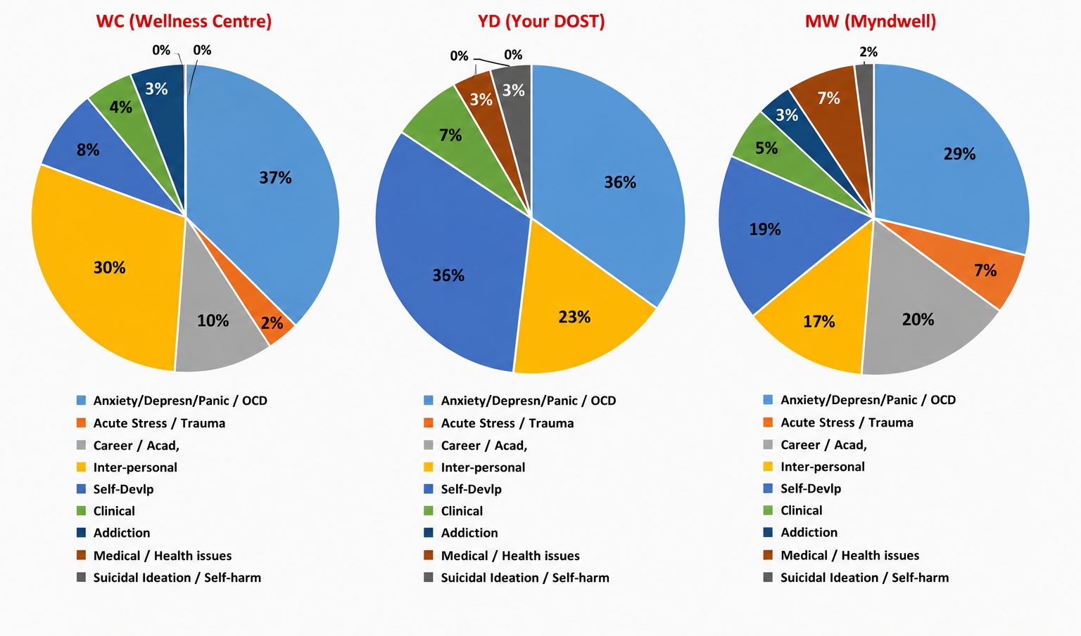
Wellness Data- Report – RANGE OF CONCERN ADDRESSED – JULY 2026

Slide 10
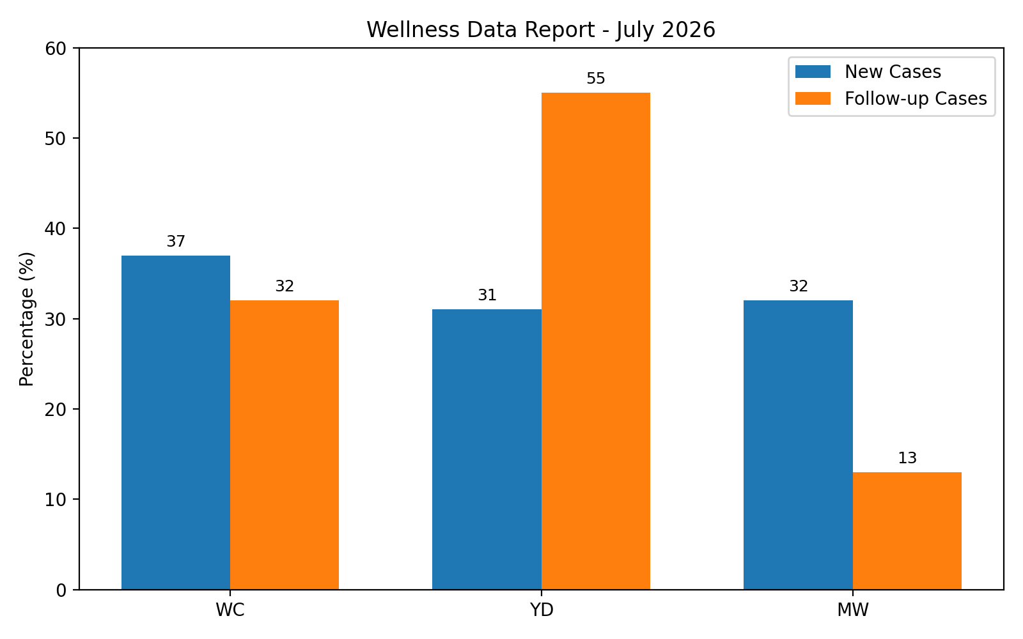

Slide 11

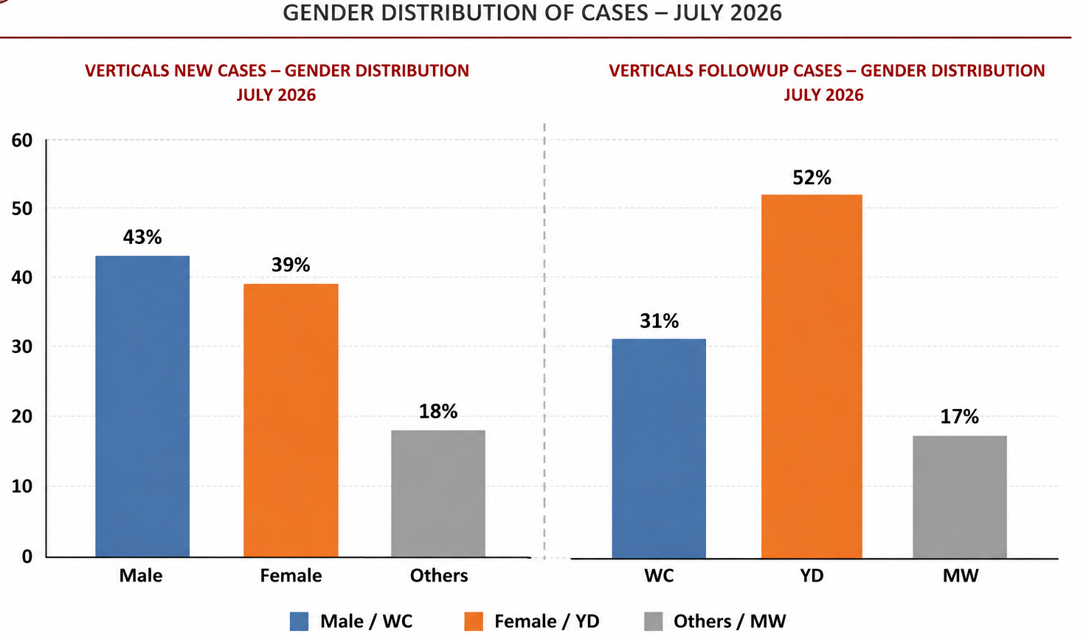
WC
YD
MW
WC
YD
MW

Slide 12
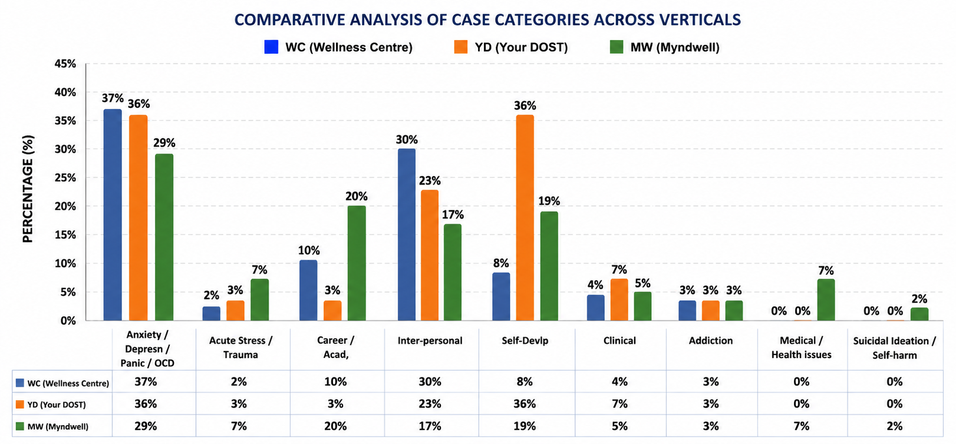
Wellness Data- Report – RANGE OF CONCERN ADDRESSED – JULY 2026

Slide 13
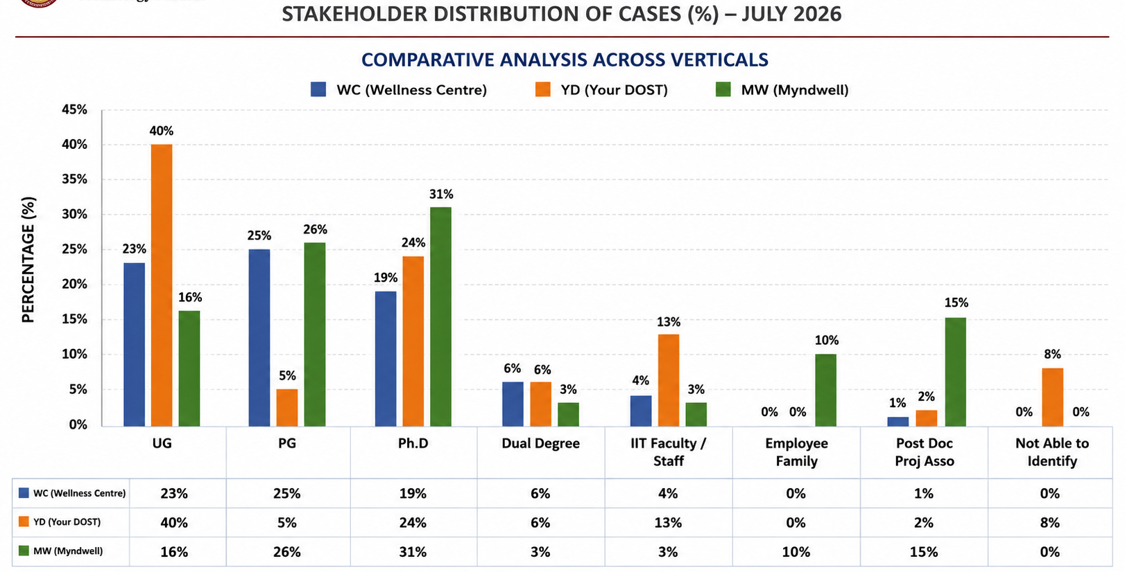
Wellness Data- Report

Slide 14
Wellness Data- Report
Activities completed so far:
Kauvery:
1. Video for Parent Orientation Programme:
Video for PoP, to orient parents towards their child’s mental well-being.
2. Website Support
Assisted the tech team with website structure and guidelines. https://dost.iitm.ac.in/ https://wellness-centre-project.vercel.app
3. Mitr and Saathi orientation events
Conducted games to orient students towards therapy
4. Parental Orientation Pamphlets
Distributed informational pamphlets for the parents (Hindi and English)
Myndwell:
12th & 13th July: Myndwell participated in the "Celebrating Minds: From Academic Excellence to Wellness" event by setting up interactive wellness stalls. Additionally, on 12th July, Dr. Srividya conducted an engaging session on "The Science of Stress," focusing on understanding stress and practical strategies for managing it.
25th July: Myndwell conducted a Parent Orientation session on "Addiction and Its Impact on College Students," aimed at increasing awareness among parents about substance use, behavioral addictions, early warning signs, and ways to support their children effectively.
Yourdost:
1. YourDOST Orientation
Conducted by Ms. Richa
2. The Happiness BootCamp & Wellness with Darts

Slide 15
Wellness Data- Report
Proposed Event:
Kauvery:
ADHD Awareness Programme
Update: Final Draft Competed
Tentative schedule: to be discussed
2. Focus-Group Discussion
Update: Topics consolidated
Tentative schedule: last week of August
Myndwell:
17th–21st August: Barefoot Training for MITR Volunteers – A structured capacity-building program designed to equip MITR volunteers with foundational helping skills, including active listening, empathetic communication, psychological first aid, boundary setting, and referral pathways. The training will be modeled on the Buddy Community Training framework to strengthen peer support and promote early identification of students in distress.
Yourdost:
Hostel Wise Orientation for All Freshers
Workshop on Mind Hacks For A Happier You for All New students

Slide 16
Wellness Data- Report
New Apps Developed:
Counselling case management system.
https://psychology-symantec-bulletin-envelope.trycloudflare.com
Feedback web app
https://wellness-centre-project.vercel.app

Slide 17
Wellness Data- Report
CASE VIGNETTE
A 24-year-old male presented with the complaints of difficulty recalling information during presentations, vivas, and examinations. He reported that whenever he is questioned by faculty or other authority figures, he experiences palpitations, rapid heartbeat, and goes blank, even though he knows the answers. He also reported a fear of being judged by others, excessive worry about how people perceive him, and a tendency to avoid public speaking and other situations where he has to perform in front of others. On exploring his history, he shared that he had experienced anxiety in performance situations since childhood. He also reported that his mother frequently scolded and punished him without allowing him to explain himself, and he felt that his interactions with authority figures now remind him of those experiences. A scale to measure the severity of social anxiety was used, which shows clinically significant social anxiety. Based on the history and assessment findings, a working diagnosis of Social Anxiety Disorder (Performance type) was made. Therapy has been carried out using CBT, focusing on psychoeducation, identifying and challenging unhelpful thoughts, relaxation techniques, developing a fear hierarchy, and gradually facing feared situations through behavioural experiments.

