Slide 1

Comparative Weekly Wellness Data
15th – 21st July to 22nd – 28th July

Slide 2
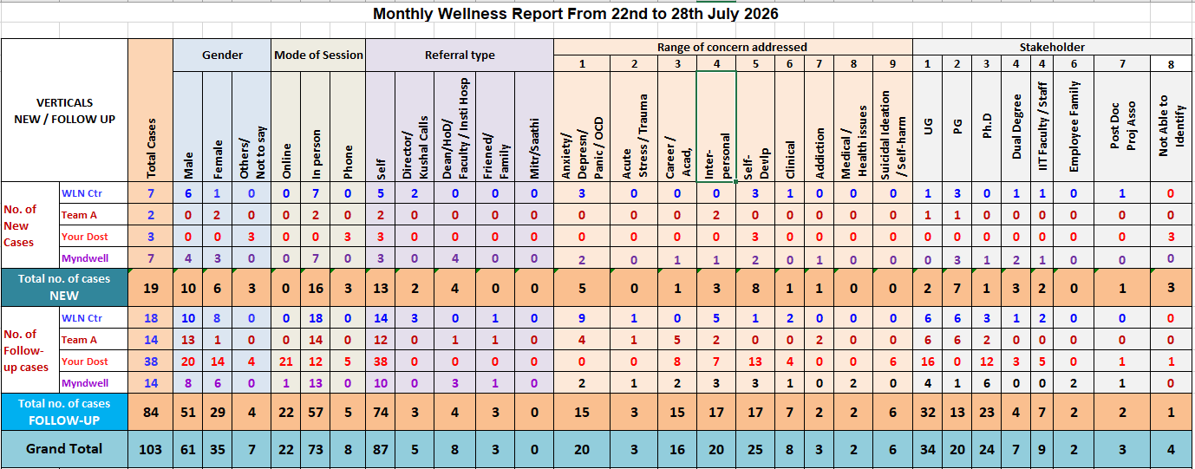

Slide 3
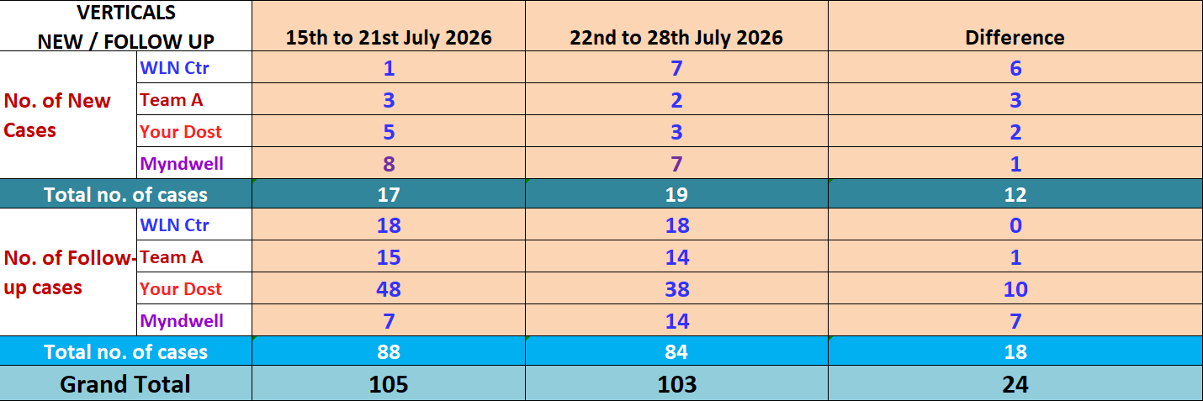

Slide 4
VERTICALS
NEW / FOLLOW UP
15th to 21st July 2026
VERTICALS
NEW / FOLLOW UP
22nd to 28th July 2026

Slide 5
STAKEHOLDER
15th to 21st July 2026
STAKEHOLDER
22nd to 28th July 2026

Slide 6
Wellness Data- Report
RANGE OF CONCERN ADDRESSED
15th to 21st July 2026
RANGE OF CONCERN ADDRESSED
22nd to 28th June 2026

Slide 7
Comparative data of cases 15th to 21st and 22nd to 28th July 2026

Slide 8
Comparative data towards Range of Concern addressed 15th to 21st and 22nd to 28th July 2026

Slide 9
Comparative data of Stakeholders 15th to 21st and 22nd to 28th July 2026

Slide 10
PROPOSED POINTS FORM WELLNESS CENTRE:

