Slide 1
Task Management System on AWS
Abdelrahman Mohammed - 10005771
Waleed Essam - 10004933
Abdelrahman Adel - 10007004
Batool Ali - 10001142
Mohamed Maged - 10002913

Slide 2
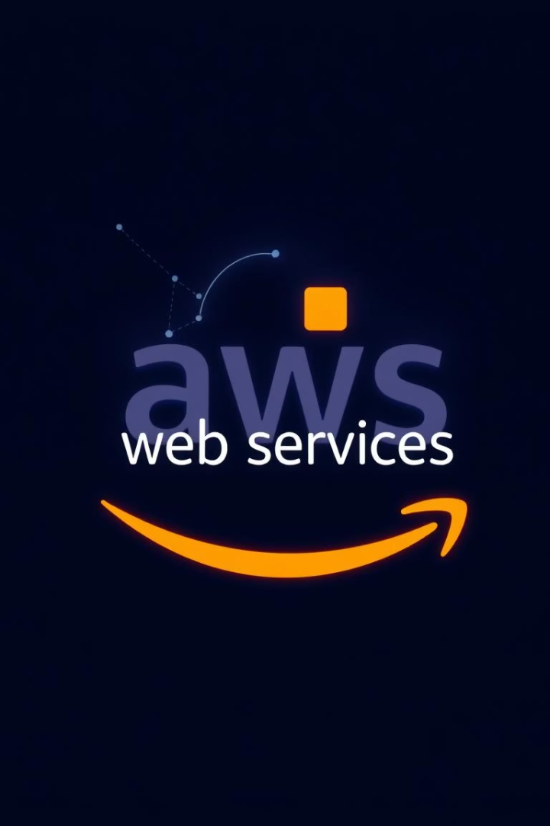
Project Overview
Web-based Platform
Task Workflow
Hosted securely on AWS cloud infrastructure
Create, assign, track, and update tasks easily
Easy Access
Enables seamless access to your created tasks and progress from anywhere

Slide 3
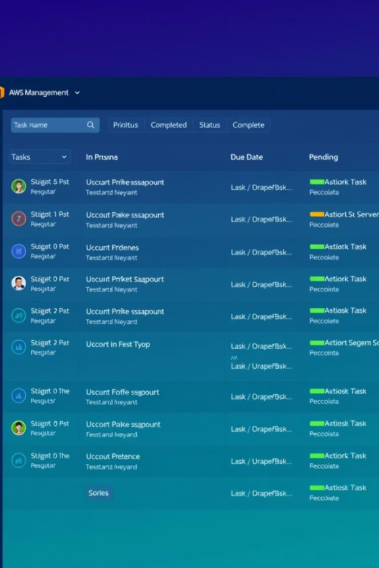




Key Features
User Authentication
Secure sign-up and login with verification
Task Management
Create, update, complete and delete tasks with attachments
File Uploads
Attach documents and images to tasks
Real-Time Notifications
Email alerts on task status changes

Slide 4
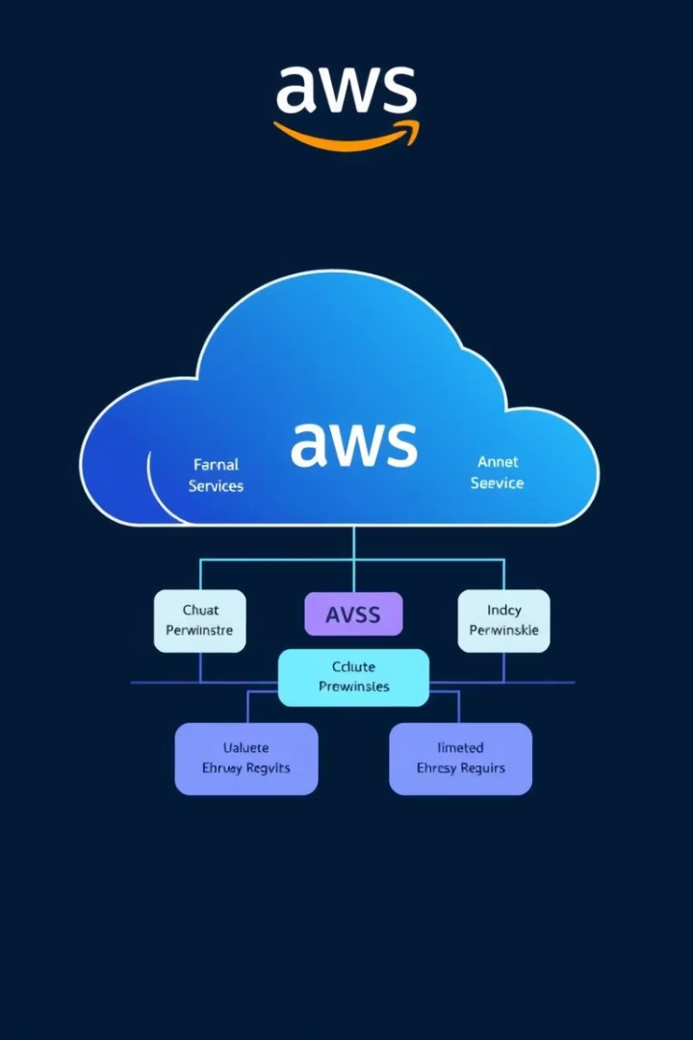
System Architecture on AWS

Slide 5










System Architecture on AWS
Amazon Cognito
IAM
EC2 & VPC
DynamoDB & RDS
User authentication and security with a ready-made solution
Resource access control to manage permissions securely
Static frontend hosting within a secure, isolated network
NoSQL stores user data; RDS handles relational task data
Amazon S3
API Gateway
Lambda
SQS
File storage for task attachments and documents
Routes and manages HTTPS requests for backend communication
Serverless backend functions eliminating need for servers
Asynchronous messaging service powering notifications
CloudWatch
SES
Monitoring, logging, and alerting for system health and debugging
Handling email notifications for tasks

Slide 6
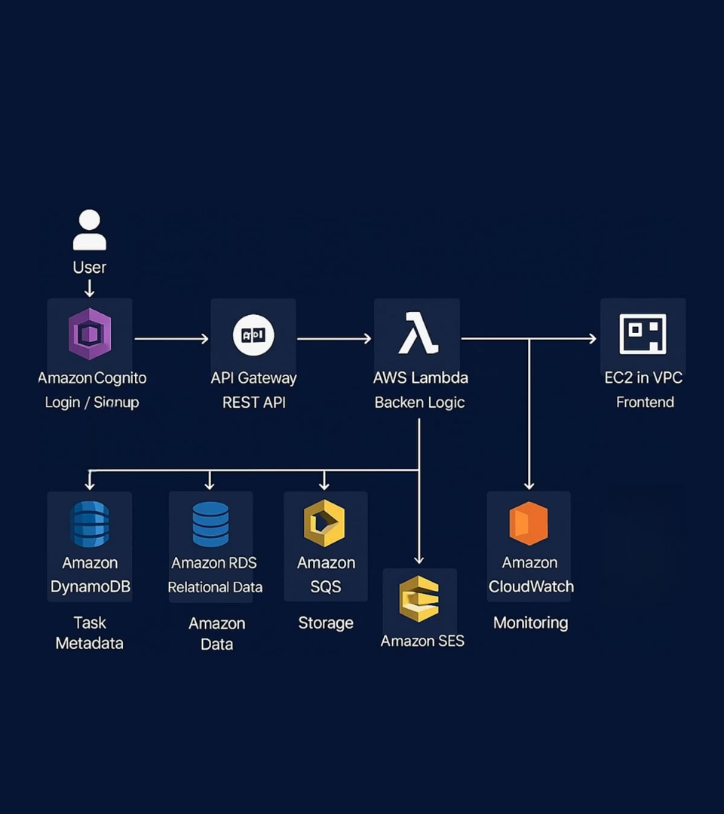
System Architecture Diagram
Static frontend hosted on EC2 instances
User authentication via Cognito flows to Web App
API Gateway routes requests to Lambda functions
Lambda accesses RDS and DynamoDB databases
Files uploaded directly to S3 storage
Notifications handled asynchronously through SQS and SES
VPC manages secure traffic for all services
CloudWatch monitors and logs system health

Slide 7



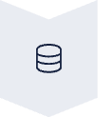



User Flow Overview
User Authentication
Users sign up or log in securely via Amazon Cognito.
Task Management
Create, update, or delete tasks using the web interface.
API Routing
API Gateway routes user requests to Lambda functions.
Data Storage
Lambda functions control and connect API to storage on RDS and DynamoDB databases.
File Uploads
Attachments are securely uploaded directly to Amazon S3 storage.
Notifications
Task updates trigger SQS queues and communicates with SES for email alerts.
Monitoring
CloudWatch logs and monitors system activity continuously.

Slide 8
Challenges & Takeaways
Coordinating multiple AWS services securely within VPC
Maintaining data consistency between DynamoDB and RDS
Addressing cold start latency in Lambda functions
Debugging across Lambda, API Gateway, and SQS services
Balancing infrastructure cost with system performance
Gained hands-on expertise designing serverless AWS architecture

Slide 9
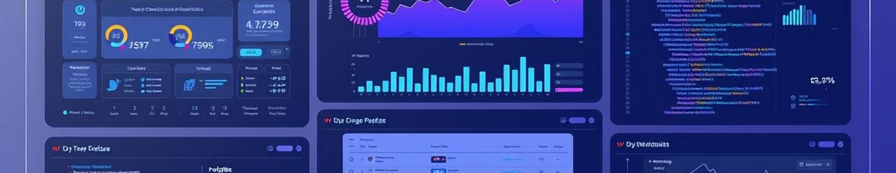


Conclusion
Successful Deployment
Feature Highlights
System fully operational on AWS with scalable architecture
Robust authentication, task handling, and notifications

Slide 10


Thank You
We appreciate your time and attention throughout this presentation.
Questions?
We're here to clarify any points or dive deeper.

