Slide 1

Facial Key-points Detection
BDMI-课程编号-01510243
CC BY-NC-SA
团队名称：BDP_team5
团队成员：陈麒宇、王云海、汪惠康、牛佳丽

Slide 2
Outline
Introduction
Using opencv to detect faces in a photo
Train the kaggle facial-keypoint data with CNN
Combine opencv with the trained model to find the 15 keypoints. (Demo)
Summary
Reference

Slide 3
Introduction
The objective of this task is to predict key-point positions on face images. This can be used as a building block in several applications, such as:
tracking faces in images and video
analyzing facial expressions
detecting dysmorphic facial signs for medical diagnosis
biometrics / face recognition

Slide 4
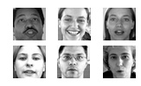
Using opencv to detect faces in a phoTO
OpenCV is an open-source BSD-licensed library that includes several hundreds of computer vision algorithms.
We use OpenCV to detect people faces in a photo and outputs its geometries in a way that is easy to parse
After photos of faces gotten, we are prepared for the CNN model building and training

Slide 5
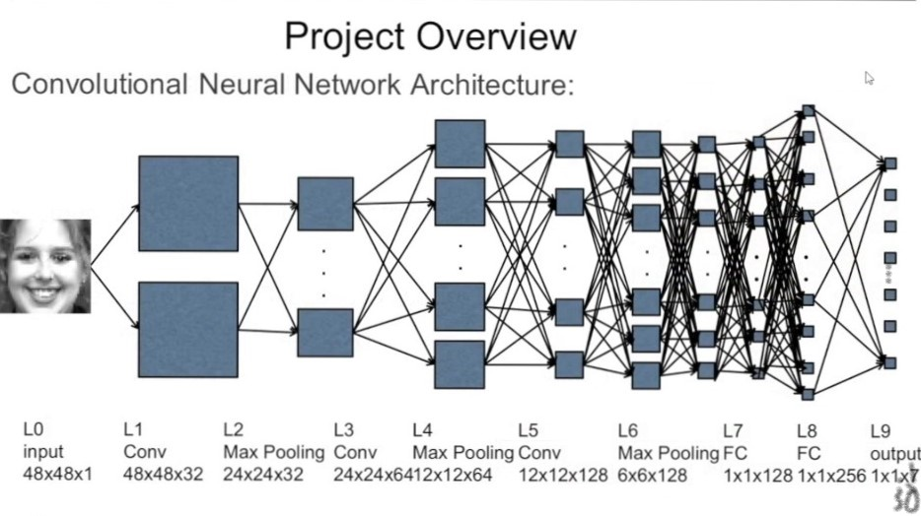
Train the kaggle facial-keypoint data with CNN
Model:
Input Layer x 1
Convolution layer x 3
Max Pooling layer x 3
Fully Connected layer x 2
Output layer x 1
Training
7049 training images
pixels and (x,y) coordinates for 15 key points
1783 testing images

Slide 6
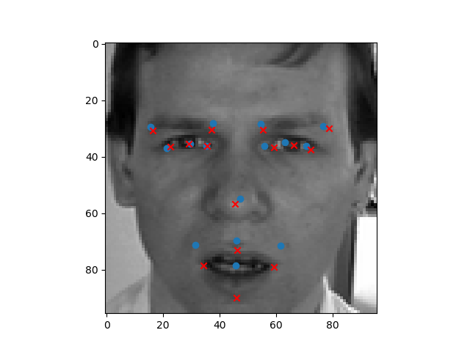
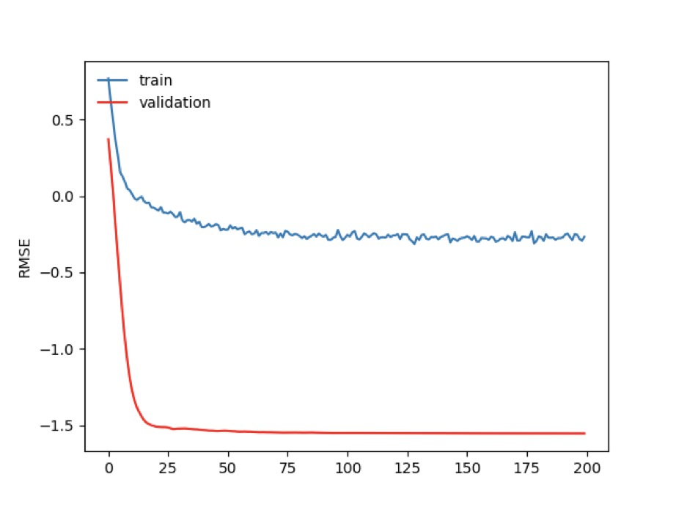
Train the kaggle facial-keypoint data with CNN

Slide 7
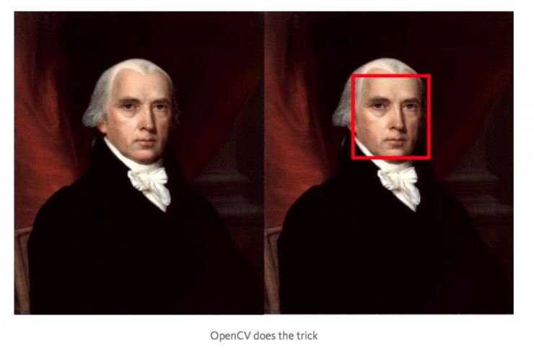
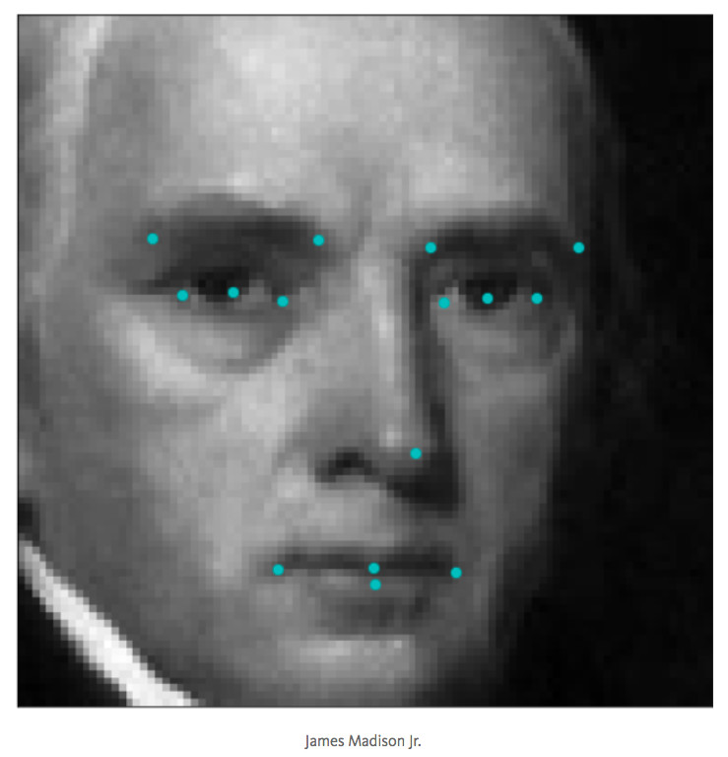
Combine opencv with the trained model to find the 15 keypoints.
After model training, we get fitted parameters and model has been built
Use Opencv to locate our face outline, extract face picture to convert it to 48*48 pixels as input of model
We can have our face detected and coordinates of 15 key-points predicted
Demo…

Slide 8
summary
Data – A Kaggle competition data set provided by Dr. Yoshua Bengio of the University of Montreal. (contains the (x,y) coordinates for 15 keypoints of human faces)
Objective – Using the given data to predict 15 keypoints
Method – Tensorflow based CNN
Future Application – create a website for users to upload photos, detect their faces, and offer some services with the 15 keypoints.

Slide 9
reference
Source of the dataset : The data set for this competition was graciously provided by Dr. Yoshua Bengio of the University of Montreal.
Facial detection by CNN : http://danielnouri.org/notes/2014/12/17/using-convolutional-neural-nets-to-detect-facial-keypoints-tutorial/
Intro to Theano : http://deeplearning.net/software/theano/
Someone’s github : https://github.com/Lasagne/Lasagne

Slide 10
Thanks！

