Slide 1
CPE 301 Project Presentation
Andrew Wells
Email: wellsa15@unlv.nevada.edu

Slide 2
AIM & ACCOMPLISHMENT
AIM:
Connect ES8266 to Thingspeak.com using wifi connection
Connect MPU-6050 to ATmega328p using I2C interface
Connect ATmega328p to ESP8266 using UART and AT commands
ACCOMPLISHMENT
Connected ESP8266 to Thingspeak.com
Connected MPU-6050 to ATmega328p
Connected ATmega328p to ESP8266

Slide 3
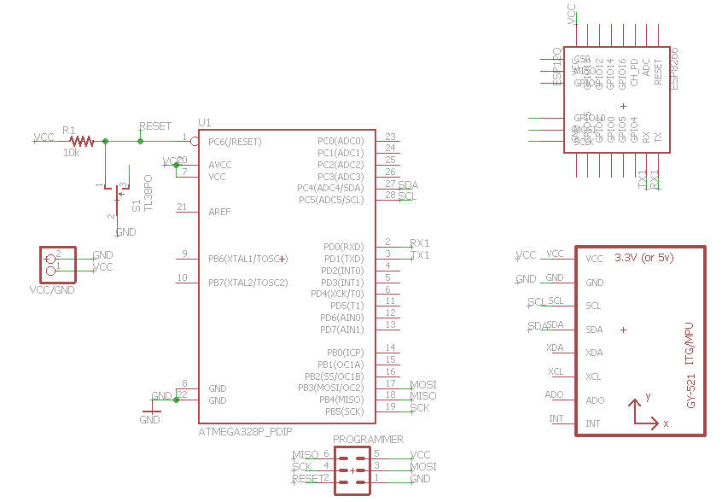
SCHEMATICS

Slide 4
DESIGN STAGES
Components
AVR: ATmega328p
Sensor: MPU-6050
IOT connection: ESP8266
Interfaces
ATmega328p – MPU6050 using I2C – Address (0x$$)
ATmega328p – ESP8266 using UART with AT-commands
ESP8266 – Thingspeak.com using Wifi
IOT
Thingspeak.com

Slide 5
CODE DEVELOPMENT
Initialization
Define Variables used
Enable global interrupts
Initialize UART
Initialize I2C Connection
Initialize MPU6050
Data Collection
Read Acceleration and Gyroscopic Data
Calculate values from raw data and Convert to Strings
OIT/Visualization
Transmit to ESP8266 over UART
Transmit to Thingspeak.com over wifi

Slide 6
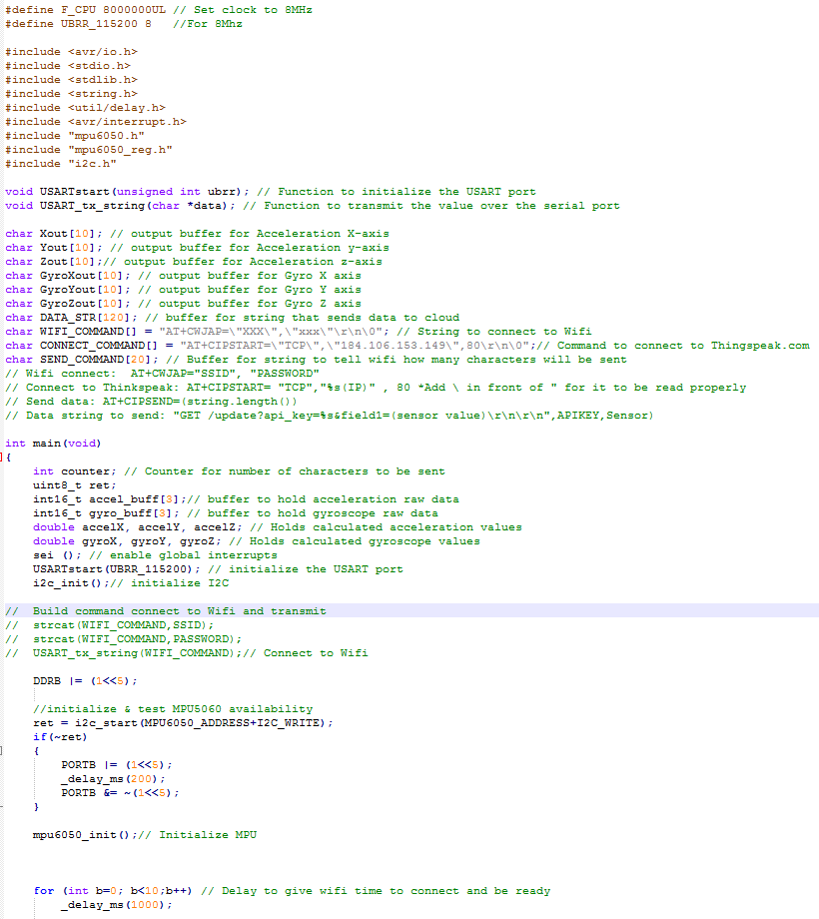
Initialization Code

Slide 7
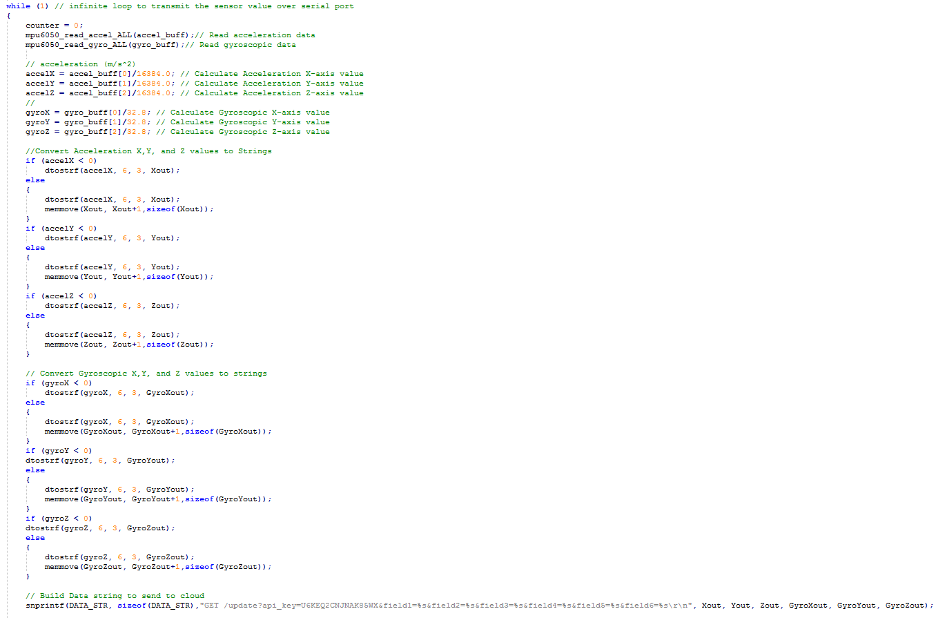
Data Collection Code

Slide 8
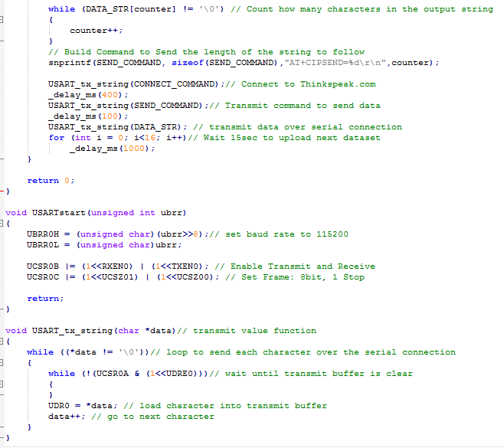
Transmit Code

Slide 9
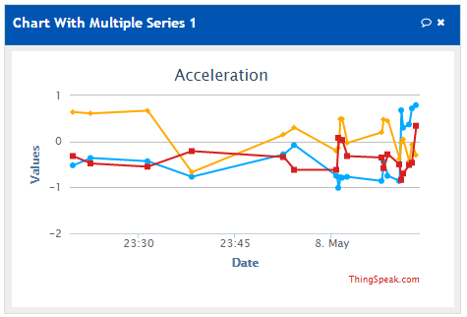
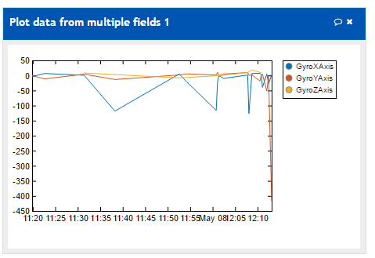
DEMO SNAPSHOT/VIDEO
Youtube Link:
https://youtu.be/0cHQnD4WA8E

Slide 10
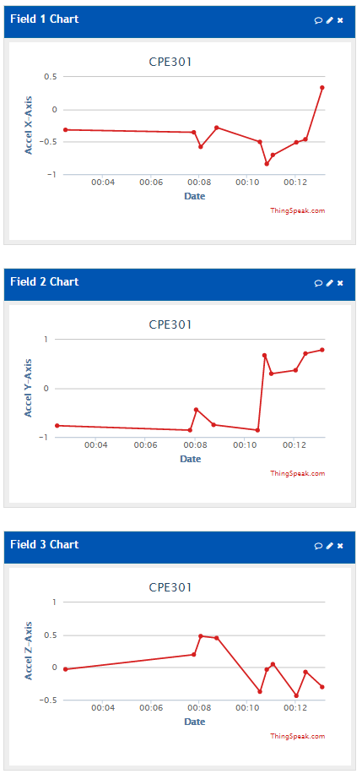
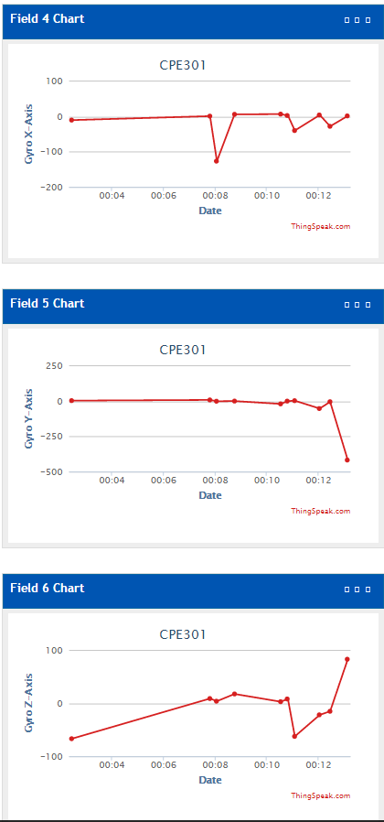
Acceleration & Gyroscopic Graphs

