Slide 1
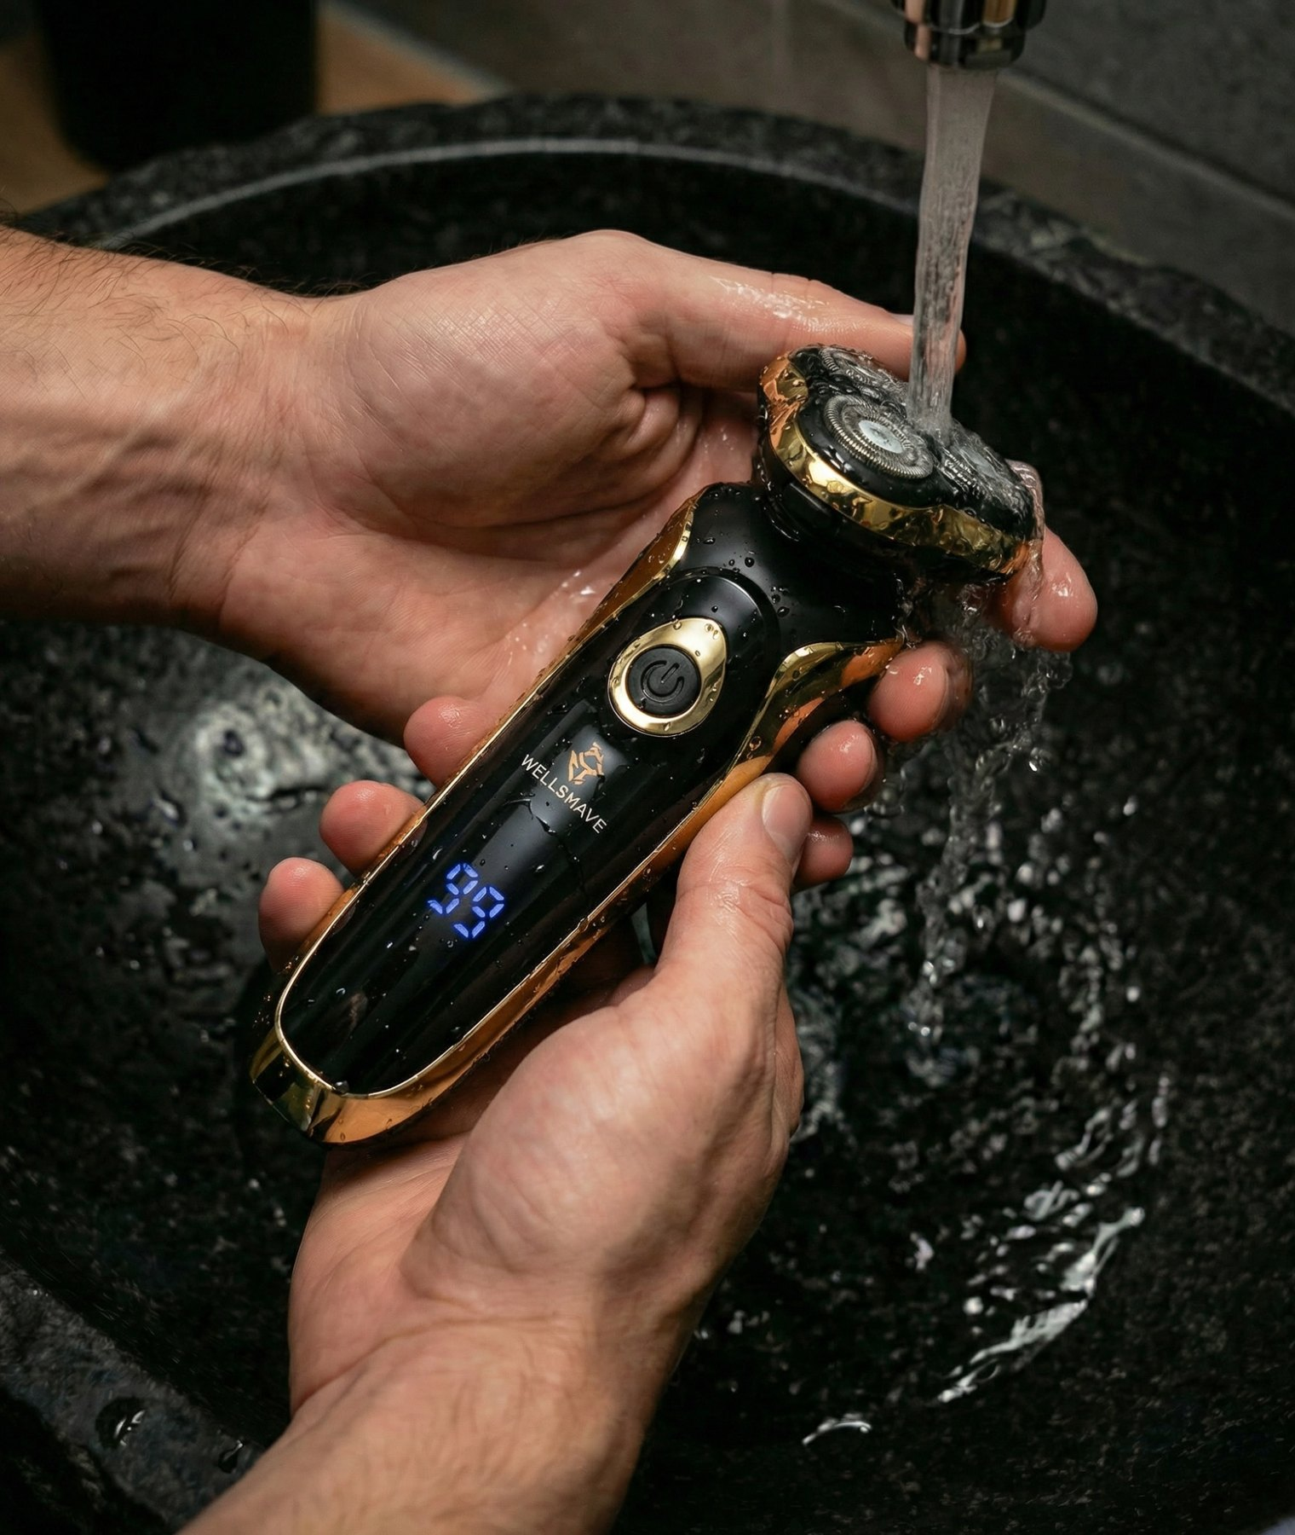

FACTORY VISIT · 工厂拜访
Introducing
Wellshave
Wellshave 品牌介绍
Dutch men's grooming brand · Netherlands & Belgium
荷兰男士理容品牌 · 主营荷兰与比利时市场
PREPARED FOR · 拜访对象
Global Best Way Co., Ltd.
温州市贝威贸易有限公司 · Jenny Huang
Wenzhou Fanke Electric Appliance Co., Ltd.
温州凡科电器有限公司 · He Ting 何婷
October 2026 · 2026 年 10 月
Notes:
Opening. Thank Jenny Huang and He Ting 何婷 (Global Best Way & Fanke) for hosting us. One sentence: who we are and why we came.

Slide 2



About Wellshave
关于 Wellshave
Wellshave is a Dutch men's grooming brand, founded in 2021. We design and sell shavers, trimmers and clippers that give men premium quality at a fair price.
Wellshave 是一家荷兰男士理容品牌，成立于 2021 年。我们设计并销售剃须刀、修剪器和理发器，以合理的价格为男士提供高端品质。
2021
NL + BE
Founded in Helmond (NL)
成立于荷兰海尔蒙德
Main markets
主要市场
Driven by customer feedback · 以客户反馈为驱动
≈ €2.5M
≈ €0.6M
Every product upgrade starts with what customers return, miss or want better.
每一次产品升级都源于客户反馈：退货原因、缺少的功能或希望改进的地方。
bol.com revenue 2026
bol.com 2026 年营业额
Own webshop 2026
自营官网 2026 年营业额
4.4 / 5
Trustpilot score, 1,000+ customer reviews
Trustpilot 评分，1000 多条客户评价
100-day trial
100 天试用
2-year warranty
2 年保修
Next-day delivery
次日送达
bol.com is the largest online marketplace in the Netherlands and Belgium. bol.com 是荷兰和比利时最大的电商平台。
Notes:
Revenue figures are approximate for 2026. Remove the two revenue tiles if you prefer not to share them.

Slide 3
Today's visit team
今日拜访团队
DG
WG
L
Dustin Gibson
Willem de Groot
Leo
Founder & CEO
创始人兼首席执行官
Creative Strategist & Operations Manager
创意策略师兼运营经理
Supply Chain Manager, China
中国供应链经理
DURING THE VISIT · 拜访角色
Brand vision, 2027 plans and final decisions
品牌愿景、2027 年计划与最终决策
DURING THE VISIT · 拜访角色
Customer insights, product presentation and operations
客户洞察、产品呈现与运营
DURING THE VISIT · 拜访角色
Your local contact for orders, quality and follow-up
订单、品质与后续跟进的本地联系人
One team, in the Netherlands and in China. 荷兰与中国，同一个团队。

Slide 4

Why we are visiting
本次拜访目的
01
02
03
04
Get to know each other
相互了解
Review current data
回顾当前数据
Share our 2027 plans
分享 2027 年计划
Improve the range together
共同优化产品
We introduce Wellshave, our customers and how we work.
介绍 Wellshave、我们的客户和工作方式。
Sales, reviews and returns of the products we buy from you.
回顾我们向贵司采购产品的销量、评价和退货情况。
Our growth plans and what they mean for your factory.
我们的增长计划及其对贵厂的意义。
Better quality, better prices and new models.
更好的品质、更优的价格和新款产品。
A good visit: we leave with samples, your recommendations and clear next steps for 2027.
成功的拜访：我们带着样品、您的建议和清晰的 2027 年下一步计划回去。

Slide 5
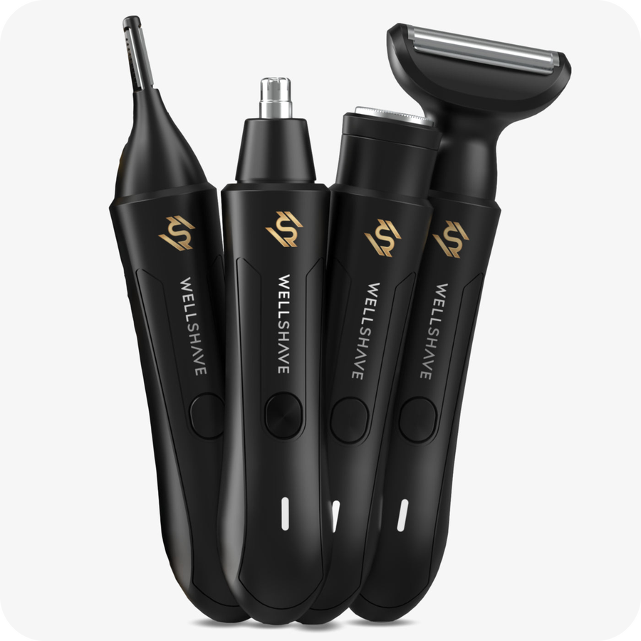
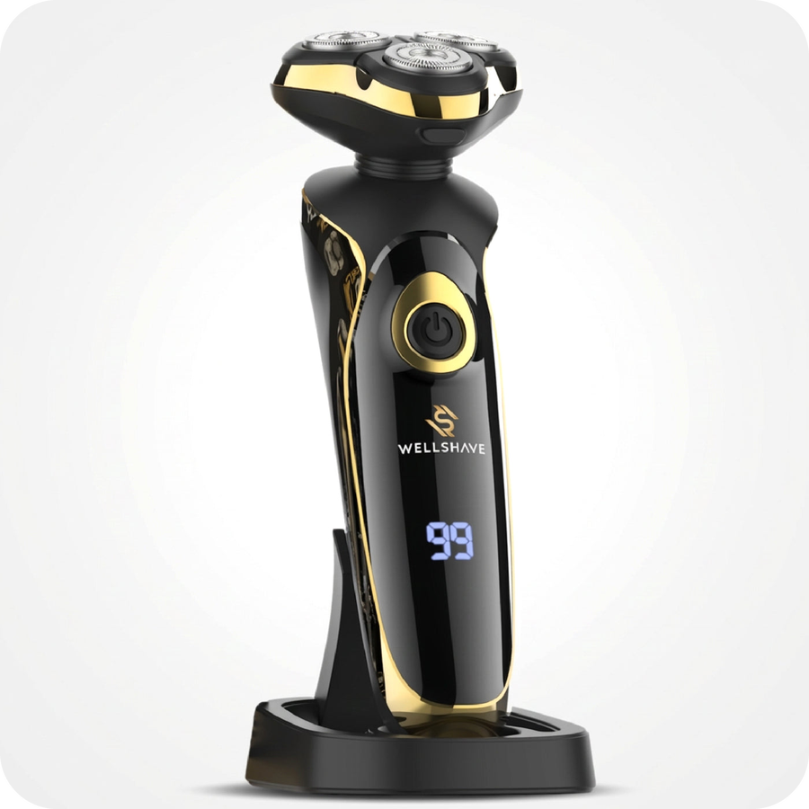
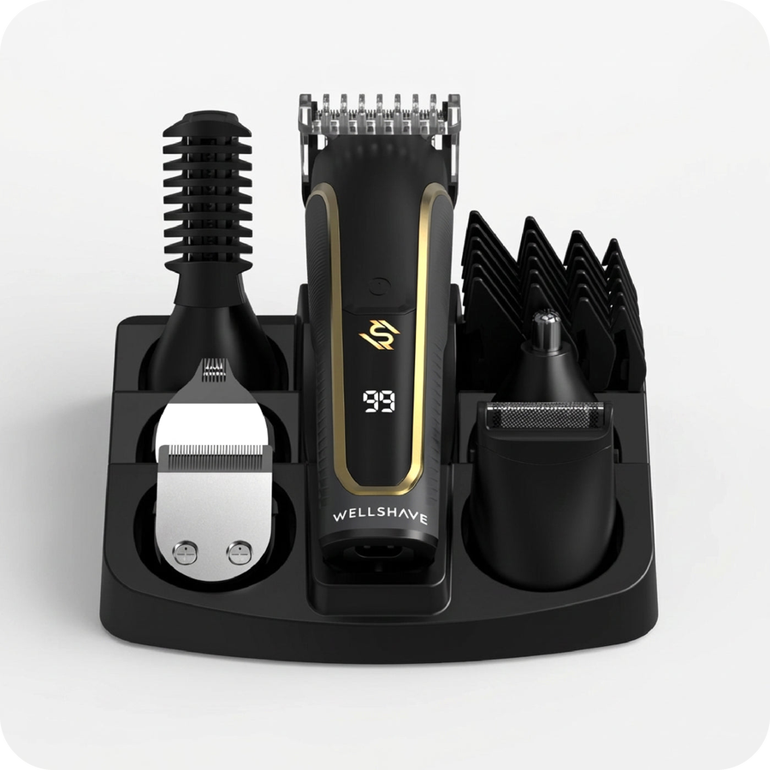
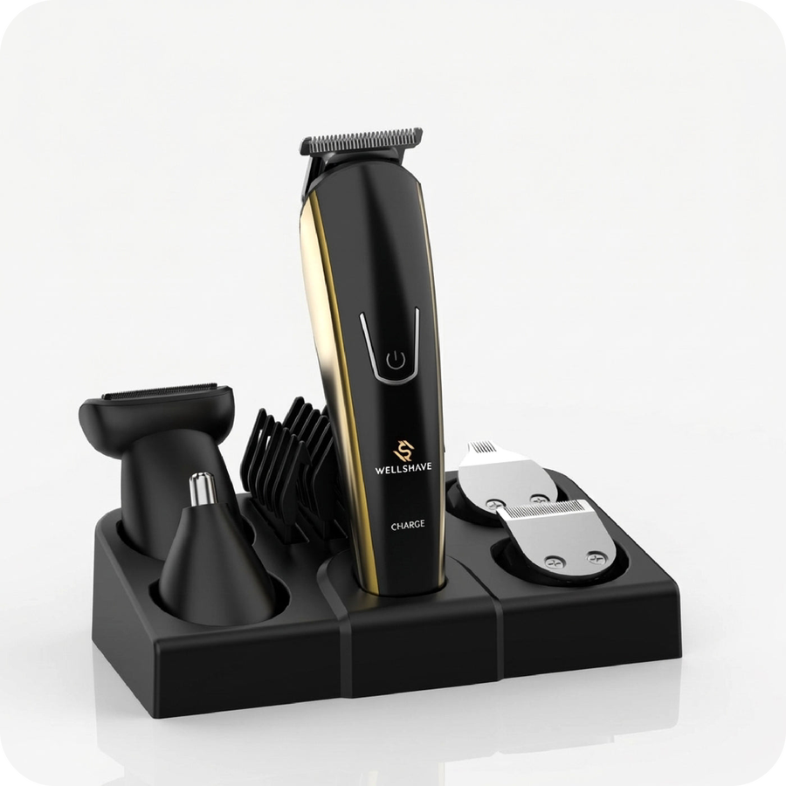
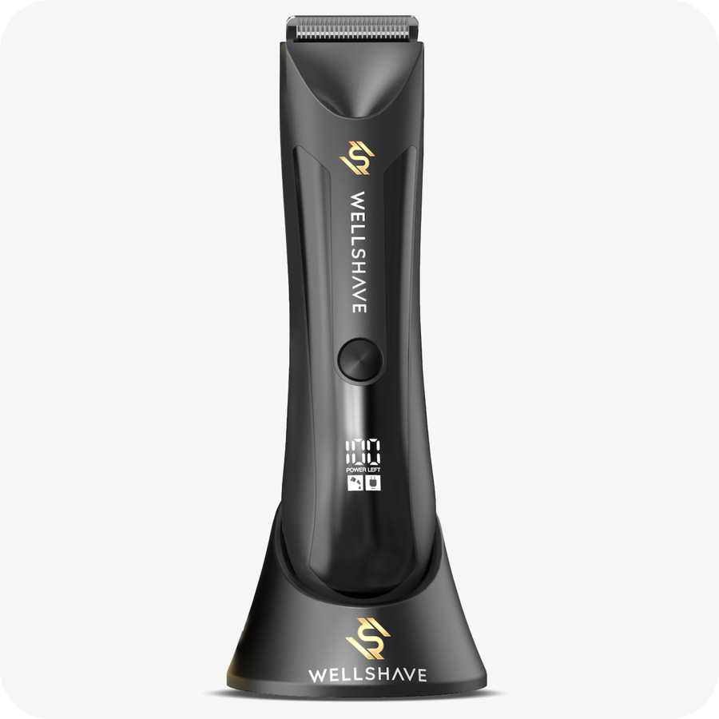
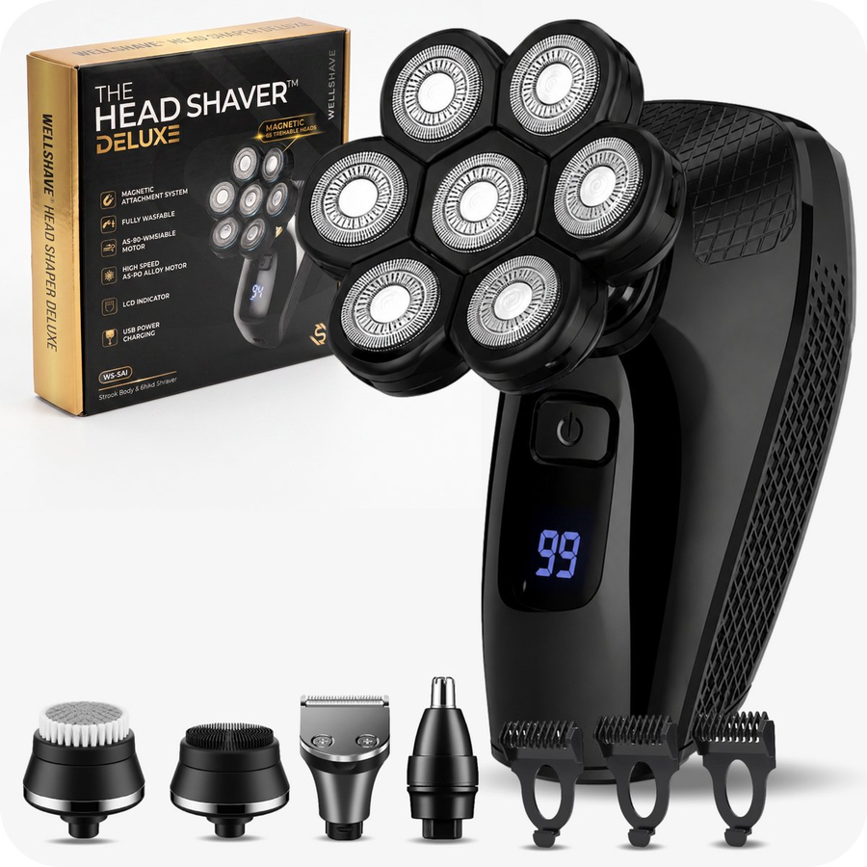
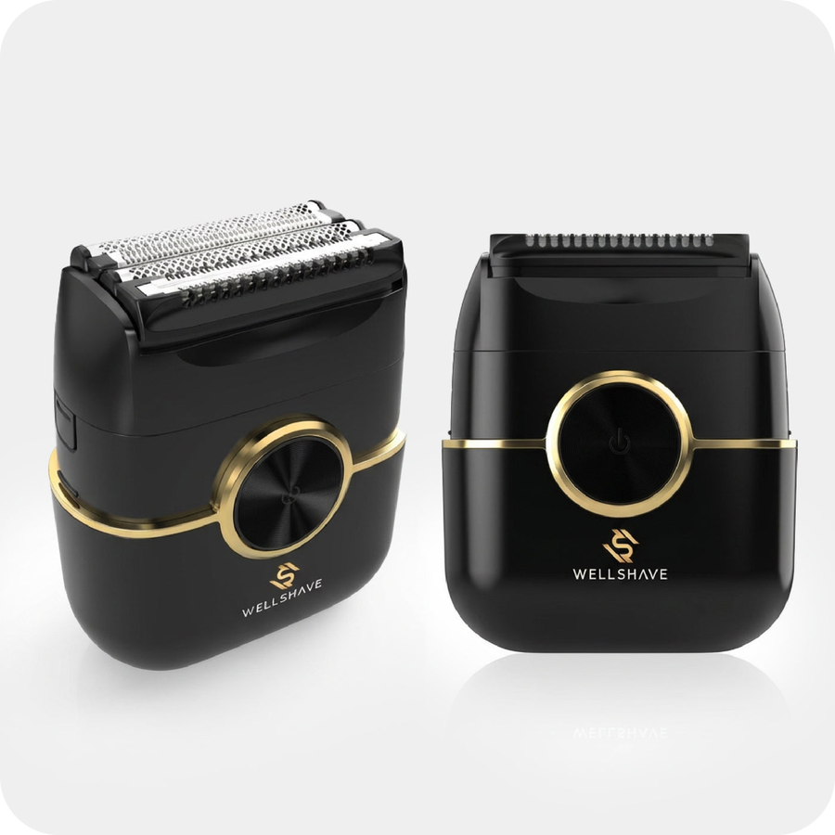
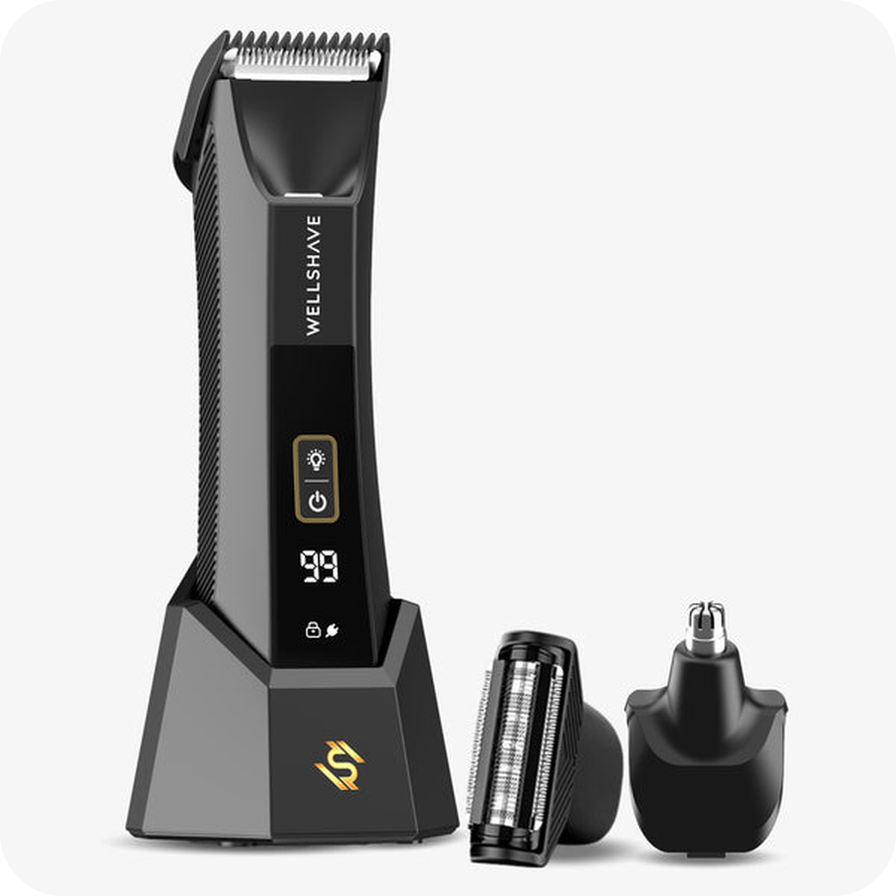
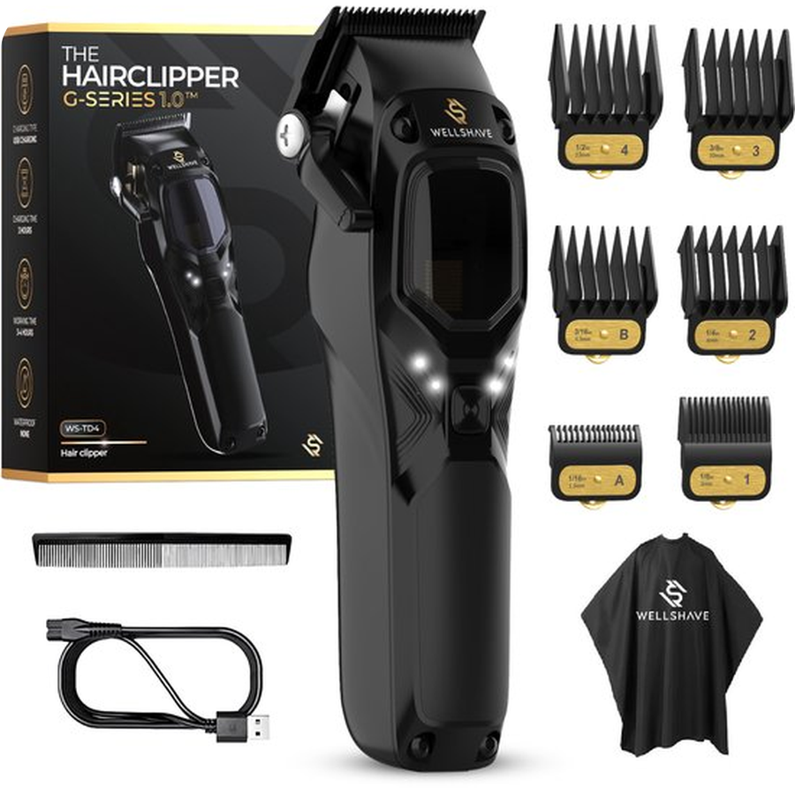
Your products at Wellshave
贵司产品在 Wellshave 的表现
Nose trimmers
鼻毛修剪器（7 款）
7 models · WS-NT1 / WS-NT2
25,627 sold · 2.1% returns
销量 25,627 · 退货率 2.1%
Shaver Elite
Elite 四合一剃须刀
8600 / WS-SA3
4,567 sold · 5.2% returns
销量 4,567 · 退货率 5.2%
Beard Trimmer Supreme
Supreme 六合一胡须修剪器
8988 / WS-BTG2
3,143 sold · 3.5% returns
销量 3,143 · 退货率 3.5%
Beard Trimmer Pro
Pro 五合一胡须修剪器
8188 / WS-BTG1
2,179 sold · 4.3% returns
销量 2,179 · 退货率 4.3%
Groom Guard
Groom Guard 身体修剪器
WS-BG1 / HT-6006
2,116 sold · 2.3% returns
销量 2,116 · 退货率 2.3%
Head Shaver Deluxe
Deluxe 光头剃须刀
WS-SA1 / JK-8588A
1,581 sold · 4.6% returns
销量 1,581 · 退货率 4.6%
Blade Baron
Blade Baron 往复式剃须刀
FK-706
1,307 sold · 5.6% returns
销量 1,307 · 退货率 5.6%
Flex Guard
Flex Guard 身体修剪器
WS-BG3
1,135 sold · 5.2% returns
销量 1,135 · 退货率 5.2%
G-Series and more
G-Series 理发器及其他
Clipper, Shave Package, spare heads
1,786 sold · 4.1% returns
销量 1,786 · 退货率 4.1%
Total 43,441 units sold on bol.com, 1 January to 15 October 2026. Return rate counts all return reasons. Webshop sales not included. We share our 2027 forecast in the meeting.
合计 43,441 件。数据来源：bol.com，2026年1月1日至10月15日。退货率包含所有退货原因，不含官网销量。2027年预测将在会议中分享。
Notes:
Only the products we buy from you. Sales are bol.com units (about 80% of our revenue). Next slides go product by product.

Slide 6
Customer service: the battery is the #1 defect
售后数据：电池是头号故障
Battery or charging 电池或充电
Other defects 其他故障
68%
146 of 215 defect reports are about the battery or charging
215 起故障报告中有 146 起与电池或充电有关
Shaver Elite
Elite 四合一剃须刀
37 / 54
Head Shaver Deluxe
Deluxe 光头剃须刀
28 / 39
Groom Guard
Groom Guard 身体修剪器
27 / 35
5 to 13 months
median time from purchase to a battery report
从购买到电池故障的中位时间
Beard Trimmer Supreme
Supreme 六合一胡须修剪器
26 / 36
Nose trimmers
鼻毛修剪器（7 款）
16 / 31
Beard Trimmer Pro
Pro 五合一胡须修剪器
10 / 15
97%
of reports: we send the customer a new device
的报告需要为客户寄送新机
Flex Guard
Flex Guard 身体修剪器
2 / 4
Blade Baron
Blade Baron 往复式剃须刀
0 / 1
Source: Wellshave customer service defect log, 1 January to 15 October 2026, webshop and bol.com customers. Category taken from the customer's complaint.
数据来源：Wellshave 售后故障记录，2026年1月1日至10月15日，含官网和 bol.com 客户。类别依据客户的投诉内容划分。
Notes:
Every product we buy from you has the same main defect: the battery or charging. 146 of 215 defect reports this year. Most fail well within the 2-year warranty, and nearly every report means we send a new device at our cost.

Slide 7

Product focus: Shaver Elite
产品聚焦：Elite 剃须刀
BATTERY · 电池
Battery fails: 37 of 54 defect reports
电池故障：54 起故障报告中有 37 起
Typically 5 months after purchase · 通常在购买后约 5 个月
“Battery shows 99%, but the shaver does nothing.”
电量显示 99%，但剃须刀完全不工作。
“After two hours of charging, the battery lasts two minutes.”
充电两个小时，只能用两分钟。
“While charging I heard a pop and smelled burning. Now it does nothing.”
充电时听到“砰”的一声，闻到焦味，之后完全不能用了。
DEFECT REPORTS · 售后故障 54
BOL.COM REVIEWS · 差评 28
37
Battery or charging
电池或充电
22
Pulls hairs, not close
剃不干净，拉扯胡须
9
Won't start, cuts out
无法启动或断电
4
Head loose or broken
刀头松动或损坏
Model 8600 / WS-SA3 型号
6
Head or parts break
刀头或部件损坏
3
Battery and charging
电池与充电
4,567
sold in 2026
2026 年销量
5.2%
return rate
退货率
54
defect reports
故障报告
OUR ASK · 我们的期望
Battery that lasts years
经久耐用的电池
More power, closer shave
更强动力，剃得更干净
Fixed-cable adapter
线缆固定的一体式适配器
Sources: bol.com sales, returns and 1 to 3 star reviews; Wellshave customer service defect log. All 1 January to 15 October 2026. Quotes translated from Dutch.
数据来源：bol.com 销量、退货及 1 至 3 星评价；Wellshave 售后故障记录。时间均为 2026 年 1 月 1 日至 10 月 15 日。引文译自荷兰语。
Notes:
Lead with the battery. Our customer service logged 54 defect reports on the Elite this year; 37 were about the battery or charging, typically 5 months after purchase, and every one got a new device. The quotes are from those reports. In bol.com reviews the most common topic is the shave itself: it pulls hairs instead of cutting them.

Slide 8

Product focus: nose trimmers
产品聚焦：鼻毛修剪器
MAIN ISSUE · 主要问题
Weak cutting: many hairs are not caught
修剪力度不足：很多毛发剪不到
22 of 55 critical reviews on bol.com · bol.com 55 条差评中有 22 条
“After 10 minutes in my nose, just as many hairs as before.”
在鼻子里用了10分钟，鼻毛还是和之前一样多。
“The blade sits too deep to catch short hairs.”
刀片藏得太深，剪不到短毛。
“Used it twice and the head was broken.”
只用了两次，刀头就坏了。
DEFECT REPORTS · 售后故障 31
BOL.COM REVIEWS · 差评 55
16
Battery or charging
电池或充电
22
Weak cutting
修剪力度不足
4
Head or parts break
刀头或部件损坏
15
Broken within months
数月内损坏
Model 7 models · WS-NT1 / WS-NT2 型号
2
Won't start, cuts out
无法启动或断电
9
Caps and parts
保护盖与配件
25,627
sold in 2026
2026 年销量
2.1%
return rate
退货率
31
defect reports
故障报告
OUR ASK · 我们的期望
Sharper blades
更锋利的刀片，不漏剪
A head that does not break
更牢固、不易损坏的刀头
Easy caps, complete box
保护盖易取下，配件齐全
Sources: bol.com sales, returns and 1 to 3 star reviews; Wellshave customer service defect log. All 1 January to 15 October 2026. Quotes translated from Dutch.
数据来源：bol.com 销量、退货及 1 至 3 星评价；Wellshave 售后故障记录。时间均为 2026 年 1 月 1 日至 10 月 15 日。引文译自荷兰语。
Notes:
Our biggest volume: 25,627 units. Few defects for that volume, but half of them are battery or charging. In reviews the blade does not catch the hairs.

Slide 9
Product focus: beard trimmers
产品聚焦：胡须修剪器
Beard Trimmer Pro 5-in-1
Pro 五合一胡须修剪器
Model 8188 / WS-BTG1
Beard Trimmer Supreme 6-in-1
Supreme 六合一胡须修剪器
Model 8988 / WS-BTG2
2,179
sold in 2026
2026 年销量
4.3%
return rate
退货率
15
defect reports
故障报告
3,143
sold in 2026
2026 年销量
3.5%
return rate
退货率
36
defect reports
故障报告
BATTERY · 电池
10 of 15 defect reports: battery or charging
15 起故障报告中有 10 起与电池或充电有关
“Fully charged, but it does nothing anymore.”
已经充满电，但完全不能用了。
BATTERY · 电池
26 of 36 defect reports: battery or charging
36 起故障报告中有 26 起与电池或充电有关
“Won't charge, stays at 0%. Tried several chargers and cables.”
无法充电，电量一直是 0%。已试过多个充电器和数据线。
DEFECT REPORTS · 售后故障 15
BOL.COM REVIEWS · 差评 11
DEFECT REPORTS · 售后故障 36
BOL.COM REVIEWS · 差评 5
10
Battery or charging
电池或充电
4
Battery or charging
电池或充电
26
Battery or charging
电池或充电
3
Uneven trimming
修剪不均匀
1
Won't start, cuts out
无法启动或断电
4
Stops within months
数月内停止工作
5
Won't start, cuts out
无法启动或断电
1
Does not charge well
充电不正常
1
On/off switch faults
开关故障
2
Cable or part missing
缺少充电线或配件
3
On/off switch faults
开关故障
1
Fragile attachments
配件易碎
OUR ASK · 我们的期望
→ Battery and charging that last 持久耐用的电池与充电
→ Cable and all attachments in the box 包装内充电线与配件齐全
OUR ASK · 我们的期望
→ Battery and charging that last 持久耐用的电池与充电
→ Even trimming, also on short stubble 修剪均匀，短胡茬也能修好
Sources: bol.com sales, returns and 1 to 3 star reviews; Wellshave customer service defect log. All 1 January to 15 October 2026. Quotes translated from Dutch.
数据来源：bol.com 销量、退货及 1 至 3 星评价；Wellshave 售后故障记录。时间均为 2026 年 1 月 1 日至 10 月 15 日。引文译自荷兰语。
Notes:
Both trimmers: battery and charging is the top defect. Supreme 8988: 26 of 36 reports. Pro 8188: 10 of 15. In reviews the Supreme is mostly about an uneven trim.

Slide 10

Product focus: shavers
产品聚焦：剃须刀
Head Shaver Deluxe
Deluxe 光头剃须刀
Model WS-SA1 / JK-8588A
Foil Shaver Blade Baron
Blade Baron 往复式剃须刀
Model FK-706
1,581
sold in 2026
2026 年销量
4.6%
return rate
退货率
39
defect reports
故障报告
1,307
sold in 2026
2026 年销量
5.6%
return rate
退货率
1
defect reports
故障报告
BATTERY · 电池
28 of 39 defect reports: battery or charging
39 起故障报告中有 28 起与电池或充电有关
“The battery suddenly jumps from about 65% to 0%.”
电量会突然从 65% 左右跳到 0%。
RETURNS · 退货
5.6% returns, the highest of these products
退货率 5.6%，为这些产品中最高
“It shaves, but not completely smooth as described.”
能剃，但没有描述的那么干净。
DEFECT REPORTS · 售后故障 39
BOL.COM REVIEWS · 差评 9
DEFECT REPORTS · 售后故障 1
BOL.COM REVIEWS · 差评 2
28
Battery or charging
电池或充电
2
Battery or charging
电池或充电
1
Weak motor, pulls hairs
动力不足，拉扯毛发
2
Not completely smooth
剃得不够干净
4
Won't start, cuts out
无法启动或断电
2
Skin irritation, cuts
皮肤刺激或划伤
3
On/off switch faults
开关故障
2
Not a smooth result
剃得不够干净
OUR ASK · 我们的期望
→ Battery and charging port that last 耐用的电池与充电接口
→ Smoother on the skin 对皮肤更顺滑温和
OUR ASK · 我们的期望
→ A closer shave 剃得更干净
→ Find the return reasons together 共同分析退货原因
Sources: bol.com sales, returns and 1 to 3 star reviews; Wellshave customer service defect log. All 1 January to 15 October 2026. Quotes translated from Dutch.
数据来源：bol.com 销量、退货及 1 至 3 星评价；Wellshave 售后故障记录。时间均为 2026 年 1 月 1 日至 10 月 15 日。引文译自荷兰语。
Notes:
Head Shaver Deluxe: 28 of 39 defect reports are battery or charging, the battery percentage drops suddenly. Blade Baron: hardly any defects, but the highest return rate of these products.

Slide 11
Product focus: body groomers
产品聚焦：身体修剪器
Body Groomer Groom Guard
Groom Guard 身体修剪器
Model WS-BG1 / HT-6006
Body Groomer Flex Guard
Flex Guard 身体修剪器
Model WS-BG3
2,116
sold in 2026
2026 年销量
2.3%
return rate
退货率
35
defect reports
故障报告
1,135
sold in 2026
2026 年销量
5.2%
return rate
退货率
4
defect reports
故障报告
BATTERY · 电池
27 of 35 defect reports: battery or charging
35 起故障报告中有 27 起与电池或充电有关
“No longer charges. Tried other charging cables.”
无法充电，已经换过其他充电线。
MAIN ISSUE · 主要问题
Misses or pulls hairs
漏剪或拉扯毛发
“The head pulls out more hairs than it shaves.”
刀头拔掉的毛比剃掉的还多。
DEFECT REPORTS · 售后故障 35
BOL.COM REVIEWS · 差评 7
DEFECT REPORTS · 售后故障 4
BOL.COM REVIEWS · 差评 4
27
Battery or charging
电池或充电
2
Too sharp, irritation
过于锋利，刺激皮肤
2
Battery or charging
电池或充电
2
Misses or pulls hairs
漏剪或拉扯毛发
6
Won't start, cuts out
无法启动或断电
2
Misses or pulls hairs
漏剪或拉扯毛发
1
Won't start, cuts out
无法启动或断电
2
Parts do not match
配件与描述不符
1
Weak motor, pulls hairs
动力不足，拉扯毛发
2
Unstable stand
底座不稳
1
Weak motor, pulls hairs
动力不足，拉扯毛发
1
Cuts and irritation
划伤与刺激
OUR ASK · 我们的期望
→ Battery and charging that last 持久耐用的电池与充电
→ A stable charging stand 更稳固的充电底座
OUR ASK · 我们的期望
→ More power, catches every hair 动力更强，不漏毛
→ Combs and attachments as described 限位梳与配件与描述一致
Sources: bol.com sales, returns and 1 to 3 star reviews; Wellshave customer service defect log. All 1 January to 15 October 2026. Quotes translated from Dutch.
数据来源：bol.com 销量、退货及 1 至 3 星评价；Wellshave 售后故障记录。时间均为 2026 年 1 月 1 日至 10 月 15 日。引文译自荷兰语。
Notes:
Groom Guard: 27 of 35 defect reports are battery or charging. Reviews also mention the charging stand tipping over. Flex Guard: few reports, pulls hairs, attachments do not match the description.

Slide 12



What we want to improve together
我们希望共同改进的方向
Better quality
更好的品质
Better prices
更优的价格
New models
新款产品
FOCUS: BATTERIES & CHARGING
重点：电池与充电
FOCUS: CURRENT RANGE
重点：现有产品
FOCUS: CO-DEVELOPMENT
重点：共同开发
Longer battery life and lifespan
续航更长，电池寿命更长
Fixed-cable adapter as standard
今后标配线缆固定的一体式适配器
So the right adapter is always used
确保客户始终使用与设备匹配的适配器
Fewer defects and returns
减少故障和退货
Lower purchase prices
降低现有产品的采购价格
Cost ideas that keep the quality
在保证品质前提下的降本方案
Prices based on 2027 volumes
基于 2027 年采购量报价
Develop new models together
共同开发新款产品
Upgrades of our best-sellers
升级我们的畅销款
Your newest technology
贵司的最新技术
Why this matters: in 2026, 146 of the 215 defect reports on your products were about the battery or charging. Each one costs a new device and a disappointed customer.
原因：2026 年，贵司产品的 215 起故障报告中有 146 起与电池或充电有关。每一起都意味着一台新机和一位失望的客户。
Notes:
Fixed-cable adapter: from now on every device ships with a charger whose cable is fixed to the adapter, so customers always charge with the right adapter for that device. Wrong adapters damage batteries and lead to returns.

Slide 13


What we would love to see
我们最期待看到的
Samples 样品
New models and improved batteries. We like to hold and test them ourselves.
新款产品和改进后的电池。我们希望亲手体验和测试。
Thank you
谢谢
We look forward to growing together.
期待与贵司共同成长。
Your recommendations 您的推荐
What sells well in other markets? What would you change in our products?
哪些产品在其他市场卖得好？您会如何改进我们的产品？
Dustin Gibson · Founder & CEO
dustin@wellshave.com
wellshave.com
No preparation needed: we mainly come to listen. 无需特别准备：我们主要是来倾听的。

