Slide 1
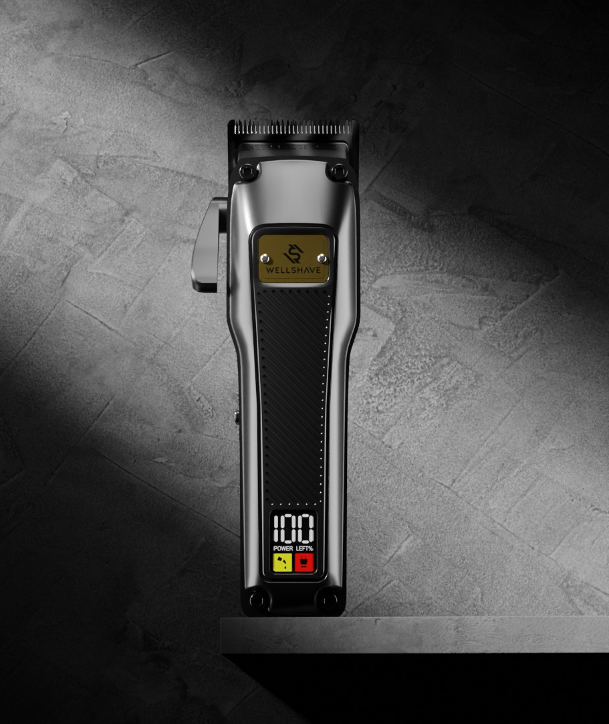

FACTORY VISIT · 工厂拜访
Introducing
Wellshave
Wellshave 品牌介绍
Dutch men's grooming brand · Netherlands & Belgium
荷兰男士理容品牌 · 主营荷兰与比利时市场
PREPARED FOR · 拜访对象
Global Best Way Co., Ltd.
温州市贝威贸易有限公司 · Jenny Huang
October 2026 · 2026 年 10 月
Notes:
Opening. Thank Global Best Way for hosting us. One sentence: who we are and why we came.

Slide 2



About Wellshave
关于 Wellshave
Wellshave is a Dutch men's grooming brand, founded in 2021. We design and sell shavers, trimmers and clippers that give men premium quality at a fair price.
Wellshave 是一家荷兰男士理容品牌，成立于 2021 年。我们设计并销售剃须刀、修剪器和理发器，以合理的价格为男士提供高端品质。
2021
NL + BE
Founded in Helmond (NL)
成立于荷兰海尔蒙德
Main markets
主要市场
Driven by customer feedback · 以客户反馈为驱动
≈ €2.5M
≈ €0.6M
Every product upgrade starts with what customers return, miss or want better.
每一次产品升级都源于客户反馈：退货原因、缺少的功能或希望改进的地方。
bol.com revenue 2026
bol.com 2026 年营业额
Own webshop 2026
自营官网 2026 年营业额
4.4 / 5
Trustpilot score, 1,000+ customer reviews
Trustpilot 评分，1000 多条客户评价
100-day trial
100 天试用
2-year warranty
2 年保修
Next-day delivery
次日送达
bol.com is the largest online marketplace in the Netherlands and Belgium. bol.com 是荷兰和比利时最大的电商平台。
Notes:
Revenue figures are approximate for 2026. Remove the two revenue tiles if you prefer not to share them.

Slide 3
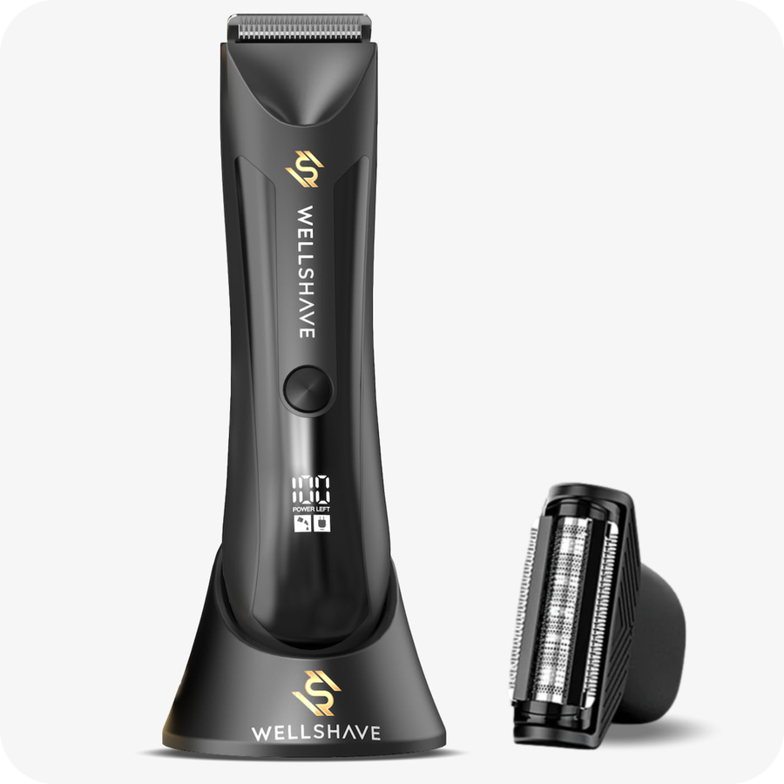
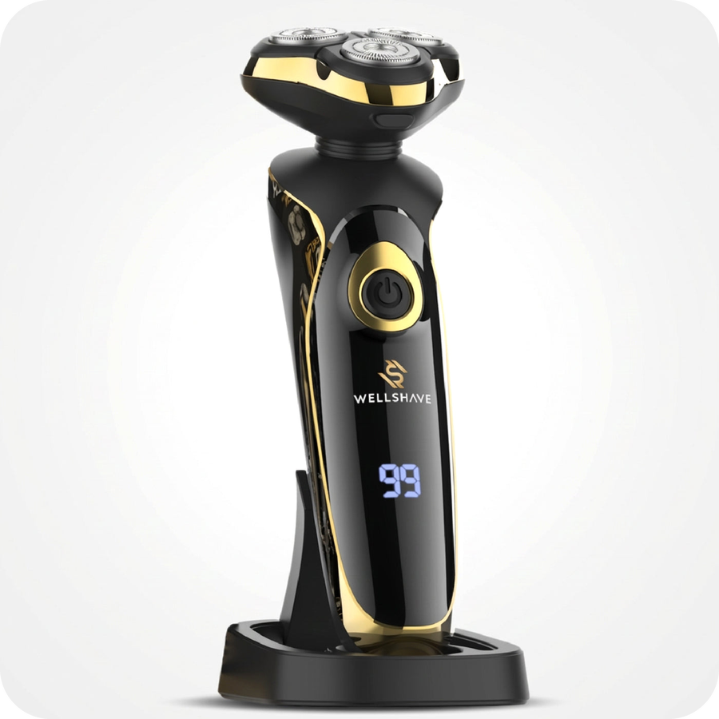
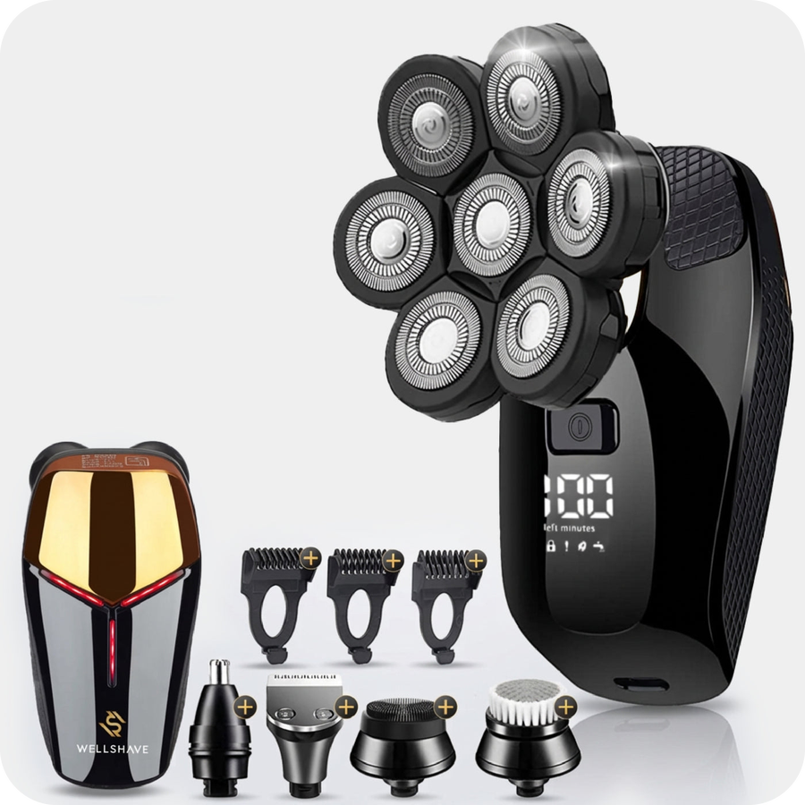
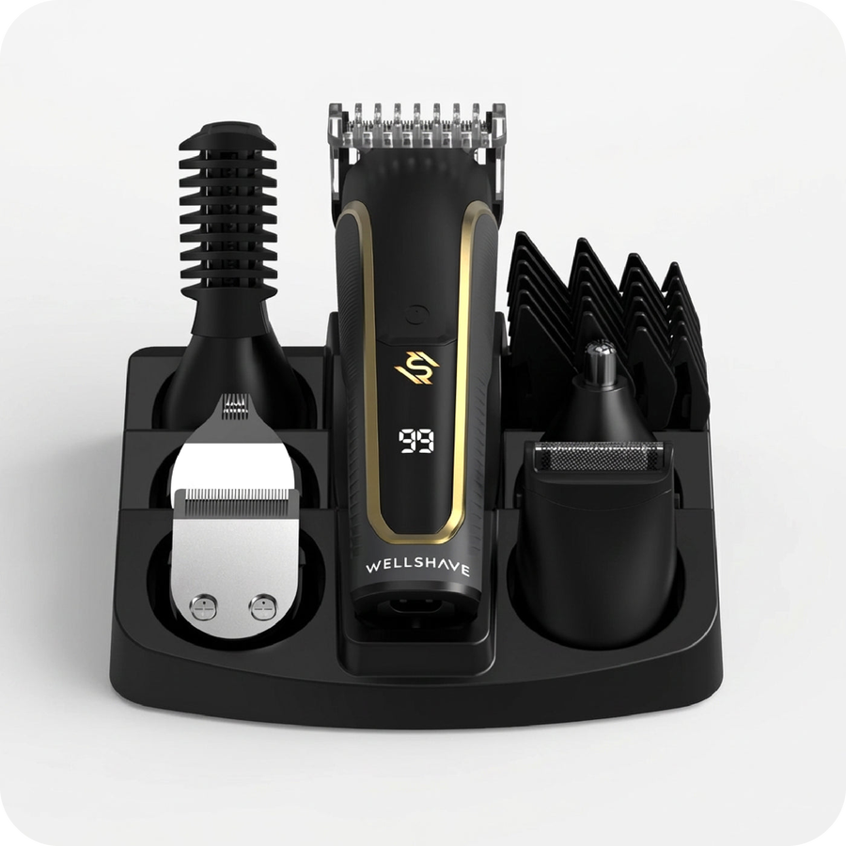
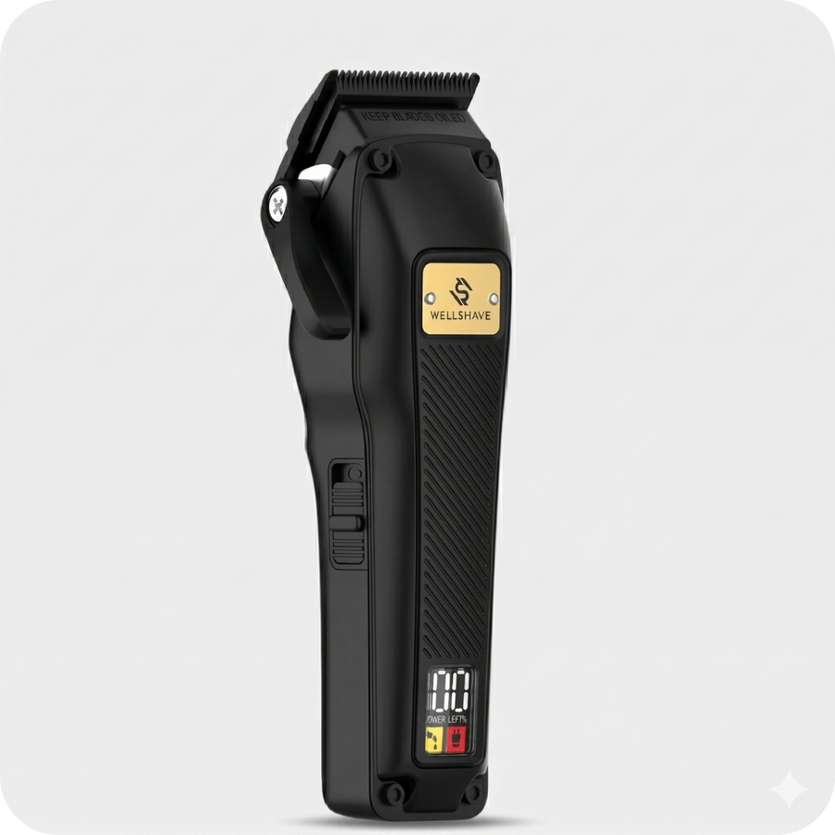
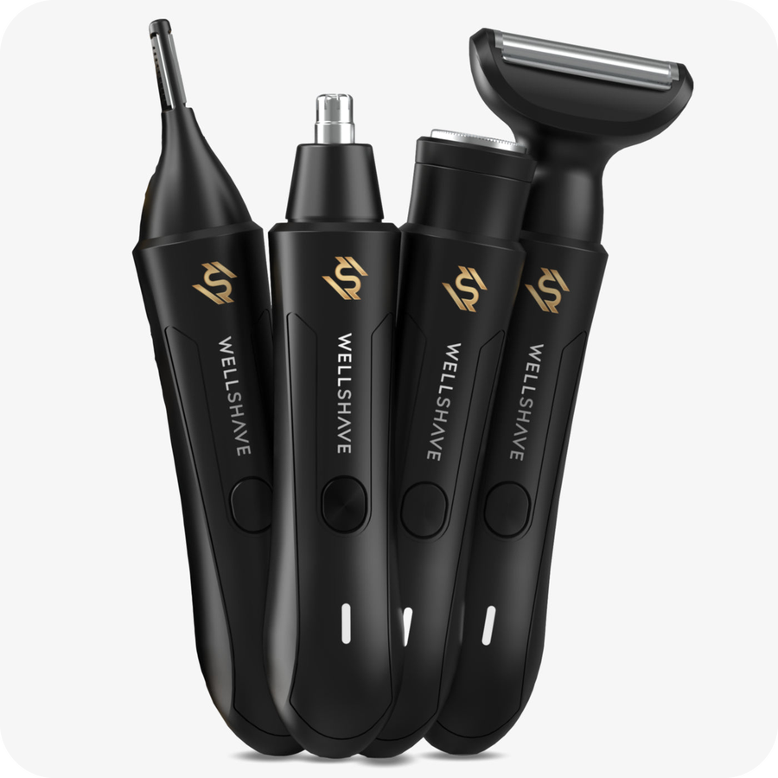
Our product range
我们的产品系列
Body groomers
身体修剪器
Groom Guard™ PRO
Electric shavers
电动剃须刀
The Gentleman Shaver™
Head shavers
光头剃须刀
Head Shaver Deluxe
Beard trimmers
胡须修剪器
Men Shaper Supreme™ 6-in-1
Hair clippers
理发器
Tondeuse Elegant™
Nose trimmers
鼻毛修剪器
Neustrimmer Ultimate™ 4-in-1
Also: safety razors, replacement blades, accessories and value bundles. 另有：安全剃须刀、替换刀片、配件及超值套装。
Notes:
Keep it short. Point at the categories this factory makes for us.

Slide 4
Today's visit team
今日拜访团队
DG
WG
L
Dustin Gibson
Willem de Groot
Leo
Founder & CEO
创始人兼首席执行官
Creative Strategist & Operations Manager
创意策略师兼运营经理
Supply Chain Manager, China
中国供应链经理
DURING THE VISIT · 拜访角色
Brand vision, 2027 plans and final decisions
品牌愿景、2027 年计划与最终决策
DURING THE VISIT · 拜访角色
Customer insights, product presentation and operations
客户洞察、产品呈现与运营
DURING THE VISIT · 拜访角色
Your local contact for orders, quality and follow-up
订单、品质与后续跟进的本地联系人
One team, in the Netherlands and in China. 荷兰与中国，同一个团队。

Slide 5

Why we are visiting
本次拜访目的
01
02
03
04
Get to know each other
相互了解
Review current data
回顾当前数据
Share our 2027 plans
分享 2027 年计划
Improve the range together
共同优化产品
We introduce Wellshave, our customers and how we work.
介绍 Wellshave、我们的客户和工作方式。
Sales, reviews and returns of the products we buy from you.
回顾我们向贵司采购产品的销量、评价和退货情况。
Our growth plans and what they mean for your factory.
我们的增长计划及其对贵厂的意义。
Better quality, better prices and new models.
更好的品质、更优的价格和新款产品。
A good visit: we leave with samples, your recommendations and clear next steps for 2027.
成功的拜访：我们带着样品、您的建议和清晰的 2027 年下一步计划回去。

Slide 6
Your products at Wellshave
贵司产品在 Wellshave 的表现
Product 产品 | Model 型号 | Sold in 2026 * 2026 年销量 * | Return rate * 退货率 *
Nose trimmers (7 models) | WS-NT1 / WS-NT2 | 25,627 | 2.1%
Body groomer Groom Guard | WS-BG1 / HT-6006 | 2,116 | 2.3%
Head Shaver Deluxe | WS-SA1 / JK-8588A | 1,581 | 4.6%
Foil shaver Blade Baron | FK-706 | 1,307 | 5.6%
Body groomer Flex Guard | WS-BG3 | 1,135 | 5.2%
G-Series clipper, Shave Package, spare heads |  | 1,786 | 4.1%
Total 合计 |  | 33,552
* bol.com, 1 January to 15 October 2026. Return rate counts all return reasons. Webshop sales not included. We share our 2027 forecast in the meeting.
* 数据来源：bol.com，2026年1月1日至10月15日。退货率包含所有退货原因，不含官网销量。2027年预测将在会议中分享。
Notes:
Only the products we buy through this partner. Sales are bol.com units (about 80% of our revenue).

Slide 7
What our customers tell us
客户反馈
Weak cutting: hairs not caught 修剪力度不足，剪不到毛发
28
33,552
“After 10 minutes in my nose, just as many hairs as before.”
在鼻子里用了10分钟，鼻毛还是和之前一样多。
units sold on bol.com in 2026
2026年bol.com销量
Broken within weeks or months 使用数周或数月后损坏
18
“Used it twice and the head was broken.”
只用了两次，刀头就坏了。
77
Caps, attachments, missing parts 保护盖、配件安装与缺件
11
critical reviews (1 to 3 stars)
差评数（1至3星）
“The cap got stuck on the head and was very hard to remove.”
保护盖卡在刀头上，很难取下来。
Skin irritation 皮肤刺激
7
2.3
“Welts on the skin right from the first use.”
第一次使用就在皮肤上留下了红痕。
critical reviews per 1,000 units
每千件产品的差评数
Battery, charging and heat 电池、充电与发热
6
“After 3 months it no longer charges.”
用了3个月后就无法充电了。
Source: bol.com reviews with 1 to 3 stars on your products, January to October 2026. One review can mention several topics.
数据来源：2026年1月至10月bol.com上贵司产品的1至3星评价，一条评价可能涉及多个问题。
Notes:
Themes are tagged by hand from the bol.com review texts. Quotes are translated from Dutch.

Slide 8



What we want to improve together
我们希望共同改进的方向
Better quality
更好的品质
Better prices
更优的价格
New models
新款产品
FOCUS: BATTERIES & CHARGING
重点：电池与充电
FOCUS: CURRENT RANGE
重点：现有产品
FOCUS: CO-DEVELOPMENT
重点：共同开发
Longer battery life and lifespan
续航更长，电池寿命更长
Fixed-cable adapter as standard
今后标配线缆固定的一体式适配器
So the right adapter is always used
确保客户始终使用与设备匹配的适配器
Fewer defects and returns
减少故障和退货
Lower purchase prices
降低现有产品的采购价格
Cost ideas that keep the quality
在保证品质前提下的降本方案
Prices based on 2027 volumes
基于 2027 年采购量报价
Develop new models together
共同开发新款产品
Upgrades of our best-sellers
升级我们的畅销款
Your newest technology
贵司的最新技术
Why this matters: our customers get a 100-day trial and a 2-year warranty, so every weak battery becomes a return and a bad review.
原因：我们为客户提供 100 天试用和 2 年保修，每一个电池问题都会变成退货和差评。
Notes:
Fixed-cable adapter: from now on every device ships with a charger whose cable is fixed to the adapter, so customers always charge with the right adapter for that device. Wrong adapters damage batteries and lead to returns.

Slide 9


What we would love to see
我们最期待看到的
Samples 样品
New models and improved batteries. We like to hold and test them ourselves.
新款产品和改进后的电池。我们希望亲手体验和测试。
Thank you
谢谢
We look forward to growing together.
期待与贵司共同成长。
Your recommendations 您的推荐
What sells well in other markets? What would you change in our products?
哪些产品在其他市场卖得好？您会如何改进我们的产品？
Dustin Gibson · Founder & CEO
dustin@wellshave.com
wellshave.com
No preparation needed: we mainly come to listen. 无需特别准备：我们主要是来倾听的。

