Slide 1
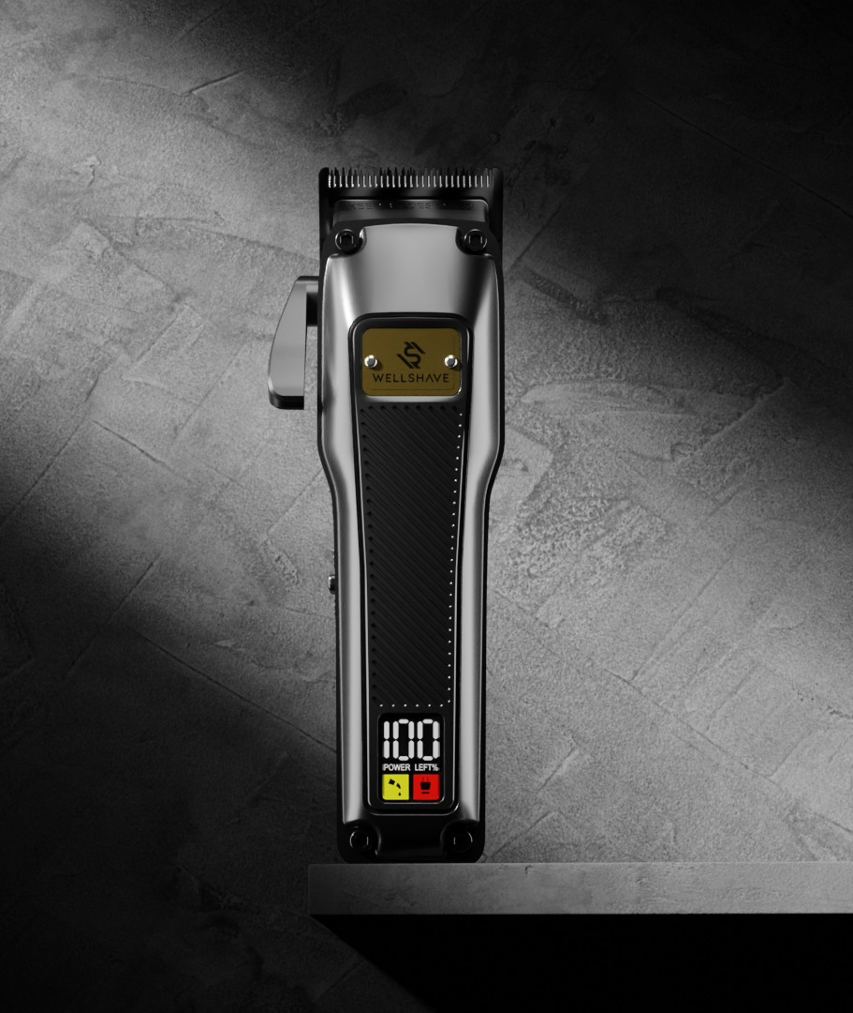

FACTORY VISIT · 工厂拜访
Introducing
Wellshave
Wellshave 品牌介绍
Dutch men's grooming brand · Netherlands & Belgium
荷兰男士理容品牌 · 主营荷兰与比利时市场
Prepared for FANKE · October 2026
拜访工厂：FANKE · 2026 年 10 月
Notes:
Opening. Thank FANKE for hosting us. One sentence: who we are and why we came.

Slide 2



About Wellshave
关于 Wellshave
Wellshave is a Dutch men's grooming brand, founded in 2021. We design and sell shavers, trimmers and clippers that give men premium quality at a fair price.
Wellshave 是一家荷兰男士理容品牌，成立于 2021 年。我们设计并销售剃须刀、修剪器和理发器，以合理的价格为男士提供高端品质。
2021
NL + BE
Founded
成立年份
Main markets
主要市场
Driven by customer feedback · 以客户反馈为驱动
≈ €2.5M
≈ €0.6M
Every product upgrade starts with what customers return, miss or want better.
每一次产品升级都源于客户反馈：退货原因、缺少的功能或希望改进的地方。
bol.com revenue 2026
bol.com 2026 年营业额
Own webshop 2026
自营官网 2026 年营业额
4.4 / 5
Trustpilot score, 1,000+ customer reviews
Trustpilot 评分，1000 多条客户评价
100-day trial
100 天试用
2-year warranty
2 年保修
Next-day delivery
次日送达
bol.com is the largest online marketplace in the Netherlands and Belgium. bol.com 是荷兰和比利时最大的电商平台。
Notes:
Revenue figures are approximate for 2026. Remove the two revenue tiles if you prefer not to share them.

Slide 3
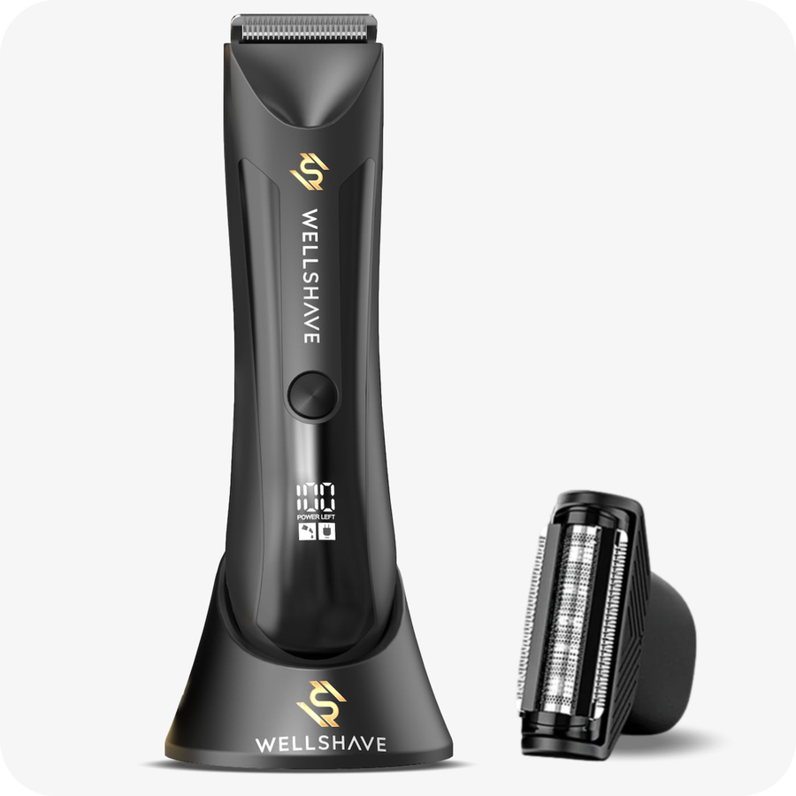
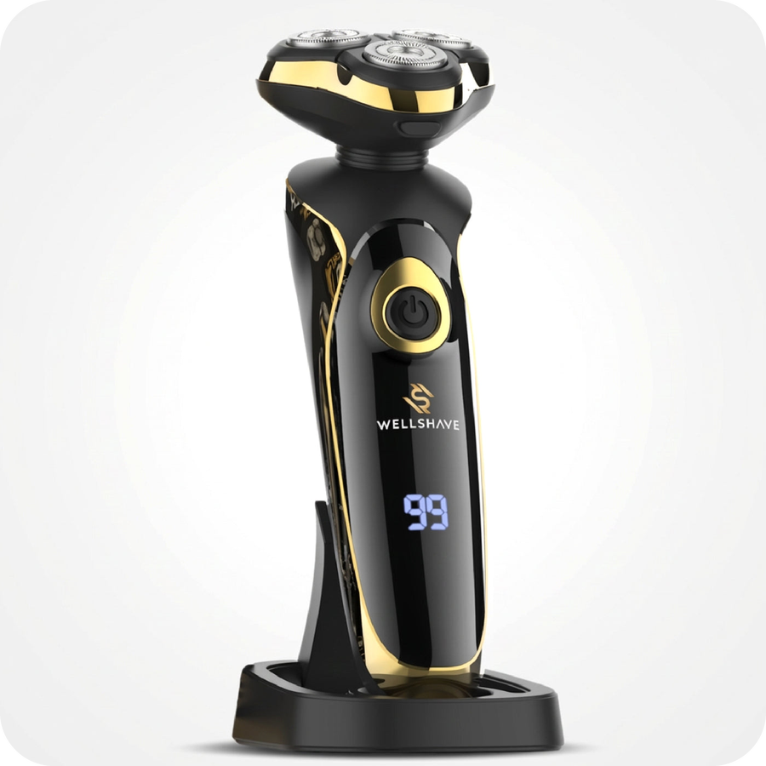
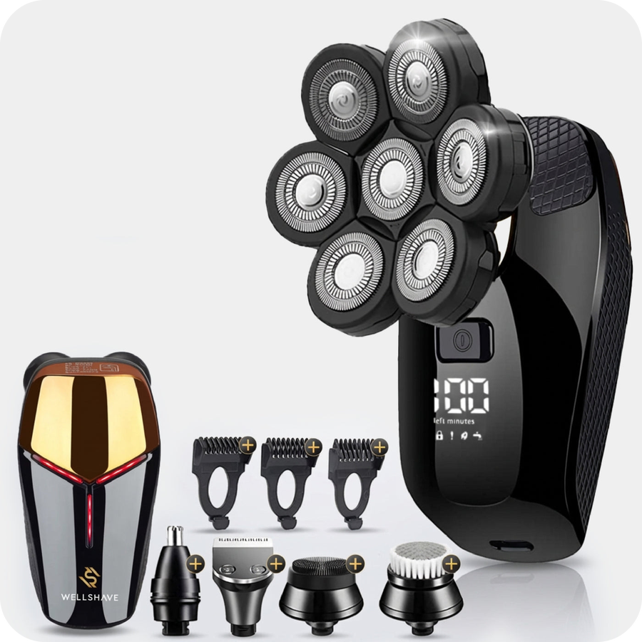
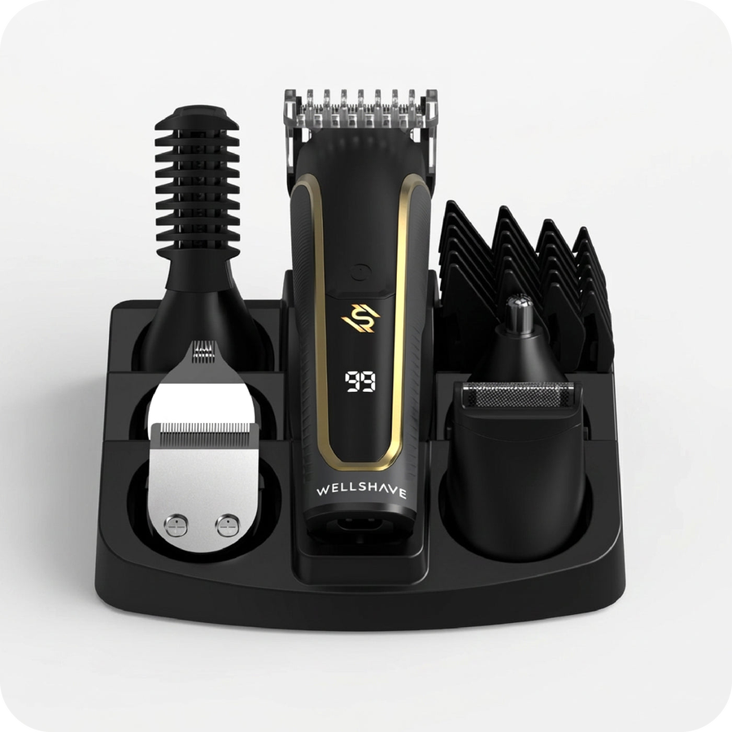
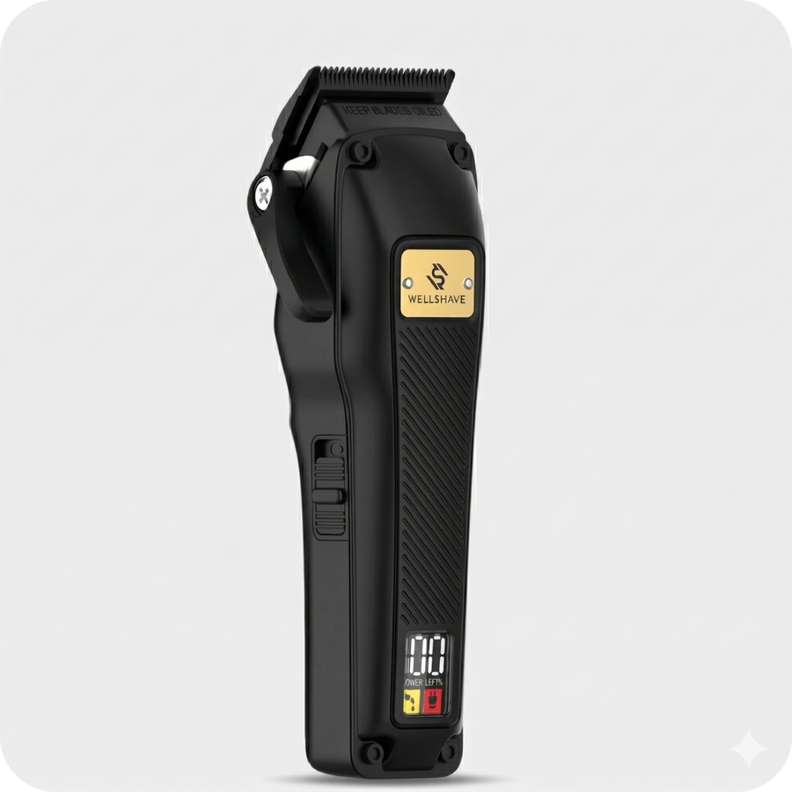
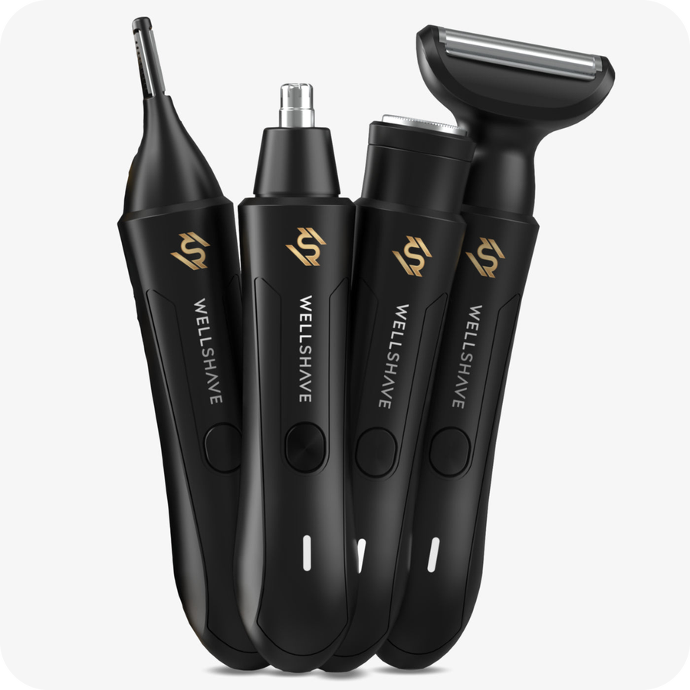
Our product range
我们的产品系列
Body groomers
身体修剪器
Groom Guard™ PRO
Electric shavers
电动剃须刀
The Gentleman Shaver™
Head shavers
光头剃须刀
Head Shaver Deluxe
Beard trimmers
胡须修剪器
Men Shaper Supreme™ 6-in-1
Hair clippers
理发器
Tondeuse Elegant™
Nose trimmers
鼻毛修剪器
Neustrimmer Ultimate™ 4-in-1
Also: safety razors, replacement blades, accessories and value bundles. 另有：安全剃须刀、替换刀片、配件及超值套装。
Notes:
Keep it short. Point at the categories this factory makes for us.

Slide 4
Today's visit team
今日拜访团队
DG
W
L
Dustin Gibson
Willem
Leo
Founder & CEO
创始人兼首席执行官
Creative Strategist & Operations Manager
创意策略师兼运营经理
Supply Chain Manager, China
中国供应链经理
DURING THE VISIT · 拜访角色
Brand vision, 2027 plans and final decisions
品牌愿景、2027 年计划与最终决策
DURING THE VISIT · 拜访角色
Customer insights, product presentation and operations
客户洞察、产品呈现与运营
DURING THE VISIT · 拜访角色
Your local contact for orders, quality and follow-up
订单、品质与后续跟进的本地联系人
One team, in the Netherlands and in China. 荷兰与中国，同一个团队。

Slide 5

Why we are visiting
本次拜访目的
01
02
03
04
Get to know each other
相互了解
Review current data
回顾当前数据
Share our 2027 plans
分享 2027 年计划
Improve the range together
共同优化产品
We introduce Wellshave, our customers and how we work.
介绍 Wellshave、我们的客户和工作方式。
Sales, reviews and returns of the products we buy from you.
回顾我们向贵司采购产品的销量、评价和退货情况。
Our growth plans and what they mean for your factory.
我们的增长计划及其对贵厂的意义。
Better quality, better prices and new models.
更好的品质、更优的价格和新款产品。
A good visit: we leave with samples, your recommendations and clear next steps for 2027.
成功的拜访：我们带着样品、您的建议和清晰的 2027 年下一步计划回去。

Slide 6



What we want to improve together
我们希望共同改进的方向
Better quality
更好的品质
Better prices
更优的价格
New models
新款产品
FOCUS: BATTERIES & CHARGING
重点：电池与充电
FOCUS: CURRENT RANGE
重点：现有产品
FOCUS: CO-DEVELOPMENT
重点：共同开发
Longer battery life per charge
单次充电续航更长
Longer battery lifespan
电池使用寿命更长
Fewer defects and returns
减少故障和退货
Lower purchase prices
降低现有产品的采购价格
Cost ideas that keep the quality
在保证品质前提下的降本方案
Prices based on 2027 volumes
基于 2027 年采购量报价
Develop new models together
共同开发新款产品
Upgrades of our best-sellers
升级我们的畅销款
Your newest technology
贵司的最新技术
Why this matters: our customers get a 100-day trial and a 2-year warranty, so every weak battery becomes a return and a bad review.
原因：我们为客户提供 100 天试用和 2 年保修，每一个电池问题都会变成退货和差评。

Slide 7

Our products with FANKE
我们向 FANKE 采购的产品
Product 产品 | Volume 2026 2026 年采购量 | Forecast 2027 2027 年预测 | Focus for this visit 本次重点
[Product name] | [pcs] | [pcs] | [quality / price / new model]
[Product name] | [pcs] | [pcs] | [quality / price / new model]
[Product name] | [pcs] | [pcs] | [quality / price / new model]
In the meeting we share the full data per product: sales, customer reviews, returns and the main complaints.
会议中我们将分享每款产品的完整数据：销量、客户评价、退货情况以及主要问题。
Notes:
Fill in the products and volumes for this factory before sharing.

Slide 8


What we would love to see
我们最期待看到的
Samples 样品
New models and improved batteries. We like to hold and test them ourselves.
新款产品和改进后的电池。我们希望亲手体验和测试。
Thank you
谢谢
We look forward to growing together.
期待与贵司共同成长。
Your recommendations 您的推荐
What sells well in other markets? What would you change in our products?
哪些产品在其他市场卖得好？您会如何改进我们的产品？
Dustin Gibson · Founder & CEO
dustin@wellshave.com
wellshave.com
No preparation needed: we mainly come to listen. 无需特别准备：我们主要是来倾听的。

