Slide 1
Predicting house prices
Ames Housing Dataset
By Dean de Cock, a Professor of Statistics at Truman State University
2,930 Observations
Target variable: Sales price (Continuous) in US dollar
79 Features:
23 Nominal Category
23 Ordinal Category
14 Discrete Numeric
19 Continuous Numeric

Slide 2
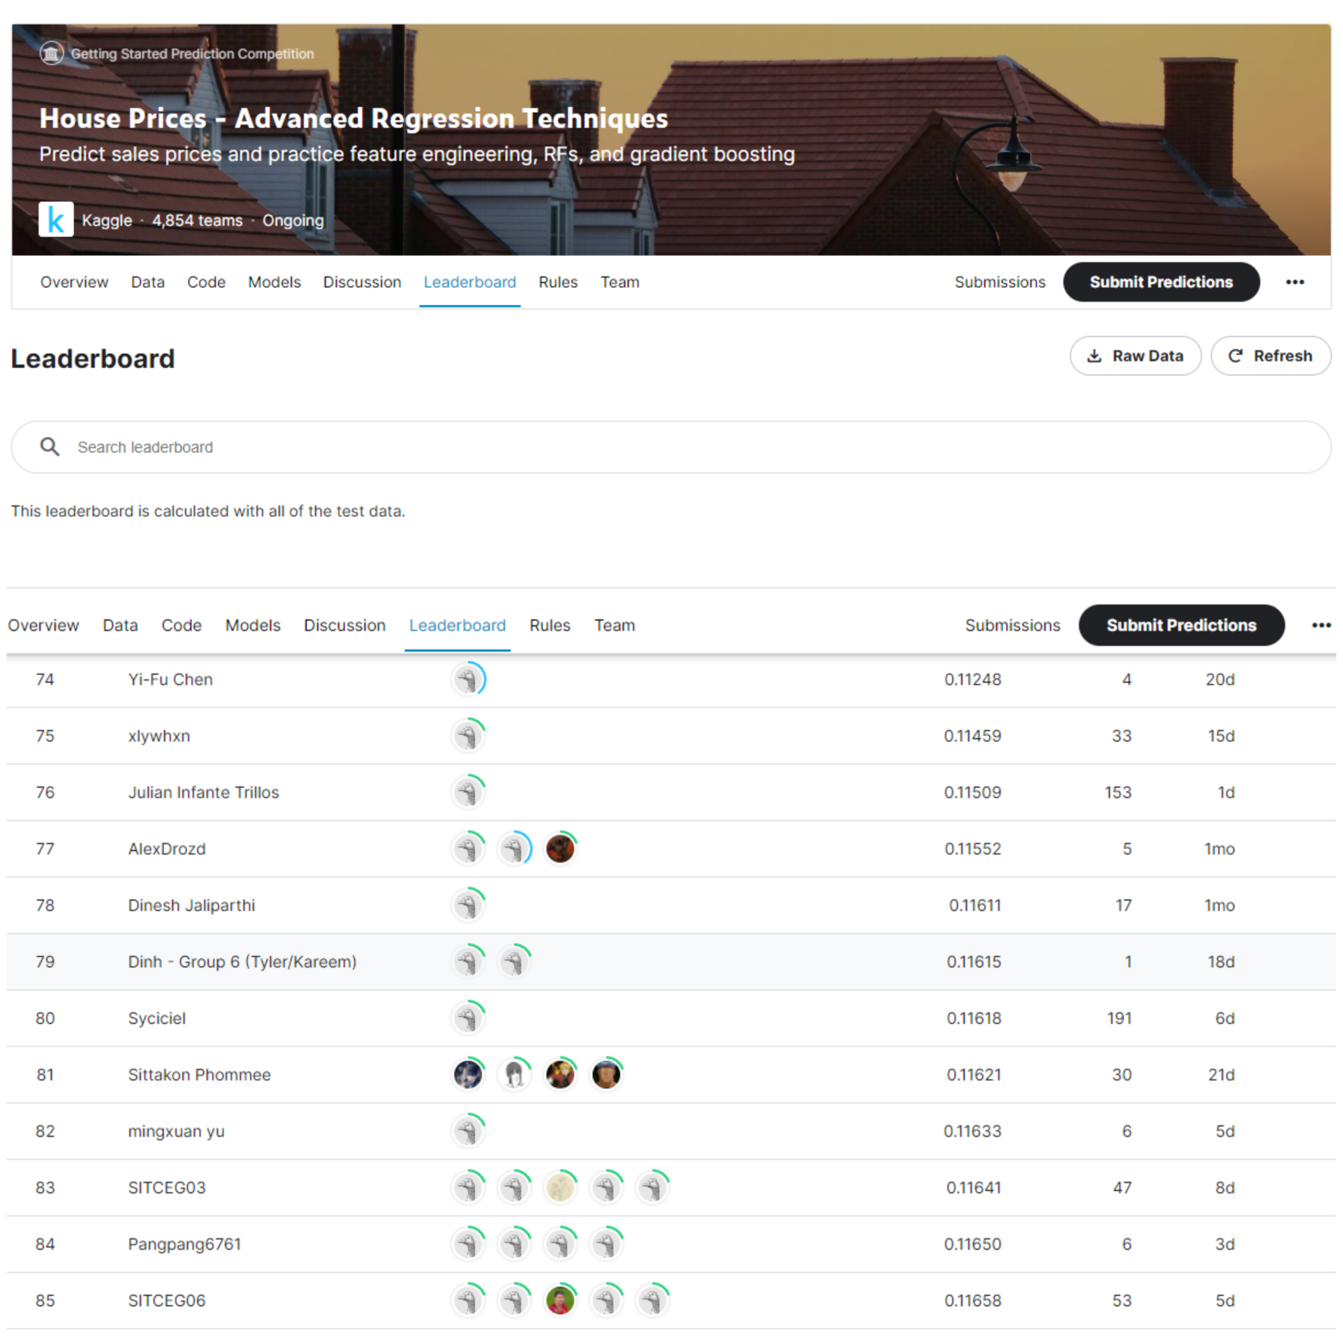
Objective
This dataset is being use in an ongoing Kaggle competition,
with a rolling leaderboard.
Performance metric is the Root Mean Squared Error between the log(predicted value) and the log(actual value),
also known as Root Mean Squared Logarithmic Error (RMSLE)
Predictive model with score (RMSLE) < 0.110
Comparable to the top 100 leaderboard on Kaggle.
5,178 competitors
Being in the top 100 out of 5,178 competitors is approximately equivalent to being in the top 2%
Rank
Score

Slide 3
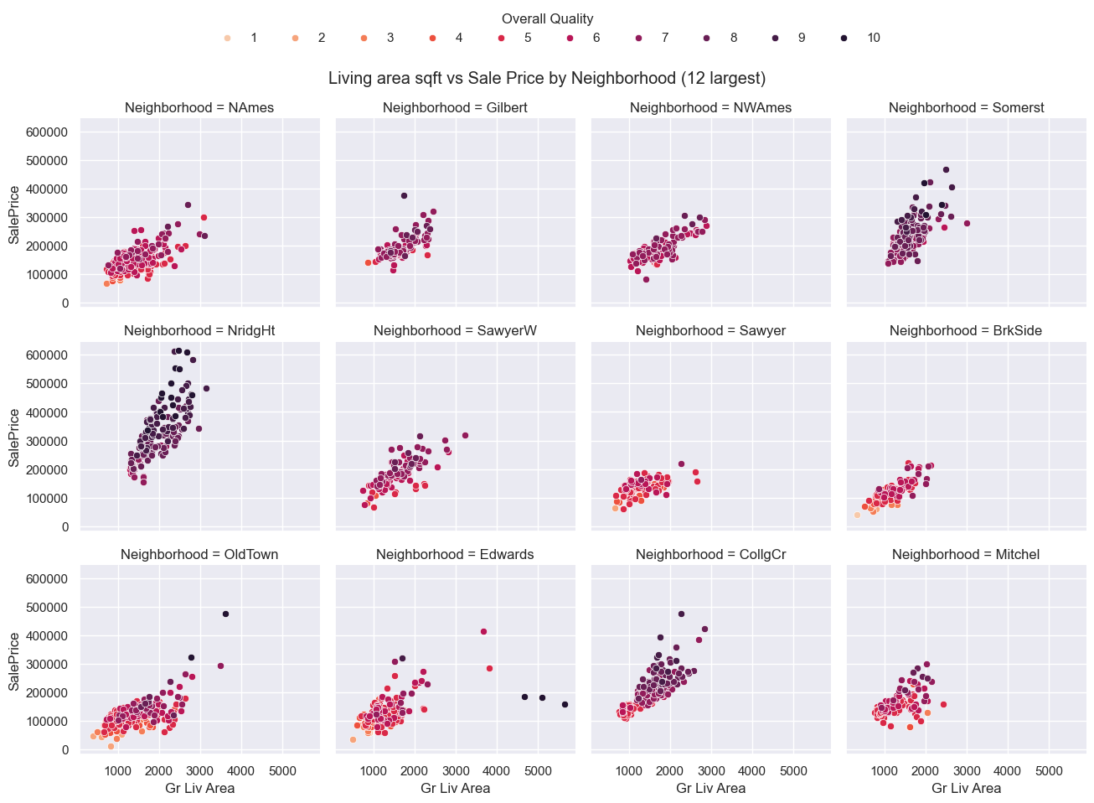
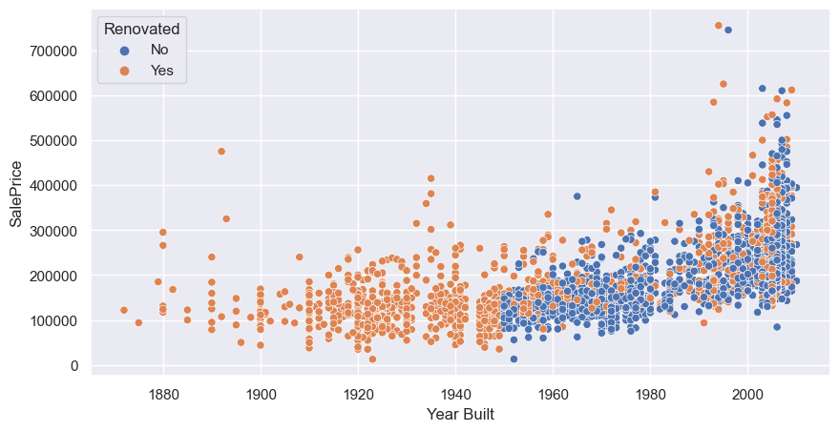
Exploratory Data Analysis
Location by Neighborhoods
Gr Liv Area (Living Area Square footage)
Age of the house

Slide 4
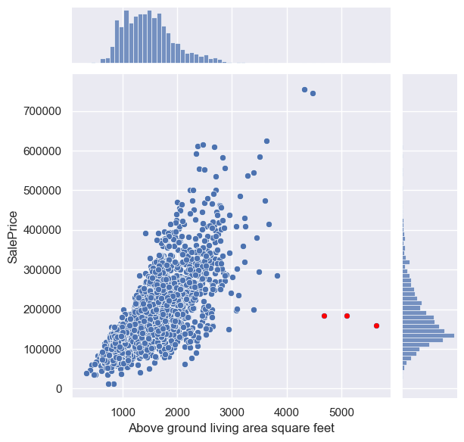
Outliers
Skewed Distributions

Slide 5
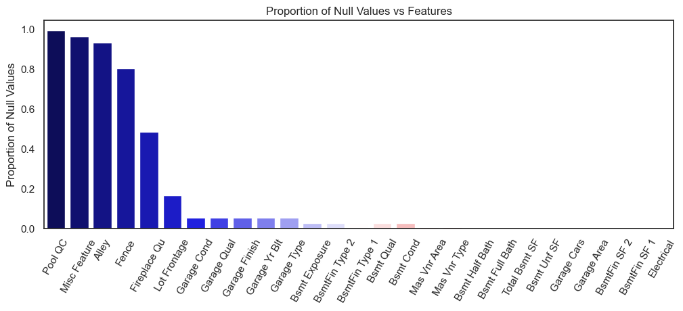
Dealing with Missing Data
Some imputations were simple:
NaN in Fireplace Quality => No Fireplace => impute with 'None’
Others like Lot Frontage were slightly more complex:
Drop Features with over 96% missing values
Dealing with skewed distribution
Box Cox transformation of highly skewed features
Using boxcox1p from Scipy, since the data contains zeros.

Slide 6
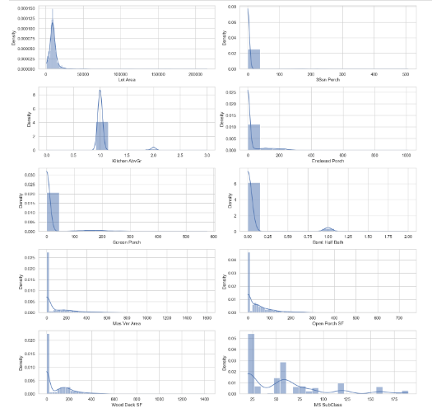
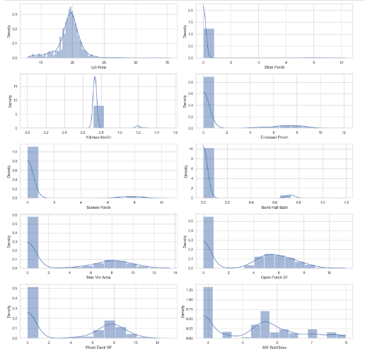
Before Transformation
After BoxCox Transformation

Slide 7
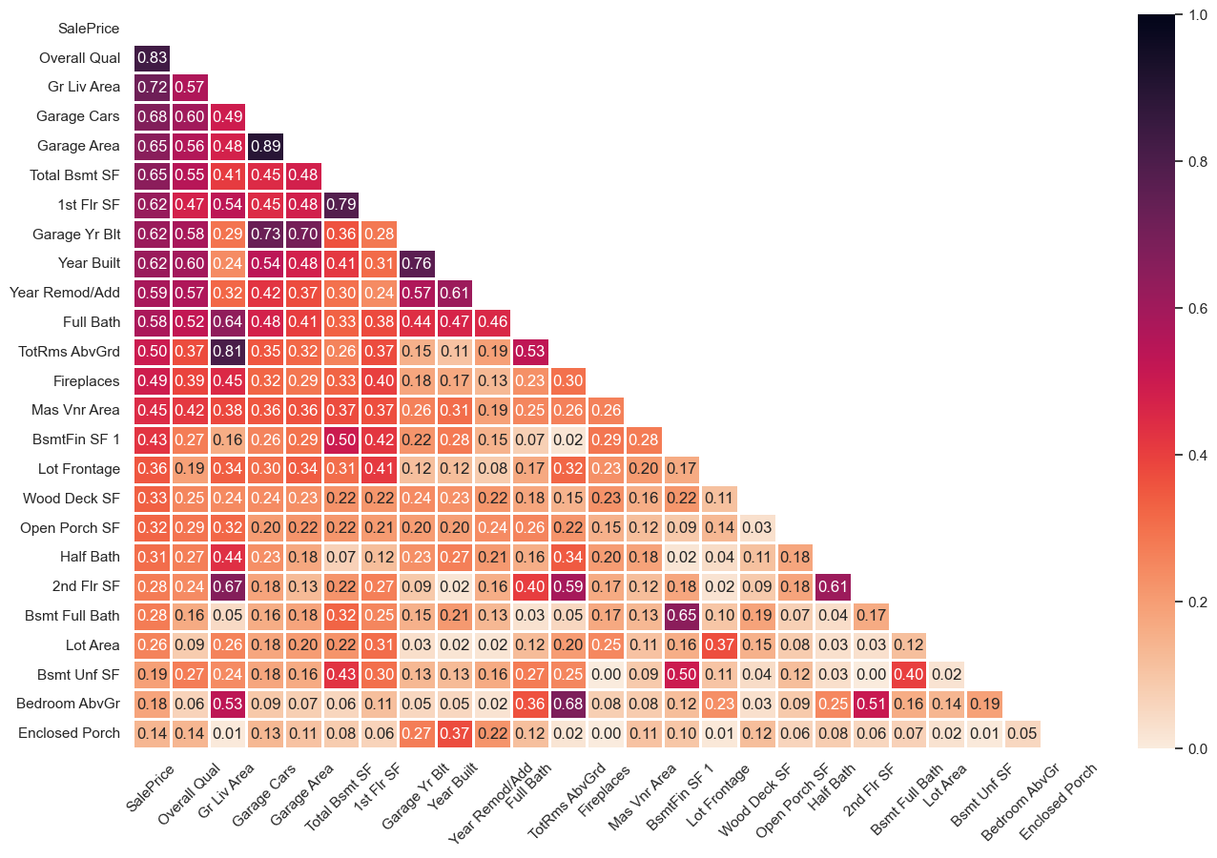
Correlation Matrix
We see high pairwise correlation between features. For example:
GarageArea and GarageCars are highly correlated.
Drop GarageCars because the information it provides is already captured in GarageArea.
Deal with the rest of the high correlated features next.

Slide 8
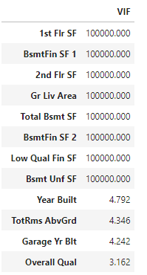
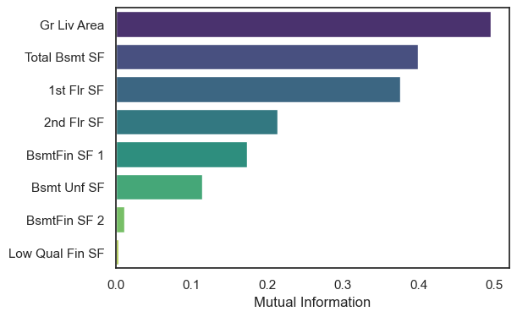
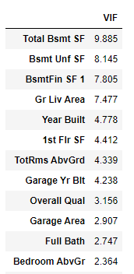
Rule of thumb:
VIF < 4
Is not a cause
For concern
Features related to square footage (SF) have perfect multicollinearity.
Drop features with perfect Collinearity (they captured the same information)
Combine into a new variable
Retain the rest and apply regularization techniques such as Ridge or Lasso
Sklearn.feature_selection Mutual Information Regression
Higher mutual information scores suggest a stronger relationship between the feature and the target.

Slide 9
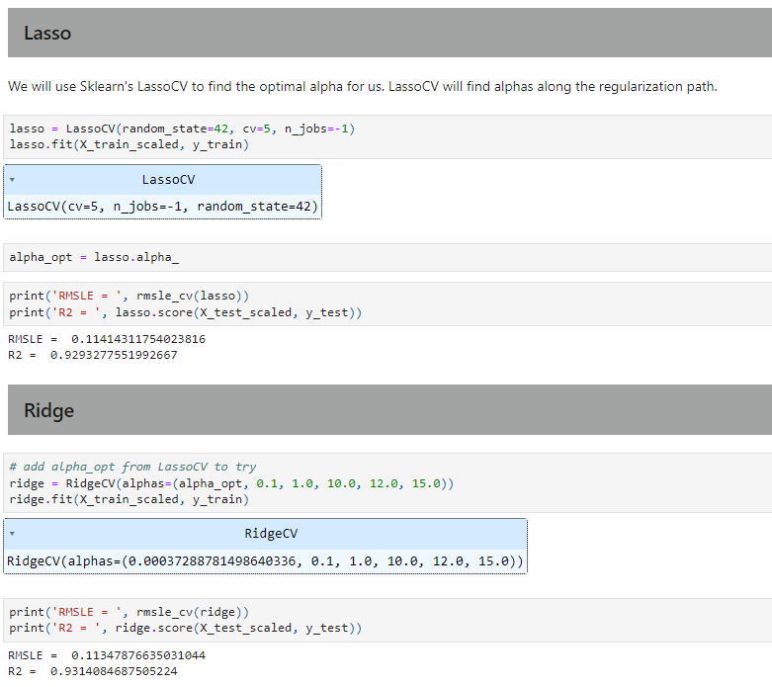
MODELING
Both Lasso and Ridge objective function introduces a regularization parameter 𝜆 (it is equivalent to alpha in Sklearn). It penalizes the values of the coefficients.
While Ridge shrinks the coefficients towards zero, Lasso encourages some of them to be exactly zero.
This results in a sparse model where only a subset of the features is selected, effectively performing feature selection.
We use Sklearn's LassoCV to find the optimal alpha. LassoCV will find alphas along the regularization path
s
Goal:
RMSLE < 0.110

Slide 10
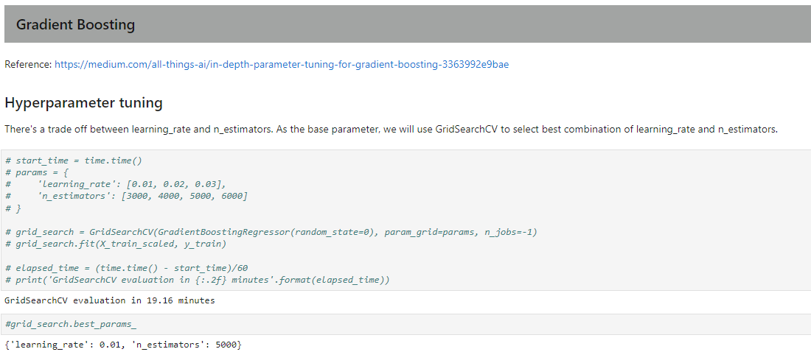
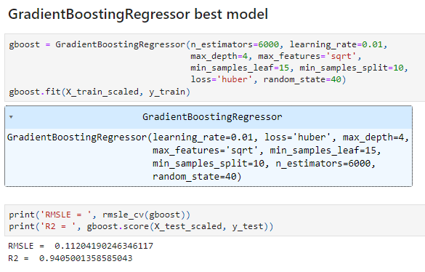
Goal:
RMSLE < 0.110

Slide 11
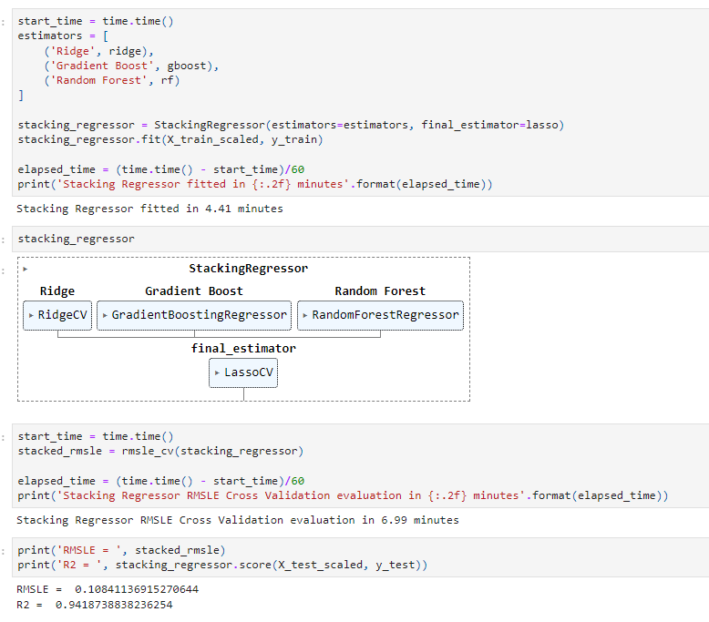
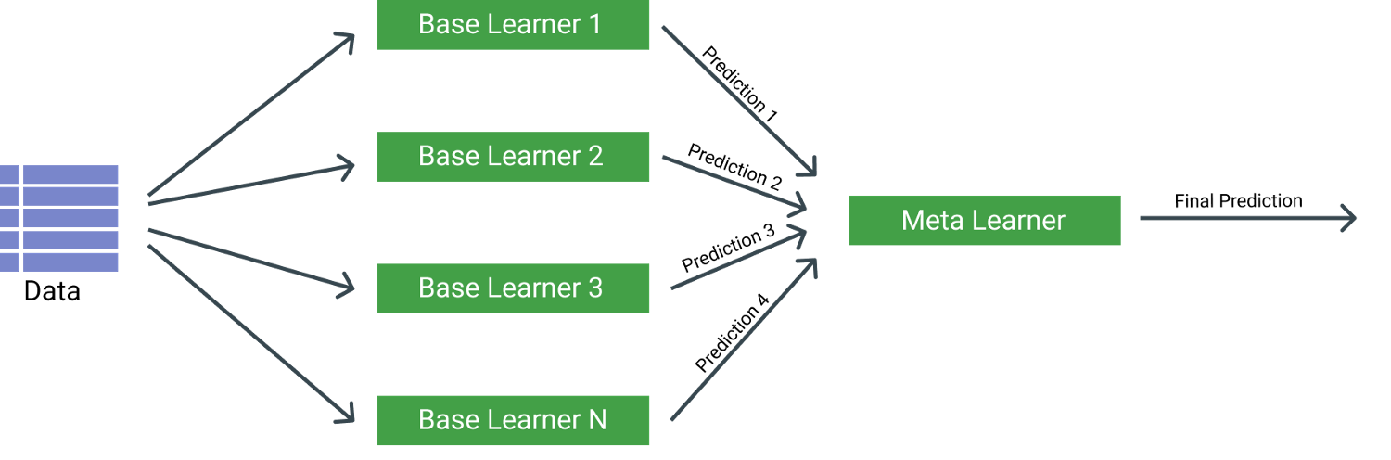
Stacking Regressor
Goal:
RMSLE < 0.11

Slide 12
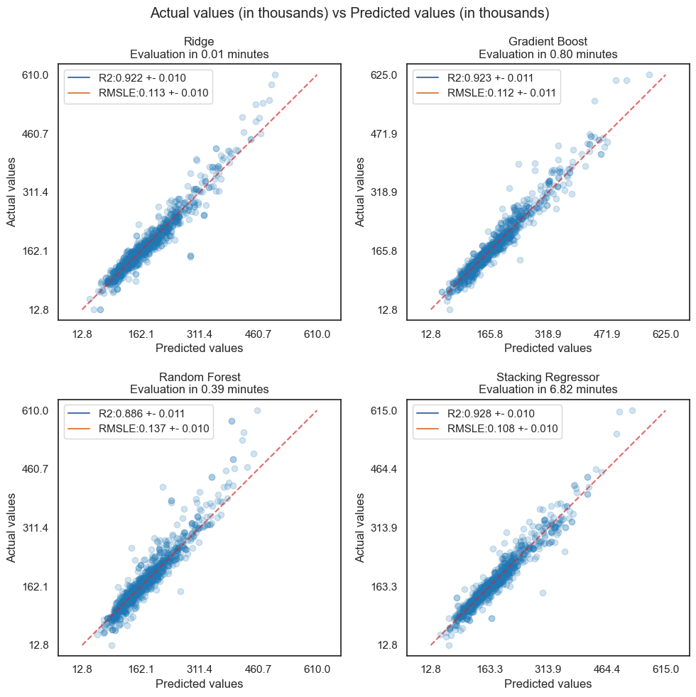
Cross Validation of Model Performances
Training the stacked regressor is much more computationally expensive.
Goal :
RMSLE < 0.110

Slide 13
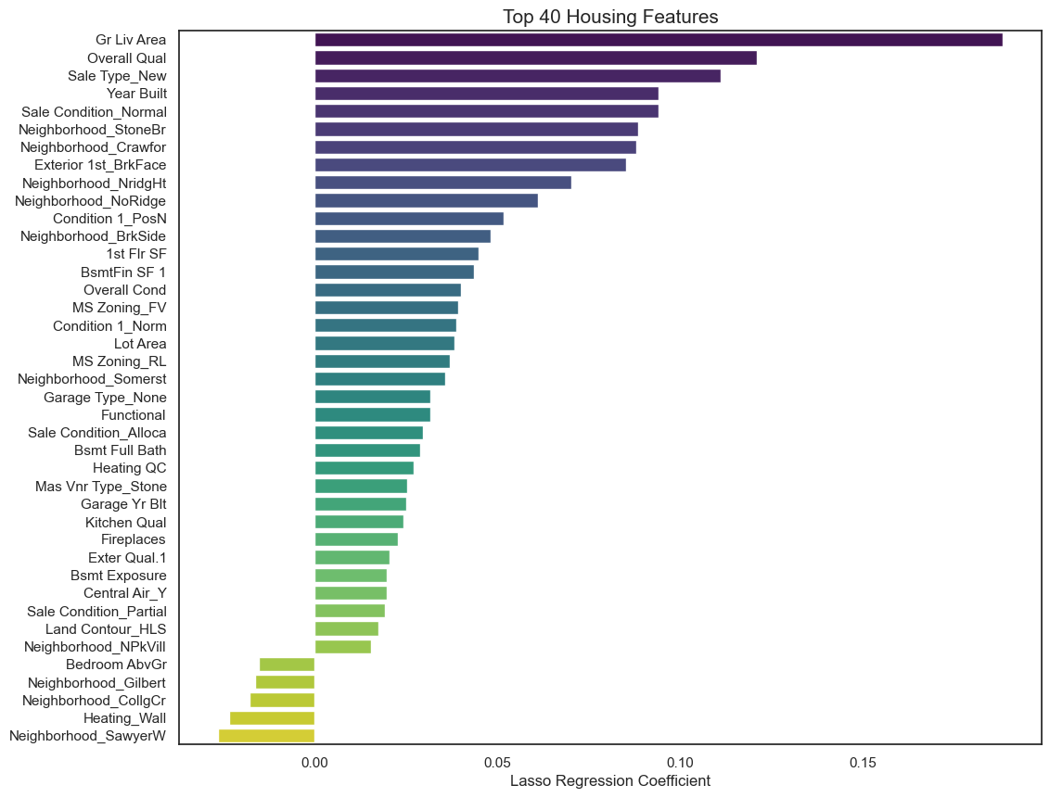

Slide 14
CONCLUSION
This project has been a learning experience for me.
Cleaning the Ames housing dataset took quite a lot of time:
handling missing values
correcting errors (wrong data types and unreasonable values)
feature engineering/selection to mitigate multicollinearity
resolving highly skewed features.
Hyperparameter tuning was a time-consuming process. It is a trade-off between computational cost, search space size, and the need for optimized hyperparameters.
As an ensemble method, the stacked regressors combine the strengths of the different single regressor. Nevertheless, a drawback is evident: the training process for the stacked regressor incurs significantly higher computational expenses.
Although the goal of achieving a model with a score below 0.11 has been met, we can further improve by creating higher order terms and interaction terms between features and
incorporating them into our model.
Thank you for your attention!

