Slide 1
太空漫游者
来自漫游着的: 张驰 李明哲 姚昕 周子孟
wellyzhangc@gmail.com

Slide 2
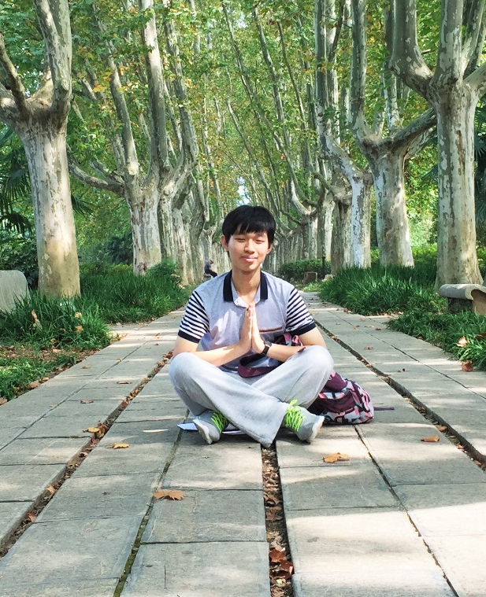

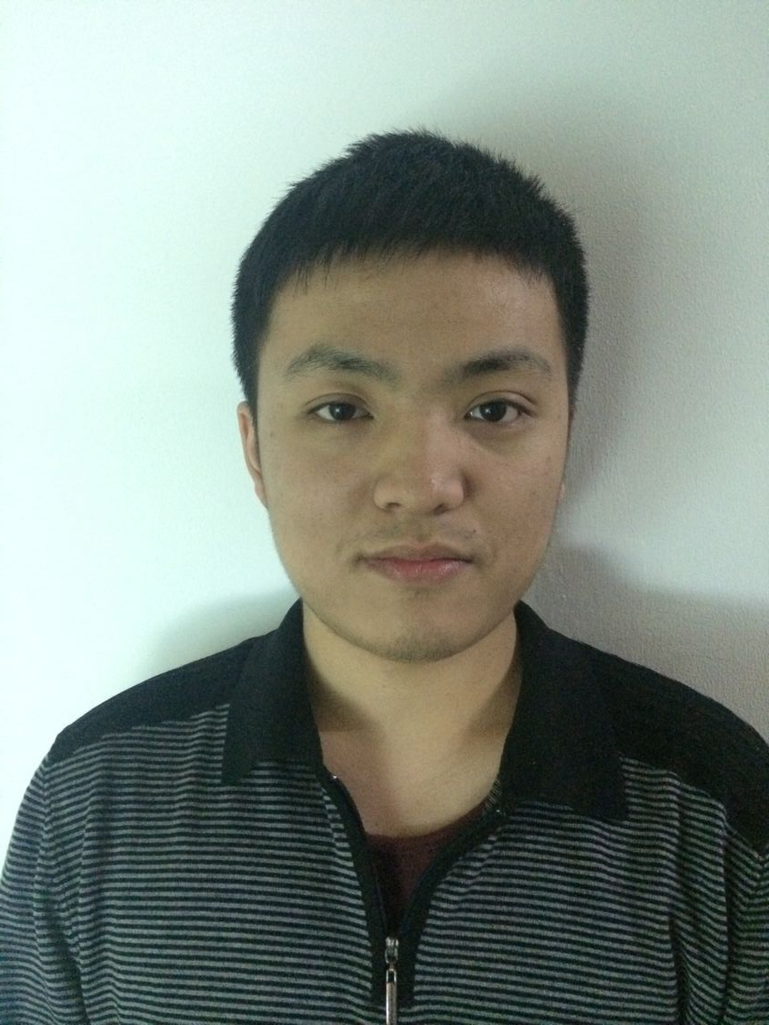
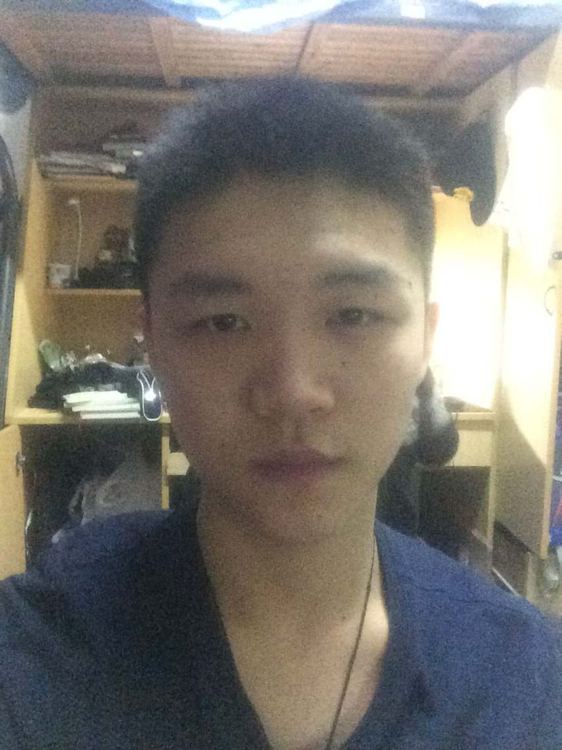
1. 当我们谈论漫游的时候我们在干啥？
驰弟
“这组参数好！”
状态：科学调参大全
小明同学
“我是蒜农”
状态：疯狂码代码
姚神
PS一波流
状态：available
子孟哥
“截屏还有谜之bug”
状态：测试狗-_-
wellyzhangc@gmail.com

Slide 3


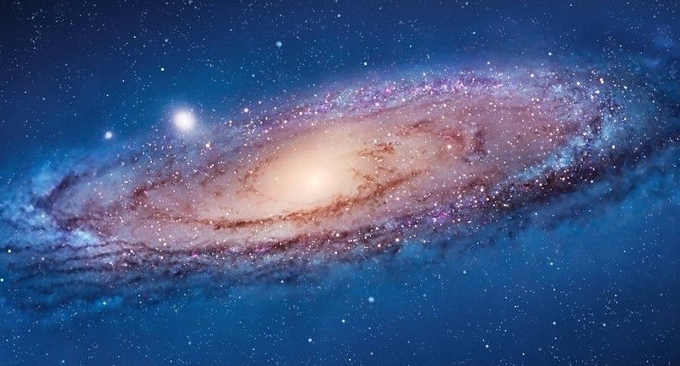
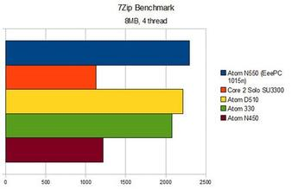

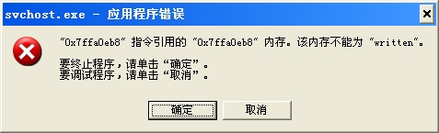
2. 是什么？不是什么？
wellyzhangc@gmail.com
Notes:
It is:
1. Pure OpenGL
2. 4 weeks with Google search
3. Possible educational tool to inspire kids of exploring space
It is not:
1. Trede Mark
2. Bug-free
3. For benchmark test

Slide 4

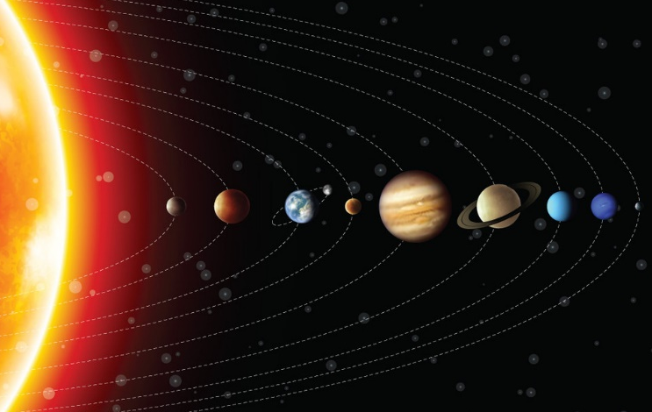
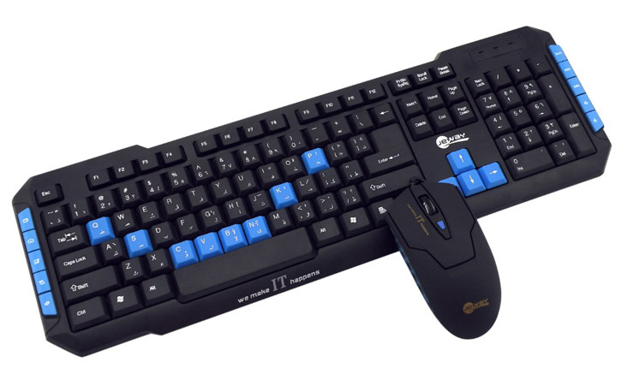
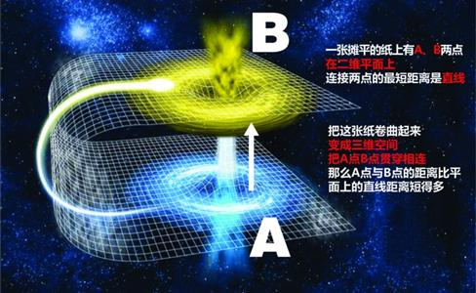

3. 好吧，它能干啥？
wellyzhangc@gmail.com
Notes:
Objective
Keyboard-mouse
Observe the solar sys
Bump detection
Wormhole effect
A objective game to explore solar system, keyboard and mouse control available with bump detection and wormhole effect.

Slide 5
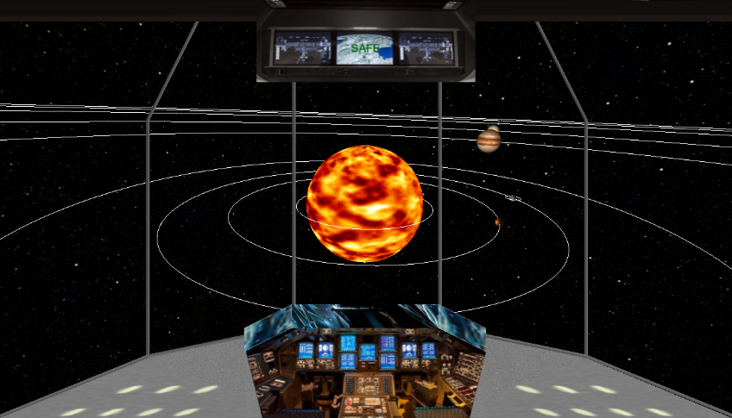
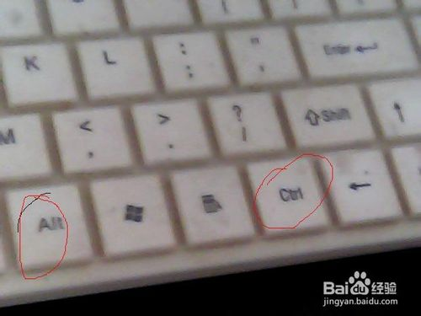

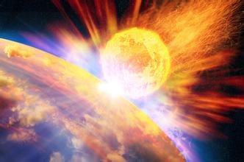


4. 有技术难点吗？
TGA → glBindTexture()
glReadPixels () → BITMAPFILEHEADER
int xixi = rand();
galaxy = new SolarSystem(xixi);
SolarSystem::testDistancewithPlanet()
SolarSystem::testDistancewithWormhole
wellyzhangc@gmail.com
Notes:
Problems and solution
1. Texture mapping: default mapping function
2. Screen shot: save each pixel in a BMP file
3. Wormhole effect: generate random galaxy
4. Bump detection: test distance
5. Lighting model: light at the Sun

Slide 6
5. 少BB，有本事亮代码！
https://github.com/WellyZhang/SpaceWanderMan
wellyzhangc@gmail.com

Slide 7
程序死循环中......
wellyzhangc@gmail.com

Slide 8
你问我猜
wellyzhangc@gmail.com

Slide 9

Thx!
wellyzhangc@gmail.com

