Slide 1



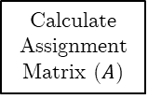

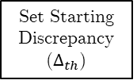
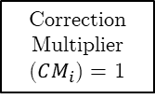
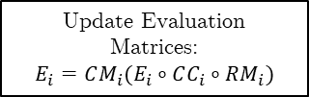
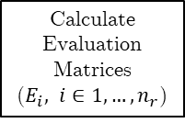


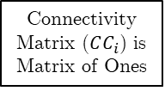

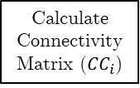



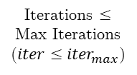




START
True
Iterations $≤$ Max Iterations ($iter≤{iter}_{max}$)
Set Starting Discrepancy ($∆_{th}$)
False
$$iter_{max}=iter_{max}/2$$
Calculate Evaluation Matrices
($E_{i}, i∈1,…,n_{r}$)
$$∆_{th}++$$
$$∆_{th}≤∆_{max}$$
False
FAILURE
Calculate Assignment Matrix ($A$)
True
$$iter=0$$
$$i=0$$
$$i=0$$
Unconnected Region
False
Acceptable Discrepancy
False
$$i++$$
$$i++$$
True
True
Calculate Connectivity Matrix (${CC}_{i}$)
Connectivity Matrix ($CC_{i}$) is Matrix of Ones
Correction Multiplier ($CM_{i}$) = 1
Calculate Correction Multiplier ($CM_{i}$)
$$i==n_{r}$$
False
Calculate Random Matrix Multiplier ($RM_{i}$)
True
All Regions Connected
False
Update Evaluation Matrices:
$$E_{i}=CM_{i}(E_{i}∘CC_{i}∘RM_{i})$$
True
$$i==n_{r}$$
False
Max – Min Cells Assigned $≤ ∆_{th}$
False
True
$$iter++$$
True
SUCCESS

