Slide 1
Market POS
Analysis and design of a supermarket
point-of-sale system
Software Engineering Practice
Taoliyuan
NUIST 202383890020 / SETU 20109990
15 October 2026
01
Notes:
Hello, my name is Taoliyuan. This individual project implements a small supermarket POS system. I will explain the Agile plan and object-oriented design, then demonstrate Process Sale and Handle Returns.

Slide 2
Two cashier workflows
Process Sale
Handle Returns
Select products and quantities
Validate cash and calculate change
Store the receipt and deduct stock
Retrieve the original receipt
Refund eligible quantities at original prices
Record the return and restore stock
Cash only. No card integration, customer accounts or receipt-less returns.
02
Notes:
The primary actor is the cashier. Customers participate through the cashier. The version handles cash, tax-inclusive EUR prices and returnable goods suitable for resale. The written use cases document success and error paths. Source: supplied assignment and Larman, Applying UML and Patterns, 3rd ed., Chapter 6.

Slide 3
Agile plan and actual checkpoints
Planned increments
15–17 Oct Cash sale and stock
18–20 Oct Returns and history
21–23 Oct Documentation and delivery
Actual evidence on 15 October: 39 → 39 → 8 points remaining
03
Notes:
The plan uses three three-day timeboxes, adapted for one person. Sprint 1 covers sale and inventory, Sprint 2 covers returns and history, and Sprint 3 covers deliverables and publication. The ideal daily plan is separate from real checkpoints. At the first verification checkpoint 31 of 39 story points had evidence. Do not describe this as multiple elapsed sprints.

Slide 4
Domain model
Sale
SaleLine
Product
1
1..*
0..*
1
saleId
dateTime
total
quantity
unitPriceAtSale
returnedQuantity
sku and name
currentPrice
stockOnHand
A refund uses the sale line’s stored price, even after the catalogue price changes.
Return and ReturnLine are persisted records in this implementation.
04
Notes:
A Sale contains SaleLines. Each line points to a Product and stores the unit price at purchase. Returns refer to the original sale and its lines. The full report includes the conceptual model and multiplicities. Source: Larman, Chapters 9 and 16.

Slide 5
Logical architecture
Presentation
Application
Domain and persistence
HTML / CSS / JavaScript
Basket and refund previews
HTTP Handler
POSService
Sale and CashPayment
SQLiteRepository
The server rechecks prices, stock and eligibility before committing.
05
Notes:
The browser manages draft input. The application layer coordinates use cases. Domain values calculate exact amounts, and the repository controls transactions. The service receives a repository through its constructor. Source: Larman, Chapter 13.

Slide 6
Object responsibilities
Object | Responsibility
POSService | Coordinate checkout and return operations
SaleLine and Sale | Calculate subtotals and total from integer cents
CashPayment | Validate cash and calculate change
SQLiteRepository | Provide transaction scope and stored records
Focused responsibilities keep HTTP formatting separate from transaction rules.
06
Notes:
POSService applies the Controller pattern. SaleLine and Sale are Information Experts for amounts. CashPayment validates tender and change. The repository controls connection and transaction lifetime. Source: Larman, Chapters 17 and 18.

Slide 7
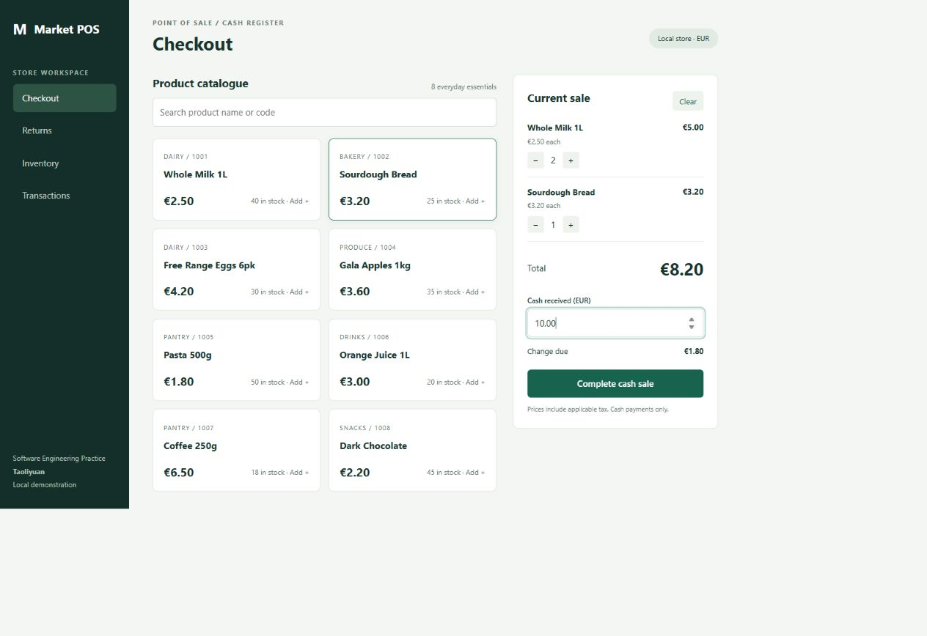
Cash sale demonstration
2 × Milk €5.00
1 × Bread €3.20
Total €8.20
Cash €10.00
Change €1.80
07
Notes:
Switch to the live application. Add two milk units and one bread. Try five euros first: insufficient cash should fail. Then enter ten euros and complete. Show the generated receipt and the one euro eighty change. The screenshot is from the real application walkthrough.

Slide 8
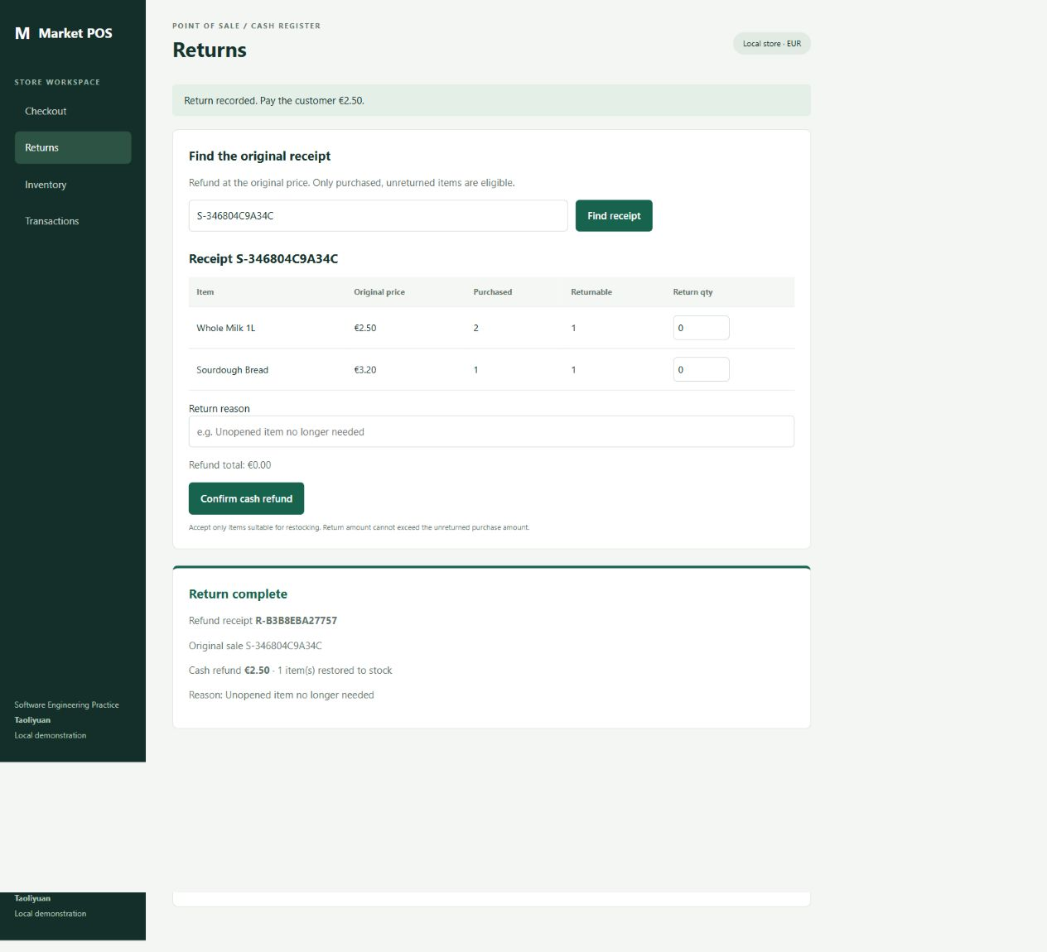
Return demonstration
Original price
€2.50 per unit
One unit returned
€2.50 refund
Milk stock
38 becomes 39
08
Notes:
Switch to Returns. Find the receipt. Select one milk unit and enter an unopened-item reason. Confirm the cash refund. Show that only one milk unit remains returnable. Try returning two more units and explain the rejection.

Slide 9
Transaction consistency
One transaction per use case
Validate
Write
Commit
Read authoritative stock
Check returnable quantity
Receipt and item records
Stock and request token
All changes succeed
Errors roll back all writes
Repeated request tokens prevent duplicate sales and refunds.
09
Notes:
The service enters BEGIN IMMEDIATE before reading current stock or returnable quantities. All receipt and stock writes commit together. An error rolls back everything. Matching request tokens return the same result on retry.

Slide 10
Verification results
22
Exact money and stock changes
Invalid input and insufficient payment
Partial and original-price refunds
Idempotent retries
Concurrent sale and return protection
Persistence and HTTP behavior
automated tests passed
Run: python -m unittest discover -s tests -v
10
Notes:
The suite passed 22 tests. Explain the business risks those tests cover. They include rollback, retry and concurrent requests, not just successful arithmetic. Browser evidence demonstrates checkout, return and history.

Slide 11
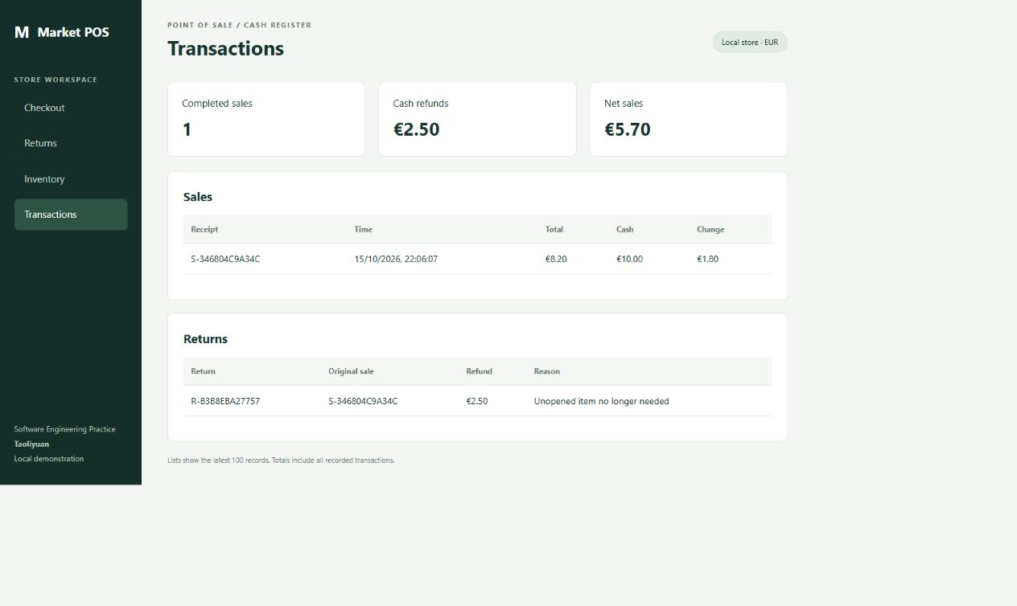
Recorded sales and refunds
€8.20 gross sales − €2.50 refunds = €5.70 net sales
11
Notes:
Show Transactions in the application. The demonstrated sale is eight euros twenty. One milk refund is two euros fifty, leaving net sales of five euros seventy. The lists show the latest 100 records while summary totals include all transactions.

Slide 12
Delivery and future work
Delivered project materials
Next steps
Runnable Python application
UML analysis and design
Technical report and Agile workbook
Tests and demonstration script
Student review and rehearsal
Repository publication verification
English video recording and upload
Final video link in the report
Future scope: cashier accounts, damaged-goods returns and receipt printers.
12
Notes:
The source repository includes code, tests and UML. The report and workbook explain planning and traceability. The next steps are student review, English recording and publishing the final video URL. Future extensions could include authenticated cashiers, damaged-goods handling and printer integration. AI assisted code and document preparation; the student is responsible for reviewing and explaining the work. Thank you.

