Slide 2
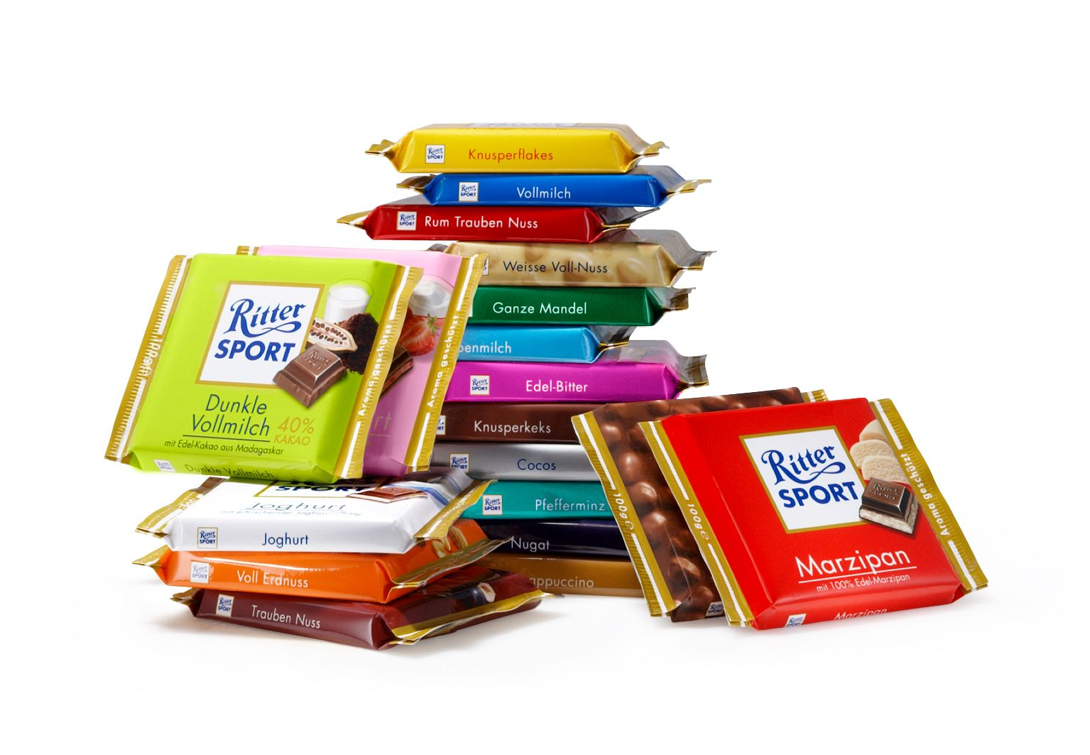

Slide 3

Company Facts
most selled chocolate in Germany after Milka
brand of chocolate for the Alfred Ritter GmbH & Co. KG
founded 1912 in Bad Canstatt
headquartered in Waldenbuch Germany
square tablet form as known today introduced 1932
owned in 3rd generation by family Ritter
aprox. 900 employees

Slide 4

Ecological / Ethical
very high reputation at Waldenbuch
has own CHP plant
does not buy nuclear power
solar panels on the roof
commendable terms for employees

Slide 5
BUT...

Slide 6
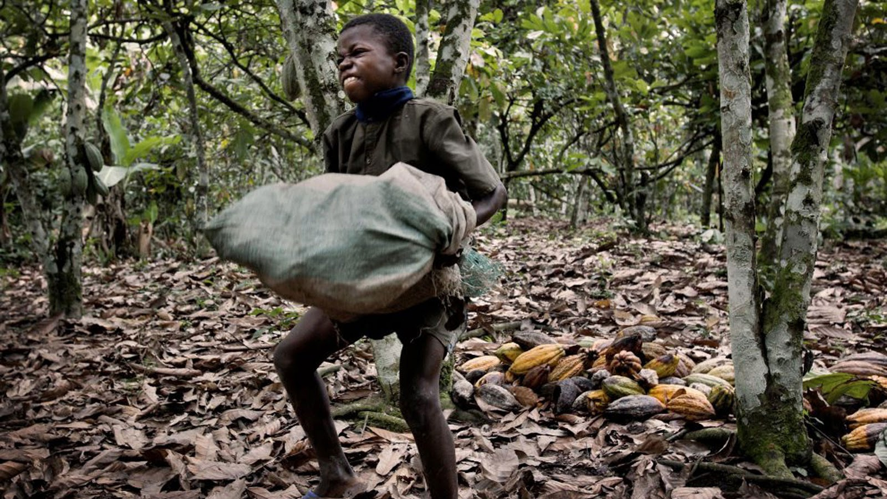

Slide 7
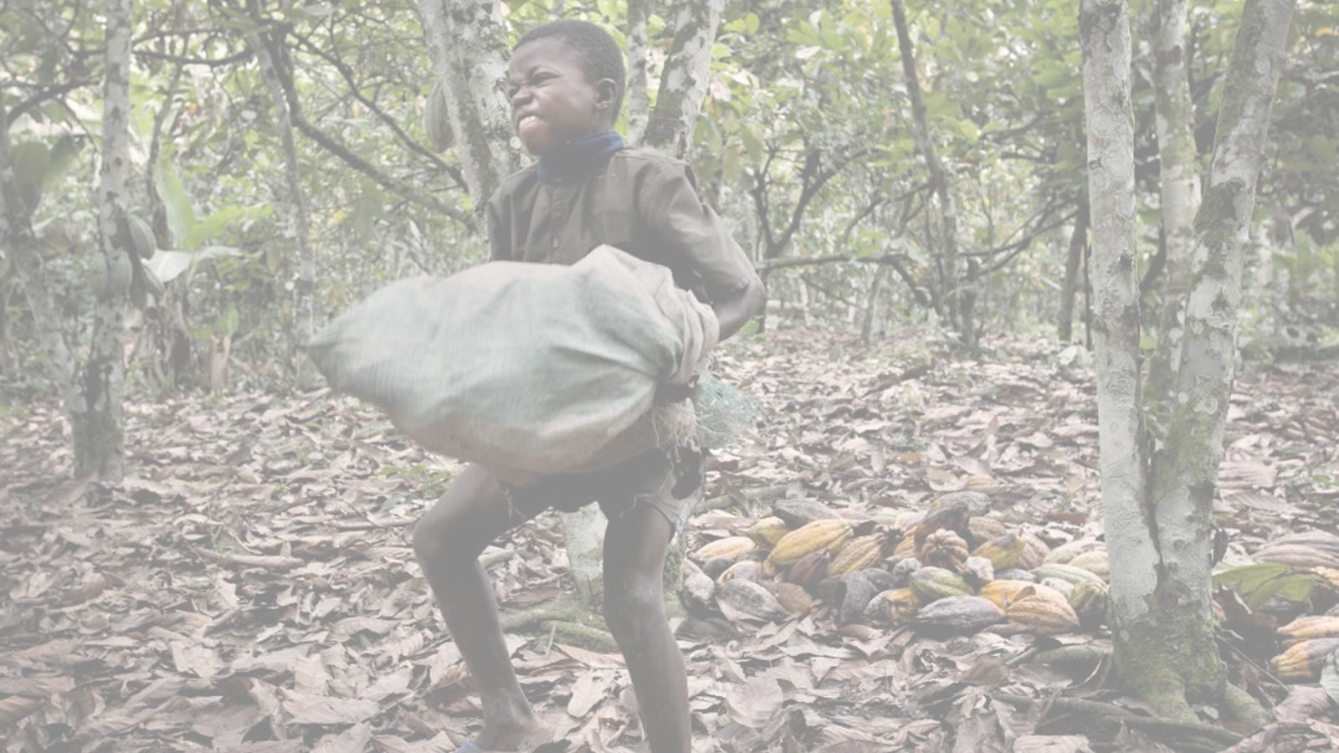
Child Labour
approx. ¾ of cocoa is from west Africa
biggest cocoa deliverer is Ivory Coast
human trafficking and child labour usual problem

Slide 8
BUT!
BUT...

Slide 9
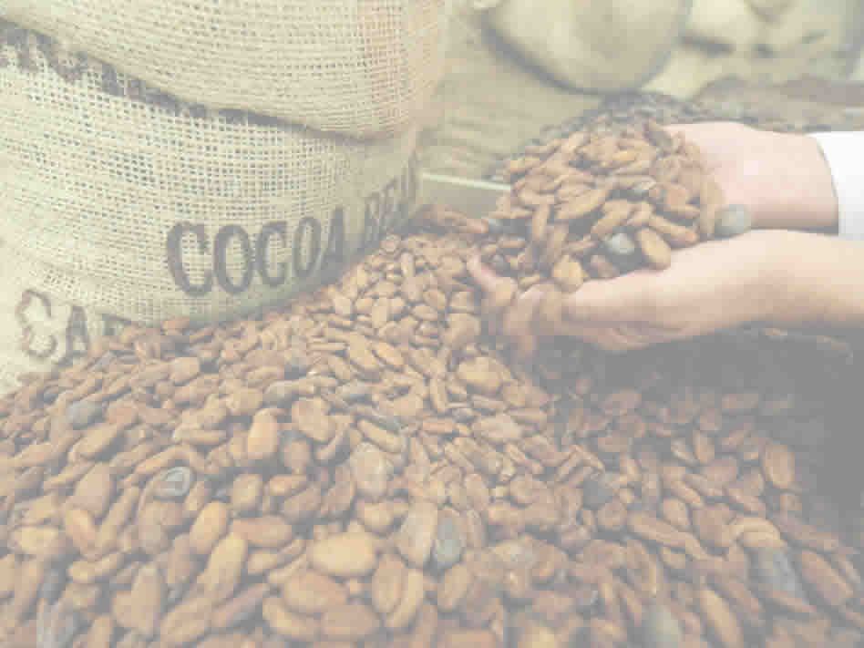
Nicaragua
very high reputation at Waldenbuch
has own CHP plant
does not buy nuclear power
solar panels on the roof
commendable terms for employees

