Slide 1
Checkpoint Project #2
Dual Axis Motion Control – Pin Spotter

Slide 2
Requirements:
Visualization:
Splash/Loading Screen
All text in text groups
Machine status shown on all screens
Global Layers
Alarms and Reactions
Units & Limits
All best practices followed.
Program
Dual-axis motion (camming or gearing)
Slaves home to a specific position (12:00)
Allow user to input an offset from slave’s homing position
Change speed during runtime from Vis
Requires user confirmation
Correct units & period settings
Consider real life and your hardware
Focus on error handling, diagnostics, and optimization.

Slide 3
Pin Spotter:
5x
The pin spotter drives a series of pins through a pad of insulation, binding the insulation to the duct panel below.
Conveyor Motor (Master): Moves a duct panel along at a steady speed.
Pin Spotter Motor (Slave): Lowers the Pin Spotter tool onto the duct panel, then raises it to reload the pin. This process is repeated 5 times per panel while the panel moves below the pin spotter.

Slide 4
Control Task States:
Alarm.Error = TRUE
ERROR
Alarm.Error = FALSE
INIT
Main.Status.Ready
Main.Status.PinsComplete
READY
Main.Cmd.Start
MOVE_PANEL
Main.Cmd.Stop AND Main.Status.Ready
Main.Status.PanelInPosition
INSERT_PINS
Main.Cmd.Stop AND NOT Main.Status.Ready

Slide 5
Control Task States:
Alarm.Error = TRUE
ERROR
Alarm.Error = FALSE
INIT
READY
RESET
POSITION_PANEL
INSERT_PINS

Slide 6
Axis Task States:
Axis.Status.Error = TRUE
ERROR
Axis.Status.Error = FALSE
POWER
Axis.Status.Active AND
NOT Axis.Status.PowerOn
INIT
Axis.Status.PowerOn
Axis.Cmd.Power
Axis.Status.PowerOn AND
Axis.Status.Homed
Axis.Status.PowerOn AND
NOT Axis.Status.Homed
READY
Axis.Status.TuneComplete
TUNE
HOME
Axis.Status.Homed
Axis.Cmd.Home
Axis.Cmd.Autotune
MainCtrl.Cmd.Run = FALSE
MainCtrl.Cmd.Run = TRUE
COUPLE
Axis.Status.Coupled
Axis.Cmd.Couple
Axis.Status.PowerOn AND
Axis.Status.Homed AND
NOT Axis.Status.Coupled
RUN
Axis.Cmd.MoveVel

Slide 7
Software Requirements:
Libraries:
Standard
Acp10main
Acp10par
Acp10_MC
NcGlobal
MpAxis
MpBase
Function Blocks:
Motion
MpAxisBasic
MpAxisCoupling
MC_GearInPos
MC_GearOut
Alarm
MpAlarmXCore
Built in Types:
Motion
MpAxisCouplingParType
MpAxisBasicInfoType
MpAxisBasicParType
ACP10AXIS_typ
Alarm
MpAlarmXListUIConnectType
MpComIdentType
MpAlarmXListUISetupType
MpAlarmXListUI
Tasks:
MainCtrl
MotionCtrl
AlarmCtrl
VisCtrl

Slide 8
Main Control Structures:
MainCtrl_type
Axis_type[0..2]
[VirtualMaster, PinSpotter, Conveyor]
MpAxisBasic[0..2]
ACP10AXIS_typ[0..2]
MpAxisCoupling
MainState_enum
Error_type
Alarm_type
MainCmd_type
MainStatus_type
Counts_type
MainState_enum
INIT
READY
RUN
ERROR
Error_type
ErrorActive
ErrorSetID
ErrorResetID
ErrorName
LastState
ErrorAcknowledgeID
Alarm_type
MpComIdentType
MpAlarmXListUIConnectType
MainCmd_type
Start
Stop
MainStatus_type
Ready
Counts_type
PanelsFinished
PinsPlacedCurrent
PinsPlacedTotal

Slide 9
Motion Structures:
Axis_type
AxisState_enum
Coupling_type
Cmd_typ
Status_type
Par_type
AxisState_enum
INIT
POWER
HOME
COUPLE
READY
RUN
TUNE
ERROR
Coupling_type
Parameters
CamCmd
Cmd_type
MoveAbsolute
MoveAdditive
MoveVel
JogPos
JogNeg
Home
Power
ErrorReset
Stop
Autotune
Initialize
Status_type
PowerOn
Active
Homed
Velocity
Info
Stopped
MoveActive
InVelocity
Position
Error
TuningDone
Ready
PanelInPosition
Par_type
BasicPars

Slide 10
Vis Structures:
Vis_type
Page_enum
VisStatus_type
VisCmd_type
Locking_type
Visibility_type
VisCounts_type
MotorConfig_type
Page_enum
Splash
Main
Config
Alarms
Diagnostics
VisStatus_type
State_enum
VisCmd_type
Run
Init
Tune
Update
Locking_type
BeltMoving
NotReady
Visibility_type
ShowAlarmDialog
VisCounts_type
PanelsFinished
PinsPlacedCurrent
PinsPlacedTotal
MotorConfig_type
Speed
Offset

Slide 11
Cam Profile:
Belt
Panel
1 Panel per 1m of belt.
1 Panel is 0.7m wide.
Panel is centered in each 1m section of belt.
Pins begin 0.1 from the leading edge, and are placed at 0.1 intervals.
1m
0.1m
0.5m
0.1m
0.7m
0.15m
0.25m
Motor Config: (?)
Virtual Master
Periodic Linear
Units: mm
Period: 1000mm
Reference distance: 1000mm
Slave1 (Pin spotter tools)
Limited Linear
Units mm
Lower Limit: -5mm
Upper Limit: 100mm
Motor1 (Conveyor)
Linear
Units: mm
Period: 1000mm
Reference distance: 1000mm
0.5m

Slide 12
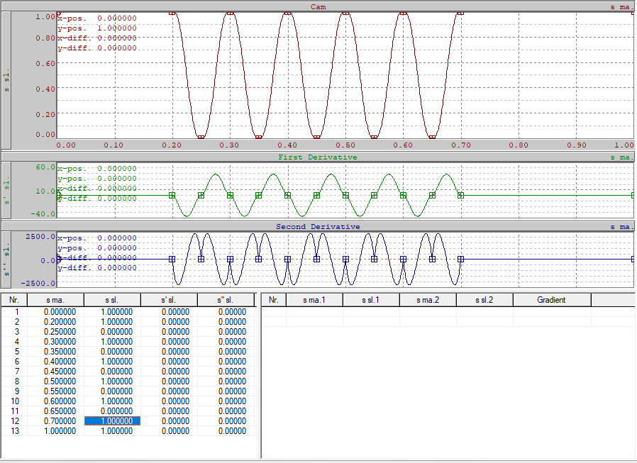
Cam Profile:

Slide 13
Shared Layer: GlobalNavStatusLayer
MachineStatus
ConveyorMotorStatus
PinSpotterMotorStatus
Main
Config
Diag
Alarm
DateTime

Slide 14
Shared Layer: MotorStatusLayer
Conveyor Power
Pin Power
Conveyor Homed
Pin Homed
Conveyor Moving
Pin Moving
Conveyor Error
Pin Error

Slide 15
Shared Layer: AlarmLayer
ERROR

Slide 16

Splash Page
Conveyor Power
Pin Power
Conveyor Homed
Pin Homed
Conveyor Moving
Pin Moving
Conveyor Error
Pin Error

Slide 17
Main Page
Machine: READY
Conveyor: READY
PinSpotter: READY
Main
Belt Position
Panel Position
Tool Position
Config
Panel Done Count
Pins Placed
Diag
Alarm
Speed
Conveyor Power
Pin Power
Conveyor Homed
Pin Homed
Conveyor Moving
Pin Moving
Conveyor Error
Pin Error
DateTime

Slide 18
Config Page
Machine: READY
Conveyor: READY
PinSpotter: READY
Main
Tune
Config
Set Pin Home
Pin Offset
Diag
Alarm
Conveyor Power
Pin Power
Conveyor Homed
Pin Homed
Conveyor Moving
Pin Moving
Conveyor Error
Pin Error
DateTime

