Slide 1
PID Training Project
Tyler Woodley
Application Engineer – Welty Automation
Tyler@WeltyAutomation.com

Slide 2
Charts: on/off
Pout
Tem
PWM
MpTemp block timing requirements

Slide 3
Software Requirements
Libraries:
Function Blocks/Functions/Types:
Tasks:
MpBase
MpAlarmX
MpTemp
MTTemp
MTBasics
MpAlarmX
MpAlarmXCore
MpAlarmXListUI
MpAlarmXListUISetupType
MpAlarmXListUIConnectType
MpAlarmXSet()
MpAlarmXReset()
MpTemp
MpTempGroup
MpTempController
MpTempControllerParType
MpTempControllerInfoType
MTTemp
MTTempController
MTPIDParametersType
MTBasics
MTBasicsOscillationTuning
MainCtrl
TempCtrl
RecipeCtrl
VisCtrl

Slide 4
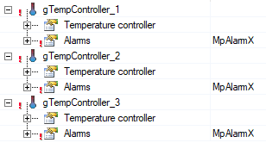

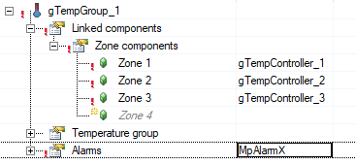
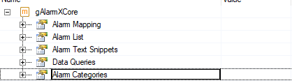
Mapp Configs
Temp Controllers:
Recipe Xml:
Temp Group:
AlarmX Core:

Slide 5
MainCtrl State:
MainCtrl_Init
MainCtrl_Idle
Cmd.Heat = TRUE
MainCtrl_Heat
Cmd.Heat = FALSE
Cmd.AutoTune = TRUE
MainCtrl_AutoTune
TuneComplete = TRUE
Cmd.ManualTune = TRUE
MainCtrl_ManualTune
TuneComplete = TRUE
Cmd.Save= TRUE
MainCtrl_SaveRecipe
SaveComplete= TRUE
Cmd.Load = TRUE
MainCtrl_LoadRecipe
LoadComplete = TRUE

Slide 6
TempCtrl State:
TempCtrl_Init
TempCtrl_Idle
Cmd.HeatOn = FALSE
CurrentTemp = AmbientTemp
Cmd.HeatOn = TRUE
CurrentTemp < TargetTemp
TempCtrl_ToAmbient
TempCtrl_ToTarget
Cmd.HeatOn = FALSE
CurrentTemp > AmbientTemp
Cmd.HeatOn = TRUE
CurrentTemp = TargetTemp
TempCtrl_Hold
ErrorPresent = TRUE
ErrorPresent = FALSE
TempCtrl_Error

Slide 7
RecipeCtrl State:
RecipeCtrl_Init
RecipeCtrl _Idle
Cmd.Save = TRUE
RecipeCtrl _Save
SaveComplete= TRUE
Cmd.Load = TRUE
RecipeCtrl _Load
LoadComplete = TRUE

Slide 8
gTempInterface
gTuneRecipe
gRecipeIO
TempGroup
Vis.TempInterface

