Slide 1

QS UNIVERSITY RANKINGS ANALYSIS

Slide 2
AGENDA
Project Overview
Objectives
Dataset
Methodology
Key Findings
Recommendations
Conclusion

Slide 3
PROJECT OVERVIEW
This project analyzes QS University Rankings data to identify the factors most strongly associated with university ranking performance and changes over time.

Slide 4
BUSINESS PROBLEM
Universities invest heavily in reputation, research, faculty, and internationalization. Which factors contribute most to ranking success?

Slide 5
OBJECTIVES
• Analyze rank movements
• Examine employer reputation and employment outcomes
• Assess research and faculty impact
• Evaluate sustainability and diversity
• Compare institutions by size and focus

Slide 6
DATASET DESCRIPTION
QS University Rankings dataset containing ranking positions, reputation scores, employment outcomes, research indicators, sustainability metrics, and institutional characteristics.

Slide 7
DATA PREPARATION
• Reviewed data quality
• Cleaned missing and inconsistent values
• Standardized variables
• Prepared data for visualization and analysis

Slide 8
METHODOLOGY
• Exploratory Data Analysis (EDA)
• Correlation Analysis
• Comparative Analysis
• Segmentation by size, focus, and research intensity
• Dashboard Visualization
Identified distributions, outliers, and structural patterns across all 28 indicators
Five Pearson correlations computed in DAX to test indicator-to-rank relationships
Compared top movers, regional patterns, and reputation gaps across institutions
Cross-tabulated Focus categories with Research Intensity to find compounding effects
Six-page Power BI dashboard with embedded correlation cards and themed pages

Slide 9
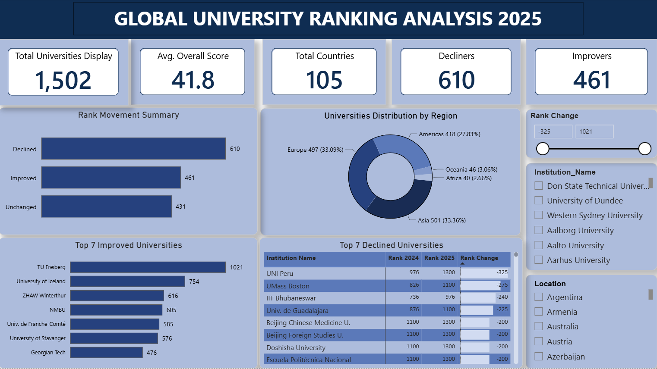
DASHBOARD OVERVIEW

Slide 10

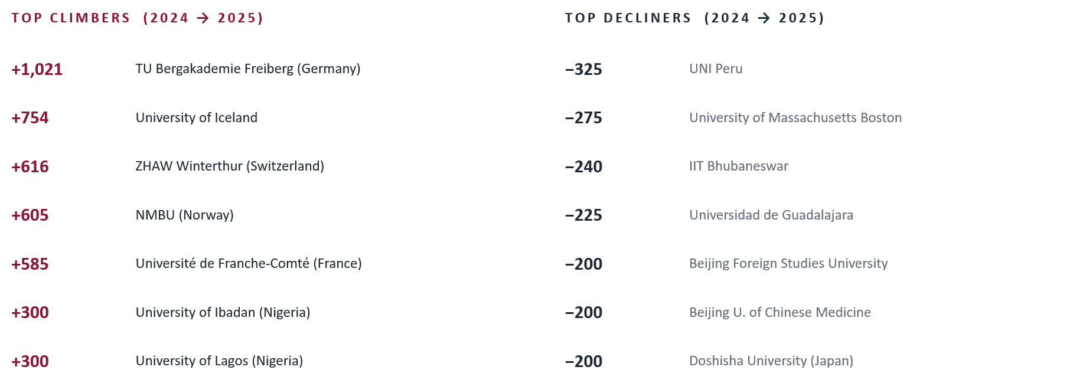
RANK MOVEMENT ANALYSIS

Slide 11
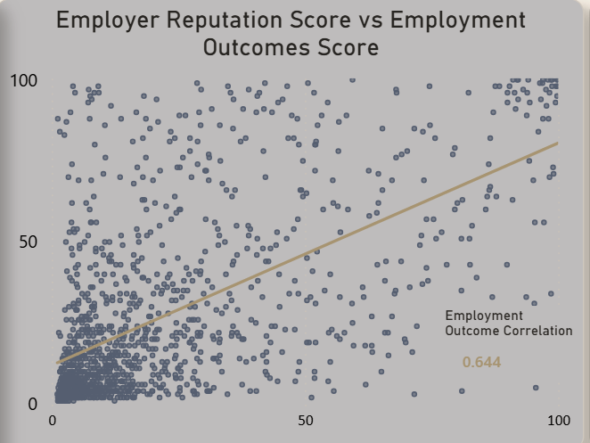
EMPLOYER REPUTATION VS EMPLOYMENT OUTCOMES
PEARSON CORRELATION
r = 0.644
Moderate-strong positive relationship
41% of variance in employment outcomes is explained by employer reputation alone.
Strong positive relationship (r = 0.644). Universities with stronger employer reputations generally achieved better employment outcomes.

Slide 12
RESEARCH PERFORMANCE FINDINGS
FACULTY / STUDENT RATIO
CITATIONS PER FACULTY
r = −0.414
r = −0.68
Moderate correlation · 17% variance explained
Strong correlation · 46% variance explained
Strongest relationship with ranking performance, highlighting research output as a key success factor.
Teaching ratios matter. They don't dominate.
The dominant academic ranking lever.

Slide 13
FACULTY RESOURCES ANALYSIS
FACULTY / STUDENT RATIO
Faculty-Student Ratio showed a moderate relationship with ranking performance (r ≈ -0.414) suggesting student support contributes to outcomes.
r = −0.414
Moderate correlation · 17% variance explained
Teaching ratios matter. They don't dominate.

Slide 14
INSTITUTION SIZE ANALYSIS
Large and Extra-Large universities performed better on research-related metrics, Medium universities had the lowest Citations (19); while smaller institutions often excelled in faculty-student ratios.

Slide 15
SUSTAINABILITY & DIVERSITY
INTERNATIONAL DIVERSITY
SUSTAINABILITY
r = 0.04
r = −0.74
NO meaningful relationship with rank
STRONG relationship with rank
<1% of rank variance explained
55% of rank variance explained
Pursue diversity for mission reasons, cultural exchange, alumni networks, employer perception not for ranking gain. UAE institutions, EPFL, City U Hong Kong all max at 100, yet none are top-ranked overall.
The single strongest single-indicator predictor of rank in the entire dataset. Sustainability demonstrated a strong relationship with rankings performance.

Slide 16
INSTITUTIONAL FOCUS & RESEARCH INTENSITY
Fully Comprehensive universities with Very High Research Intensity achieved the strongest overall performance across key indicators.

Slide 17
RECOMMENDATIONS
01
Increase research investment
02
Strengthen employer engagement
03
Expand sustainability initiatives

Slide 18
CONCLUSION
Research output, sustainability, and employer reputation are the strongest predictors of ranking success. Strategic investment in these areas offers the greatest opportunity for improvement.

