Slide 1
Dangers of Change Approval Processes
Web-420

Slide 2
What is a change?
ITIL defines change as the addition, modification or removal of anything that could affect IT services.
Changes are often seen as problems and received with reluctancy and suspicion. They are actions that constitutes a risk to an IT service.
Changes need to be treated as that, a change, in order to minimize impacts and risks while making sure to meet the needs of the company

Slide 3
The Process
The change management process seeks to control the lifecycle of all changes, enabling changes that are beneficial to be made with little disruption to IT services.
The main goal of the change management process is to make sure that all changes made are recorded, evaluated, authorized, prioritized, planned, tested, implemented, documented and reviewed in a controlled manner.
For this control to be implemented successfully, change management process must oversee change methods and procedures.

Slide 4
The Process
Among the change management processes that need to be implemented, we find:
Reuse standardized methods and procedures
Make sure that those methods are known and applied by all participants
Record all changes
Consider risks and impacts on business

Slide 5
Scope
The scope pf the change management process can be easily recognized by any addition, modifictation or removal of anything that could potentially have an effect on IT services.
What needs to be examined is what events should be considered a change and how the IT department should handle the event.
With change comes risk and this ricks needs to be known and managed.

Slide 6
Categorization
There are three categories of change: standard, normal, and urgent change.
Standard change – authorized by change management, implemented according to a re-established procedure or workflow. Standard changes include: patches upgrades, replacement of a printer, relocation of more than x users, etc. A list of what a standard change is can be predefined; changes that are not part of this list would be treated as a normal change.

Slide 7
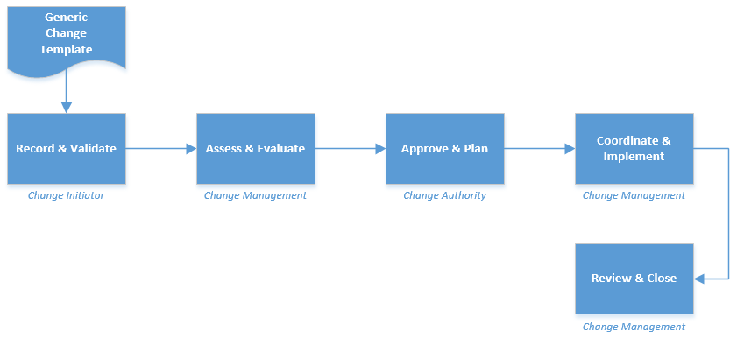
Standard change
Image taken from https://wiki.octopus-itsm.com/

Slide 8
Categorization
Normal change – a normal change is a change that is not standard (not part of the standard change predefined list) or urgent. A normal change follows activities in the change management process.
Based on risks, impacts, costs and dependencies with other changes, it can be categorized into minor, significant or major.
Urgent change – a normal change that needs to be made as soon as possible. Urgent changes follow the same process as the normal changes but are adapted to the emergency situation. If the CAB cannot meet quickly, the ECAB, will be invoked. As much testing as possible must be carried out and documented, documentation of change and configuration data may be completed later.

Slide 9
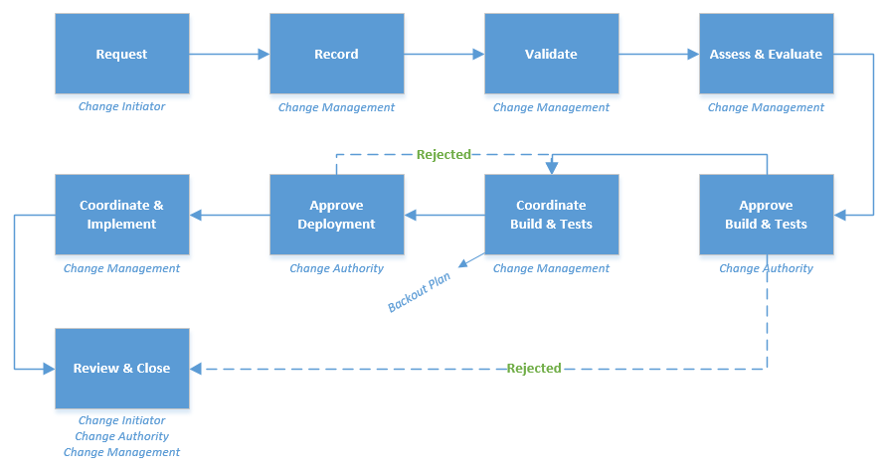
Normal change
Image taken from https://wiki.octopus-itsm.com/

Slide 10
Activities
Activities of the change management process:
Record – changes recorded are identified by a unique number. Things to record are: impacts, benefits of change. The information recorded is used to validate and evaluate the change.
Review – filtering of submitted changes.
Assess & Evaluate – The change is categorized and the apprropriate approval level is applied. The composition of the CAB is determined. Change justification, business benefits, implact, cost and risks are evaluated.

Slide 11
Activities
Approve – After a change has been approved it can acess the production environment; change management is in charge of this. Impacts, risks, benefits, backout procedures, etc have been evaluated and the approval authority approves or refuses deployment. Standard changes are pre-approved. Change manager approves minor changes. The CAB authority approves changes that are significant, major and urgent, with the ECAB taking over in case the CAB is not available.
Coordinate & Implement – execution tests for approved changes are sent to the relevant technical team so test users can implement the changes. Changes must be tested, documentes and a backout procedure needs to be identified along with temporary solutions for potential incidents documented.
Review & Close – Implemented normal and urgent changes are reviewed after deployment; CAB instance determines if the review is necessary. If the change is successful, it can be closed.

Slide 12
Metrics
Number or % of changes successful / partially successful / unsuccessful
Number or % of unsuccessful changes without backout plan
Number or % of non authorized changes
Number of backlog changes
% of completed changes in time
% of changes that has caused incidents
Number or % of urgent changes

Slide 13
References
Change management - ITIL® PROCESS. (n.d.). Retrieved February 04, 2021, from https://wiki.octopus-itsm.com/en/articles/change-management-itilr-process

