Slide 1
Technology Value Stream
Web-430

Slide 2
Lead Time
Starts
Ends
Lead Time is the time needed to implement, test and deliver the code in an application.
Lead time is the time between a commit and the resulting code gets into production.
When the request is made
At delivery

Slide 3
Process Time
Starts
Ends
Process time aka Cycle Time is the time between commencement of a process and its completion for the next downstream customer.
When the request is being worked on
At delivery

Slide 4

Lead Time VS Process Time
Lead time is a metric in the Lean community to measure performance in value streams.
It starts being measured from the time the request is made.
Processing time AKA touch time or task time is measured from the time when the request is being worked on – it omits the time the work is in the queue.

Slide 5
Lead Time VS Process Time
Both the Lead Time and the Process Time are important DevOps metrics because the ratio of these two metrics serves to measure efficiency.
To achieve fast flow and short lead times, we must reduce the time the work is waiting in queues.
In the DevOps ideal, developers receive fast, constant feedback on their work, this enables them to quickly and independently implement, integrate and validate their code and deploy the code into the production environment.

Slide 6
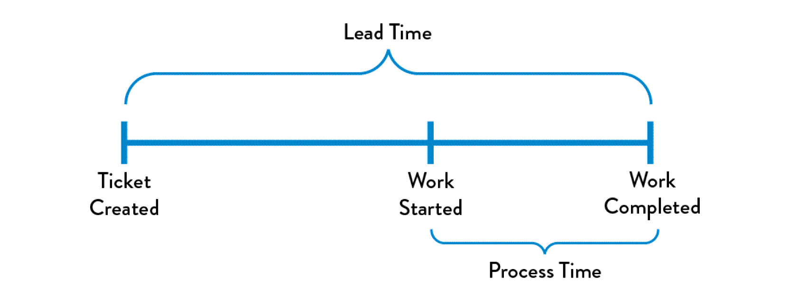
Lead Time VS Process Time
The DevOps Handbook (1st ed. 2016) Kim et al.

Slide 7
Common Scenario
Deployment Times Requiring Months

Slide 8
Common Scenario
Often, deployment lead times require months. Common in large, complex organizations working with tightly-coupled, monolithic applications, often with scarce integration test environments, long test and production environment lead times, high reliance on manual testing, and multiple required approval processes.
Long lead times often result in lack cohesiveness – requiring days or weeks of investigation to find out who made a mistake along the way, and results in poor customer outcomes.

Slide 9
Common Scenario
Common reasons large corporations require long lead times:
Tightly coupled applications
Monolithic applications
Scarce test and production environment lead times
Relying heavily on manual testing
Processes that require multiple approvals.

Slide 10
Deployment Lead Times of Minutes
DevOps Ideal
DevOps ideal is for developers to receive fast, constant feedback on their work, to enable them to quickly and independently implement, integrate, validate their code, and have the code deployed into the production environment.
Shorter lead times are achieved by continually checking changes made into the control repository, performing automated and exploratory testing against it, and deploying it into production.

Slide 11
Deployment Lead Times of Minutes
DevOps Ideal
Shorter lead times enables us to be confidents that the changes will operate as designed in production and that problems can be quickly detected and corrected.
This can be achieved by having modular architecture, that is well encapsulated and loosely-coupled so small teams can work with higher degrees of autonomy, with failures being small and contained, and without causing global disruption.s

Slide 12
—Wen-D
EOF
References:
Lead time - A key metric in DevOps: Humanitec. (n.d.). Retrieved December 19, 2020, from https://humanitec.com/blog/lead-time-a-key-metric-in-devops
Khanduri, A. (n.d.). DevOps Metrics: Measuring What Matters. Retrieved December 19, 2020, from https://blog.sonatype.com/devops-metrics-measuring-what-matters
Kim, G., Debois, P., &amp; Humble, J. (2017). Chapter One- Agile, Continuous Delivery, and the Three Ways. In The DevOps handbook: How to create world-class agility, reliability, and security in technology organizations. Portland, OR: IT Revolution Press, LLC.

