Slide 1
Microservices
Wendy Leon
Assignment 8.3

Slide 2
What are Microservices?
Also known as the microservice architecture, microservices is a style of architecture that assembles an application as a collection of services that are:
Easy to maintain, scale, and test.
Loosely coupled.
Independently deployable.
Organized around business capabilities.

Slide 3
What is an API gateway?
An API gateway serves as an API management tool that sit between the client and the microservice architecture.
API gateways accept a remote request and returns a response. It also handles the following tasks:
Authentication and rate limiting.
Analytics and monitoring.
Billing
Calls to distinct applications

Slide 4
Advantages of microservices
Microservices offers a unique kind of modularization that, increase productivity, are flexible in terms of choosing technologies and are great for distributed teams. A few advantages of microservices
Easier to maintain – because they are divided into a set of smaller, components.
Organized around business capabilities.
Improved productivity and speed – decomposing applications into services, reduces the amount of development time.

Slide 5
Microservices Disadvantages
While Microservices can provide amazing results, there also challenges that need to be taken into consideration before moving into a SOA.
Dividing an application into a microservice architecture increases its complexity.
They require a cultural change. A mature agile and DevOps culture is needed. All teams should have a deep understanding of the end-to-end process to develop, deploy, test and monitor applications.
More expensive – as each microservice is isolated and requires its own COU and runtime environment.

Slide 6
Microservices deployment and management
One strategy to deploy microservices is to use the multiple Service Instances per host pattern.
The benefits of using Multiple Service Instances per Host Pattern is that one or more hosts are provisioned and run multiple service instances in each one. Each service runs at a well-known port on one or more hosts.

Slide 7
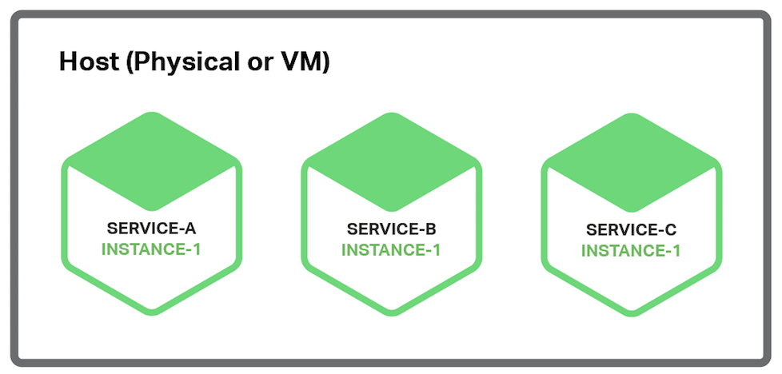

Microservices deployment and management

Slide 8
Scaling Microservices
Scaling microservices is a complex task. To successfully scale a microservice architecture, several things needs to be taken into consideration in order to successfully scale applications
Implement production development units. Using a model called product development units (PDUs). Follow the 2 pizza rule.

Slide 9
Scaling Microservices
Scaling should be limited to the application components that have the most traffic.
Determine service boundaries to avoid adding latency.
Roll out one service at a time.

Slide 10
Scaling Microservices
Embrace multiple ways of testing - Unit testing and integration should be a big part of a continuous deployment model.
Security needs to be brought front and center – implement different types of security controls to stay GDPR, HIPAA and PCI compliant.

Slide 11
References
What are microservices? (n.d.). Retrieved December 06, 2020, from https://microservices.io/
What does an API gateway do? (n.d.). Retrieved December 06, 2020, from https://www.redhat.com/en/topics/api/what-does-an-api-gateway-do
5 Major Benefits of Microservice Architecture. (2020, October 28). Retrieved December 06, 2020, from https://skelia.com/articles/5-major-benefits-microservice-architecture/
Microservices Disadvantages &amp; Advantages. (2020, November 23). Retrieved December 06, 2020, from https://www.tiempodev.com/blog/disadvantages-of-a-microservices-architecture/
Eventuate, C. (2019, July 17). Deploying Microservices: Choosing a Strategy. Retrieved December 06, 2020, from https://www.nginx.com/blog/deploying-microservices/

Slide 12
The End

