Slide 1
Devops
Testing
Web 420 – Presentation 3.2
Wendy Leon

Slide 2
Why Automation?
Automation is one of the key principles of DevOps. DevOps seeks to automate the entire Software Development Lifecyle.
Automation speeds up infrastructure configuration and software deployment. The result is greater accuracy, consistency, reliability and more deliveries per day across different platforms.
Manual configuration is always error-prone. Automation reduces human error and saves time. It enables every activity of development and operation whichever is automatable, repeatable, whichever nees accuracy, and takes a long time to be automated,

Slide 3
Benefits of Automation
Automation removes manual errors, dependency on an individual, performs faster, and achieves accuracy, consistency and reliability. The result is high-quality delivery, frequent and faster releases.
Removes manual errors
Team members are empowered
Dependency removed
Latency removed
Increases no of deliveries
Reduces the lead time
Increases frequency of releases
Provides faster feedback

Slide 4
Why Automation?
Automation is one of the key principles of DevOps. DevOps seeks to automate the entire Software Development Lifecyle.
Automation speeds up infrastructure configuration and software deployment. The result is greater accuracy, consistency, reliability and more deliveries per day across different platforms.
Manual configuration is always error-prone. Automation reduces human error and saves time. It enables every activity of development and operation whichever is automatable, repeatable, whichever nees accuracy, and takes a long time to be automated,

Slide 5
Automated Testing
The need for testing software before it is released has always been there. However, it is up to each organization to determine what types of testing to do, and how through the testing needs to be.
Testing methodologies and procedures are carried out by dedicated testers, running the software through a series of tests to expose flaws and weaknesses.
Testers are however, not the only ones running tests. The responsibility falls on developers, testers, and various types of user groups.

Slide 6
Test Categories
The Pyramid
of Tests
Acceptance Tests
Integration tests
Unit tests

Slide 7
Unit Tests
In simple words, unit testing is a piece of code (aka unit test) to verify the code (unit) written for implementing requirements.
The unit of software being tested can be an individual function, object, method, procedure, or module in the software under test.
Unit Testing Methods:
Manual – manually executed tests without the use of an automated tool
Automated testing – software testing automation tools

Slide 8
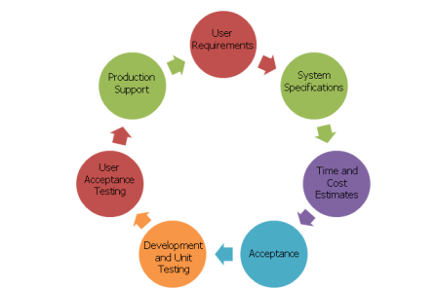
Unit Testing in SDLC
Image taken from softwareinvestinghelp.com
https://www.softwaretestinghelp.com/unit-testing/

Slide 9
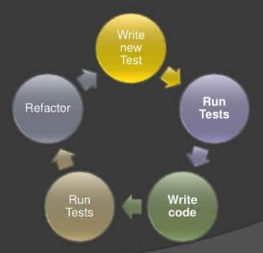
Unit Testing Cycle
Image taken from softwareinvestinghelp.com
https://www.softwaretestinghelp.com/unit-testing/

Slide 10
Unit Testing Guidelines
A Unit test should test single unit of code and not code integration.
Small Unit tests with clear naming so easy to write and maintain.
Changing other parts of the software should not affect the Unit.
It should run quickly
A Unit test should be reusable

Slide 11
Acceptance Testing
The last phase of the software testing process. This is where the customer decides GO / No-Go for the product and is required before leasing products to the market.
After the system testing process is completed and signed off by the testing team, the entire product / application is handed to the customers to test acceptability. It should flawlessly meet both critical and business requirements.
The production-like environment will be used as the testing environment for accepting testing (frequently termed as staging, pre-prod, fail over, UAT environment)

Slide 12
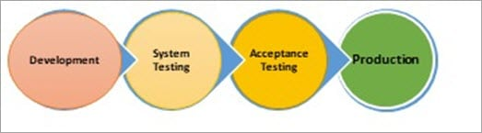
Acceptance Testing
Image taken from https://www.softwaretestinghelp.com/what-is-acceptance-testing/

Slide 13
Acceptance Testing Benefits
Helps us gain confidence in the product that is getting released to the market.
Helps ensure the product is working in the way it intended to.
Helps ensure the product matches current market standards and is competitive enough with the similar products in the market.

Slide 14
Integration Testing
Integration testing is performed to test module / components integration in order to make sure they work as expected.
Its main goal to test the interfaces between the units / modules.
After the unit tests are performes, they are integrated one by one until they are all integrated, to check the combinational behavior, and to validate requirements are implemented correctly.
We must note that integration testing does not happen at the end of the SDLC, it is performed simultaneously with the development.

Slide 15
Integration Testing Advantages
Ensures all integrated components / modules work properly
Starts once the modules are ready to be tested.
It detects errors related to the interface

Slide 16
Integration Testing Steps
Prepare Integration Test Plan.
Prepare integration test scenarios & test cases.
Prepare test automation scripts.
Execute test cases.
Report the defects.
Track and re-test the defects.
Re-testing & testing goes on until integration testing is complete.

Slide 17
References
DevOps Automation: How is Automation Applied in DevOps Practice. (2020, November 13). Retrieved January 14, 2021, from https://www.softwaretestinghelp.com/devops-automation/
Jagtap, D., Kumar, R., Founder, V., Kaczanowski, T., Mamata, Malli, . . . Lawrence, S. (2020, November 13). Keys to Successful Unit Testing. Retrieved January 14, 2021, from https://www.softwaretestinghelp.com/unit-testing/
Krishna, Gopi, Luck, C., Anthony, Dinesh, Burcu, . . . Sarath. (2020, November 13). What is Integration Testing (Tutorial with Integration Testing Example). Retrieved January 14, 2021, from https://www.softwaretestinghelp.com/what-is-integration-testing/
Integration Testing in an Enterprise DevOps Environment. (2020, November 12). Retrieved January 14, 2021, from https://www.plutora.com/blog/integration-testing-enterprise-devops

