Slide 1
Open Authentication (OAUTH)

Slide 2
What is OAUTH
OAUTH is a token-based open standard authorization framework that allows you to share user account between services without exposing the user account credentials.
It was first released on 2007 to authorize users for the twitter API. In 2010 it was published by the IETF OAuth Working Group as the OAuth 2.0 protocol. A completely new protocol that is not compatible with OAuth 1.0.
New features in the OAuth include: new authorization code flow to accommodate mobile applications, simplified signatures, and short-lived tokens with long-lived authorizations.

Slide 3
How OAUTH works
The authorization flow in a OAuth is a six-step process:
A user visits a web or mobile application requesting authorization to access protected resources.
The resource owner authenticates and authorizes the user access to the resources. The OAuth 2.0 framework defines four types of grants: Authorization Code, Client Credentials, Device Code and Refresh Token.
The client then requests an access token from the server by representing the authorization grant returned from the authorize endpoint along with authentication of its own identity to the token endpoint.

Slide 4
How OAUTH works
If the client’s identity can be authenticated and the authorization grant is valid, the authorization server or authentication provider will issue an access token to the user.
The user can now request access to the protected resource server by presenting the authentication access token.
If the token is valid, the resource server returns the requested resources to the application.

Slide 5
How can oauth can be used?
OAuth can be used to allow one web service to access protected resources stored with another service by letting users register or login using their account credentials from websites such as Facebook, Twitter, LinkedIn, Google, GitHub or Bitbucket.

Slide 6
OAuth 1.0 vs. OAuth 2.0
OAuth 2.0 is a complete re-write of OAuth 1.0. It uses different terminology and terms.
The main change is function between the two versions is the better separation of duties, easier client-side development and user experience.
OAuth offers specific authorization flows for web applications, desktop applications, mobile phones, living room devices, and non-browser-based applications such as API based services.

Slide 7
History of oauth and oauth 2.0
OAuth came out in 2012 when Google moved from 1.0 to OAuth 2.0 to provide greater flexibility between web applications and devices.
OAuth new features include token expiration and is not compatible with OAuth 1.0.
Critics of OAuth found it to be more complex, less interoperable, less useful, more incomplete and the result of insecure implementations.
In spite of the criticism, OAuth was become very popular and it is adopted by big companies like Amazon, Facebook, LinkedIn, Microsoft, Instagram, Paypal, and Netflix.

Slide 8
Why Oauth is so popular
Users like to be able to authenticate using the credentials from one website instead of having to create new credentials for every application they want to access. OAuth allows users to log in via an existing account. It can be Google, Facebook or any other social media account or private account.

Slide 9
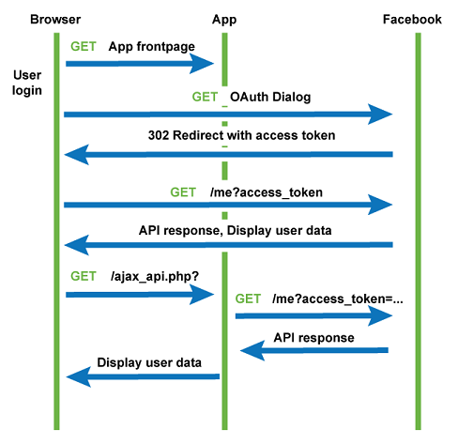
End to end data flow of an Oauth API

Slide 10
OAuth 2.0 Terms
End Points – used to get an access token from the authorization server.
Access Token – used for both authentication and authorization to access resources from the resource server.
Refresh Token – used to get a new access token when the old one expires.
MAC Token – similar to signatures, they provide a way to have partial cryptographic verification of the request.

Slide 11
OAuth 2.0 Terms
Grants – methods to get access tokens from the authorization server. The four basic types of grants are: Authorization Code, Implicit, Resource Owner Credentials, and Client Credentials.
Authorization Code – sent to the client via a browser redirect to get an access token.
Grant Type Extensions – a mechanism for extending grant types as a bridge to other authorization frameworks, or for specialized clients.

Slide 12
resources
OAuth2 Overview. (n.d.). Retrieved December 10, 2020, from https://www.soapui.org/docs/oauth2/oauth2-overview/
Contributors, T. (2020, February 07). What is OAuth and How Does it Work? Retrieved December 10, 2020, from https://searchapparchitecture.techtarget.com/definition/OAuth

