Slide 1
SOAP
Web 420 – Presentation 3.3
Wendy Leon

Slide 2
What is SOAP
SOAP (Simple Object Access Protocol) is an XML-based communication protocol for exchanging information between computers.
SOAP can be used to call a remote procedure or exchange entire documents.
SOAP can be used to broadcast a message.
SOAP is platform and language independent.
SOAP provides a way for applications running in different operating systems and using different technologies and programming languages to exchange information among them.

Slide 3
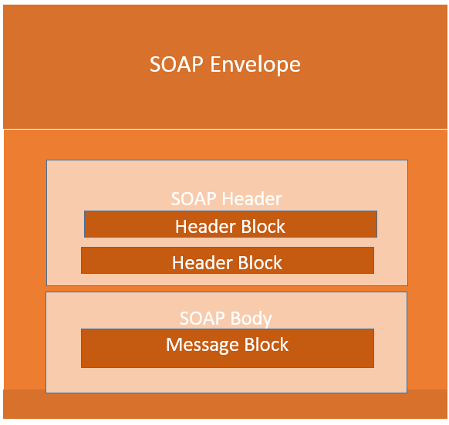
SOAP
Building Blocks
Graphical representation of a SOAP
from guru99.com

Slide 4
Envelopes
SOAP envelope is a mandatory part of a SOAP message.
SOAP Envelope is the root element in the SOAP message.
The SOAP Envelope must contain only one body element and can only contain one header. The header must be the first child of the Envelope, before the body element.
The Envelope is specified using the ENV namespace prefix and the Envelope element.

Slide 5
Headers
Headers are optional and offer a framework for specifying application-level requirements.
Headers are an optional part of SOAP messages
Headers add new features and functionality.
Headers are the first child element of the SOAP envelope.
Multiple headers can be defined – they are interpreted as SOAP header blocks.

Slide 6
Header - Attributes
Headers are optional and offer a framework for specifying application-level requirements.
Headers are an optional part of SOAP messages
Headers add new features and functionality.
Headers are the first child element of the SOAP envelope.
Multiple headers can be defined – they are interpreted as SOAP header blocks.

Slide 7
Faults and Fault Codes
A fault element is the response to a SOAP message after an error occurs during processing.
The fault elements returns information about the error – predefined code, description, and the address that generated the fault.
Points to Note
A SOAP message can have only one fault block.
The Fault element is an optional part of a SOAP message.
Fault messages are link to the 500 – 599 status codes range.

Slide 8
SOAP Fault Codes
The following values defined below must be used in faultcode element to describe faults:
Error | Description
VersionMismatch | Found an invalid namespace for the SOAP Envelope element
MustUnderstand | An immediate child element of the Header element, with the mustUnderstand attribute set to "1", was not understood
Client | The message was incorrectly formed or contained incorrect information
Server | There was a problem with the server so the message could not proceed
Faultcode table taken from www.w3schools.com

Slide 9
End-to-end data flow
of a SOAP API
The W3C SOAP specification talks about a the “Message Exchange Patterns” (MEP) concept. In this concept two message exchange patterns exists:
Request – Response
Response

Slide 10
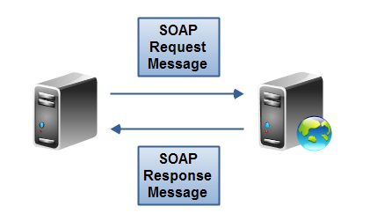
API data flow
Graphical representation of a SOAP request – response message Exchange
from tutorials.jenkov.com

Slide 11
SOAP API data flow
Request - Response
In a SOAP request – response message exchange pattern the SOAP clients sends a SOAP request to the web service. The service responds with a SOAP response message.
This type of MEP (Message Exchange Pattern) is used when the SOAP client needs to send data to the SOAP service in order for the SOAP service to execute the request.

Slide 12
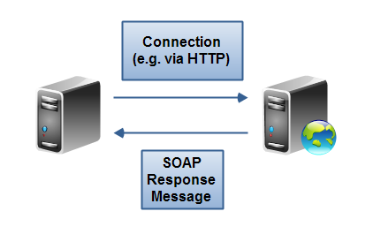
API data flow
Graphical representation of a SOAP response message exchange
from tutorials.jenkov.com

Slide 13
SOAP API data flow
Response
In a SOAP response message exchange pattern the SOAP client connects to the web service without sending a message. Instead, the client sends a simple HTTP request. The SOAP service then responds with a SOAP message.
This is similar to how browsers communicate with a web server.. When a browsers send an HTTP request to a server requesting to serve a web page, the request does not contain additional data. The servers sends an HTTP response containing the requested page.

Slide 14
References
SOAP Web Services Tutorial: Simple Object Access Protocol EXAMPLE. (n.d.). Retrieved October 31, 2020, from https://www.guru99.com/soap-simple-object-access-protocol.html
(n.d.). Retrieved October 31, 2020, from https://www.w3schools.com/xml/xml_soap.asp
Jenkov, J. (n.d.). SOAP Message Exchange Patterns. Retrieved October 31, 2020, from http://tutorials.jenkov.com/soap/message-exchange-patterns.html
What is SOAP? (n.d.). Retrieved October 31 2020, from, https://www.tutorialspoint.com/soap/what_is_soap.htm

