Slide 1
BT4012 Fraud Analytics Group 26
A0236495U Lim Zhen Yong
A0234935Y Lam Wen Jett
A0233839W Ng Han Leong, Jordan
A0236437B Lo Zhi Hao

Slide 2
Table of contents
01
02
03
04
05
Introduction
Exploratory Data Analysis
Data Preprocessing
Models Evaluation
Conclusion & Future Works

Slide 3
01
Introduction

Slide 4



Introduction to the Problem of Online Job Fraud
Online job portals have become crucial in connecting job seekers with potential employers
In the first quarter of 2022, the US alone recorded over 20,700 cases of job-related frauds, a third of which resulted in monetary losses.
Platforms that effectively filter out these scams can gain a competitive edge, retain more users, and potentially increase revenue.

Slide 5



The Problem - Impact on Stakeholders
Job Seekers:
Facing financial and emotional distress
Job Platforms:
tarnish the reputation of online job platforms.
Employers:
Inefficient recruitment process
Disrupts the job market

Slide 6
Our Aim
Enhance the reliability of online job markets by developing a fraud detection system.

Slide 7
Introduction to Dataset
Name: Employment Scam Aegean Dataset (EMSCAD)
Period: Between 2012 and 2014
Source: real-life job ads posted by Workable, software-as-a-service that provides applicant tracking system and recruitment software
Contributors: All the entries were manually annotated by specialized Workable employees.
Curators: Vidros et al., University of the Aegean
Criteria of Fraud: based on client’s suspicious activity on the system, false contact or company information, candidate complaints and periodic detail analysis of the clients.

Slide 8
02
Exploratory Data Analysis

Slide 9
Overview
Univariate Analysis
Bivariate Analysis
Text Data Analysis

Slide 10

Univariate Analysis
Dataset Overview - Null Values Detection - Fraudulent Class Distribution - Feature Distribution (Industry, Department, Location)

Slide 11
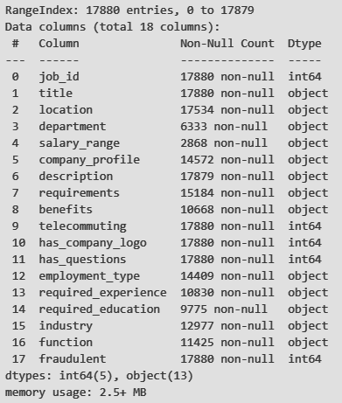
Dataset Overview
Dataset: Employment Scam Aegean Dataset (EMSCAD)
Dimensions: 17880 rows and 18 columns (including target variable)
Target Variable: fraudulent (Class 0 - Non-Fraudulent, Class 1 - Fraudulent)
Features: job_id, title, location, department, salary_range, company_profile, description, requirements, benefits, telecommuting, has_company_logo, has_questions, employment_type, required_experience, required_education, industry, function

Slide 12
Features Overview
telecommuting, has_company_logo, has_questions
location, department, salary_range, employment_type, required_experience, required_education, industry, function
company_profile, description, requirements, benefits
Binary Features
Multiclass Categorical Features
Text Features

Slide 13
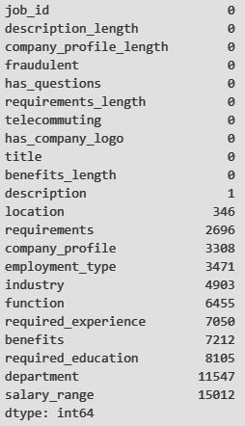
Null Values Detection
Overall, out of the 17 features columns in the dataset, 12 features have missing values.
The features that have missing values includes (from least to most):
description
location
requirements
company_profile
employment_type
industry
function
required_experience
benefits
required_education
department
salary_range

Slide 14
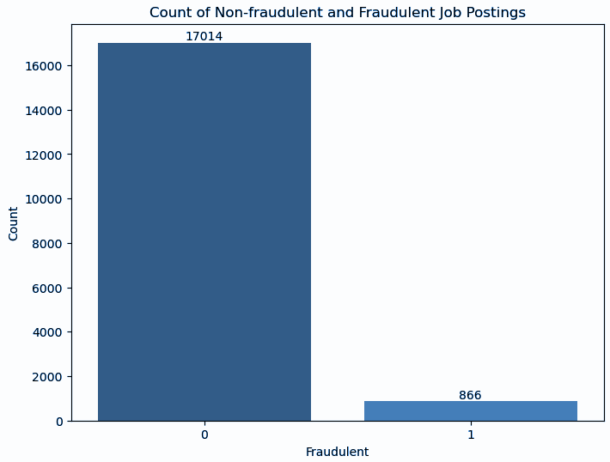
Fraudulent Class Distribution
We noticed significant class imbalance in the Fraudulent target class, with 17,014 instances of non-fraudulent job postings, and only 866 instances of fraudulent jobs.
95% Non-Fraudulent VS 5% Fraudulent

Slide 15
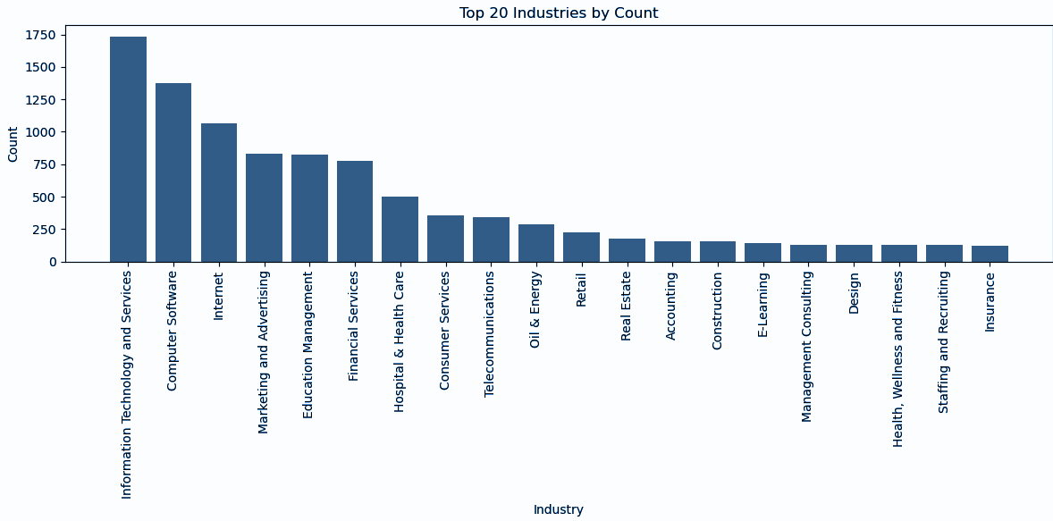
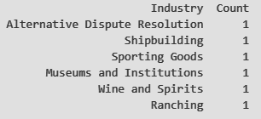
Feature Distribution - Industry
There are 133 unique industries that are observed in total. Top 3 industries are IT and Services, Computer Software and Internet.
However, 6 industries has only 1 observation, while 42 industries have less than 10 observations.

Slide 16
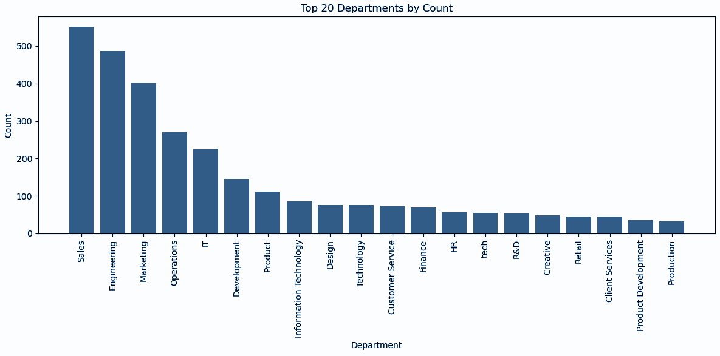
Feature Distribution - Departments
There are 1,337 unique departments that are observed in total. Top 3 departments are Sales, Engineering and Marketing.
However, 815 departments has only 1 observation, while 1256 departments have less than 10 observations.

Slide 17
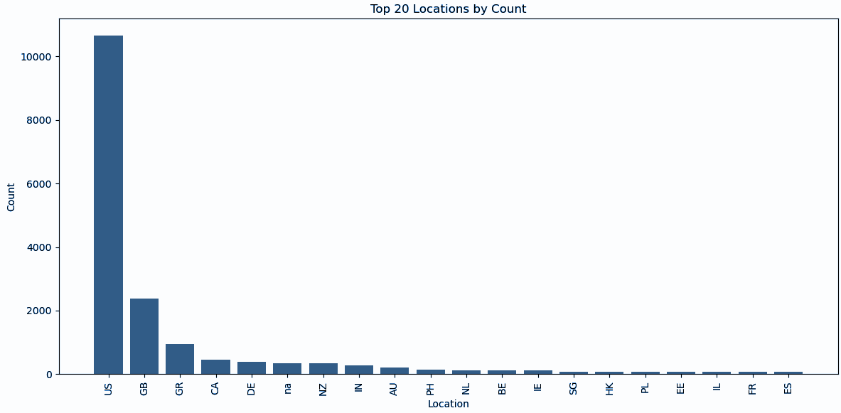
Feature Distribution - Location
In terms of location, we processed it into country and cities (details will be shared later!). There are 91 unique countries that are observed. Top 3 locations of postings are United States, Great Britain and Greece.
However, 14 countries has only 1 observation, while 38 countries have less than 10 observations.

Slide 18

Bivariate Analysis
Fraudulent Postings by Features (Telecommuting, Have Company Logo, Have Questions, Employment Type, Function, Required_education, Required_experience)

Slide 19
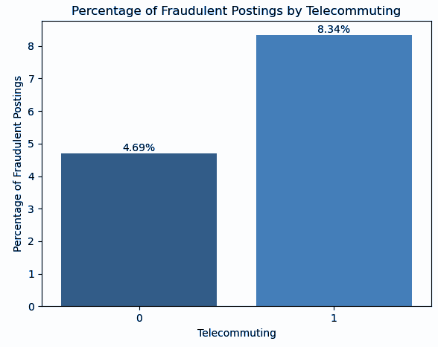
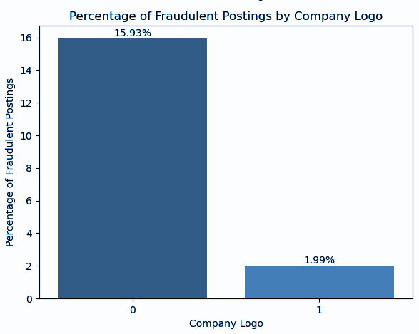
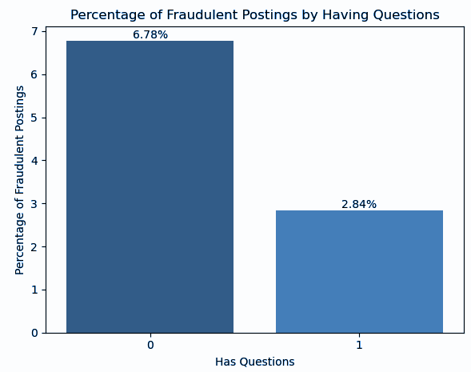
Binary Features vs Fraudulent
Telecommuting
Have Company Logo
Has Questions
We noticed significant differences in terms of chances of fraudulent job postings across the binary features. Job that allows telecommuting, does not have screening questions, and posted by companies which does not provide company logo are more likely to be fraudulent.

Slide 20
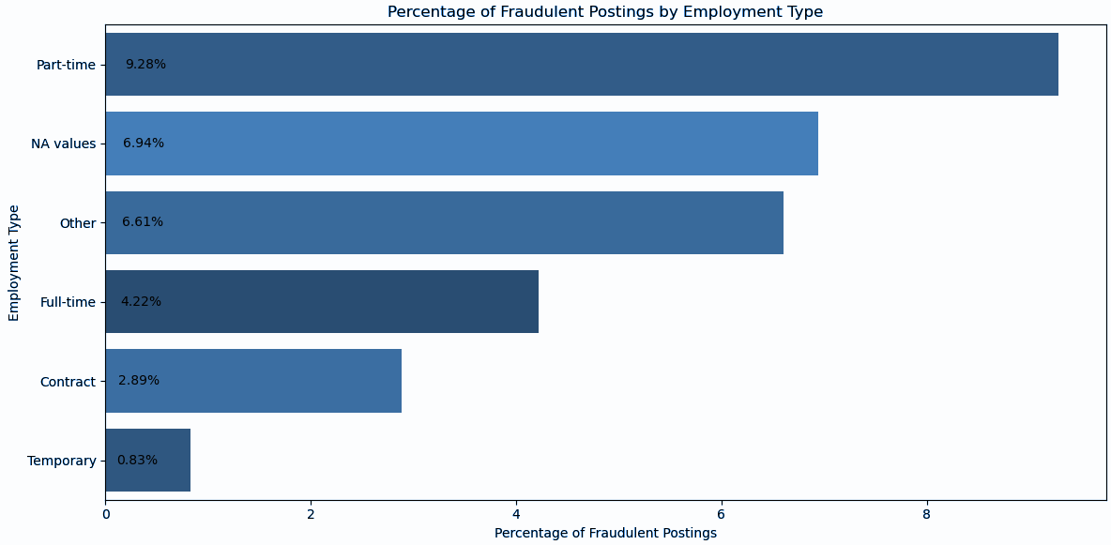
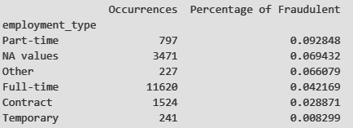
Employment Type vs Fraudulent
Part-time job postings have a higher chance of being fraudulent.
When employment type is not provided (Missing Value) or is stated as others, the chances of the job posting being fraudulent is higher as well.

Slide 21
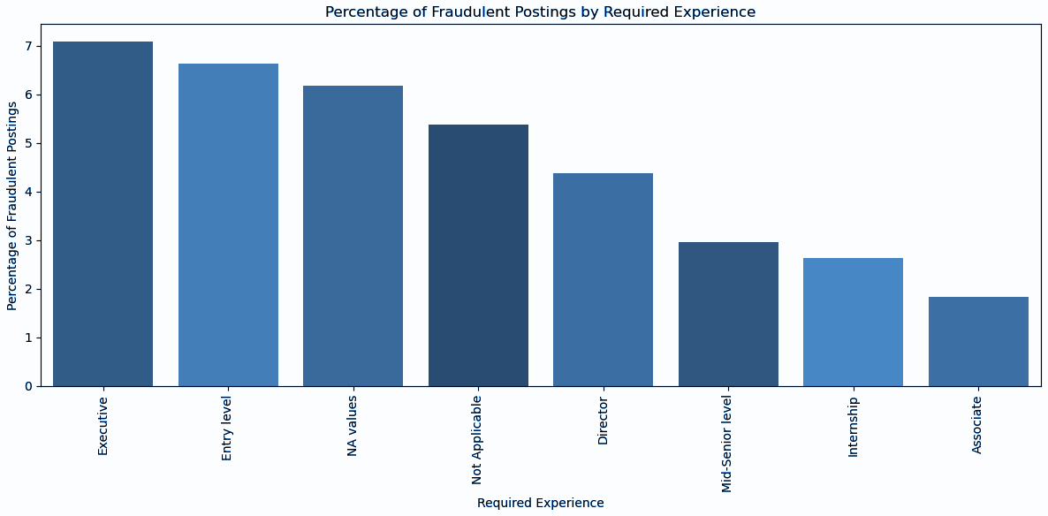
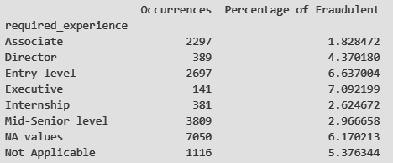
Required Experience vs Fraudulent
Executive and Entry Level required experience have a higher chance of being fraudulent as compared to others.
We should also note that there is a higher chance of fraud when required experience are not available or not applicable.

Slide 22
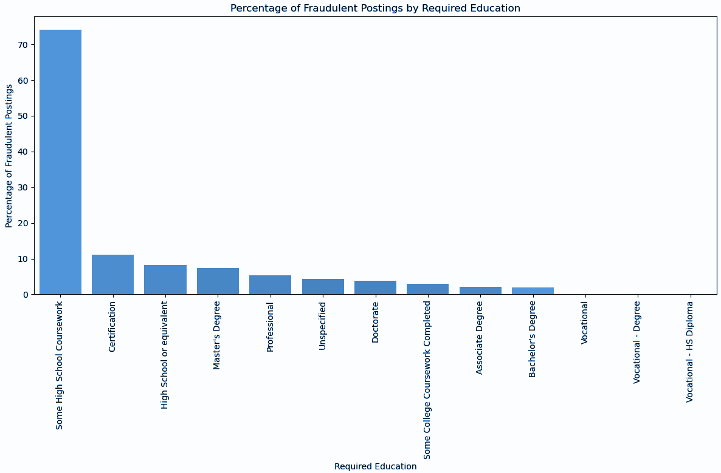
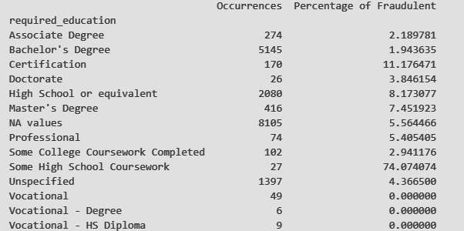
Required Education vs Fraudulent
In terms of education, we note that positions that require high school or certification education levels are more likely to be fraudulent.
Positions that requires master’s degree also exhibited higher chance of being fraudulent.

Slide 23
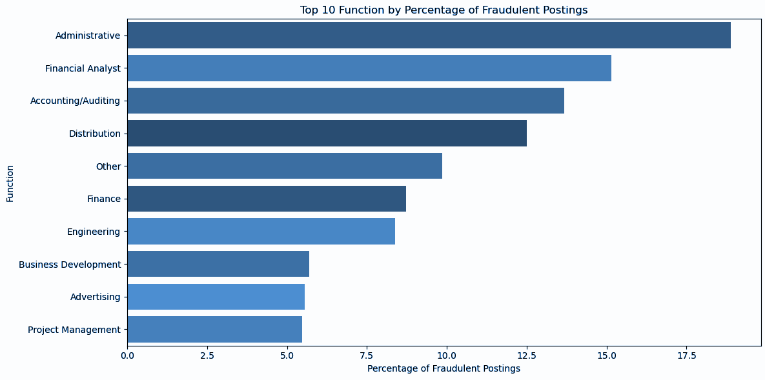
Function vs Fraudulent
In terms of job functions, we notice that Administrative functions, Financial Analyst and Accounting/Auditing have the highest chance of being fraudulent.
Coupled with the observations from required education and required experience, we do notice that most of the fraudulent postings are targeted towards less educated and experienced personnels.

Slide 24

Text Data Analysis
Company Profile Analysis - Job Requirements Analysis - Job Title Analysis - Job Description Analysis -
Job Benefits Analysis

Slide 25
Job Titles vs Fraudulent
Fraudulent Job Titles
Data Entry Admin/Clerical Positions - Work From Home
Cruise Staff Wanted *URGENT*
Home Based Payroll Data Entry Clerk Position - Earn $100-$200 Daily
Account Sales Managers $80-$130,000/yr
Payroll Clerk
Non-Fraudulent Job Titles
English Teacher Abroad
Customer Service Associate
Software Engineer
Account Manager
Project Manager
Job titles in fraudulent postings tend to be more entry level, and tend to include details such as salary and special characters.

Slide 26

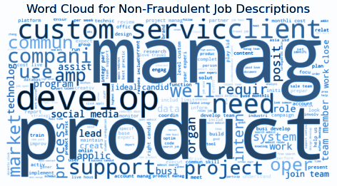



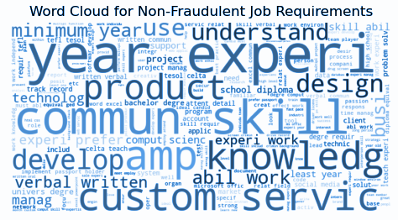
Job Details vs Fraudulent
In terms of job descriptions, requirements and benefits, we notice a few subtle difference between fraudulent and non-fraudulent posts.
This includes more frequent use of words such as `project`, `online` and `require`, among the rest.
Thus, from our analysis, we do believe that text data are important and should be processed as features for our classification model.

Slide 27
03
Data Preprocessing

Slide 28
Data Preprocessing Techniques
Text Encoding
Handling Missing Values
Feature Engineering
SMOTE Oversampling
Text Preprocessing

Slide 29

Handling of Missing Values
After performing Exploratory Data Analysis:
Categorical → “Unknown”
Text → “No available data”
Reasoning:
Lack of context in data collection and job postings details → Missing Completely At Random (MCAR)
Application:
Applied across all columns with NA values for a consistent approach

Slide 30

Feature Engineering
Column-specific feature engineering:
‘Location’ → Split into ‘country’ and ‘city’, followed by one hot encoding
‘Department’ → Categorize rare departments as ‘others’
Reasoning:
Ensure interpretable data for model
Mitigate overfitting & reduce training data dimensionality
Application:
Applied to ‘Country’, ‘city’ and ‘industry’ columns as well

Slide 31

Text Preprocessing
From our Exploratory Data Analysis:
Significant amount of text data (‘title’, ‘company_profile’, ‘description’, ‘requirements’, ‘benefits’)
Capture context of text → high value features
Text Preprocessing Methods:
Removing stopwords → reduce noise & enhance relevance of text data
Tokenization → individual words
Stemming and Lemmatization → basic form
Application:
Applied to ‘full_text’ column → contains concatenated text data from key columns

Slide 32

Text Encoding
Transforming text data into machine-readable format:
Bag of Words (BoW) → statistical embeddings of vocabularies
Pre Trained Word2Vec Word Embedding → preprocessing method that yield the best features
Reasoning:
Enhance significance of features derived from text data
Statistical embeddings capture nuanced relationships within the text

Slide 33
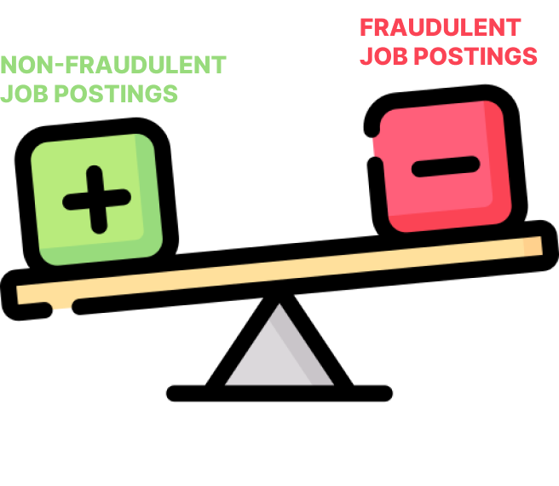
SMOTE Oversampling
Due to an imbalanced dataset:
Utilize Synthetic Minority Oversampling Technique (SMOTE)
Reasoning:
Address class imbalances → improve model performance
Counter biases towards majority class → prevent model skewing
Enhance generalizability to unseen data

Slide 34
04
Model Evaluation

Slide 35
Metrics for Evaluation
Accuracy
Roc AUC
Measures overall correctness by calculating the ratio of correctly predicted instances to the total number of instances.
Illustrates the trade-off between true positive rate and false positive rate.
Precision
Recall
F1 Score
Assesses the accuracy of positive predictions by calculating the ratio of true positives to the sum of true positives and false positives.
Correctly identify all relevant instances of a class, calculated as the ratio of true positives to the sum of true positives and false negatives.
Combines precision and recall into a single metric, providing a balance between false positives and false negatives in a model's performance.

Slide 36
Best Performers (Before SMOTE)
Model | Accuracy | F1-Score | Precision | Recall | Roc AUC
LSTM (With CountVec) | 99% | 87% | 97% | 78% | 81%
Decision Tree Classifier (With CountVec) | 98% | 78% | 76% | 81% | 90%

Slide 37
Best Performers (After SMOTE)
Model | Accuracy | F1-Score | Precision | Recall | Roc AUC
XGBClassifier (With Word2Vec) | 99% | 87% | 93% | 82% | 99%
KNN Classifier (With TF-IDF) | 86% | 42% | 27% | 97% | 95%

Slide 38
Optimal Model Selected
Model | Accuracy | F1-Score | Precision | Recall | Roc AUC
XGBClassifier (With Word2Vec without SMOTE) | 98% | 80% | 98% | 67% | 99%
XGBClassifier (With Word2Vec and SMOTE) | 99% | 87% | 93% | 82% | 99%
The Recall score increased for the model after oversampling.
Although this comes at the cost of lower Precision, the cost of false negative is much high than false positive.

Slide 39
05
Conclusion & Future Works

Slide 40
Conclusion - Project Achievements
Successfully developed a machine learning-based fraud detection system
Combines data preprocessing, feature engineering, and the implementation of various classifiers to identify fraudulent job postings
Determined the most effective classifier

Slide 41



Integration of Fraud Detection Model in Real-Life Applications
Allow real-time analysis and classification of job postings
Integrate our model through an API
Ensures that fraudulent listings are identified and addressed before they reach job seekers
Periodically review existing listings on platforms
Safeguarding the job market against scams
Continuously improving its adaptability to new fraud patterns.
Feedback loop

Slide 42



Limitations
The EMSCAD dataset, while extensive, has a significant class imbalance which can bias the system.
Its temporal scope, focusing on listings from 2012 to 2014, may limit its effectiveness against newer fraudulent strategies
Its limited geographic representation could restrict its applicability globally.

Slide 43



Future Directions
Enrich the dataset with more recent and geographically diverse data
To explore deep learning models for improved accuracy, especially in complex text data analysis
A collaborative effort across job platforms for a unified fraud detection system

Slide 44
Thank You!

