Slide 1
Modulation Techniques

Slide 2
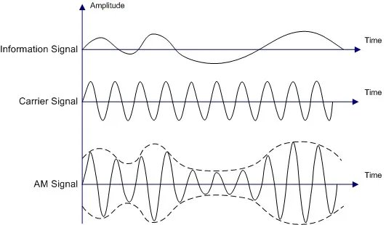
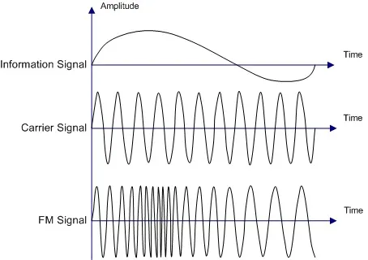
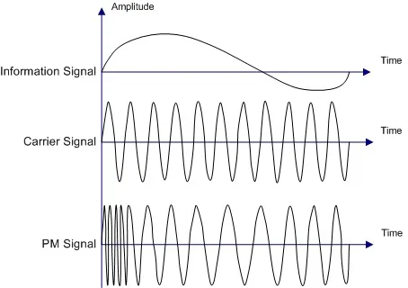
Analog Modulation
Key difference between analog and digital modulation is that the information signal for analog is continuous, and discrete (0 or 1) for digital

Slide 3
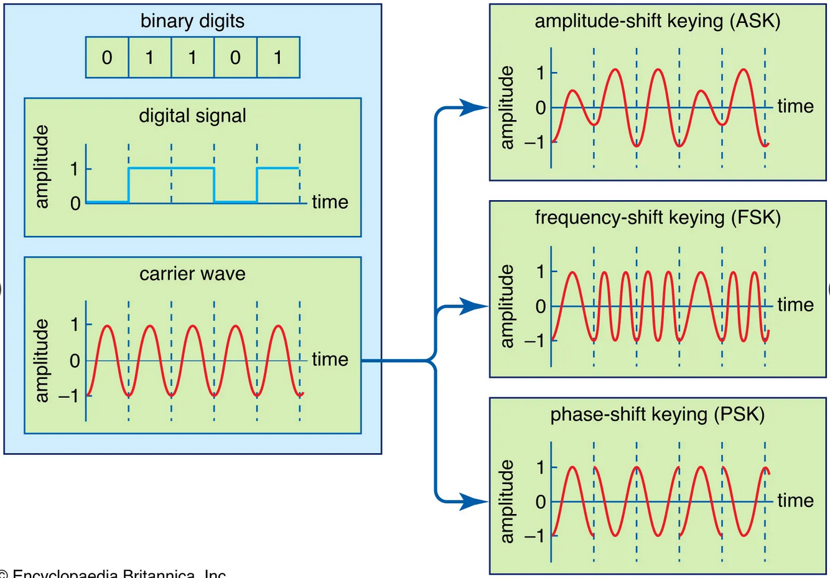
Basic Analog Modulation

Slide 4
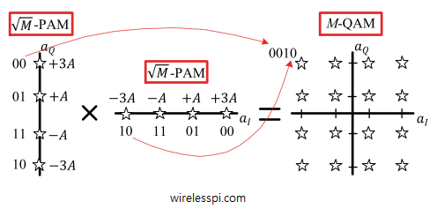
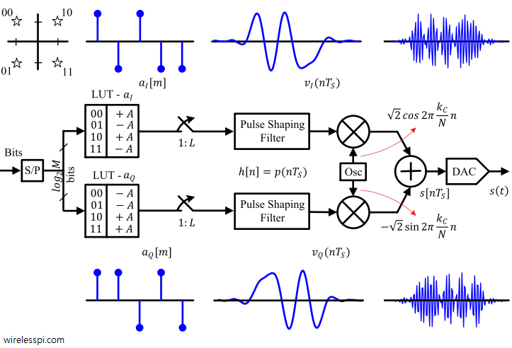
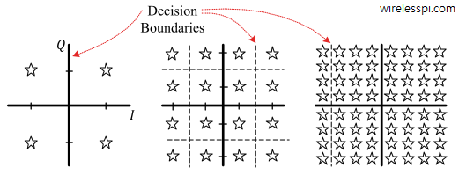
Advanced Analog Modulation
4-QAM Modulation (QPSK)
16, 32-QAM

Slide 5
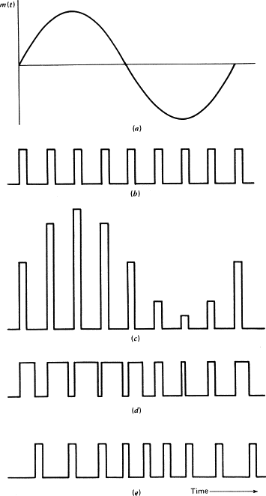
Pulse Modulation
(a) Modulating wave. (b) Pulse carrier. (c) PAM wave. (d) PDM wave. (e) PPM wave.

Slide 6
Multiplexing
Because of the installation cost of a communications channel, such as a microwave link or a coaxial cable link, it is desirable to share the channel among multiple users. Provided that the channel’s data capacity exceeds that required to support a single user, the channel may be shared through the use of multiplexing methods. Multiplexing is the sharing of a communications channel through local combining of signals at a common point.

Slide 7
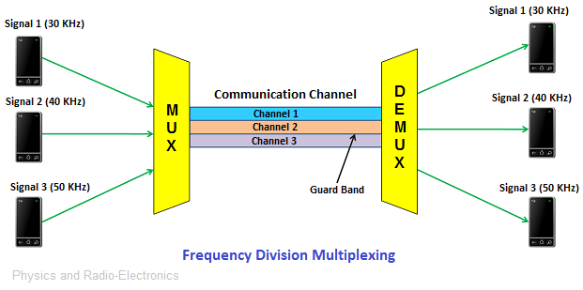
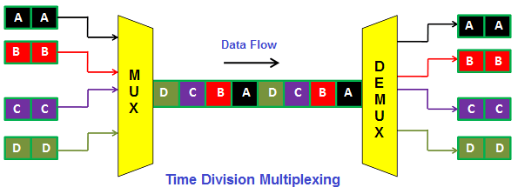
Multiplexing

Slide 8
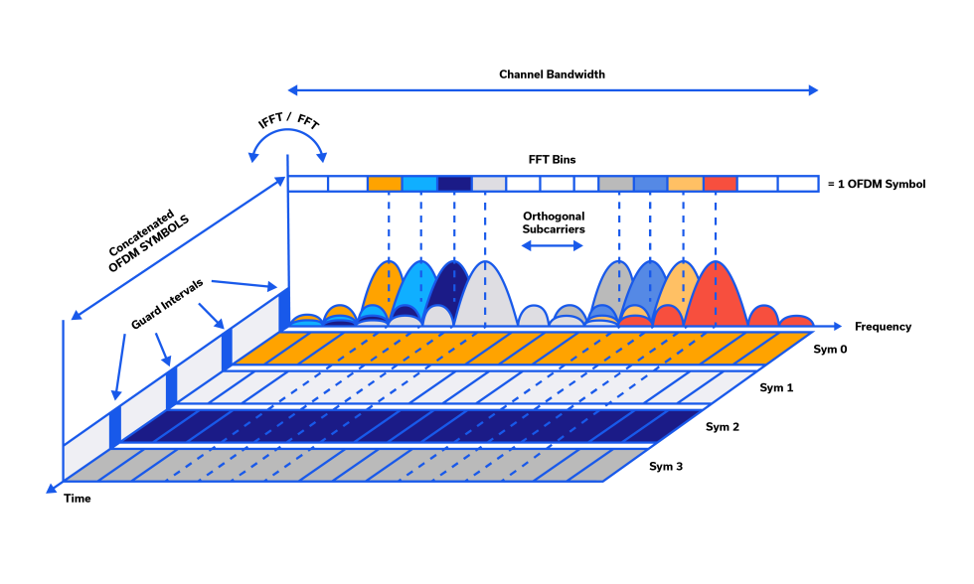
Advanced Multiplexing
OFDM is used in Digital radio, Digital Radio Mondiale, digital audio broadcasting, and satellite radio.
OFDM is used in Wired data transmission, Asymmetric Digital Subscriber Line (ADSL), Institute of Electrical and Electronics Engineers (IEEE) 1901 powerline networking, and cable internet providers.

Slide 9
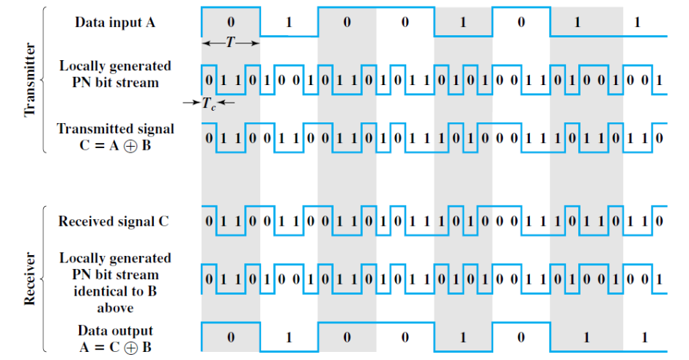
Spread Spectrum
Direct Sequence Spread Spectrum (DSSS)
each bit in the original signal is represented by multiple bits in the transmitted signal, using a spreading code
spreading code spreads the signal across a wider frequency band in direct proportion to the number of bits used

Slide 10
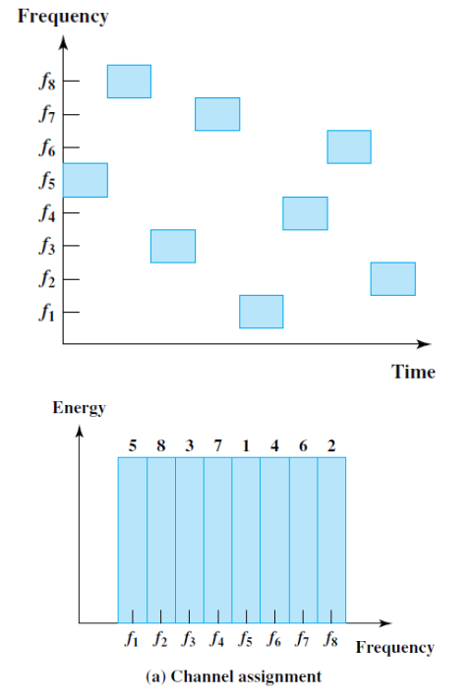
Spread Spectrum
Frequency Hopping Spread Spectrum
the signal is broadcast over a seemingly random series of radio frequencies, hopping from frequency to frequency at fixed intervals.
The transmitter operates in one channel at a time for a fixed interval
A receiver, hopping between frequencies in synchronization with the transmitter, picks up the message
Width of each channel usually corresponds to the bandwidth of the input signal

Slide 11
https://www.britannica.com/technology/telecommunication/Modulation
https://www.sciencedirect.com/topics/physics-and-astronomy/pulse-modulation
https://wirelesspi.com/quadrature-amplitude-modulation-qam/
https://www.physics-and-radio-electronics.com/blog/multiplexing/
https://www.physics-and-radio-electronics.com/blog/multiplexing/
https://blog.minicircuits.com/the-basics-of-orthogonal-frequency-division-multiplexing-ofdm/
http://manaskhatua.github.io/courses/CS311/DC_Lec13_Spread_Spectrum.pdf

