Slide 1


INDIVIDUAL PROJECT
FROM CHEMISTRY TO QUALITY:PREDICTING WINE QUALITY USING CHEMICAL PROPERTIES
WENDY MARTINEZ

Slide 2


INTRODUCTION
The aim of this research is to predict the quality of wine based on past customer ratings and using the following wine chemical properties: fixed acidity, volatile acidity, citric acid, residual sugar, chlorides, free sulphur dioxide, total sulphur dioxide, density, pH, sulphates, and alcohol.

Slide 3

ABOUT THE DATASETS
We are working with two datasets: winequality_red and winequality_white. Both datasets contain the same chemical properties and quality scores, but they correspond to red and white wines, respectively. These datasets were obtained from the UCI Machine Learning Repository.
SHAPE: 1359 ROWS AND 13 COLUMNS (AFTER CLEANING)
NO MISSING VALUES
240 DUPLICATED THAT WERE REMOVED
SHAPE: 3961 ROWS AND 13 COLUMNS (AFTER CLEANING)
NO MISSING VALUES
937 DUPLICATED THAT WERE REMOVED
MERGED DATASET
RED WINE DATASET
WHITE WINE DATASET

Slide 4
EXPLORATORY DATA ANALYSIS (EDA)
01
EXPLORE DESCRIPTIVE STATISTICS
02
CHECK FOR OUTLIERS
03
EXPLORE THE DISTRIBUTION OF THE CHEMICAL PROPERTIES
04
EXPLORE HOW COSTUMERS RATED THE WINES
05
EXPLORE THE RELATIONSHIP BETWEEN THE CHEMICAL PROPERTIES
06
EXPLORE HOW THE CHEMICAL PROPERTIES ARE RELATED WITH WINE QUALITY.

Slide 5

FINDINGS AND INSIGHTS FROM EDA
Outliers were present and removed using Zscore in order to improve model performance;
The most common ratings were 5 and 6 scores;
The chemical properties that shows a positive relationship with quality are:
- alcohol
- residual sugar -
- total sulfur dioxide
- suplphate
- ph
- free sulfur dioxide
- citric acid

Slide 6

MODELS EXPERIMENTATION

Slide 7
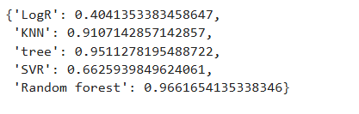
CLASSIFICATION MODELS AND THEIR PERFORMANCE
Logistic Regression
KNN
Decision Tree
SVD
Random Forest

Slide 8
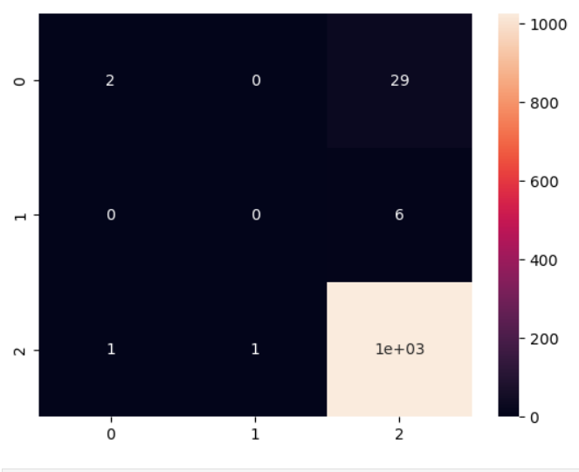
CONCLUSION
The Random Forest model is the most effective in addressing our research question; however, improvements are necessary to mitigate bias towards certain classes.

Slide 9
THANK YOU

