Slide 1
台大獸醫所公衛組專題討論
A Survey of Dog Population
犬群數量的調查
指導老師：費昌勇老師
學 生：張仁川
學 號：R87629038
日 期：1998. 12. 22

Slide 2
Dog Population
Owned dog
Stray dog

Slide 3
Owned dog
Cared
Vaccination
Veterinary
Licensed or Registered dog

Slide 4
Stray dog
Unowned dog
Roaming in the street, park and outside
No Licensed and Registered
Feed by itself

Slide 5
找出狗群正確數目的原因
Zoonotic influence
Dog chronic disease incidence rate
In order to develop control program
To find the relationship between environment and man’s health

Slide 6
Methods
Owned dog :
Questionnaires

Slide 7
Methods
Stray dog : 1. Questionnaires
2. Capture - Recapture Method ( Mark
Recapture Method )
3. Photograph Recapture Method

Slide 8
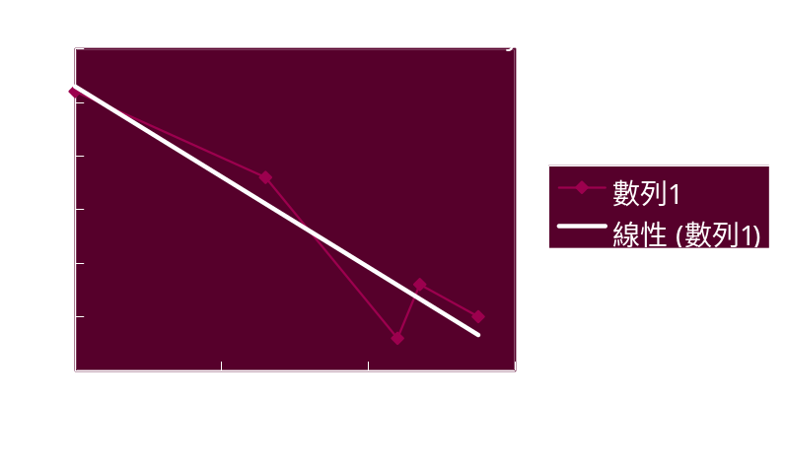
照相捕捉法
當日捕捉數 總捕捉數
26 0
18 26
3 44
8 47
5 55
y x
Y = 26.50 - 0.42 X
R = 0.91
Total = 63 隻

Slide 9
Denver’s approach to rabies control
-- Anderson R. W. 1955 --

Slide 10
4,788 of 30,000 dogs were vaccinated in 1949
Beginning in Sep 1949 ( 3 case )
In Feb 1950 ( 30 case )

Slide 11
Mass vaccinate ( 70% - 80% )
In Dec 1950 ( vaccinated 23,552 )
1952 ( dogs population 32,800 )
People : Dogs = 198,643 : 32,800
= 6.1: 1

Slide 12
Dogs distribution in Connecticut
-- Mill J. H. 1967 --

Slide 13
Age, breed and sex ( 5,212 of 168,000 dogs)
62% were 5 or under years old
30% were between 6 - 10 years old

Slide 14
28.5% were mixed dogs
36% were Beagle, German shepherd dog, Collie, Poodle and Cocker
Male : Female = 53.6 : 46.4
People : Dogs = 1056,600 : 168,000 = 6.28 : 1

Slide 15
A survey in Champaign Country, Illinois
-- Griffith A. O. 1977 --

Slide 16
A survey of telephone questionnaire ( 623 households )
37.4% had 1 or more dogs
Dog’s mean age ( 4.64 years old )
People : Dogs = 164,200 : 22,188 = 7.4 : 1

Slide 17
Pet ownership in Yolo County, California
-- Franti C. E. 1974 --

Slide 18
Rural, Urban / Suburban
Davis, Woodland, East Yolo and Rural Yolo county

Slide 19
Owned dogs or cats ( 62% households )
Owned horses ( 3% households )
Rural > Urban / Suburban
People : Dogs = 91,788 : 20,218 = 4.54 : 1

Slide 20
A Study of the Manhattan, Kansas
-- Nassier R. 1980 --

Slide 21
Canine population dynamic
A households telephone questionnaire
In 1979 ( 40% of 1500 households )

Slide 22
Roaming dogs ( 12.4% )
Spayed female dogs ( 66% )
Migrated dogs, under 6 months ( 57% )
Dogs population change was close to 1
People : Dogs = 40,000 : 9,600 = 4.14 : 1

Slide 23
總結
這五個實驗在1950 - 1980 年之間
Denver = 6.1 : 1 Yolo county = 4.54 : 1
Connecticut = 6.28 : 1 Manhattan = 4.14 : 1
Champaign = 7.4 : 1
In the total USA about 7 : 1 ( 2.6 to 40.5)

Slide 24
養狗風氣的盛行似乎與經濟收入有相關性。收入越高的地區，人/狗比例越小，也就是狗口數越多。
在1980年代以後，計算犬群數量的調查，大都加入了犬群動力學去計算。得到的數字較精確，可靠。

Slide 25
調查的方法，大都只用電話、問卷等形式而較少用實地調查的方法。
調查的方法，最好要將地區依人口、都市化的程度，來分類計算比較準確。

Slide 26
在台灣方面的情形
在1993年，葉力森老師以電話訪問。估計全省家犬數約237萬隻。其中：北區約101萬隻，中區約73萬隻，南區約63萬隻。
在1995年，楊姮婈醫師以郵寄問卷的方法調查。台北市家犬數約為50萬隻。

Slide 27
討論

